Slide 1
The American Woman Suffrage Movement
right to vote = suffrage = enfranchisement

Slide 2
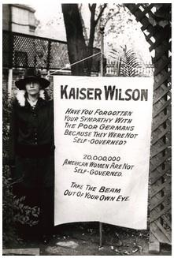
Do Now
What do you see here?
Around what year do you think this photograph was taken?
How do you think the public responded?

Slide 3
Seneca Falls, New York 1848
In the early 1800s, many women were involved in the abolition (anti-slavery) and temperance (no alcohol) movements
A group of women and men gathered at a conference in Seneca Falls, NY in 1848
This conference was led by Elizabeth Cady Stanton and Lucretia Mott
Conference attendees wrote the Declaration of Sentiments

Slide 4
Fifteenth Amendment, 1871
Granted African-American men the right to vote
Disappointed many women who thought African-American men and women would be enfranchised together
African Americans were split over whether men should get vote before women

Slide 5
Frederick Douglass, 1869
“When women, because they are women . . . are dragged from their houses and hung upon lamp posts; when their children are torn from their arms, and their brains dashed upon the pavement . . . Then they will have an urgency to obtain the ballot equal to our own.”
But was this not true for black women?
“Yes, yes, yes. It is true for the black woman but not because she is a woman but because she is black!”

Slide 6
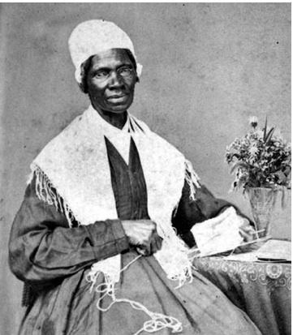
Sojourner Truth, 1869
“There is a great stir about colored men getting their rights, but not a word about the colored women … And if colored men get their rights, and not colored women theirs, you see the colored men will be masters over the women, and it will be just as bad as it was before.”
Sojourner Truth, 1864

Slide 7
Before 1910
National American Woman Suffrage Association (NAWSA)
Big leaders: Susan B. Anthony, Elizabeth Cady Stanton
Two big strategies:
Try to win suffrage state by state
Try to pass a Constitutional Amendment (but this would need to be ratified by 36 states – or three-fourths)

Slide 8
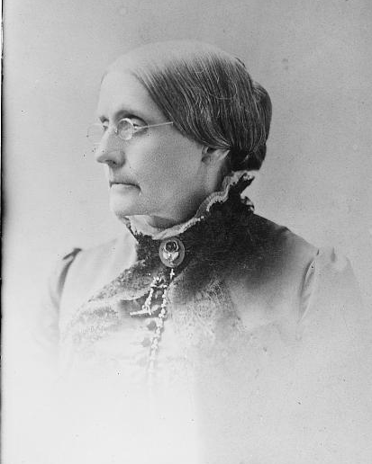
Susan B. Anthony
In the late 1800s, Susan B. Anthony tried several times to introduce an Amendment bill for women’s suffrage, but it was always killed in the Senate.
Susan B. Anthony

Slide 9
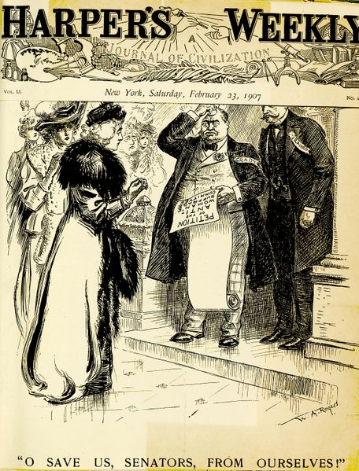
Anti-suffragists
Those who opposed extending the right to vote to women were called anti-suffragists. Many anti’s were women.
Political cartoon mocking anti’s: “O Save Us, Senators, from Ourselves!”

Slide 10
Beliefs of Anti-Suffragists
Women were high-strung, irrational, and emotional
Women were not smart or educated enough
Women should stay at home
Women were too physically frail; they would get tired just walking to the polling station
Women would become masculine if they voted

Slide 11
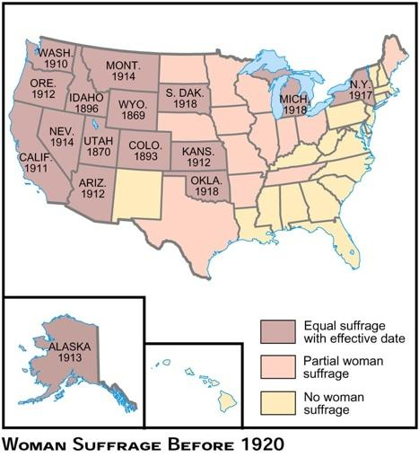
Map of Women’s Suffrage Before 1920

Slide 12
Compelling Question: Final Reflection
Using what you have gathered from the activity, answer the following using at least 1 piece of evidence from the documents we analyzed.
Why did people, including women oppose women’s suffrage?

Slide 13
The Next Generation
Elizabeth Cady Stanton died in 1902
Susan B. Anthony died in 1906
But in the early 1900s many young, middle-class women were going to college and joining the suffrage movement
Many working-class women also joined the cause, hoping the right to vote would help improve working conditions

Slide 14
Safe or Sorry?
Carrie Chapman Catt led the National American Woman Suffrage Association. She believed in:
Careful state-by-state strategy
Supporting President Wilson even though he didn’t outright support suffrage because Democrats were a safer bet than Republicans
Acting ladylike so as not to embarrass the movement

Slide 15
National Woman’s Party
Alice Paul led the NWP and believed in more aggressive strategies:
Focused on passing a Constitutional Amendment
Adopted un-ladylike strategies from British suffragettes (e.g. heckling politicians, picketing)
Refused to support President Wilson if he wouldn’t support woman suffrage
NWP members were arrested for picketing in front of the White House. They were put in jail, went on a hunger strike, and were force-fed.

Slide 16
19th Amendment, 1920
Tennessee was the 36th state to ratify, and it passed by only 1 vote.
The right of citizens of the United States to vote shall not be denied or abridged by the United States or by any State on account of sex.
Congress shall have power to enforce this article by appropriate legislation.

