Slide 1
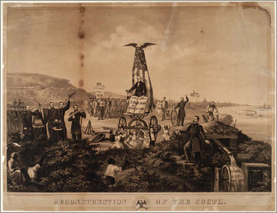
Reconstruction

Slide 2
Politics of Reconstruction: Section 1
Last 10 Minutes of Ken Burns Civil War- Clip
Ken Burns: Civil War Ken Burns: Better Angels of our Nature (Amazon) (12 Mins)
Reconstruction was the period during which the U.S. began to rebuild after the Civil War, lasting from 1865-1877.
Everyone (Lincoln, Johnson and Congress) had different ideas on how reconstruction was to be handled.

Slide 3
Lincoln’s Ten Plan
Lenient Reconstruction Policy
Wished to make the South’s return to the Union and quick and painless as possible.
Pardoned all Confederates except high ranking officials and those accused of crimes against prisoners of war.
Confederates would swear allegiance to union.
After 10% of those on the 1860 voting lists took this oath of allegiance a Confederate state could form a new congress and gain representation.

Slide 4
Radical Republicans
Radical dude!
Radical Republicans: Led by Charles Sumner and Thaddeus Stevens. They wanted to destroy to political power of former slaveholders. Wanted to give African Americans full citizenship and the right to vote!
Wade Davis Bill: Proposed that Congress not the President be responsible for reconstruction. Lincoln used pocket-veto to kill bill. (Ignored the bill)

Slide 5
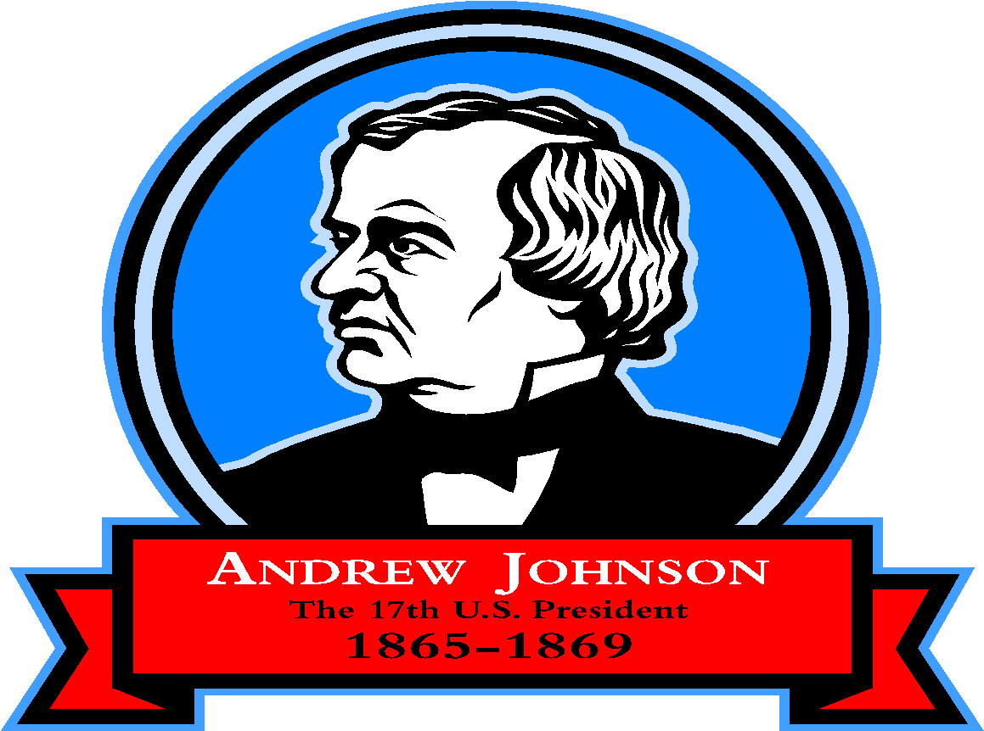
Johnson’s Plan
After Lincoln’s assassination Democrat Andrew Johnson took office.
Declared that remaining southern states that hadn’t been admitted into the union could join if they would withdraw their secession, swear allegiance to the Union, anul Confederate war debts, and ratify the 13th amendment.
Radicals believed his plan failed to address the needs of former slaves in three areas: land, voting rights, and protection under law.
All states eventually met his terms.
Johnson pardoned southern legislatures and Confederate generals.

Slide 6
Freedman’s Bureau
In 1865 Congress disputes the fact that Reconstruction was complete.
Congress voted to enlarge the Freedman’s Bureau. It assisted former slaves and poor whites in the South by distributing clothing and food. It also set up more than 40 hospitals, 4,000 schools, 61 industrial institutes, and 74 teacher-training centers.
Two months later Congress passes the Civil Rights Act of 1866 which gave African-Americans citizenship and forbade states from passing discriminatory laws called black codes.

Slide 7
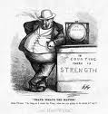
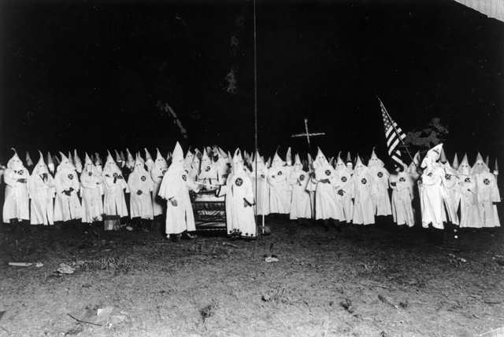
Black Codes
Prohibited blacks from carrying weapons, serving on juries, testifying against whites, marrying whites, and traveling without permits. In some states they were forbidden to own land. Southern whites used violence to keep blacks from improving their position in society.

Slide 8
Congress Tries to Pass More Reconstruction Acts
Two months later Congress passes the Civil Rights Act of 1866 which gave African-Americans citizenship and forbade states from passing discriminatory laws called black codes.
Johnson vetoed both these Acts.
Moderates join with Radicals and override the president’s vetoes.
Fourteenth Amendment is born and declares that “all persons born or naturalized in the U.S. are citizens of the country.”
Race riots in Memphis, TN, and LA convinced the federal government that it must protect the rights of African Americans.
Reconstruction Act of 1867 is finally passed.

Slide 9
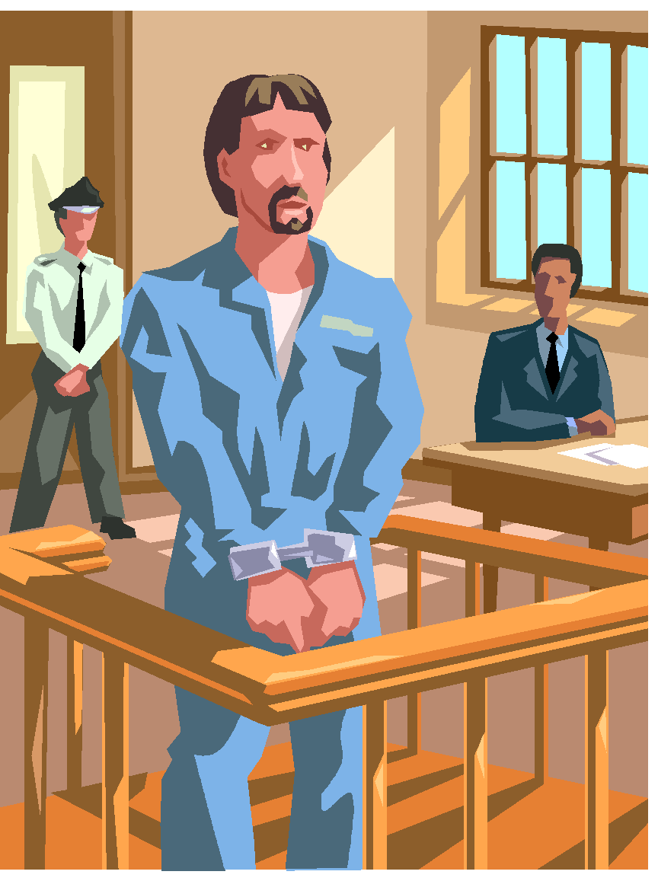
Reconstruction Acts and Johnson
Reconstruction Acts did not recognize state governments set up by Lincoln and Johnson. States were divided into six military districts. All voters would elect delegates to conventions where new state constitutions would be drafted.
Radical leaders felt the President was not carrying out his constitutional obligation to enforce the Reconstruction Act. AKA violated the Tenure in Office Act….
Johnson was impeached: removal failed by one vote.

Slide 10
Military Districts

Slide 11
Grant as President
Ulysses S. Grant elected President
Fifteenth Amendment: No-one can be kept from voting because of “race, color, or previous condition of servitude.”

Slide 12
Opposition to Reconstruction
Ku Klux Klan:
Founded as a social club for confederate veterans. Started in TN in 1866. Its overarching goal was to restore white supremacy. Its method was to prevent African Americans from exercising their political rights.
Between 1868 and 1871,the Klan and other secret groups killed thousands of men, women, and children, and burned schools, churches, and property.
Tried to prevent African Americans from making economic progress as well as political progress.
Enforcement Acts in 1870 and 1871.
Federal supervision of elections in Southern States.
President could use federal troops in areas where the Klan was active.

Slide 13
The Fall of the Republican Party
Fraud and Bribery
Scandals: Construction Company skimmed off large profits from railroad contract.
Republicans angered by the corruption.
Whiskey-Ring Exposed: Internal Revenue collectors and other officials accepted bribes from whiskey distillers who wanted to avoid paying taxes on their product.

Slide 14
Economic Turmoil
Panic of 1873: Northern and Southerners borrowing increasing amounts of money. Many took more debt than they could afford.
Philadelphia Banker Jay Cooke invested in railroads and eventually went bankrupt setting off a series of financial failures.
Government issued Greenbacks (Paper money issued during the war that was not backed by an equal value in gold.
Some wanted to withdrawal these greenbacks others wanted an increase in the money supply.
Country returns to gold standard.

Slide 15
Supreme Court Cases Undermine Reconstruction
Slaughterhouse- 1873, said that American’s basic civil rights were obtained through their citizenship in a state and that the 14th amendment did not protect those rights.
Cruikshank- 1876, the federal government did not have the right to punish individual whites who oppressed blacks.
Reese- 1876, Court ruled in favor of those officials who had barred African Americans from voting. 15th amendment did not guarantee suffrage for anyone, just listed grounds on which states could not deny suffrage.

Slide 16
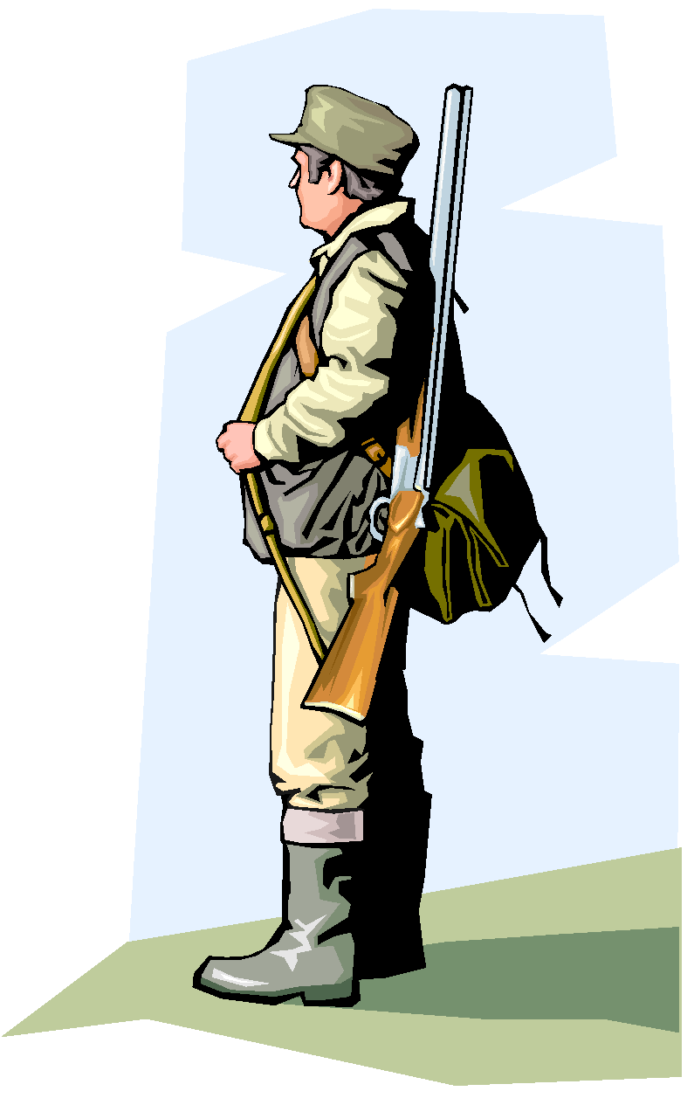
Redemption for the South
Redemption?
Democrats return to power in the south
Rutherford B. Hayes ( R) (won electoral vote)
Samuel J Tilden (D) (won popular vote)
Congressional Commission appoints Hayes
Compromise of 1877: Withdrawal of federal troops from the south.
Hayes to appoint a conservative VP. Hayes peacefully inaugurated.
This equals the end of Reconstruction!
Home Rule: Ability to run state governments without federal intervention.

