Slide 1
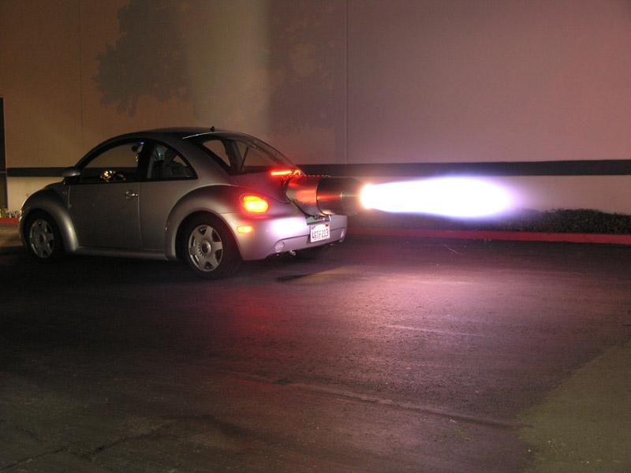
Launching the New Nation
3.3 Migration within North America and competition over resources, boundaries, and trade-intensified conflicts among peoples and nations.

Slide 2
North America from 1700..
Wiki interactive map

Slide 3
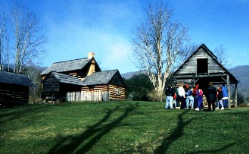
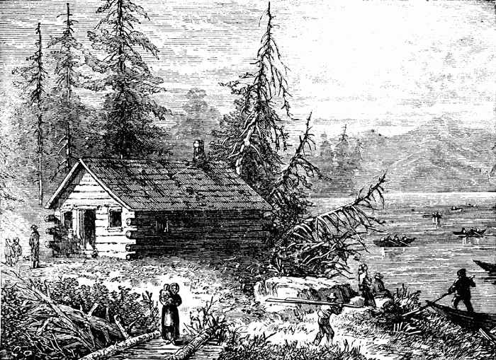
History Shaped By Environment: European Settlers
Make several inferences about the relationship between people and place.
How did these people affect their environment?
How did these people learn to adapt to their environment?

Slide 4
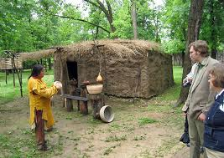
The Cherokee
Make several inferences about the relationship between people and place.
How did these people affect their environment?
How did these people learn to adapt to their environment and the changes that were taking place in the nation?

Slide 5
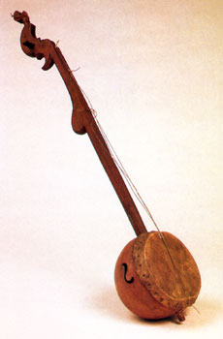
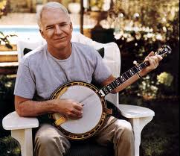
Slavery in the New Government
In 1619 the first black slaves were imported to Virginia, ninety black women were aboard this ship.
Slavery in Appalachia?
Vance Birthplace
Social Hierarchy
Banjo
Harriet Tubman said, "I looked at my hands to see if I was the same person now I was free. There was such a glory through the trees and over the fields, and I felt like I was in heaven."

Slide 6
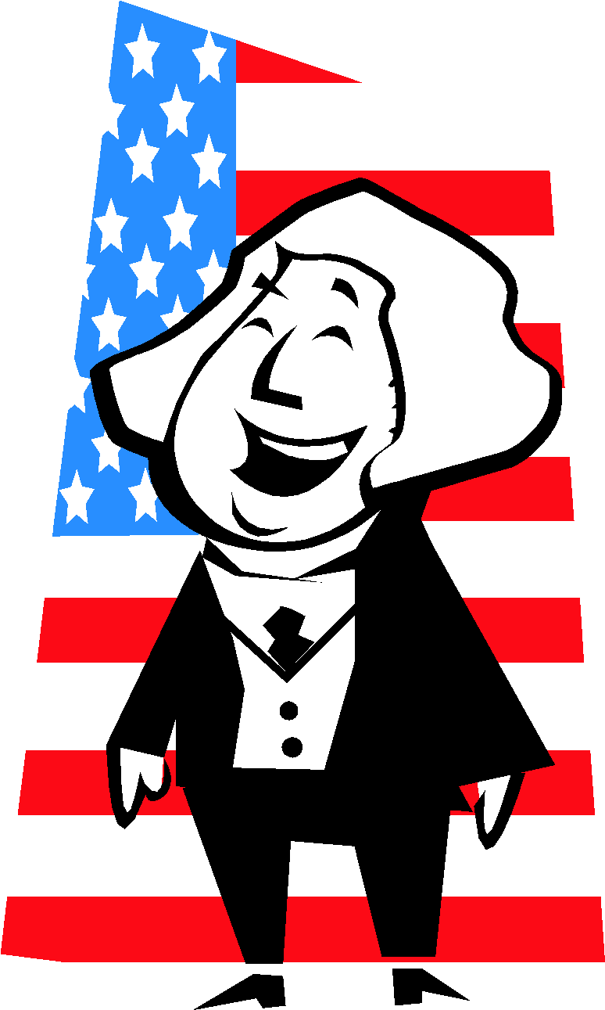
Washington Heads the New Government
George Washington had no desire to be president after the Constitutional Convention.
He just wanted to chill out in his big ol’ house up in Mt. Vernon.
He got put on the ballot anyway, and reluctantly accepted.
Nonetheless his salary was about 25,000/year equivalent to about 1 million dollars today. Oh and at least 7% of that was spent on alcohol!
Judiciary Act of 1789
A law that established the federal court system and the number of Supreme Court Justices, and provided for the appeal of certain state court decisions to the federal courts.

Slide 7
Judiciary Act Cont. (Know This!)
Supreme Court of one chief justice and five associate justices.
Set up 3 federal circuit courts and 13 federal district courts throughout the country.

Slide 8
Shaping the Executive Branch
It only had two officials, VP and President.
He needed some help!
Created three departments
Department of State
Thomas Jefferson
Department of War
Henry Knox
Department of Treasury
Alexander Hamilton
This was then called the President’s Cabinet

Slide 9
Hamilton vs Jefferson
Jefferson
Sharing power with state and local government
Fear of absolute power of ruler
Democracy of virtuous farmers and trades people
Strict interpretation of Constitution
Economy based on farming
Payment of only national debt
Supporters: Plain People
Democratic- Republican
Hamilton
Strong Central Gov.
Fear of mob rule
Loose Interpretation of Constitution
National Bank Constitutional
Economy based on shipping and manufacturing
Payment of national and state debts
Supporters: merchants, manufacturers, landowners, investors, lawyers, clergy.
Federalist

Slide 10
First Political Parties and Rebellion
Sparked by the Hamilton/Jefferson rift.
Federalists: Favored strong central government
This era can be called The Federalist Era
Democratic-Republicans: Wanted strong state governments.
Two-Party System was established.

Slide 11
Hamilton’s Financial Plan
3 Steps:
Pay off War Debts
Raise Government Revenue
Create National Bank
Agreed that National Government would pay off war debt of the states.
Most southern states had paid theirs off and did not want to help northern states.
Compromise: National Capital would be in the south.
Favored Tariffs
Taxes on imported goods.
Benefits of Tariffs?
Create National Bank
Issue loans
Safe place to keep money
Issue bank notes (paper money)

Slide 12
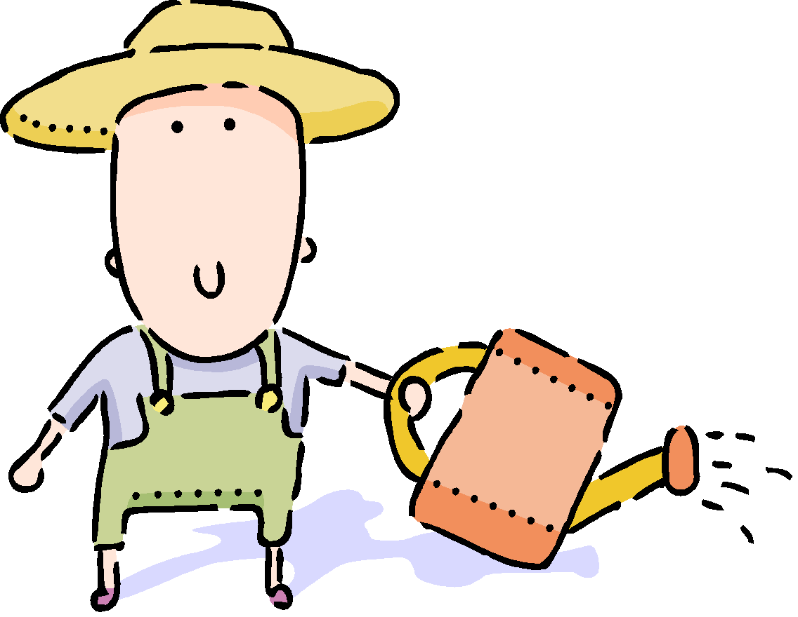
Whiskey Rebellion
In 1789 Congress passed the protective tariff
An import tax on goods produced in Europe.
Meant to encourage American production.
Brought in revenue but Hamilton wanted MORE!!
Pushed excise tax
Tax on a product’s manufacture, sale or distribution to be levied on Whiskey.
Who produced Whiskey?
Small Farmers and main source of income.
In Penn farmers refused to pay tax and beat up federal marshals and threatened to secede from the Union.

Slide 13
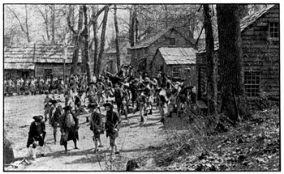
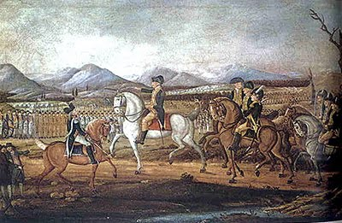
Whiskey Rebellion Cont.
P2: Explain how president Washington used the Whiskey rebellion to reinforce his power as president.
So Hamilton and Washington wanted to show them what federal government was made of.
Brought in 15,000 militiamen.
Scattered rebels without loss of a single life.
Question-What was the purpose of Hamilton’s response to the Whiskey Rebellion?
Moonshine Still- Gillian Welch - (Play Song)

Slide 14
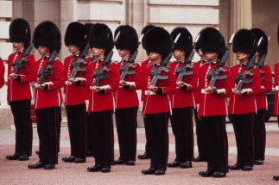
OR
U.S. response to events in Europe
Initially Americans supported the French Revolution because it was inspired by the idea of republican rule. The alliance between France and the U.S was created by the Treaty of 1778.
Nonetheless, Americans became divided over the French Revolution
This became one of the most important foreign policy question that the young nation faced.
A radical group in France seized control and started beheading all royalty- they also declared war on various other monarchies like Great Britain. Being buddies with the U.S they wanted our support.
Washington issued a declaration of neutrality –

Slide 15
Expansion
U.S. also wanted to secure land claims west of the Appalachian Mts. and gain shipping rights on the Mississippi River.
Needed agreement with Spain

Slide 16
Expansion Cont.
Negotiations with Spain stalled because of craziness in Europe.
Thomas Pinckney eventually was able to meet with Spain and both sides signed the treaty.
Spain gave up all claims to land east of the Mississippi except (Florida) and recognized boundary between (31st parallel) (Pinckney’s Treaty)
Mississippi river open to Spanish and Americans to use as well as the Port of New Orleans.

Slide 17
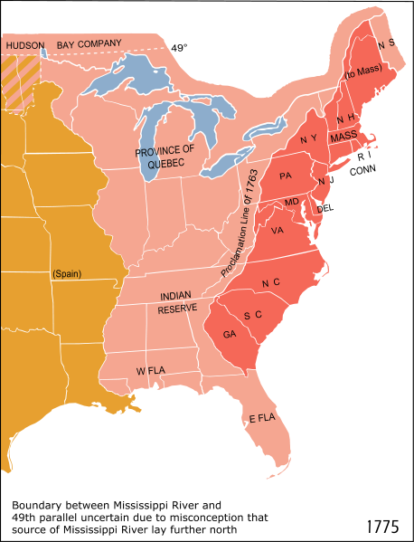
Native Americans
Pioneers assumed after Treaty of Paris (Great Britain ceded its land rights), that they got free reign over all land.
Native Americans excluded from all Treaty’s.
Read Excerpt from Treaty of Hopewell

Slide 18
Native Americans
Continued to claim their tribal lands and demanded direct negotiation with the United States.
Treaty of Greenville
To gain control over a tribal land in Ohio the federal government sent an army. The troops clashed with a confederacy of Native Americans led by Little Turtle. (Called First Battle of Fallen Timbers)
Native Americans won battle.
The following year the US army defeated the confederacy in the Second Battle of Fallen Timbers.
This victory ended Native American resistance in Ohio

Slide 19
Jay’s Treaty
At the time of the Battle of Fallen Timbers, John Jay the chief justice of the Supreme Court was in London to negotiate a treaty with Britain
U.S. wanted some of the territory west of the Appalachians. British agreed to evacuate their posts in the Northwest Territory and a treaty was signed Nov 19th, 1794. (Jay’s Treaty)
Some Americans still angry because treaty still allowed British to continue fur trade in that area.

Slide 20
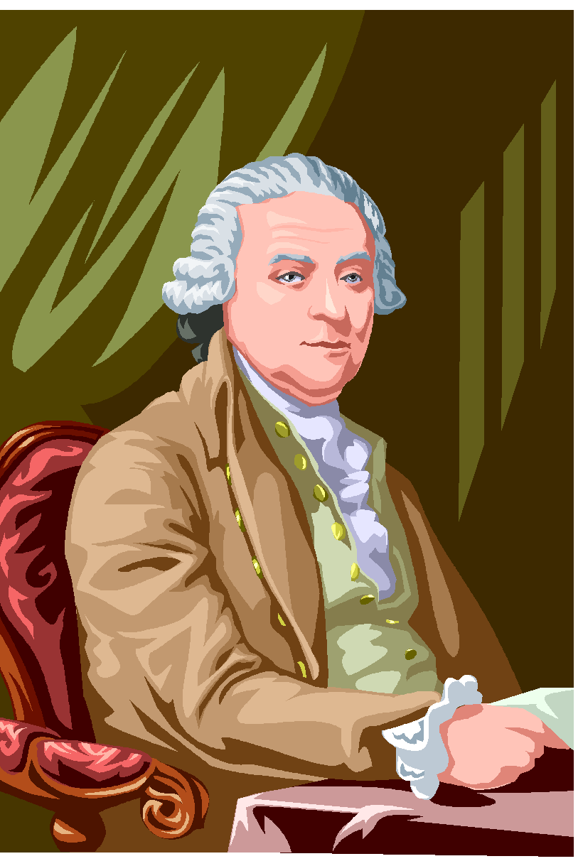
Mr. John Adams Nickname: “His Rotundity”
American’s were pretty upset about Jay’s Treaty. (Why?- because some people didn’t like British)
There was a growing division between the two parties (Federalists and Dem-Rep) Washington decided not to seek a third term. (He hated political parties!)
In his farewell address he urged the U.S. to “steer clear of permanent alliances” with other nations
Did we take his advice?
Presidential Election of 1796
John Adams (Federalists)
Thomas Jefferson (Dem-Rep)
Adams won however Jefferson had to be appointed VP (runner-up)

Slide 21
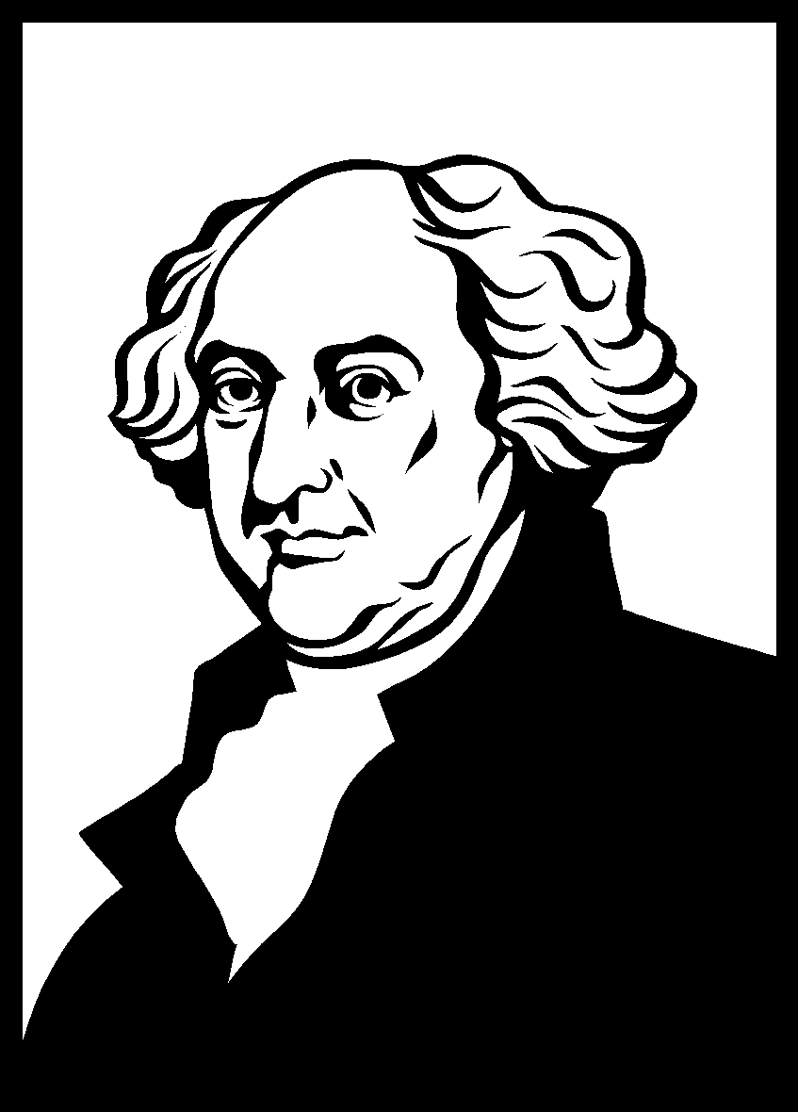
President John Adams
Sectionalism: The growing danger of placing the interests of the one region over those of the nation as a whole. (Almost all the electors from the southern states voted for Jefferson, while all the electors from the northern states voted for Adams.)
Avoiding War: France mad about Jay’s Treaty
They Started Seizing American Ships
Sent three man delegation: Chief Justice John Marshall, Minister to France Charles Pinckney, Elbridge Gerry

Slide 22
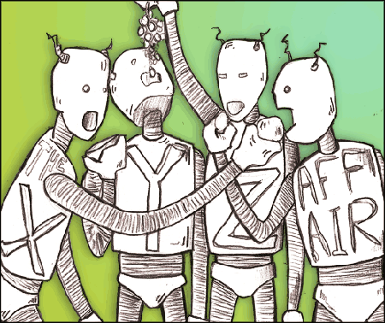
XYZ Affair
The American delegation went over and planned to meet with French foreign minister, Talleyrand.
They got sent three low-level officials called XYZ.
Demanded Bribe 250,000
U.S. decided to seize French ships (we were mad!)
For the next two years an undeclared naval war raged between France and the U.S. AKA The Quasi War

Slide 23
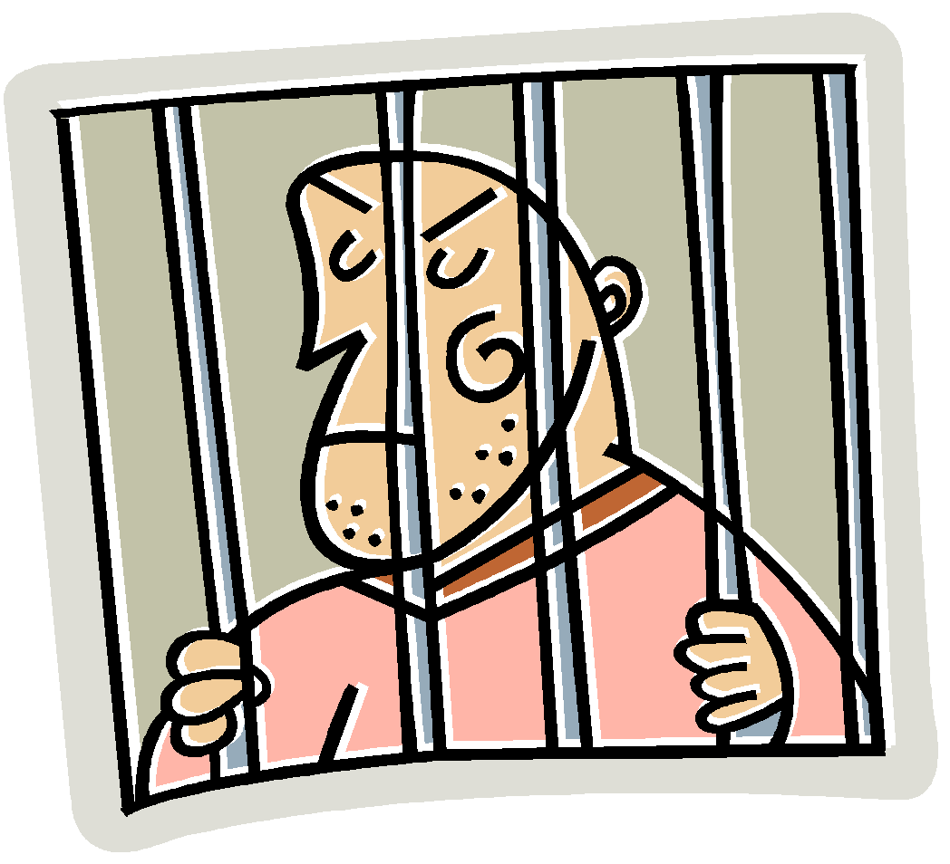
Alien and Sedition Acts
To counter what they saw as growing resentment against the government. (Possible French agents, new arrivals from foreign countries) passed in 1798 four measures called the Alien and Sedition Acts.
Alien Act raised the residence requirement for American citizenship from five years to 14 years. And allowed the president to deport or jail any alien considered undesirable.
Is this constitutional? Could our government pass this law today?
Sedition Act set fines and jail terms for anyone trying to hinder the operation of the government or expressing “false statements” against the government.
What 1st amendment right is this in violation of?

Slide 24
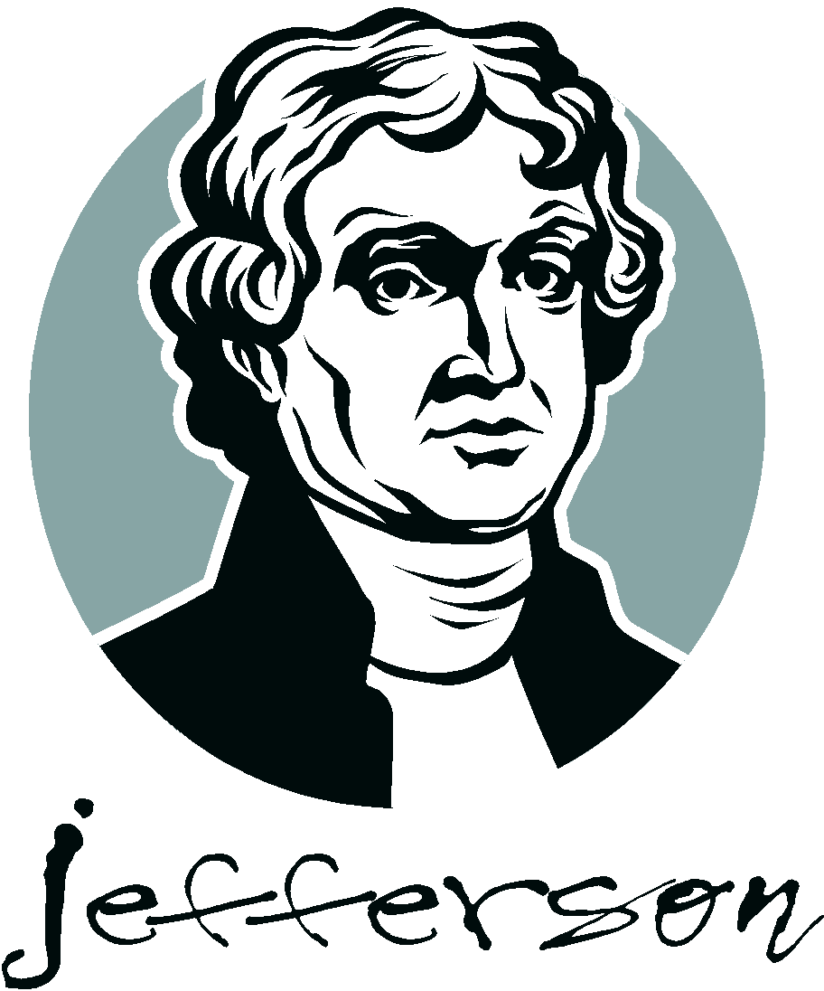
Virginia and Kentucky Resolutions
Dem-Rep leaders saw the Alien and Sedition Acts as a serious misuse of power.
Organized an opposition by appealing to the states.
James Madison drew up resolutions adopted by the Virginia legislature. Jefferson wrote resolutions approved in Kentucky. These asserted the principle of nullification.
Nullification: states had the right to nullify or consider void, any act of Congress that they deemed unconstitutional.
Virginia and Kentucky Resolutions viewed the Alien and Sedition Acts as unconstitutional.

Slide 25
Let's take a closer look…………
John Pierre Lafleur (an American citizen) said some nasty remarks about John Adams. He is arrested and jailed without any explanation. Explain why there are anti-French sentiments at this time and why it is legal to jail someone without explanation. Also discuss what some Americans did in order to overturn these unconstitutional laws. Your explanation should be at least ½ page.
Use the following terms:
XYZ Affair
Alien and Sedition Acts
VA and KY Resolutions

Slide 26
Jefferson and the Election of 1800
Jefferson Wins Presidential Election of 1800
Defeated Adams by 8 electoral votes.
Aaron Burr (also running) received the same amount of votes as Jefferson.
House had to decide
Hamilton as speaker persuades them to cast votes for Jefferson.
Burr upset and challenges Hamilton to a duel
Hamilton shot dead by Burr
Duel: Hamilton v. Burr

Slide 27
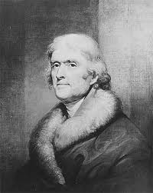
Jefferson’s Presidency
Shrank government costs
Reduced size of the army
Halted expansion of navy
Greeted foreign dignitaries in his pajamas!
Had one of the largest slave operated estates in the country! “All men are created equal”??
Lowered expenses of government social functions (thus PJ’s)
Favored free trade
Decline of Federalists was hastened by Jefferson’s political moderation

Slide 28
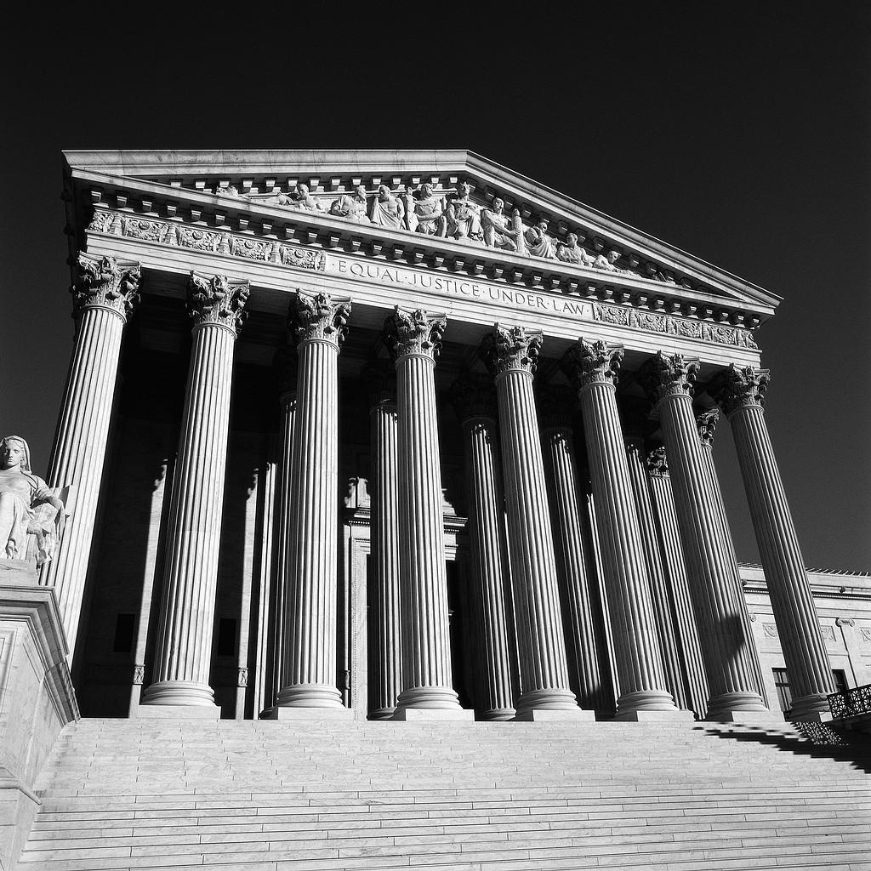
John Marshal and the Supreme Court
John Marshal: Staunch federalist and chief justice
Judiciary Act of 1801
Increased number of federal judges by 16
Marbury v Madison- Confusion over midnight judges that Adams signed on in the last night as president.
Jefferson argues they are invalid
Supreme court declared them unconstitutional
Led to Marbury v. Madison (Know this!)

Slide 29
Marbury v Madison
Created Judicial Review:
The ability of the Supreme Court to declare an act of Congress unconstitutional.

Slide 30
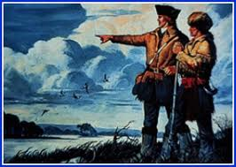
Expanding West
Louisiana Purchase
1800 Napoleon persuaded Spain to return Louisiana Territory.
Jefferson agreed that the U.S needed to expand west and decided to set up negotiations with Napoleon.
Louisiana Territory sold to America for 15 million
Eager to explore Lewis and Clark left for their expedition.
Sacagawea
Two years and four months

Slide 31
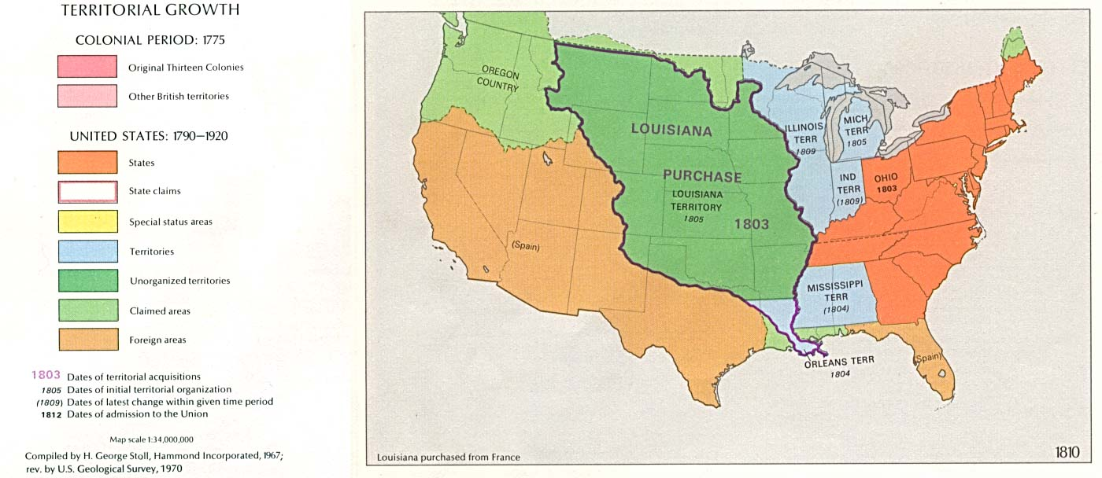
The United States By 1803

Slide 32
The War of 1812

Slide 33
War of 1812
Jefferson won second term
Attacks against America
British trying to attack France by using a blockade
Started seizing American ships as well
Impressments: Seizing Americans and forcing them to fight in the British Navy
Chesapeake incident
British searching American ship opened fire and killed three Americans.
Jefferson convinces congress to declare an embargo: ban on all goods coming from Britain

Slide 34
Tecumseh’s Confederacy
Meanwhile…….
General William Henry Harrison invited several Chiefs to Indiana to sign away land.
Tecumseh wanted to protect land and formed a confederacy
Began negotiations with the British
Tried to recruit followers
Was able to acquire weapons from the British

Slide 35
War Hawks
Tecumseh’s brother led attack on Harrison and troops.
Harrison defeated them and burned the Shawnee Capital.
Found out Native Americans were using guns from Britain
Young Congressmen called War Hawks demanded for war against British!!

Slide 36
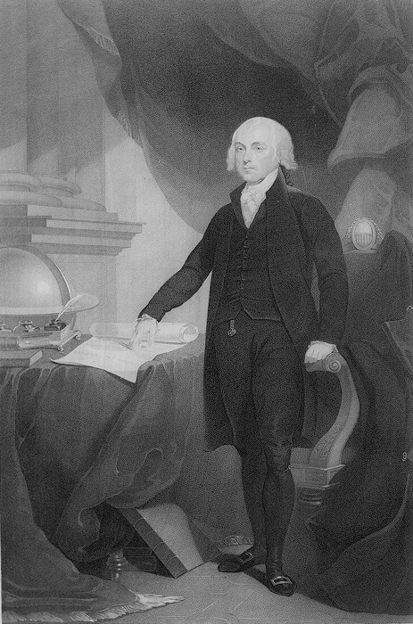
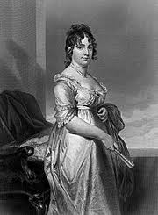
James Madison (He was only 5’4”!)
Election of 1808 James Madison won as a Dem-Rep
In 1812 he decided to go to war against Britain
American military not prepared
Detroit Captured
Badly outnumbered at sea
3 war ships that were super speedy and sneaky!
Things started looking up
However they blockaded the Delaware and Chesapeake Bays

Slide 37
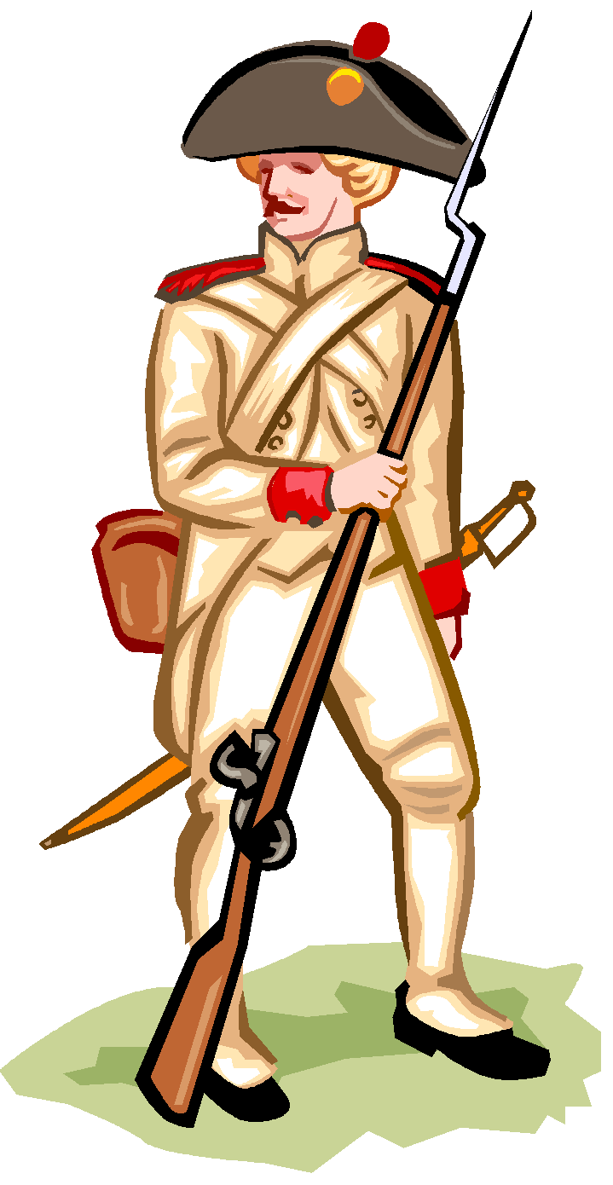
War!
British burned White House
Retaliation
Battle of New Orleans
Battle of New Orlean's Song
General Andrew Jackson- Saved Us!
Treaty of Ghent
Signed Christmas Eve 1814 declared an armistice
1815 commercial trade opened
1817 agreement to number of warships in great lakes
Northern Boundary of Louisiana Territory at the 49th parallel
Ten year joint occupation of Oregon Territory

Slide 38
Slap game !
The first student to slap the correct word after 10 second gets the point. Once you slap a card you cannot slap again.
This was set up by Washington and created the federal court system

Slide 39
Slap game !
This treaty gave us all land east of the Mississippi River and was negotiated with Spain

Slide 40
Slap game!
Gave the Supreme Court the power of Judicial Review

Slide 41
Slap game!
This favored a uniform currency and paying off all national and state debts.

Slide 42
Slap Game!
“Hands Off” Government

Slide 43
Slap Game
Farmers revolt against the excise tax on Whiskey, Hamilton brings in troops.

Slide 44
Slap Game
The First Ten Amendments to the Constitution

Slide 45
Slap Game!
Bought from France for 15 Million Dollars!

Slide 46
Slap Game
Chief Justice of the Supreme Court- Decided Marbury v. Madison

Slide 47
Slap Game
Signed away land by Native American Groups in Ohio- Little Turtle refused.

Slide 48
Slap Game
Issued the proclamation of neutrality during the French Revolution

Slide 49
Slap Game
Refusal to trade with another country- Jefferson put this on Britain before the War of 1812

Slide 50
Slap Game - Double
Slap both correctly to get any points!
Acquired the Northwest Territory
Acquired the territory up to the Mississippi

Slide 51
Slap Game
Believed in a strict interpretation of the constitution

Slide 52
Slap Double!
Group of states or tribes that have come together
Tax on imported goods!

Slide 53
Slap Game
These people demanded for war against the British!

Slide 54
Slap Game
Incident between us and the French- created anti-French sentiments in the US!

Slide 55
Slap Double
Slap both two to get any points
The act of a state to declare a federal law unconstitutional- and void

Slide 56
Slap Game
In this he warned us again making alliances and creating political parties

Slide 57
Slap Triple!
You have to slap all three correct to get any points!
Power to declare laws unconstitutional
Set up the federal courts
Nullified the alien and sedition acts!

