Slide 1
Everything You Need to Know From 1920-2000
Periods 7-9 AP U.S History

Slide 2
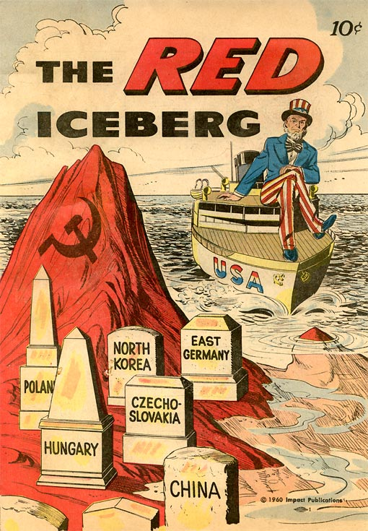
Part I: The early 1920s
Sense of isolationism and sadness at the loss of life in WWI led to ideas of:
Normalcy
Nativism – prejudice against foreign born people.
Fear of Communism following the Bolshevik Revolution and Stalin’s Takeover – Red Scare
What is communism? (Simulation)

Slide 3
The Red Scare
Communist State – An economic and political system based on a single-party government ruled by a dictatorship.
Russian regime overthrown and Lenin established a new Communist state. (Bolshevik Revolution)
Communist Party in the U.S. formed shortly after.
Some members of the Industrial Workers of the World were involved.
When several dozen bombs were mailed to government and business leaders, people became fearful that the communists were taking over!

Slide 4
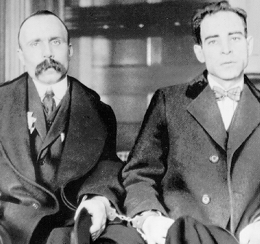
Fighting Communism
U.S. attorney general appoints J. Edgar Hoover to hunt down Communists, Socialists, and Anarchists.
Sacco and Vanzetti – arrested and charged with robbery and murder.
Prejudicial remarks were given by the judge.
Guilty and sentenced to death.
Evidence circumstantial.
Reactions! Protests rang out in the U.S. These men were immigrants. Both died by electric chair.
Video Clip: Sacco and Vanzetti

Slide 5
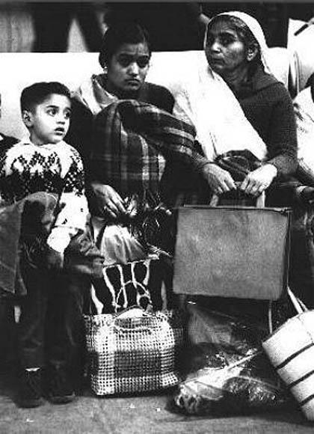
Limiting Immigration and the Influence of Nativism
KKK on rise again…why?
Quota System – Established the max number of people who could enter the US from each foreign country.
In response to nativist pressure.
Connections to today?
Connections to past historical events?

Slide 6
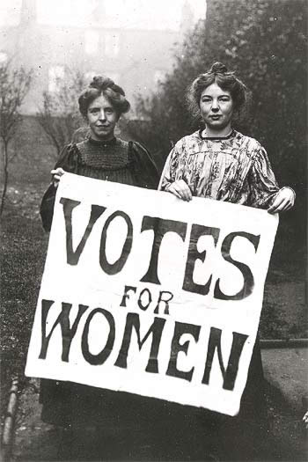
Time of Labor Unrest
Boston Police Strike, Steel Mill Strike, Coal Miners Strike (A lot of unions tended to be socialist..why?)
During WWI the government wouldn’t allow workers to strike because they didn’t want it to interfere with the war effort.
However in 1919 there were more than 3,000 strikes and more than 4 million workers walked off the job.
John L. Lewis- Leader of the United Mine Workers – 1890. Was able to achieve a 17% wage increase for coal miners.
Don’t forget 19th Amendment!

Slide 7
The Harding Presidency
Woodrow Wilson’s term ends in 1921
Harding becomes president.
Tea-Pot Dome Scandal:
Lots of corruption in the administration already. Oil rich public lands for navy. Albert B Fall managed to get the oil reserves transferred to his department then leased the land to oil companies.
Albert Fall Secretary of the Interior suddenly receives $400,000 dollars and becomes the first person holding a cabinet post to be convicted of a felony.
Fordney McCumber Tariff- Raised Taxes on U.S imports to 60%. Protected U.S businesses but made it impossible for Britain and France to pay war debts. Causes resentment…why?

Slide 8
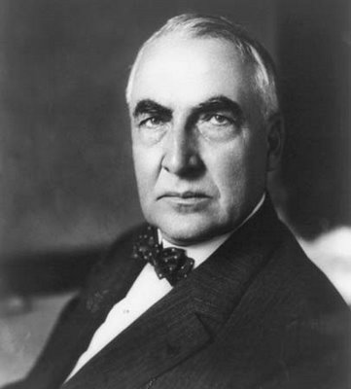
The Ohio Gang
Harding appoints his buddies to his cabinet called the Ohio Gang- poker playing buddies.
One buddy was caught illegally selling government medical supplies to private companies.
Harding declared, “I have no trouble with my enemies…but my friends, they’re the ones that keep me walking the floor at night!”
One month later Harding dies from a stroke. Calvin Coolidge assumes presidency.

Slide 9
Business in America
Calvin Coolidge President – Pro Business
Automobile led to:
Construction of paved roads, houses with garages, liberated an isolated rural family, etc.
Urban Sprawl – define?
Charles Lindbergh May 20th 1927, made first nonstop solo flight across the Atlantic.
Electrical Appliances – Vacuum Cleaner, Washing Machine.
Standard of Living Grows.

Slide 10
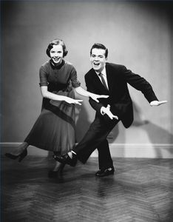
Superficial Prosperity
Installment Plan = Credit
Most people focused their attention on the present with little thought of the future.
This causes significant changes in social norms.
1920s The Charleston!
End Part I: The early 1920s

Slide 11
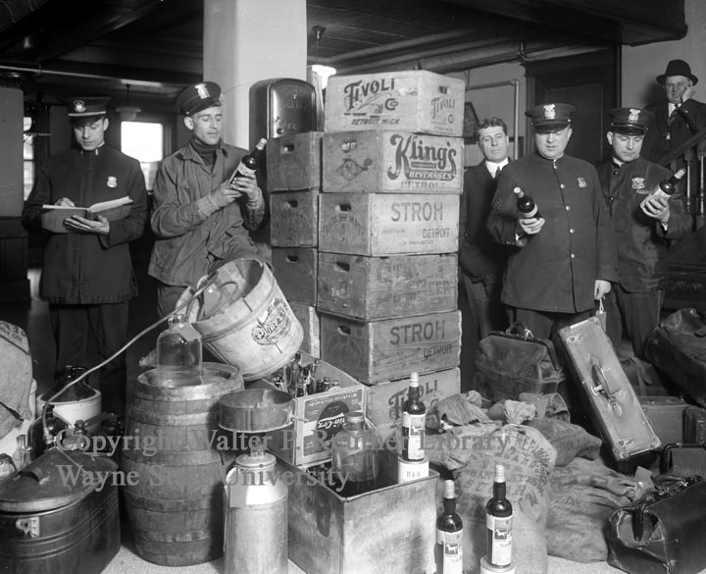
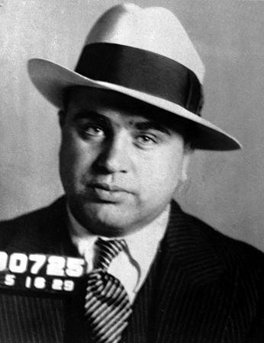
Part II: 1920s New Urban Life
Prohibition – 18th Amendment- Ban on manufacture, sale and transportation of alcohol was prohibited.
Repealed in 1933 with the
Speakeasies
Bootleggers – Al Capone and Organized Crime.

Slide 12
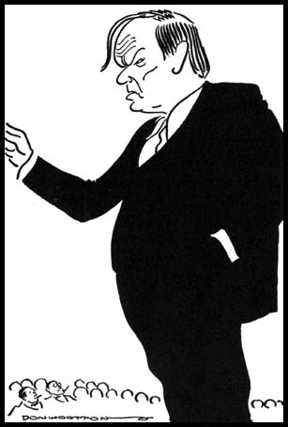
Fundamentalism
Fundamentalists – skeptical of scientific discoveries and theories, especially evolution!
Clarence Darrow and Scopes Trial – fight over evolution in the schools.
Clarence Darrow was the lawyer for the ACLU. William Jennings Bryan served as the prosecutor.
Inherit the Wind- http://www.youtube.com/watch?v=S_DQUAuNUvw
Scopes trial was a fight over evolution and the role of science and religion in public schools.
TN authority fined scopes $100 and kept the law outlawing evolution.

Slide 13
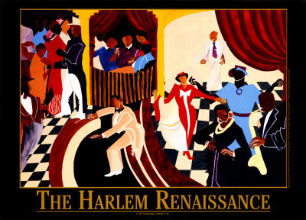
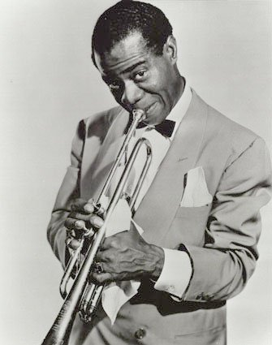
Harlem Renaissance
Great Migration
Daily discrimination led to activism in the NAACP and Back to Africa movement started by Marcus Garvey.
Harlem Renaissance became a haven for creativity. Defined as a literary and artistic movement celebrating African American culture.
Langston Hughes – Poet
Paul Robeson – Actor
Louis Armstrong – Jazz Trumpet Player
Bessie Smith – Singer

Slide 14
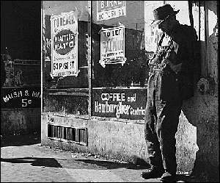
Troubles on the Horizon: 1928
Economic troubles (Causes of the Great Depression)
Farmers – boosted production to fast
People Living on credit
Uneven distribution of income – rich got richer and poor got poorer.
Dreams of Riches in the stock market. People buying on margin (paying part of stock borrowing money for rest)

Slide 15
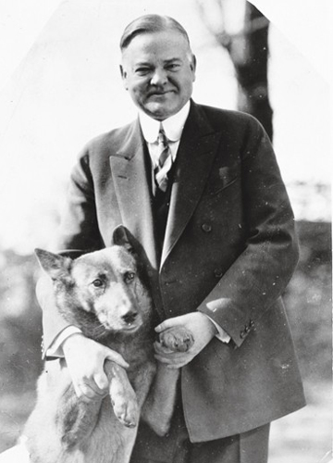
Hoover in 1928
Stock Market Crashes
October 29th known as Black Tuesday –
Stockholders frantically tried to sell stocks before prices plunged lower. Investers Lost 30 Million = Spent in WWI

Slide 16
The Collapse
Great depression – 1929 – 1940 in which the economy plummeted and unemployment skyrocketed.
Bank and business failures. GNP cut in half. Other countries suffered as well.
Hawley Smoot Tariff – attempted to protect American farmers and manufactures but had opposite effect. Reduced flow of goods into U.S. (Hoover)

Slide 17
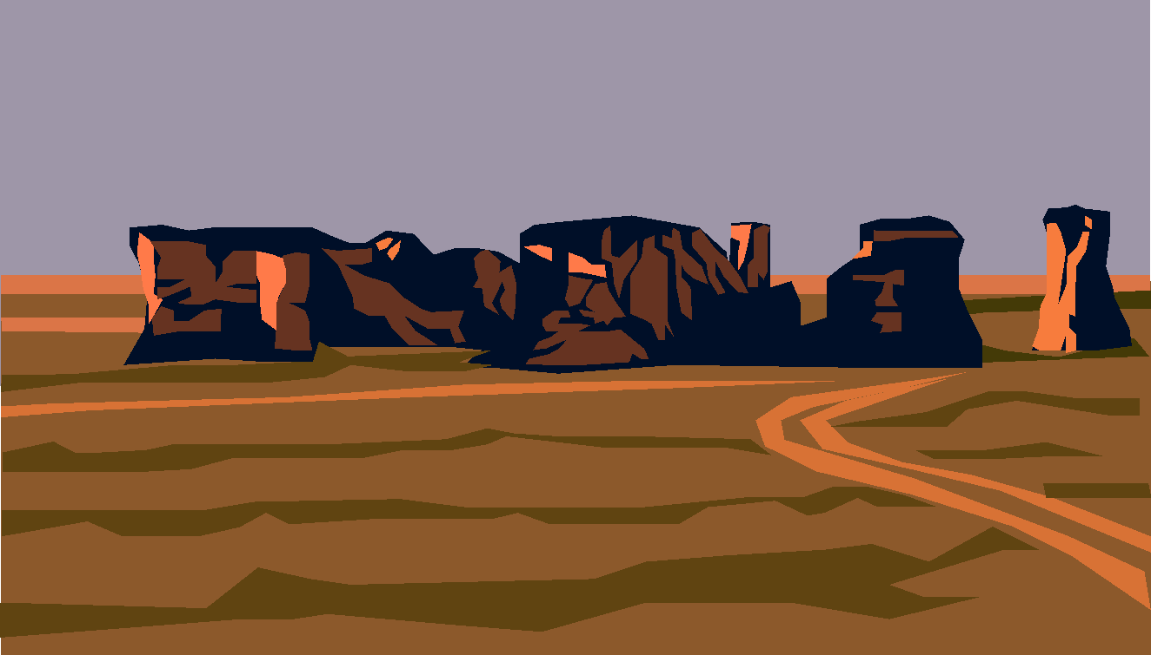
Effects of the Depression
Soup Kitchens, Breadlines
Shantytowns – shacks
Hobo Symbols – page 681
Dust Bowl – Kansas, Oklahoma, NM and Colorado.
No direct relief – or federal cash payments.

Slide 18
What tries to be done….
Hoover
Reassurance
Do nothing philosophy
Some construction projects – Boulder Dam
Federal Home Loan Bank Act. – lowered mortgage rates.
Reconstruction finance Corp – 2 billion for emergency financing for banks.
Bonus Army
Roosevelt
New Deal: Three general Goals – Relief, economic recovery, and financial reform.
100 days –passed more than 15 acts of legislature..

Slide 19
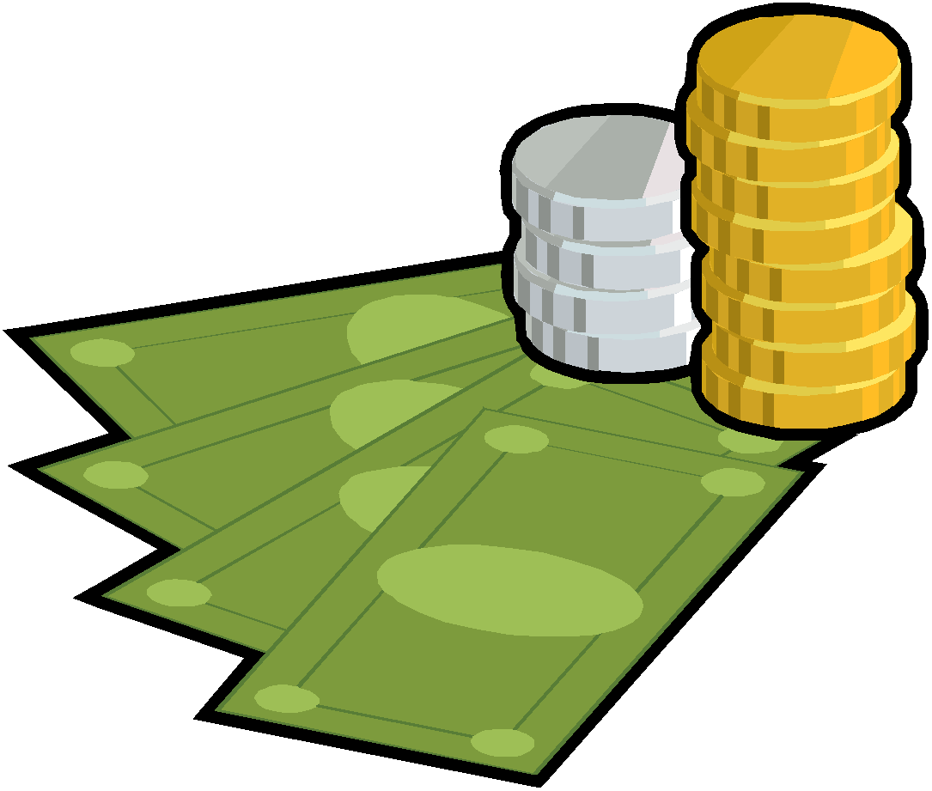
Roosevelt’s Plan
First 100 days
Glass Steagall Act – FDIC Insurance up to 5,000 dollars.
Agricultural Adjustment Act – raise crop prices by lowering production.
Civilian Conservation Corps, National Industrial Recovery Act (Schools, community buildings.)
Deficit Spending

Slide 20
Roosevelt’s Plan
Second 100 days
Works Progress Administration – Created Jobs
Wagner Act – protected workers.
National Youth Administration – Jobs for young people.
Social Security Act – old age insurance, unemployment compensation, aid to families with dependent children and the disabled.
New Deal Coalition – brought together various groups in the support of the Democratic Party.
Tennessee Valley Authority – water power, dams
Complete New Deals Activity- See Chart

Slide 21
Part III: World War II and Its Aftermath… 1931-1960
Nationalism
Stalin – Russia – Totalitarian (complete control)
Mussolini- Italy's – Fascist (state above individual)
Hitler – Germany – Nazism (extreme nationalism)
War breaks out in Europe – Austria and Czech fall to Hitler.

Slide 22
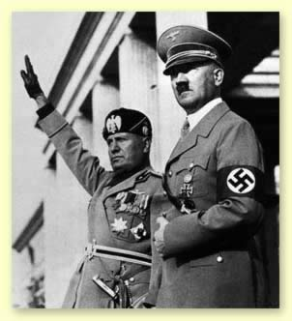
German Offensive
Blitzkrieg warfare – lighting war.
America remains isolationist
Fall of France
Battle of Britain

Slide 23
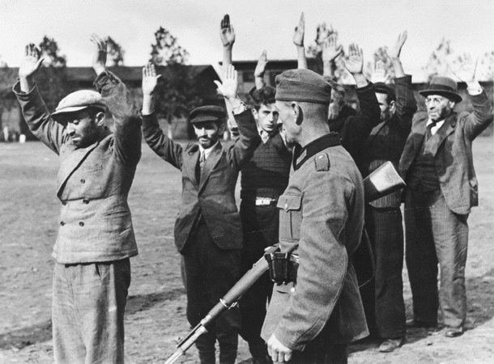
Holocaust
Systematic murder of 11 million people across Europe – more than half Jews.
Kristallnacht – “Night of Broken Glass”
Hitler’s Final Solution – Genocide- deliberate killing of entire population.
Concentration Camps, Mass Exterminations in the final stage.

Slide 24
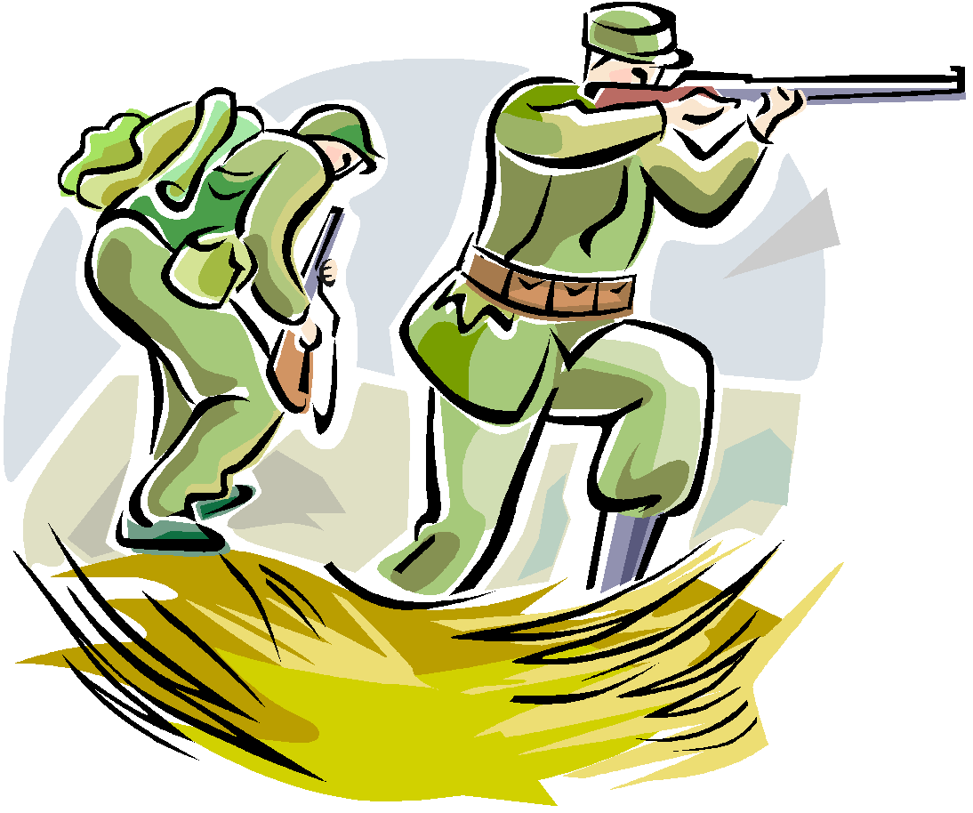
America Joins
America begins to provide arms to France and Britain.
Get wind of Japan, Germany, and Italy joining to become Axis Powers.
Roosevelt wins a third term
Japan Attacks U.S. – Pearl Harbor
Eastern Front – Europe, Eisenhower great general.
D-Day – June 6, 1944 largest operation in history land, sea air.
VE Day – (Victory in Europe) May 8, 1945
Western – Pacific – General MaCarthur - Battle of Midway Turning Point., kamikaze, Hiroshima and Nagasaki.
Roosevelt Dies- Truman takes over
Hiroshima and Nagasaki and unconditional surrender

Slide 25
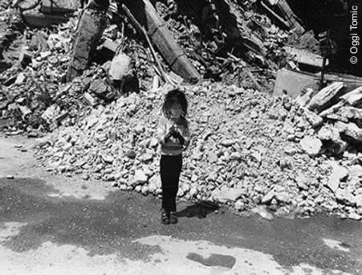
Effects of War
Immediate
Defeat of Axis
Loss of life
Recognition of Holocaust
UN
Nuremberg Trials
Internment Camps
Nuclear Bomb
Long Term
Rise of US and Soviets as world powers.
Cold War
Nuclear Capability

Slide 26
Cold War
Truman is president
Satellite nations – countries dominated by Soviet Union
U.S policy of containment – “iron curtain”
Cold War – conflict between the U.S and the Soviet Union.
Truman Doctrine – policy of U.S. to support free people who are resisting communism.
Marshall Plan – Aid European nations that needed it.
Berlin Airlift – Gave those taken over by the soviets food and supplies.
NATO – Pledged military support to each other.

Slide 27
China becomes Communist
Chiang Kai-shek (U.S Supported) v. Mao Zedong (Communist)
38th Parallel and the Korean War – 1950

Slide 28
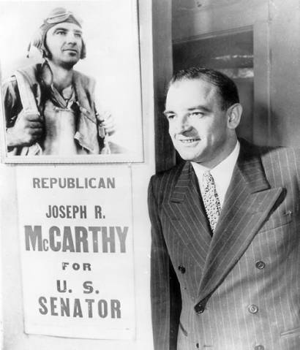
Cold War at Home
Fear of Communist Influence
Hollywood Ten
Ethel and Julius Rosenberg – pleaded fifth and sentenced to death.
McCarthyism

Slide 29
Living on the Edge…
Warsaw Pact – Russia and 7 Eastern European Nations
H-Bomb Race
Eisenhower Doctrine – U.S. would defend the Middle East from Communism.

Slide 30
Postwar Boom
Suburbs
GI Bill of Rights
Truman as President
Baby Boom
Mass Media and the FCC
Beat Movement – SF expressed the social and literary nonconformity of artists.
White Flight

Slide 31
Living with Great Turmoil
Kennedy and the Cold War
Debate Nixon v. Kennedy
Kennedy and Civil Rights
Cuban Dilemma – Missile Crisis
New Frontier! – Space, Other Countries – Peace Corps
Assassination of Kennedy - 1963

Slide 32
Lyndon B Johnson
War on Poverty – Economic Opportunity Act – Job Corps, VISTA, Head Start, Community Action.
Medicare, Medicaid
Immigration Act of 1965

Slide 33
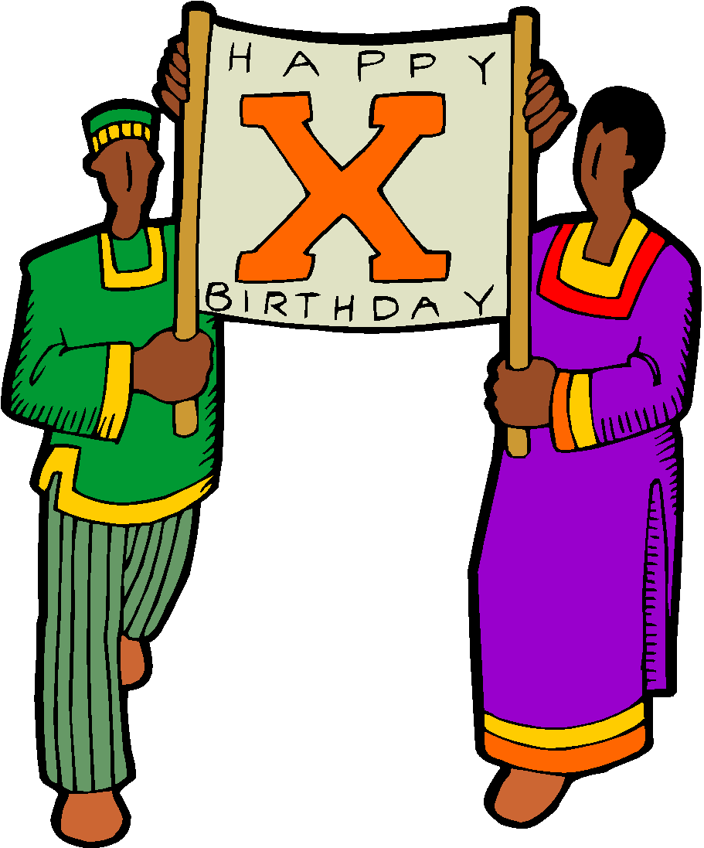
Civil Rights
Segregation – Plessy v. Ferguson
Brown v. Board of Ed. Overturned Plessy.
Rosa Parks
MLK or. Malcolm X
Student Nonviolent Coordinating Committee
Sit-ins, Freedom riders,
Civil Rights Act of 1964 – prohibited discrimination because of race, religion, national origin, and gender.
Voting Rights of 1965 – Eliminated literacy tests.
Affirmative Action

Slide 34
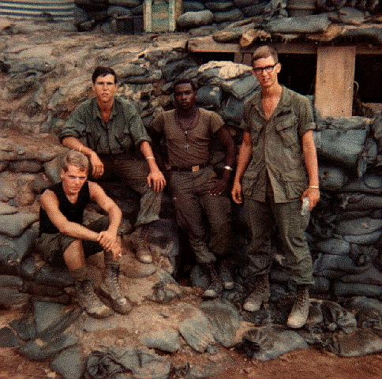
Vietnam Years 1965-1969
Domino Theory – Communist Countries
Vietcong – Opposition group in South Vietnam. See Tunnels of the Vietcong.
Geneva Accords – divided Vietnam along 38th parallel.
Tonkin Gulf Resolution – Granted Johnson broad military power in Vietnam.
Napalm (gasoline base that set fire to the jungle) and Agent Orange – leaf killing toxic chemical.
American search and destroy missions – uprooted civilians and killed farms and livestock if ties to Vietcong.

Slide 35
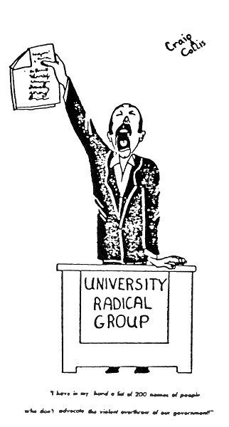
Nation Divided
Draft
African Americans accounted for more than 20% of American combat deaths despite representing only 10% of the U.S. population.
New Left – Changed for American Society.
Doves (withdraw) Hawks (greater military force)

Slide 36
1968: A Crazy Year
Tet Offensive – January 30th Japanese New Year’s Eve. Festivities known as Tet. Weeklong truce, and funerals being held. These coffins contained weapons and Vietcong agents. Attacked over 100 town and 12 U.S. air bases.
Changed public opinion – more supported withdrawal.
Johnson steps down and Nixon takes office

Slide 37
Legacy of War…
Nixon and Vietnamization
Kissinger – idea for gradual withdrawal of troops and allow south Vietnam to take power.
Kent State University – students protest led to the burning of the ROTC building. Gunfire wounded nine people and killed four.
Pentagon Papers – 7,000 page document called for U.S to enter the war even if Lyndon Johnson did not want to send troops.
War Powers Act – president must inform Congress within 48 hours of sending forces into a hostile area without a declaration of war.

Slide 38
Social Equality: Women, Latinos, Native Americans
Cesar Chavez – Mexican-American farm worker trying to organize a union for CA Spanish-speaking farm workers.
American Indian Movement
Feminism – women should have political, economic, and social equality with men.
Betty Friedan and the Feminine Mystique
National Organization for Women
Gloria Steinem – journalist, political activist

Slide 39
Counterculture
A movement made up mostly of white, middle class college youths who had grown disillusioned with the war in Vietnam and injustices in American in the 1960s.
Haight-Ashbury – hippie capital in San Francisco, did not outlaw hallucinogenic drugs until 1966.

Slide 40
Changing Culture
Music – Beatles, Woodstock, Grateful Dead, Bob Dylan, Joan Baez, Jimi Hendrix, Jefferson Airplane.
Conservatives attack counterculture – FBI director J Edgar Hoover issues a warning that “revolutionary terrorism” is plunging society into anarchy.

Slide 41
Passage to a New Century 1968-2001
Nixon and new conservatism.
Family Assistance Program – every family of four with no outside income would receive a basic federal payment of 1,600 a year.
Slows Integration – No support for busing.
High Inflation and high unemployment – stagflation.
Realpolitik – politics based on power not principals. Détente – eased Cold War Tensions. Nixon visited China and Moscow.
SALT I Treaty – 5-year agreement, limits number of missiles that can be made.

Slide 42
Watergate
Nixon administration attempted to cover up a burglary of the Democratic National Committee.
Nixon Resigns, Ford takes over.

Slide 43
New Liberalism: Part IV
Jimmy Carter – Peanut Farmer and governor of Georgia.
National Energy Act – tax placed on gas guzzling cars.
Promoted Human Rights – Moral Principles guide his policy.
Yielding Panama Canal
Camp David Accords – Israel agrees to withdraw from Sinai Peninsula which it had seized from Egypt.
Environmental Activism – Rachel Carson and Silent Spring. Earth Day, EPA
U.S Invasion of Lebanon
Iran Contra Affair

Slide 44
Conservatism
The New Right – Focused on controversial social issues such as abortion, blocking equal rights amendment, and evading court ordered busing.
Criticized affirmative action.
Moral Majority – Evangelical fundamental Christians interpreted the Bible literally.
Texas v Johnson
Swann v Charlotte Mecklenburg Schools

Slide 45
Ronald Reagan
Reaganomics
Budget cuts
Tax cuts
Increased Defense Spending
If people paid few taxes they would buy more stuff!
Strategic Defense Initiative – Star Wars.
Sandra Day O'Connor – First woman appointed to Supreme Court
Anita Hill v. Clarence Thomas

Slide 46
Deregulating the Economy
Deregulation – cutting back on federal regulation – like the EPA.
George Bush Sr. Elected!
Health Education and Cities in Crisis
AIDS
Drug Abuse
Abortion

Slide 47
Operation Desert Storm
Liberate Kuwait from Iraqi control.

Slide 48
Clinton
First member of the Baby Boom to win the Presidency.
Health Care reform
Balanced Budget and Economic Boom
NAFTA
Energy Boom!
Solar

Slide 49
Crime and Terrorism
Columbine
Oklahoma City Bombing
September 11th, 2001.

Slide 50
Trade and Global Economy
North American Free Trade Agreement.
Newt Gingrich and the Contract with America.
Ten items Rep promised if they won control of Congress. Balanced Budget, tax cuts, tougher crime laws, and welfare reform.
Clinton Impeached.

Slide 51
Bush
Election night confusion: Al Gore v. George Bush.
Growth of jobs in service sector – nearly 80% did service jobs. (Teachers, doctors, lawyers)
Traditional workplaces decline (factories, farms)
Bill Gates, Shawn Fanning and NAPSTER, Internet, Genetic Engineering

Slide 52
Controversies
Immigration
Aging America
Urban Flight
Anything Else?????

