Slide 1
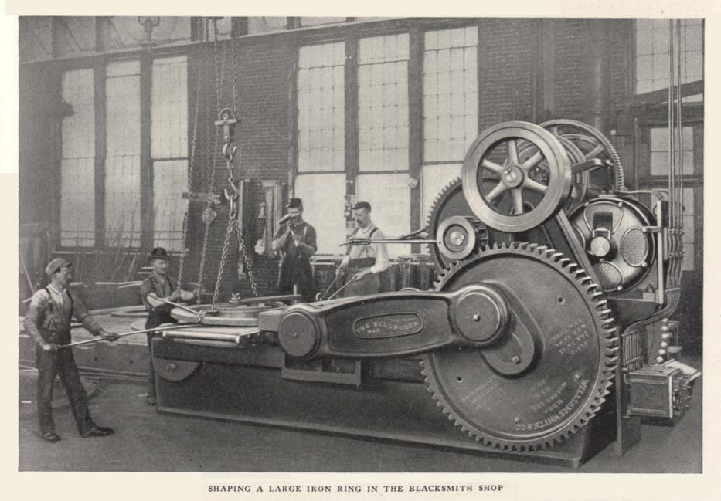
Balancing Nationalism and Sectionalism

Slide 2
Imagine
The year is 1828. You are a senator from a Southern state. Congress has just passed a high tax on imported cloth and iron in order to protect Northern Industry. The tax will raise the cost of these goods in the south and will cause Britain to buy less cotton. Southern states hope to nullify, or cancel, such federal laws that they consider unfair
Would you support the federal or state government?
What might happen if some states enforce laws and others don’t?
What does it mean to be a nation?

Slide 3
The Industrial Revolution
In 1801 Eli Whitney demonstrated to President John Adams the first musket made with interchangeable parts.
Mass Production: production of goods in large quantities was possible.
Brought about the Industrial Revolution – social and economic reorganization that took place as machines replaced hand tools and large-scale factory production developed

Slide 4
Industrial Revolution Cont.
Primary source of income earlier was international trade.
But now:
Jefferson passed the Embargo Act of 1807
War of 1812 Americans started focusing on domestic industries.
Embargo-prevented shipping goods to Europe
New England: Agriculture not highly profitable focused on industry
1793: Samuel Slater established first successful mechanized textile factory.
Weaving factory sprang up in Massachusetts

Slide 5
Industry versus Agriculture in the U.S.
Two Economic Systems Develop (Overhead Activity)
Northeasterners invested their capital in factories and manufacturing operations. Cash crops did not grow well in the Northern climate
Southerners had begun to reap huge profits from cotton by the mid 1790s. As a result North and South had two distinct economies.
By the 1700s slavery in the North was dying out. And an increasing number of Northerners began to voice their religious and political opposition of slavery. By 1804 almost all of the Northern states and voluntarily abolished slavery.
Cotton King: Eli Whitney’s invention of the Cotton Gin helped to set the South on a difference course of development from the North.

Slide 6
The American System
Henry Clay proposed the American System
As the north and south began to develop different economies, a plan for unifying the nation needed to take place.
In 1815 James Madison proposed this plan to congress
Developing transportation systems and other internal improvements
Establishing a protective tariff
Resurrecting the national bank
Industry in the North would produce manufactured goods for the south and west.
Agriculture in the south and west would support the north.

Slide 7
1: Unification through Transport
First steamboat locomotive built in 1825
Railroads
Most travel was canals and roads.
Most states built turnpikes
Construction of the National Road began in 1811
Erie Canal: Linked the Hudson River to Lake Erie or in effect the Atlantic to the Great Lakes.
New York becomes dominant port after 12 years

Slide 8
2 and 3: Taxes and Money
Tariffs and the National Bank
British goods were not as good but cheaper
Putting a tariff on imports made people less likely to buy British stuff.
Tariff of 1816
National Bank would provide a currency that could be nationwide
James Monroe elected President, was republican but took a tour of northeast and was liked by Federalists. “Era of Good Feelings” all warm and fuzzy….yay
End of Section 1

Slide 9
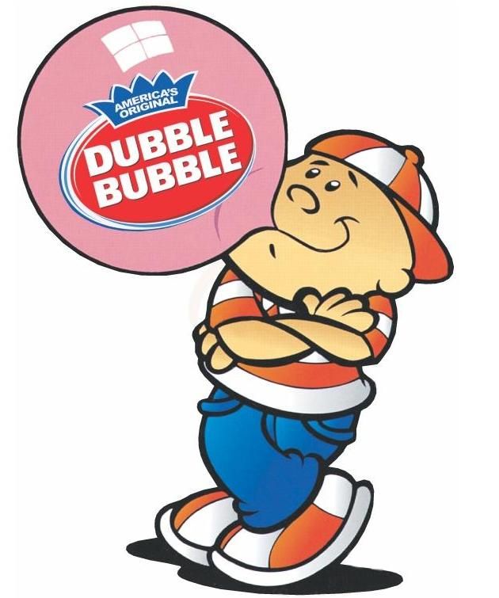
Reflection…
Ok so you have 20 minutes to answer the following prompt...
Explain the many differences both environmental and economic that exist between the north and the south. This disunity forced the U.S. government to take action. Explain what actions were taken to bring these two regions together.
Create an illustrated double bubble using what you know about the different regions of the north and the south and the similarities created through the American System.

Slide 10
The Underground Railroad
The Underground Railroad
system by which escaped slaves from the South were helped in their flight to the North.
The system started in 1787 when Isaac T. Hopper, a QuakerThe system started in 1787 when Isaac T. Hopper, a Quaker, began to organize a system for hiding and aiding fugitive slaves.
Opponents of slavery allowed their homes, called stations, to be used as places where escaped slaves were provided with food, shelter and money.
The various routes went through 14 Northern states and Canada.
It is estimated that by 1850 around 3,000 people worked on the underground railroad.

Slide 11
Routes of the Underground Railroad

Slide 12
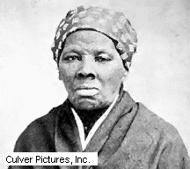
People of the Underground Railroad
The Underground Railroad also had people known as conductors who went to the south and helped guide slaves to safety.
Harriet Tubman
Stations were usually about twenty miles apart. Conductors used covered wagons or carts with false bottoms to carry slaves from one station to another.
Runaway slaves usually hid during the day and traveled at night.
Some of those involved notified runaways of their stations by brightly lit candles in a window or by lanterns positioned in the front yard.

Slide 13
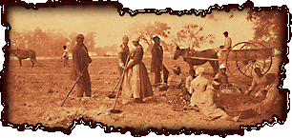
The Opposition
Plantation owners became concerned at the large number of slaves escaping to the North and in 1850 managed to persuade Congress to pass the Fugitive Slave Act.
Any federal marshal who did not arrest an alleged runaway slave could be fined $1,000. Any person aiding a runaway slave by providing shelter, food or any other form of assistance was liable to six months' imprisonment and a $1,000 fine.
The Fugitive Slave Act failed to stop the underground railroad.
Thomas Garrett, the Delaware station-master, paid more than $8,000 in fines.
Calvin Fairbanks served over seventeen years in prison for his anti-slavery activities.
John Fairfield, one of the best known of the white conductors, was killed working for the underground railroad.

Slide 14
Freedom Quilts
In order for slaves to escape in the early 1800s, they relied heavily on the Underground Railroad.
It is here that the story of the quilt code begins. Since quilts were hung outside for drying, it is thought that they were used as "billboards" to give clues to escaping slaves on the road.
To those who knew the code, the block patterns of each quilt symbolized a direction, or prepared an escaping slave for what was ahead on the road to freedom.

Slide 15
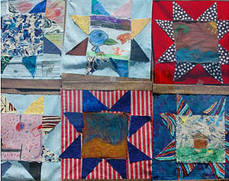
Freedom Quilts Cont.
Our class will complete our own freedom quilt.
Pick two different quilt pieces to color however you want.
Look up what each of your pieces means and write this information on the back of each piece.

Slide 16
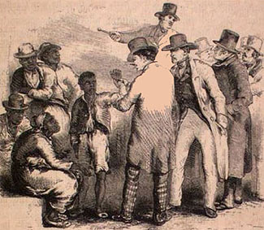
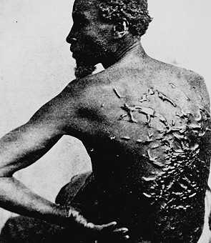
Exit Slip
Knowing a little more about slavery in the United States- what do you think are some of the long term affects of slavery on American society? Are there any problems in today’s society that can be attributed to the issue of slavery?

Slide 17
Section 2: Nationalism at Center Stage
The Supreme Court Boosts National Power
In 1807 Robert Fulton’s Boat the Clermont propelled by steam engine cruised 150 miles up the Hudson River in 32 hours. This started the steamboat era.
In 1808 Robert Fulton received a charter from the New York Legislature
Gave him the exclusive right to run steamboats on rivers in that state.

Slide 18
Ogden V. Gibbons
Aaron Ogden believed he was the only operator legally entitled to run a steamboat on that stretch of the Hudson.
Thomas Gibbons did the same in the same area.
Ogden took Gibbons to court
1824 the Supreme Court ruled that interstate commerce could be regulated only by the federal government.

Slide 19
McCulloch v. Maryland
Maryland attempted to levy a heavy tax on the local branch of the BUS hoping to make it fail. Marshall said states do not have this right.
(1819) Chief Justice John Marshal guided the Supreme Court to a ruling that supported the national government over state governments.

Slide 20
Nationalism Shapes Foreign Policy
Chief Justice Marshall guided the Supreme Court to decisions that increased the power of the federal government.
Secretary of State John Quincy Adams established foreign policy guided by nationalism – the belief that national interests should be place ahead of regional concerns or the interests of other countries.
Expansion of Territory: Under President James Monroe, Adams wanted to work on expansion. Worked out treaty with GB to reduce the Great Lakes fleets of both countries to only a few military vessels.

Slide 21
Monroe Doctrine
Rush Bagot Treaty eventually led the US and Canada to demilitarize their border. Adams arranged U.S. border at 49th parallel.
1819 Spain ceded Florida to the US in the Adams-Onis Treaty and gave up claims to Oregon Territory.
Monroe Doctrine: After Spain and Portugal defeated Napoleon in 1815 these European powers wanted to reclaim their former colonies. Russia pushing in from the NW.
In 1823 President Monroe sent a message to Congress warning all outside powers not to interfere with affairs in the Western Hemisphere.

Slide 22
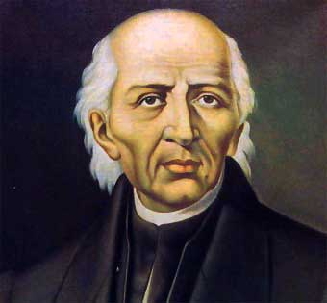
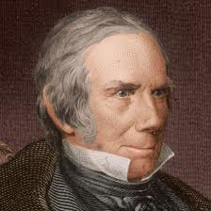
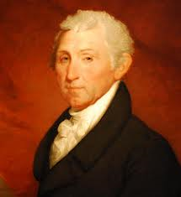
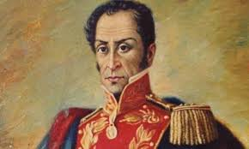
Act It Out: Monroe Doctrine
Cast of Characters:
Miguel Hidalgo/Henry Clay
Simon Bolivar/James Monroe
Step 1: Read pages 169-170 about the story behind the Monroe Doctrine.
Step 2: In your teams put together a small script of the circumstances that surround the Monroe Doctrine. Each person must have a character. And you must write out the actions that are occurring as if it was a play.
Step 3: Performance!

Slide 23
Nationalism Pushes West YeeeHawww!
Missouri Compromise:
In 1819 Missouri requested admission into the Union but was split on the issue of slavery.
Until 1818 the US consisted of ten free and ten slave states. Illinois was the 11th Free State. People expected Missouri to be the 11th slave state.
NY congressmen James Tallmadge passed a law that Missouri had to gradually free its slaves. Southerners attempted to block this bill. Alabama admitted as a slave state.
Northerners accused southerners of plotting to extend slavery into other states. Southerners accused Northerners of trying to end slavery.
Foreshadowed the war to come.
Under Henry Clay Congress made a series of agreements collectively called the Missouri Compromise
Maine admitted as a free state. Missouri as a slave state. South of the Missouri compromise line slavery was legal. North except Missouri slavery was banned

Slide 24
Missouri Compromise

Slide 25
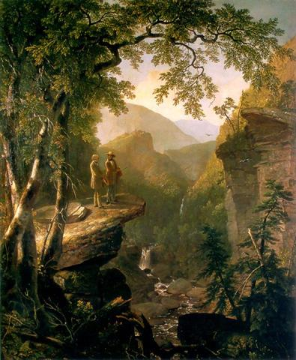
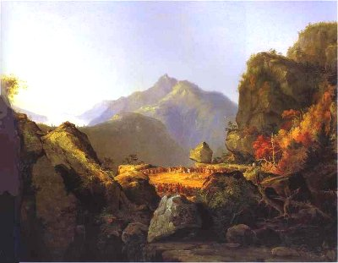
Artists Portraying Nationalism
Thomas Cole
Asher Durand

Slide 26
Section 3: The Age of Jackson
Expanding Democracy Changes Politics
Adams and Jefferson Died. Adams had son John Quincy Adams not effective president mostly due to his political opponent Andrew Jackson
In election of 1824 Jackson won the popular vote but not the majority of electoral votes. House had to decide. Henry Clay a lot of power in the House could swing election either way. Did not like Jackson. Adams elected president...
Jacksonians accused Adams of stealing presidency. Clay became secretary of state.
During Adams presidency most states eased the voting requirements so the voting population grew.

Slide 27
Jackson’s Presidential Style
Jackson appealed to the common man
Campaign of 1828 Jackson called Adams an intellectual elitist. And made him to be a man of humble origins even thought we were a wealthy plantation owner. Jackson won. Named “Old Hickory”
Jackson’s Spoils System
Appointees to federal jobs would serve a max of four years.
Incoming officials throw out former appointees and replace them with their own friends.
Fired 10% of the federal employees.

Slide 28
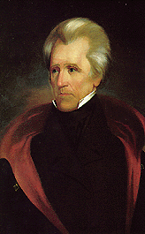
Removal of Native Americans
Two attitudes towards removal
favored displacement and dispossession
Convert Native Americans to Christianity turn them into farmers.
Jackson thought assimilation wouldn’t work. Believed only solution was to move them further west.
Indian Removal Act in 1830: Federal government provided funds to negotiate treaties that would force the Native Americans to move west. Jackson thought this “liberal and generous”.

Slide 29
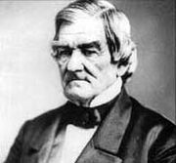
Cherokee Fight Back
Cherokee tried to win just treatment through the legal system. John Marshall refused to rule on the first case the Cherokee brought against Georgia. Had no federal standing because it was not a state but a domestic dependent nation.
In Worchester v. Georgia - Cherokee won final recognition as a political community.
Cherokee leader John Ross tried to fight it. Van Buren ordered their forced removal. Becoming the Trail of Tears.
Southeastern Removal
I wonder/I noticed

Slide 30
Journal: Section 3
Now that you have read a little about the Trail of Tears and Indian Removal Act, describe some of the events that took place and your feelings towards the governments action against Native Americans.
Because of these events many Native Americans lost their land their family and any source of income. Do you think the government should have to payback for what they did to this race of people?
Should their be government compensation to make up for what they lost? Describe…….

Slide 31
Reparations? (Agree or Disagree?)
Each group will read a viewpoint:
As each individual is reading, take notes on what points the author is making. Then get together a as a group.
Explain your articles viewpoint on poster paper
Each individual will write down 1 point that supports their articles viewpoint. (3-4 points total)
Use specific colored markers to show which person wrote which viewpoint. This is graded.
Whole group will present their viewpoints to the class.
Take notes on the opposing viewpoint.
Complete reflection question:
In no less that 10 sentences describe your opinion about reparations towards Native Americans. Back up your opinion by citing specific ideas (at least 2!) used by the author of either article.
*Extra Credit!- Research what kind of reparations are given to the Eastern Band of Cherokee. Research must be reliable and documented. Present to class.

Slide 32
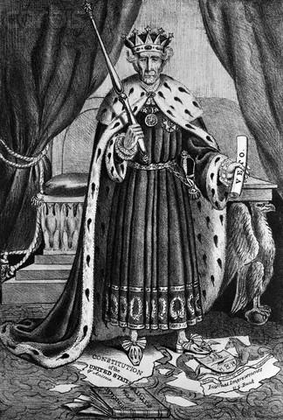
King Andrew I……..? Section 4

Slide 33
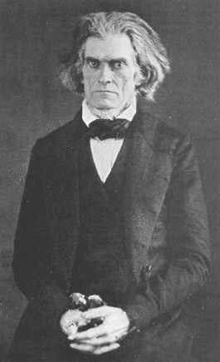
States Rights and National Bank: Section 4
Daniel Webster: an ardent nationalist. Defended the federal government’s power to make laws that applied to all states in the Union.
Tariff Raises the States Rights Issue
Congress in 1816 passed a tariff to protect the infant American industries.
Jackson’s vice president John C. Calhoun of SC called the 1828 tariff a Tariff of Abominations. The high tariff reduced British exports to the U.S. and forced the South to buy more expensive Northern manufactured goods.
Calhoun was known as a nationalist but the tariff made him change his views. SC’s economy had failed. In 1828 Calhoun wrote down a theory which said that if the federal government refused to permit a state to nullify a federal law, the state had the right to withdraw from the Union.

Slide 34
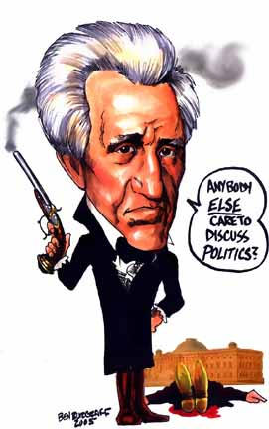
State’s Rights!
Haynes and Webster Debate State’s Rights. In 1830 a debate between Robert Haynes of SC debated Senator Daniel Webster. Haynes delivered a pointed condemnation of the tariff.
Webster (Senator for Mass) could not conceive a “middle course” between submission to the laws and open resistance or revolution on the other.
Jackson: “Our Union must be preserved.”
Calhoun said: “The Union, next to our liberty, the dearest, may we all remember that it can only be preserved by respecting the rights of the States and distributing equally the benefit and burden of the Union. The two men would not work together again.
The issue of states rights was finally put to a test in 1832 when Congress passed a tariff law that SC legislators found unacceptable. They threatened to secede.

Slide 35
Treason! War?!
Jackson furious. Declared SC actions treasonous and threatened to hang Calhoun and march federal troops into SC to enforce the tariff. Jackson also passed the Force Bill in 1833.
Allowed the federal government to use the army and navy against SC if state authorities resisted paying proper duties.
Confrontation seemed inevitable till Henry Clay (Great Compromiser) proposed a tariff bill that would gradually lower duties over a ten-year period. For now it was controlled but the issue would be a major cause of the civil war.

Slide 36
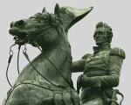
Jackson Attacks the National Bank
Jackson waged a personal war on the Bank of the U.S.
Vetoed to recharter the bank.
Jackson and his allies made certain that the public knew that the BUS was a privileged institution. BUS stockholders earned the interest from deposits and got lower interest rates that the average citizen.
Jackson told running mate that the BUS was a monster that corrupter our statesman and wanted to destroy our republican institution.
(Jackson distrusted all banks) However he felt he could wield power over the national bank.

Slide 37
Interpret this picture…..

Slide 38
Biddle and “Pet Banks”
Pet Banks: Placed government funds in certain state banks called “pet banks” because of their loyalty to the Democratic Party.
Nicholas Biddle (Banks President) decided to have the bank call in our make new loans. He thought this would make people want to have a new bank charter. Biddle folds.
Whig party: Jackson’s tactics angered many people. Including some in the Democratic Party. Henry Clay, John Quincy Adams, and Daniel Webster formed a new party called the Whig party. Backed the ideals of the American system.

Slide 39
Van Buren Deals with Jackson’s Trash
Democrats chose VP Van Buren as their candidate. Won
Pet Banks became wildcat Banks. Printed blank notes wildly in excess of the gold and silver. And federal government selling land was left with bag of useless money. So they had to pay with real gold or silver.
Panic of 1837: Bank closing and the collapse of the credit system cost many people their savings, and put more than 1/3 of the population out of work.
Van Buren tried to help by reducing federal spending but that cause already declining priced to drop further.

Slide 40
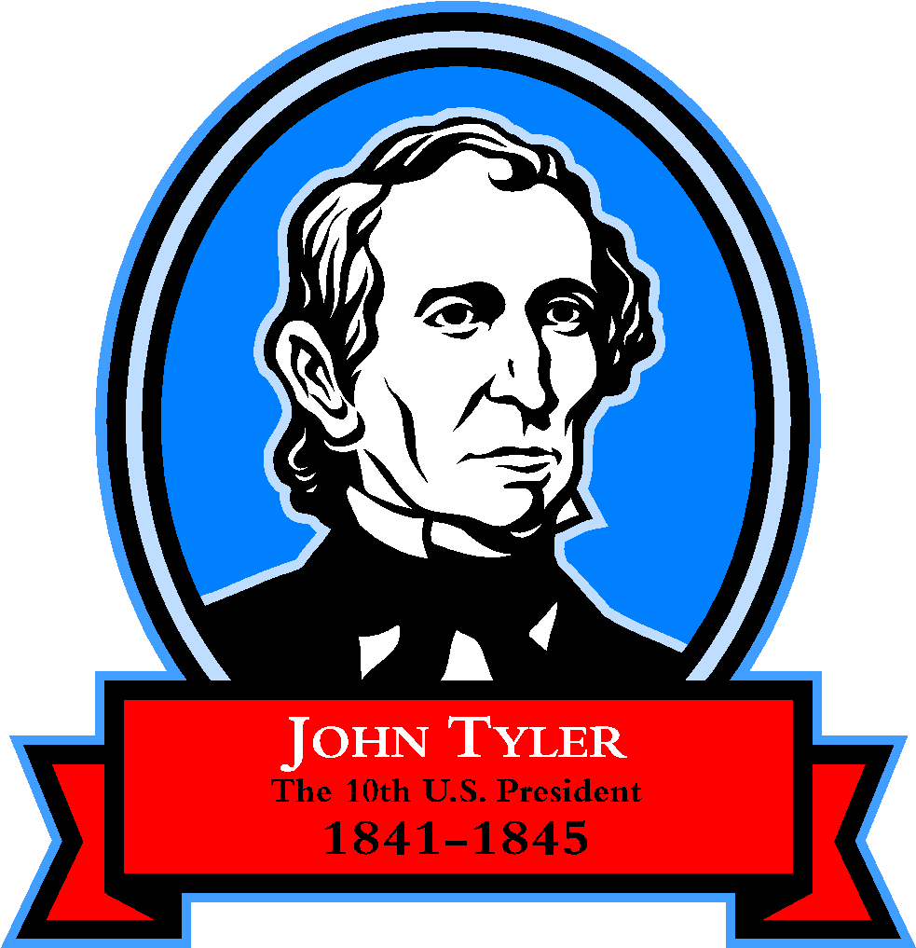
Harrison Who?
Harrison and Tyler: When Van Buren ran for reelection William Henry Harrison ran under the Whig party. Harrison was the war hero while Van Buren was a pampered aristocrat.
Harrison won and immediately took steps to enact the Whig program to revitalize the economy. However after a month being president he died from pneumonia.
John Tyler Harrison’s VP and didn’t agree much with Whig policy. During his four years the Whigs viewed his presidency as a grave mistake.

Slide 41
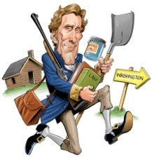
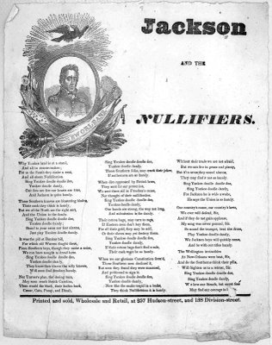
Reflection
How was the debate regarding state’s rights versus federal power evident in the South Carolina Nullification Crisis? Explain

