Slide 1
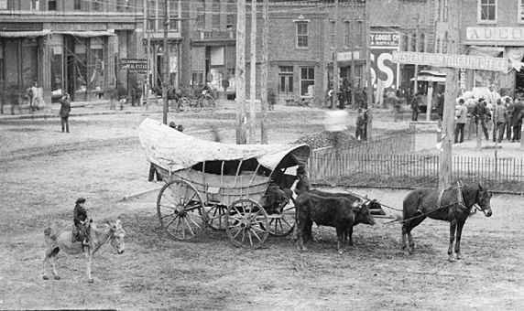
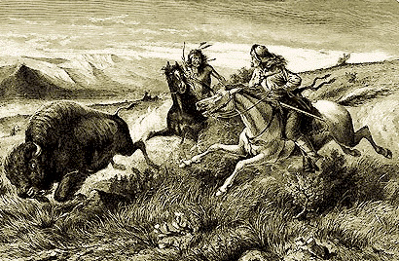
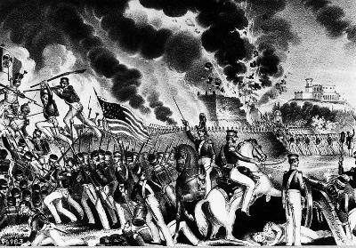
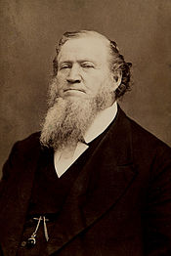
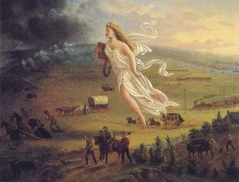
Period 5: Expansion

Slide 2
Causes of the Market Revolution
Market Revolution: Changed U.S. economy. Grew more than it had in 40 years.
Specialization: Result of the rise in textile mills and the factory system.
Capitalism: Private business and individuals control production.
Entrepreneurs: “to undertake” invested in industries.

Slide 3
New Inventions that Affected Expansion
Charles Goodyear: vulcanized rubber, no more India Rubber. (wouldn’t freeze in the cold, used for boots)
Sewing Machine- I.M. Singer
Mechanized farm equipment. Manufactured items grew less expensive.
Steel Plow- John Deere
Mechanical Reaper- Cyrus McCormick
Telegraph: Samuel F. B. Morse

Slide 4
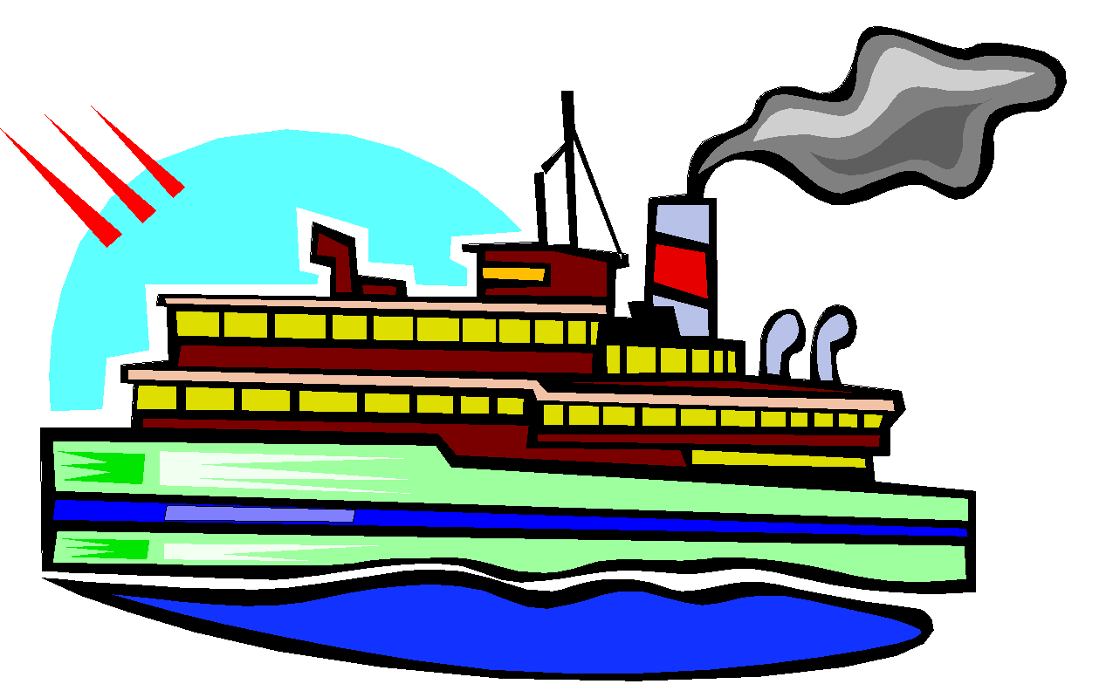
Economic Revolution
Impact on Transportation:
Better and faster transport became essential.
Steamboat
Erie Canal
Mississippi River
Railroads: Cost was more to ship by rail. Roads offered what advantages?

Slide 5
New Markets Link Regions
Improved transportation and communication made America’s regions interdependent.
This growing link between regions caused the development of regional specialties.
South: Cotton, Tobacco, Rice
West: Grain and livestock
John Deere: first steel plow
Cyrus McCormick: mechanical reaper
North: Textiles and Machinery

Slide 6
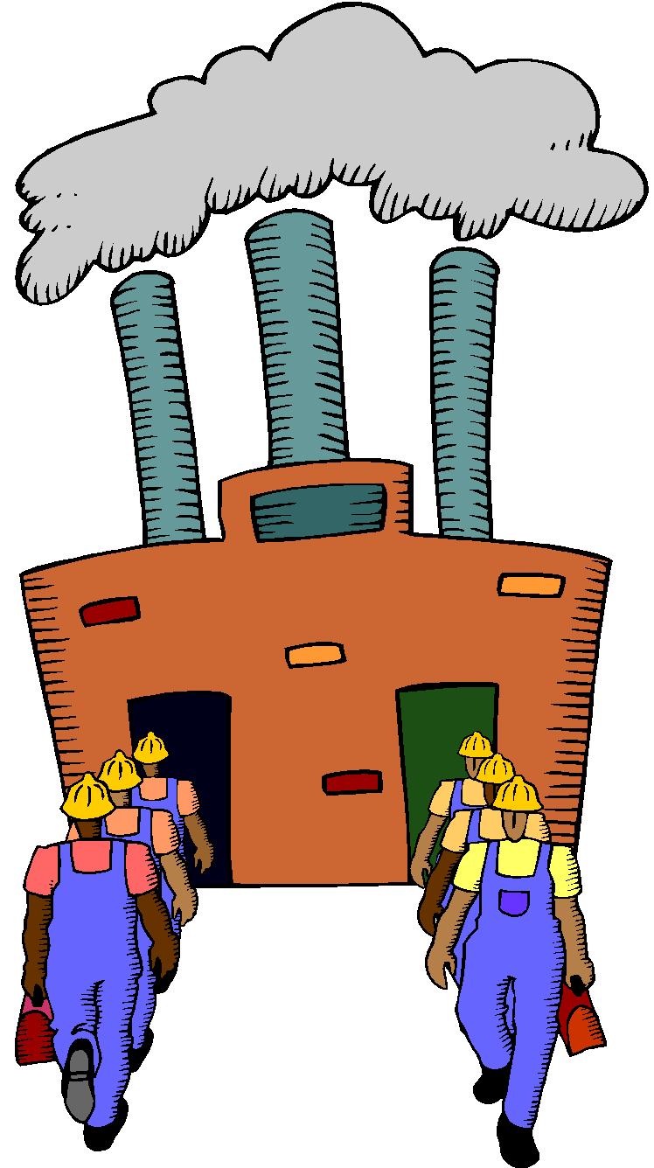
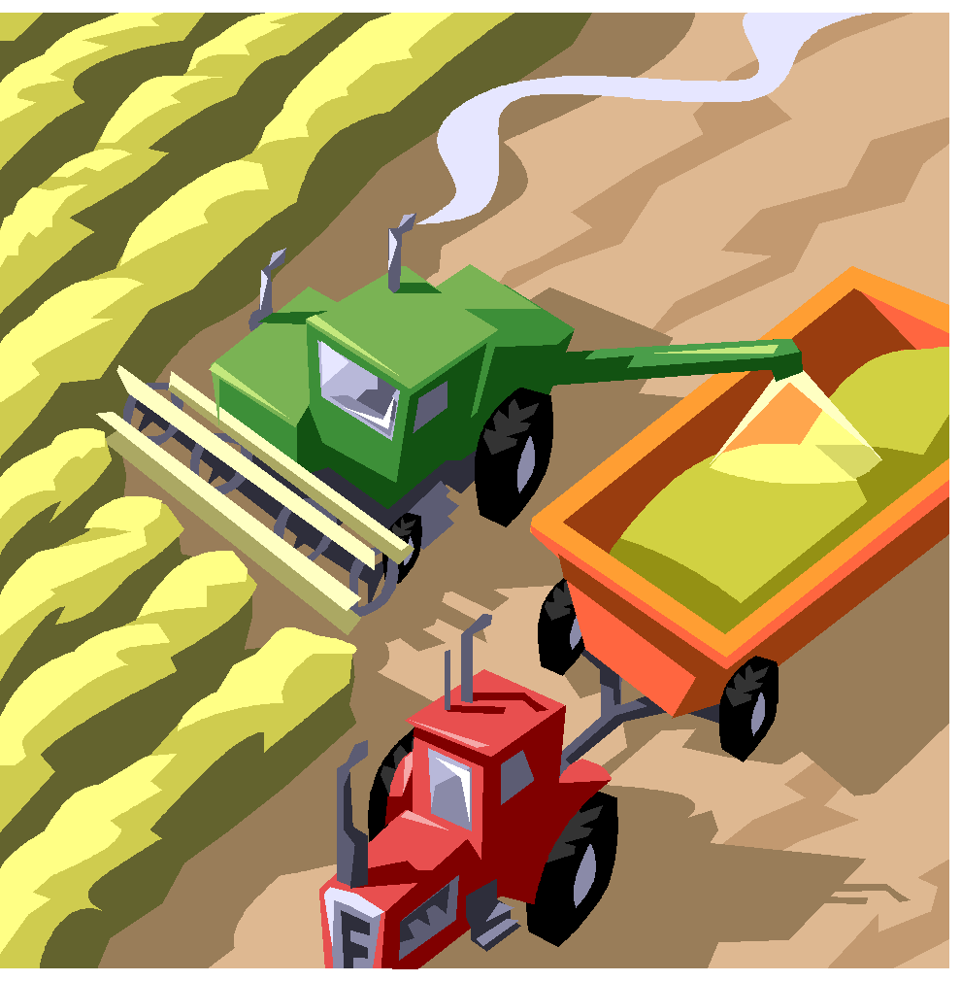
Interdependency
The North
The West
The South

Slide 7
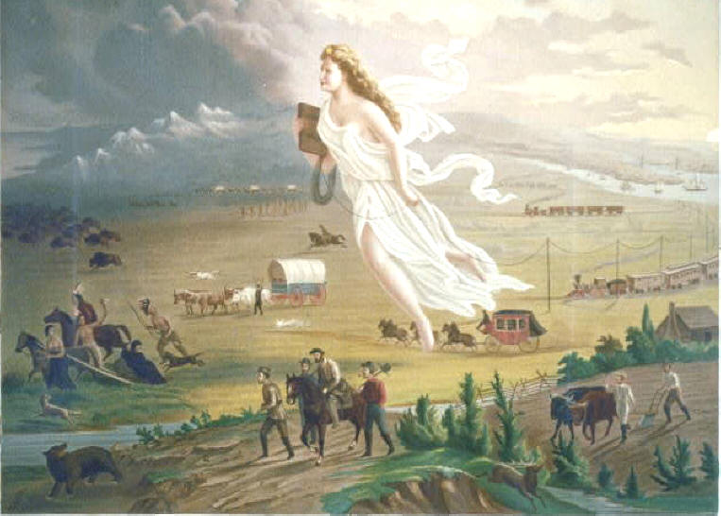
Manifest Destiny

Slide 8
Manifest Destiny
Empire for Liberty: Louisiana Purchase, Annexation of Texas, “fulfillment of our manifest destiny to overspread the continent” (manifest=obvious)
Why move west?
Economic problems (Panic of 1837)
Harbors in Oregon Territory: Trade with Japan and China

Slide 9
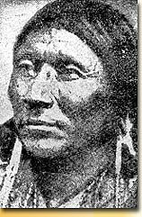
Settlers and Native Americans
Black Hawk War:
1830s white settlers in Iowa wanted the native Americans in that area to move west of the Mississippi.
Native Americans recognized this conflict and went to Chief Black Hawk of the Sauk Tribe.
Black Hawk had a vision that he would lead his tribe into war and win back the old homes of his people
Started war in Illinois and spread to the Wisconsin Territory. Ended in August of 1832 when the militia killed for that 200 Sauk and Fox People. They were forcibly removed.

Slide 10
Cont.
Middle Ground? The place that neither the Native Americans or the settlers dominated. This was west of the Mississippi.
Fort Laramie Treaty: In 1851, provided various Native American nations control of the central plains. Government said they would make annual payments to the tribes.
These agreements were not honored.
In the end Native Americans had to abandon their land and move to reservations.

Slide 11
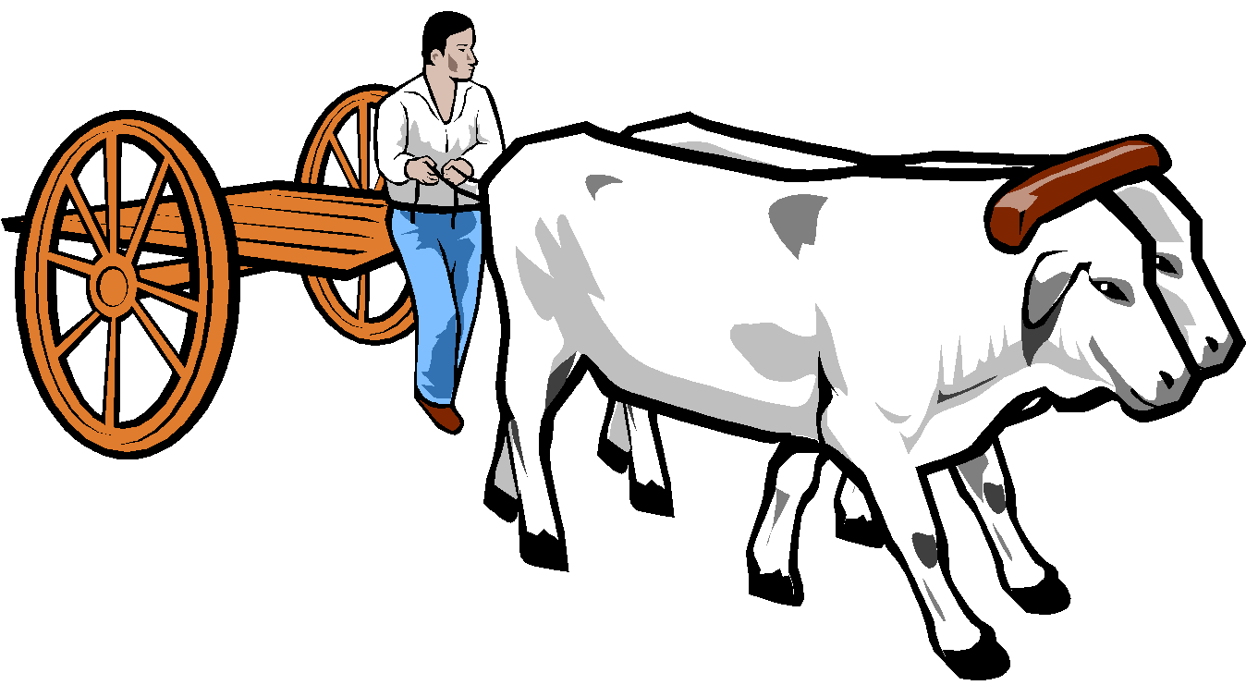
Westward Ho!
Santa Fe Trail: led 780 miles from Independence Missouri to Santa Fe, NM
Donner Party- Video http://www.history.com/topics/donner-party
Oregon Trail: Started in Independence ended in Portland OR.
Territorial Disputes
OR territory point of contention between U.S. and Britain.
Pres James K. Polk called for annexation of entire territory.
54-40 or fight!

Slide 12
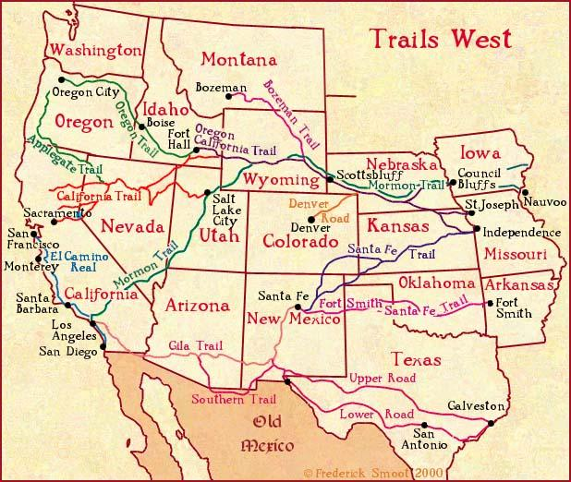
54-40 or Fight!
Fur trade in decline in the mid 1840s so Britain’s interest waned.
Both countries agreed to extend boundary to where it is now.

Slide 13
Church of Jesus Christ of Latter-day Saints
Mormon Migration: Religious Community started in Fayette, NY that played a large role in the settlement of the west.
Started by Joseph Smith and five associates of the Mormon Church. 20,000 people. Settled in Nauvoo, Illinois. However printed protests of polygamy from angry neighbors made Smith mad and destroyed their printing press.
Jailed and anti-Mormon mob broke into jail and murdered smith and his brother.
Successor Brigham Young: Moved them to the Great Salt Lake in Utah.

Slide 14
The Great Salt Lake: RAFT
Write a ½ page journal about your experience as a Mormon traveling west. Answer the following in your letter:
1. Why are you moving west? After Joseph Smith’s murder why did you continue to follow Brigham Young?
2. Where is Brigham Young taking you? What has he promises has he made for your new life?
3. Describe your hopes and dreams for your new life in the west.
Role: Mormon Traveling West
Audience: Your Journal
Format: A Journal Entry
Time Period: 1840s

Slide 15
Expansion in Texas
The Mission System: 1821 Spain’s system of Roman Catholic missions in CA, NM, and TX tried to convert Native Americans and settle them on mission lands.
System declined in the 1830s after Mexico won its independence
Mexicans tried to capture native Americans for forced labor, however the Comanche, and Apache retaliated by terrorizing Mexican settlements in TX.

Slide 16
Impact of Mexican Independence
Trade opportunities between Mexico’s northern provinces and the US multiplied.
Trade restrictions were made easier.
Provinces were far away from the capital therefore it made the country hard to control.
The prevent border violations by horse thieves and to protect territory from Native Americans attacks, Mexican government encouraged Americans to settle in TX.
Stephen F. Austin: established a colony in TX. Word about the greatness of TX spread.
John Quincy offered to buy TX for 1m, Andrew Jackson for 5m. Mexico refused to sell.

Slide 17
Texas Fight for Independence
As the Americans population grew in TX, tensions grew over cultural differences and slavery.
Many settlers were southern cotton farmers who brought slaves with them.
Mexico outlawed slavery in 1824.
In 1830 Mexico sealed in borders and put a heavy tax on the importation of Americans goods.
Americans pop still doubled
President of Mexico: Antonio Lopez de Santa Anna.
Santa Anna had Austin imprisoned for inciting a revolution. (he had gone to Mexico city to present petitions for greater self-gov.)

Slide 18
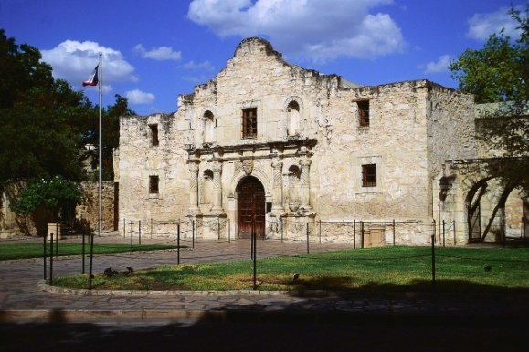
The Alamo
Determined to force Texas to obey laws Santa Anna marched toward San Antonio with a 4,000 member army.
Austin issued call for his people to arm themselves.
In late 1835 they drove the Mexican forces from the Alamo (an abandoned mission used as a fort)
In response Santa Anna drove northward and stormed and destroyed the small American garrison in the Alamo.
All 187 U.S. defenders died including James Bowie and Davy Crockett
Later in the March of 1836 Santa Anna’s troops executed 300 rebels and Goliad. 6 weeks after the Alamo, Texans struck back.
Led by Sam Houston: defeated Santa Anna. Killed SA’s soldiers in 18 minutes and captured Santa Anna
Signed Treaty of Velasco which granted independence to Texas. Sam Houston was president.

Slide 19
Texas in the Union
In 1838 Sam Houston invited the U.S. To annex or incorporate the Texas republic into the U.S.
Most people wanted this to happen.
Issue of slavery came up.
On Dec 29 1845 TX became the 28th state in the Union.
But Mexico was furious. Did they want war?

Slide 20
Polk Urges War
Hostilities between the U.S and Mexico which flared during the Battle of the Alamo reignited over the annexation of Texas.
U.S. and Mexico may have settled peacefully if it hadn’t been for Mexican instability and the U.S. belief in the territorial aspirations of the U.S. president James K Polk.
Polk believed he could acquire not only Texas, but CA, and NM.

Slide 21
Slidell’s Rejection
In 1844 Santa Anna ousted as Mexico’s President.
Polk sent John Slidell to Mexico to purchase CA and NM and to gain approval of the Rio Grande as the Texas border.
Mexican officials refused to see him
Polk hoped for Mexican aggression that would unify Americans behind war.
Polk issued orders to general Zachary Taylor to march to Rio Grand and blockade the river. Mexican viewed this as a violation of their rights.
U.S. wanted expansion but were split over military action.

Slide 22
Sectional Attitudes
Abolitionist James Russell considered the war “a national crime committed in behoof of slavery, our common sin.”
Southerners saw the annexation of TX as an opportunity to extend slavery. And increase southern power in congress.
Wilmot Proviso: proposed amendment to prohibit slavery in lands that might be gained from Mexico.
Turned this into a debate on slavery.

Slide 23
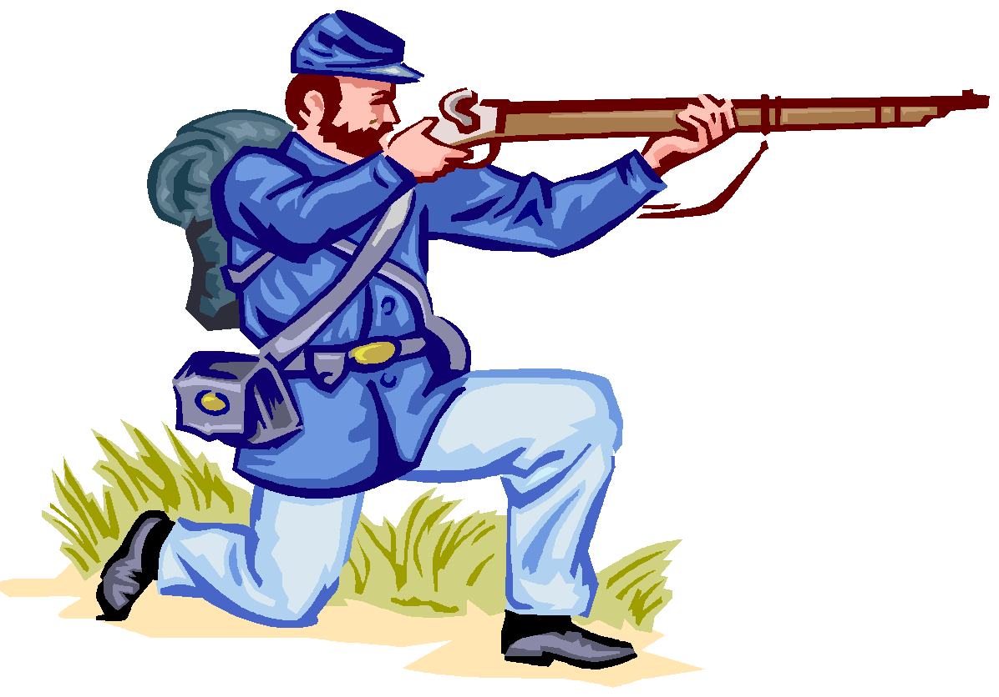
The War Begins
Taylor Positions forces in Rio Grand.
John C. Fremont led exploration through Mexico’s Alta California Province. (Mexico had had enough)
Mexico sent troops to Rio Grand. A small skirmish killed 9 U.S. soldiers.
Polk responded by declaring war. (They had shed U.S. blood on U.S. soil)
Abraham Lincoln (Representative) questioned the truthfulness of the message.

Slide 24
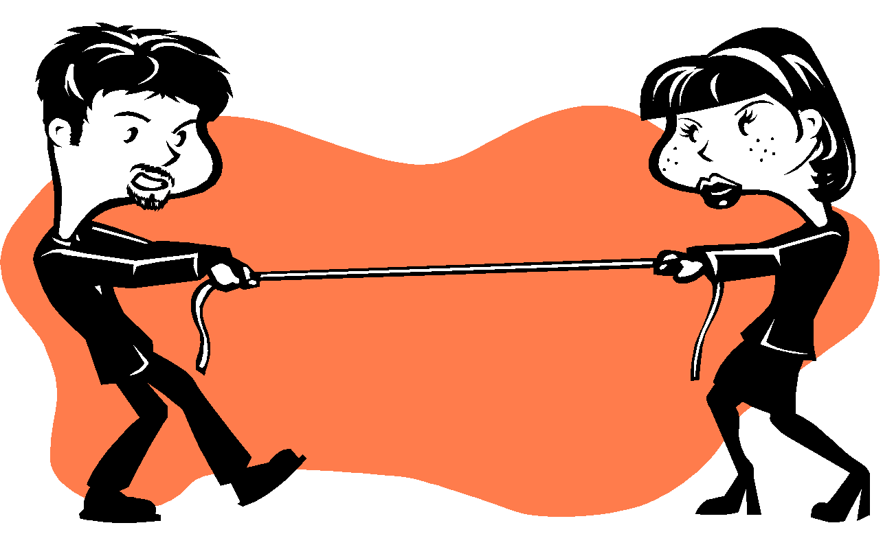
War Begins Cont.
Truthful or not the House recognized a state of war with Mexico 174 to 14.
Full reality of what happened on Rio Grande kept secret.
War Begins
Kearny marches west – plan to seize New Mexico and CA. Crossed 800 miles.
NM fell to U.S. without a shot being fired.
12,000 Mexicans in CA and 500 U.S.
A Group of settlers seized town of Sonoma in 1846 – Hoisting grizzly bear flag. – Republic of CA
U.S. troops join in and Mexican Troops give way.

Slide 25
War in Mexico
Easily won.
Robert E. Lee and Ulysses S. Grant nations best officers.
American invasion lasted a year.
Winfield Scott “Old Rough and Ready”. Captured Monterrey with Taylor.
Polk Hatches bizarre scheme with Santa Anna living in exile. Said he would help him back into power if he agreed to end war.
Santa Anna agreed, comes back, and attacked U.S. forces.
However U.S. army was ready and September 14 they captured Mexico City.

Slide 26
Spoils of War
Treaty of Guadalupe Hidalgo – Rio Grande as border for TX, ceded NM and CA to U.S.
U.S. paid Mexico 15 million. AZ, UT, NM, NV, CA
Gadsden Purchase – established current borders of lower 48.
Zachary Taylor wins election in 1848 - Whig

Slide 28
The Gold Rush!

Slide 29
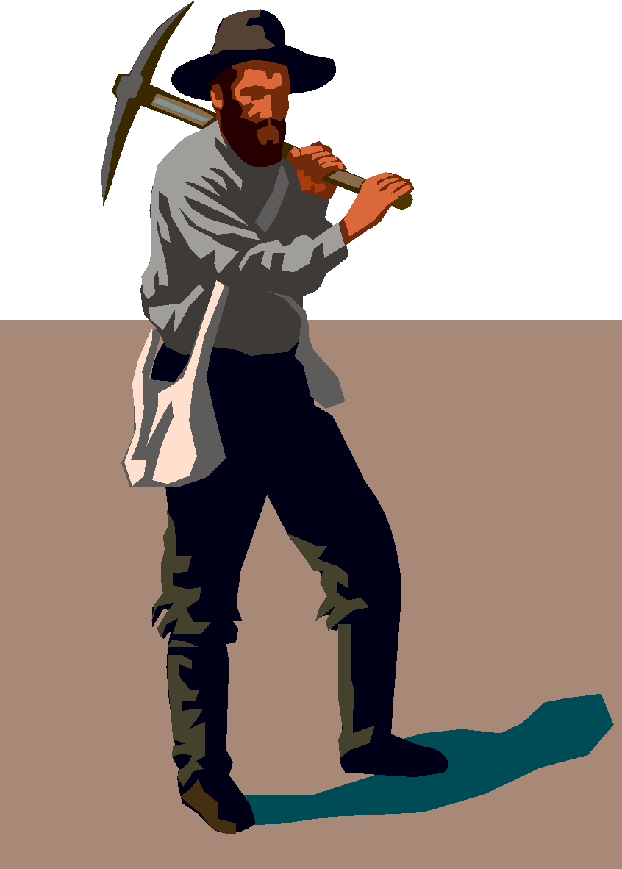
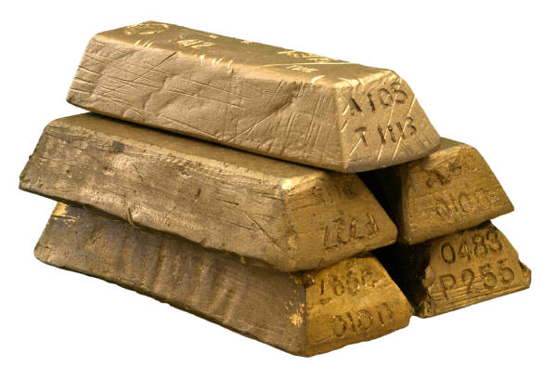
CA Gold Rush!
James Marshall, American Carpenter working in CA discovered gold in Sutter’s Mill.
Gold Fever- migration 400 to 44,000.
Forty-Niners
San Francisco – population exploded.
Diversity – Chinese largest group from oversees, Free Blacks, wealthiest living in CA, Mexicans.
CA statehood.

