Slide 1
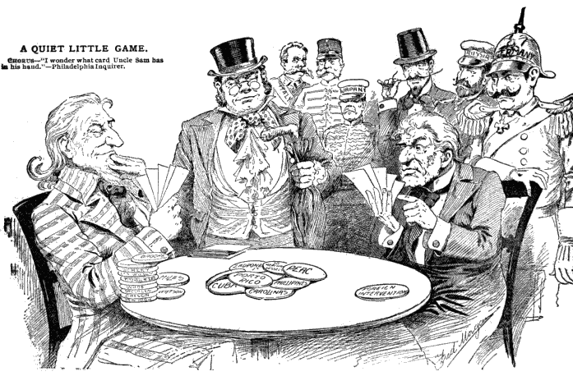
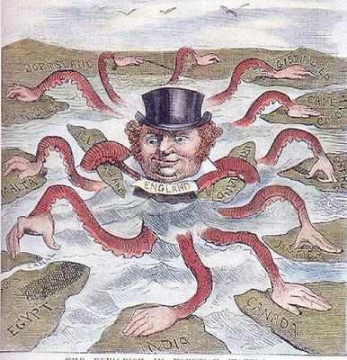
America Stretches Its Wings-A History of Imperialism: Outcome 4

Slide 2
Timeline…..1890-1920
Puerto Rican’s become U.S Citizens
USS Main Explodes
William Taft President
WWI in Europe
1890
1893
1898
1901
1908
1912
1914
1917
1920
Queen Lil is overthrown
Teddy Roosevelt becomes president
Woodrow Wilson Elected President
Women’s right to Vote
Panama Canal

Slide 3
What is imperialism? Section 1
Imperialism- the policy in which stronger nations extend their economic, political, or military control over weaker territories-already a trend around the world.
Britain, Germany, Belgium, Portugal, Spain, France, and The United States- (Remember Africa Map)
Three factors fueled the American belief in Imperialism.
Desire for military strength
Thirst for new markets
Belief in cultural superiority (Social Darwinism)

Slide 4
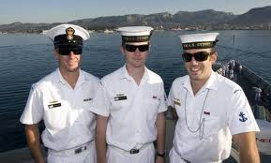
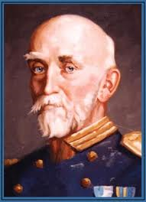
Factor 1: Desire for Military Strength
Afred T. Mahan
Wanted U.S. to build up military power in order to compete with other powerful nations.
United States built nine steel-hulled cruisers between 1883 and 1890. With construction of modern battleships – The Maine and The Oregon, we became the third largest naval power in the world.
Not these Guys!
This Guy!

Slide 5
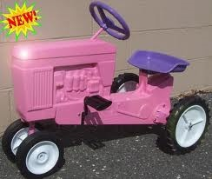
Factor 2: Thirst for New Markets
In the late 19th century the advances in technology enable American farms and factories to produce far more products than American’s could consume. Increasing foreign trade would provide the solution to this overproduction.

Slide 6
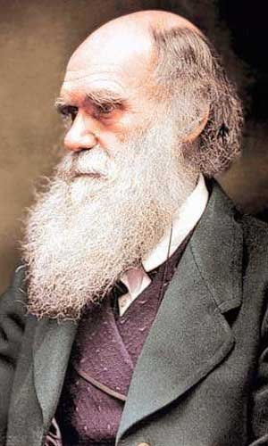
Factor 3: Cultural Superiority
Social Darwinism- Survival of the fittest- with the belief in the racial superiority of Anglo Saxons.
That’s not what I meant!

Slide 7
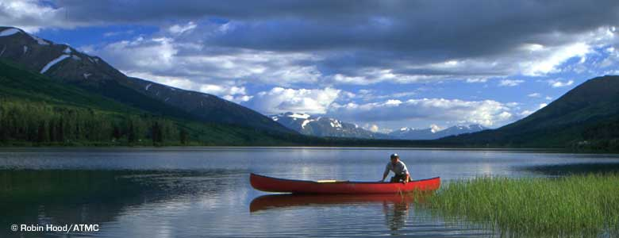
Alaska!
Early supporter of American expansion was William Seward, secretary of state under Lincoln.
In 1867 Seward arranged for the U.S. to buy Alaska from the Russians for 7.2 million. Seward had a hard time persuading the legislature to put forward the money.
Finally they excepted and found out Alaska was rich in many resources including OIL!
1959 Alaska became a state

Slide 8
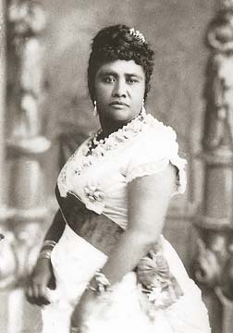
Chapter 18: Imperialism in America 1890-1920
“I, Liliuokalani, do hereby solemnly protest against any and all acts done against myself and the constitutional government of the Hawaiian Kingdom.”
-Queen Lil

Slide 9
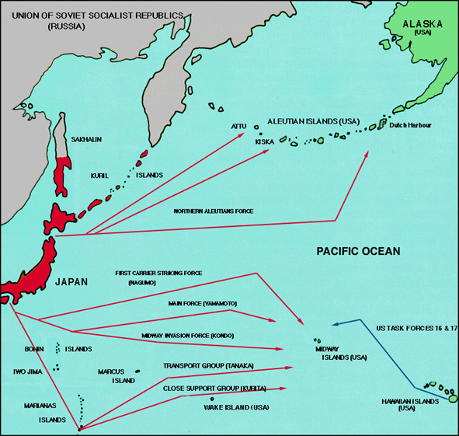
Midway Islands and Hawaii

Slide 10
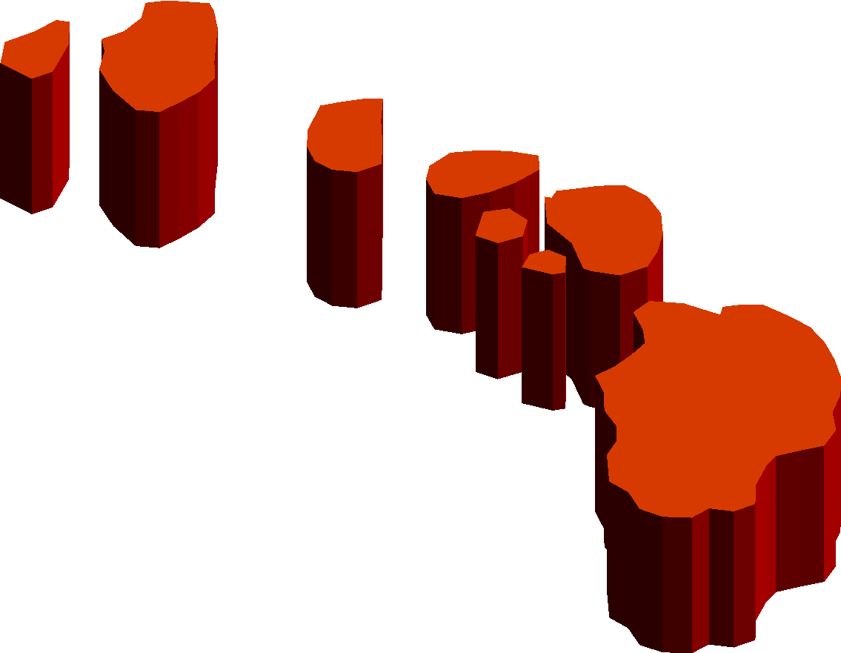
Hawaii!
The same year Alaska was purchased the U.S. took over the Midway Islands which lie in the Pacific 1300 miles from Hawaii. The Hawaiian Islands had been economically important to the U.S. for a while. Merchants stopped there on their way to China. American missionaries built churches and became sugar planters on the island.
In the mid 19th century American sugar planters wanted annexation. (Wanted duty free trade) They accounted for most of the wealth in Hawaii.
In 1887 Hawaii was pressured into letting the U.S. build a naval base at Pearl Harbor.
Hawaiian Queen tries to “get Hawaii back” but U.S. marines organize a revolution and overthrow the Queen.
Sanford B Dole. Becomes the head of government.

Slide 11
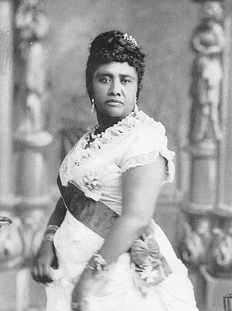
The first to change their name to Lil’
Queen Lil (Liliuokalani)
Sister to previous king, took over in 1891.
“Hawaii for Hawaiians” agenda
This prompted American leaders to act.

Slide 12
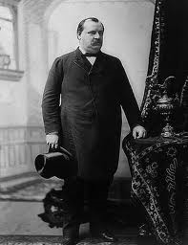
The End of the Monarchy
President Cleveland did not favor annexation and did not recognize Dole unless the majority of Hawaiians favored it.
Dole refused to surrender.
McKinley took power and favors annexation and recognized Hawaii as part of the United States.
Hawaii did not become the 50th state until 1959.
I Do Not Favor...

Slide 13
3, 2, 1
3 Things You Learned?
2 Things You Found Interesting?
1 Question You Still Have?

Slide 14
Spanish-American War Section 2
Main Idea: In 1898, the U.S. went to war to help Cuba win its independence from Spain.
U.S. had a long interest in Cuba. In 1854 diplomats recommended that the U.S. buy Cuba from Spain.
Spain said it “would rather see Cuba sunk in the Ocean.”
America’s interest continued. When a second war for Independence erupted American Journalists used Yellow Journalism to catch American Sympathy for native Cubans.
Yellow Journalism is a sensational style of writing, which exaggerates the news to lure and enrage readers.

Slide 15
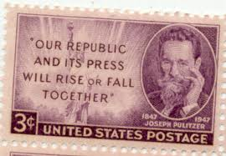
Hearst and Pulitzer
William Randolph Hearst and Joseph Pulitzer, two competing newspaper editors fanned the flames of war. Stories of poisoned wells and of children being thrown to the sharks deepened American sympathy for the native Cubans.
Watch Clip: http://misspittctge5910.blogspot.com/

Slide 16
Yellow Journalism #5
Using what you know about Yellow Journalism pick a two topics and create two newspaper headlines with illustrations.
Using a sensationalist style of writing try to persuade readers that this topic is IMPORTANT!
Here are some ideas…
Animal Rights
War in Afghanistan
Police Brutality
Profiling
Child Labor
The Economy
Airport Security
Student Rights
Your Own

Slide 17
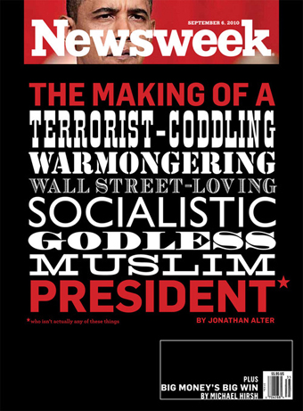
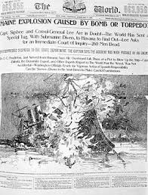
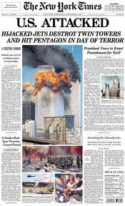
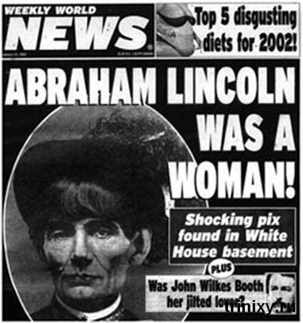
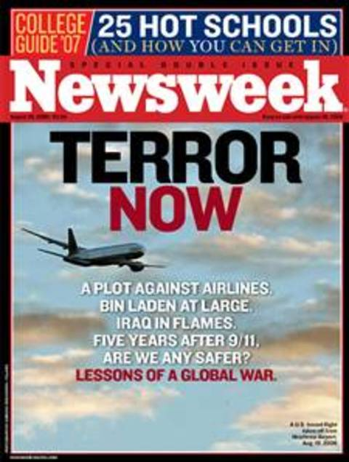

Slide 18
Yellow Journalism Assignment
Examples of Yellow Journalism
Article I
Highlight 3 Elements of Yellow Journalism in Article
Article II
Highlight 3 Elements of Yellow Journalism in Article
Article III
Highlight 3 Elements of Yellow Journalism in Article
Summarize and Describe Agenda of Article I
Summarize and Describe Agenda of Article I
Summarize and Describe Agenda of Article I

Slide 19
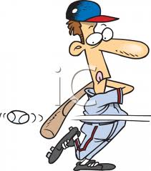
The De Lome Letter- Strike 2
American sympathy for Cuba Libre! grew. When McKinley took office in 1897, demands for war were on the rise.
McKinley tried a diplomatic approach and looked like it was going to succeed, and then the De Lome letter was discovered!
February 1898 New York Journal published a private letter written by the Spanish minister to the U.S. stolen by a Cuban rebel and leaked it to the newspaper. It criticized President McKinley, calling him “weak” and a “bidder for the admiration of the crowd.” American’s were angry!

Slide 20
USS Maine Explodes- Strike 3
Right after the De Lome letter was publicized President McKinley orders the U.S.S. Maine to Cuba to bring home American citizens in danger from the fighting. On February 15th, 1898 the ship blew up in the harbor of Havana. More than 260 men were killed.
At the time no one really knew how it exploded, but guess who they blamed!

Slide 21
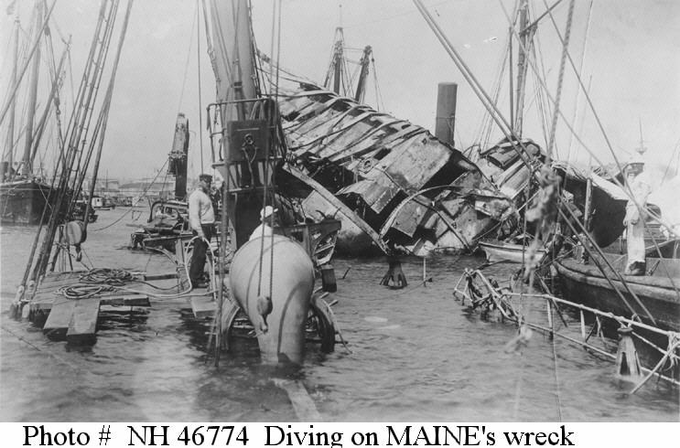
U.S.S. Maine

Slide 22
Exit Slip
Using what you learned from the notes, discuss America’s reasons for entering into a war with Spain.

Slide 23
Warm-Up
Using what you know and remember from yesterday’s notes complete a cause flow map for the Spanish American War.
List at least 4 causes (4 minutes)
Turn to a partner and share your causes. (2 minutes)
Add at least one new cause to your map…

Slide 24
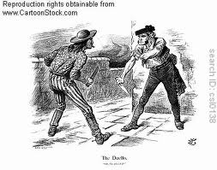
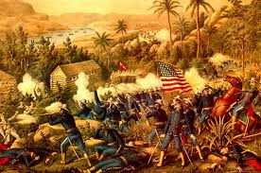
War with Spain Erupts
There was no holding back. “Remember the Maine!” became the rallying cry and it made no difference that the Spanish government agreed on April 9th to almost everything the United States demanded.
Public opinion favored war.
Spanish though Americans would invade Cuba first but the first battle took place in a Spanish colony called the Philippine islands.

Slide 25
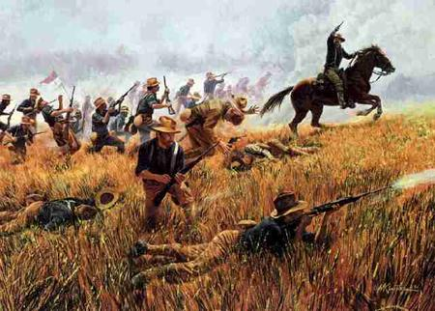
Philippines and Caribbean
Commodore George Dewey gave the command to open fire on the Spanish fleet. Within hours every Spanish ship was destroyed. Filipinos supported American takeover.
In the Caribbean, hostilities began with a naval blockade of Cuba.
Most soldiers inexperienced.
Rough Riders landed in Cuba – a volunteer Calvary under the command of Teddy Roosevelt.
Victory in Battle of San Juan Hill cleared the way for infantry attack
On their way to victory American troops invaded Puerto Rico

Slide 26
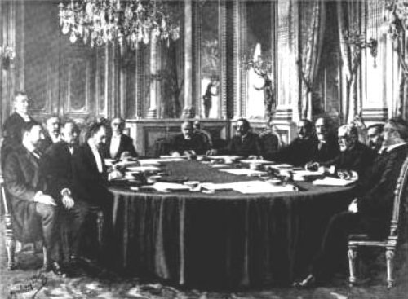
Treaty of Paris
U.S and Spain signed an armistice, a cease fire agreement on August 12th.
At the peace talks Spain freed Cuba and turned over the islands of Guam and Puerto Rico. It also sold the Philippines to the U.S. for 20 Million dollars.
Debate over annexation continued. Centered on imperialism as a moral issue.
Annexation approved.

Slide 27
Bus Stop!
Do you believe America should intervene in foreign conflicts?
Why or Why Not?

Slide 28
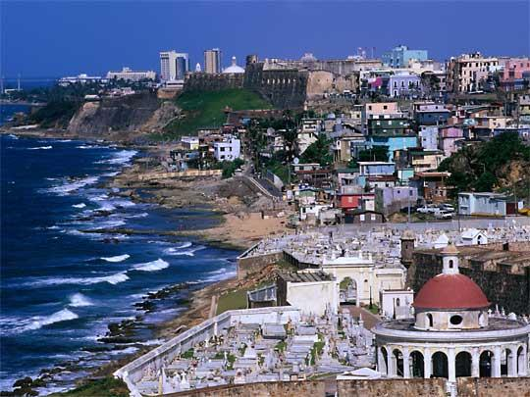
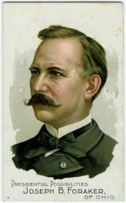
Ruling New Lands: Section 3
During war, U.S. set up a military rule on Puerto Rico. Following war Americans set up a civil government under the Foraker Act. 1900
Ended military rule and set up a civil government.
President of the U.S. has the power to appoint governor and members of the upper house.
Constitution did not automatically apply to people in territories.
Citizens

Slide 29
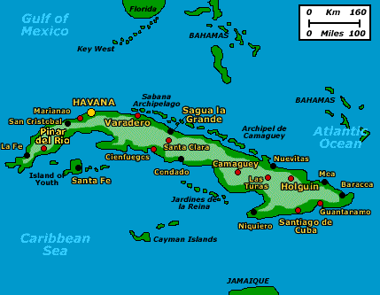
Cuba and the United States
Passed the Teller Amendment- which stated the U.S. had no intention of taking over Cuba.
Cuba had its independence. However military occupied Cuba once war was over.
On the other hand the military provided food and clothing for thousands of families. Helped farmers, built schools, improved sanitation and helped eliminate yellow fever.

Slide 30
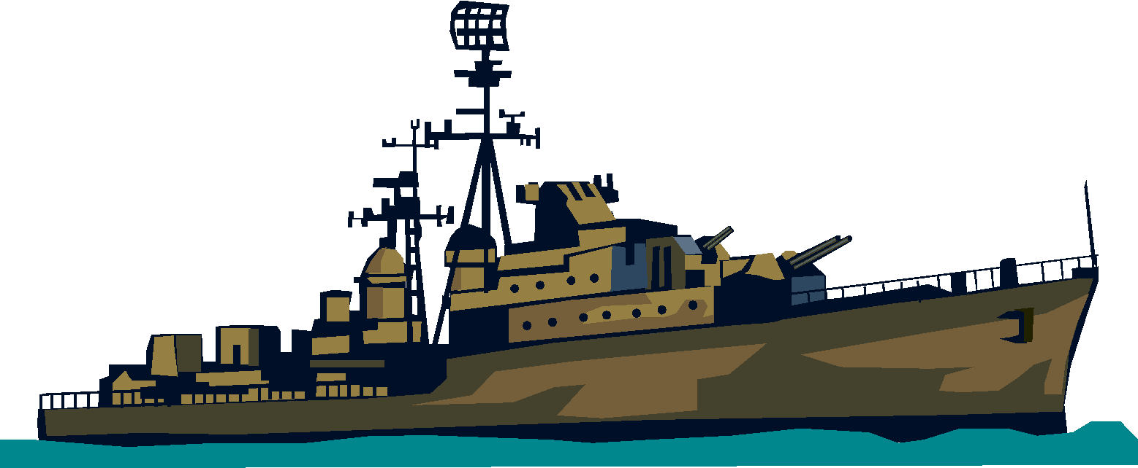
Platt Amendment
In 1900 Cuba wrote its own constitution. U.S added an amendment.
Cuba could not make treaties that might limit its independence.
U.S reserved right to intervene in Cuba
Cuba could not go into debt.
U.S could buy or lease land for naval stations and refueling stations.
Remained in effect for 31 years.
Cuba became a protectorate – country whose affairs are partially controlled by a stronger power.
Most important reason for America to maintain strong political presence was to protect its investments in sugar, tobacco, and mining industries.

Slide 31
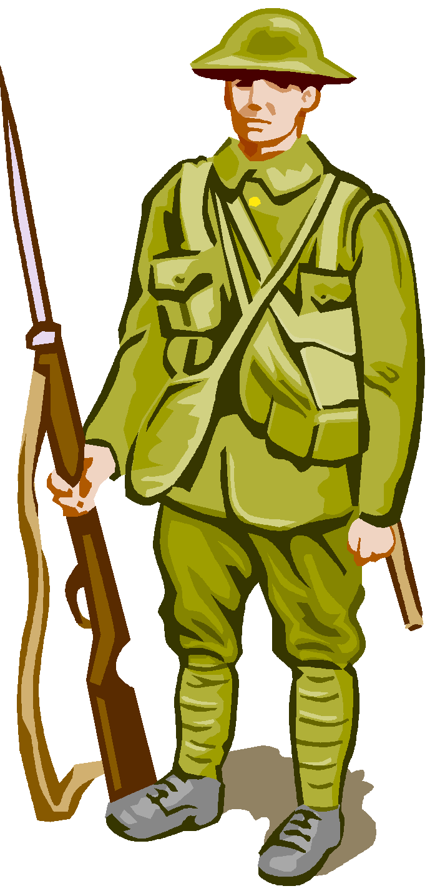
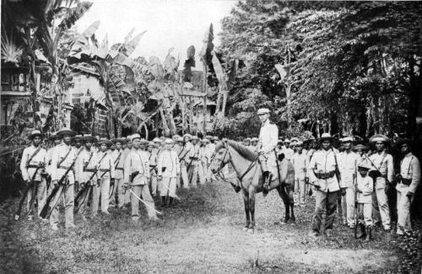
Filipinos Rebel
Outraged by Treaty of Paris- rebel leader Emilio Aguinaldo and his followers vowed to fight for freedom.
Philippine American War – took Americans three years to put down the rebellion. The war cost 20 times the price the US had paid for the islands.
Set up government similar to Puerto Rico.
Gradually moved towards independence and finally became an independent republic in 1946

Slide 32
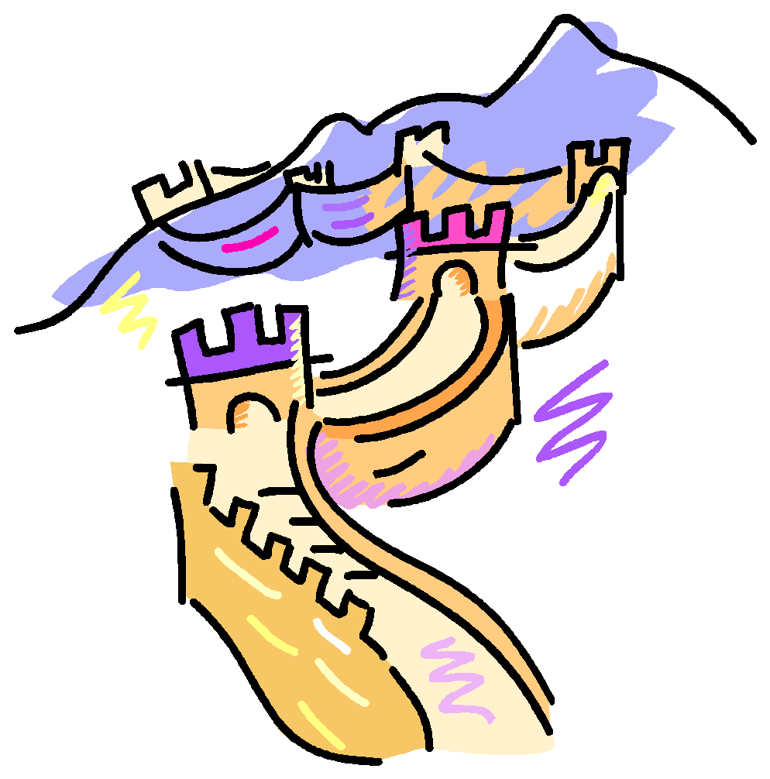
Influence in China
France, Germany, Britain, Japan, and Russia had established small settlements along the coast of China.
U.S. feared they would be shut out.
U.S. secretary John Hay issued Open Door Notes which stated that other nations must share their trading rights with the U.S.
Europeans began to dominate China’s cities. Chinese formed secret societies to rid the country of “foreigners”.
The most famous was called the Boxers.
Foreign powers joined forces and put down the Boxer Rebellion and thousands of Chinese died during fighting.

Slide 33
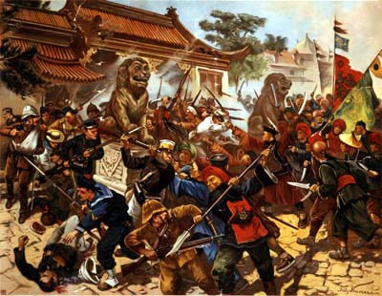
Boxer Rebellion

Slide 34
Panama Canal: Section 4
How did we get it?- 3 minute quest……Page 566.
Complete Circle Map in a group of 3. Each person must use a different color. You must include at least 10 facts.
Panama Canal

Slide 35
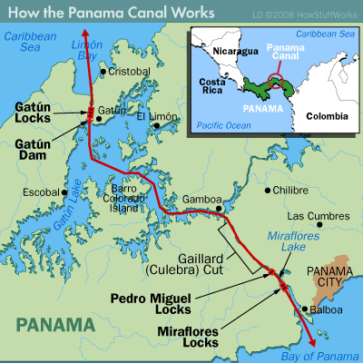
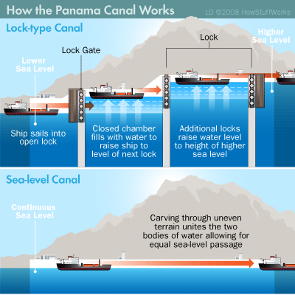
Panama Canal
Panama Canal

Slide 36
Complete 4 Senses…

Slide 37
What do we know now?
Teddy felt the need for a canal to reduce travel time for commercial and military ships.
U.S and Britain agreed to share the rights to a canal. However Britain gave us exclusive rights. (Hay-Pauncefote Treaty)
Decided to use Panama had to help Panamanian’s gain independence from Columbia.
Treaty- Paid Panama 10 million plus annual rent of 250,000, payments began in 1913.
Total cost for the U.S 380 Million
1914 Canal opens and more than 1,00 ships passed during the first year.
Latin American relationships are damaged.
Paid Columbia 25 Million.
Panamanians given control of the canal in 1977.

Slide 38
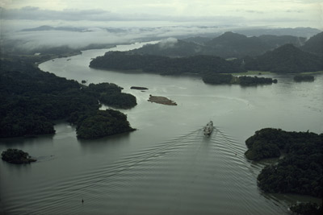
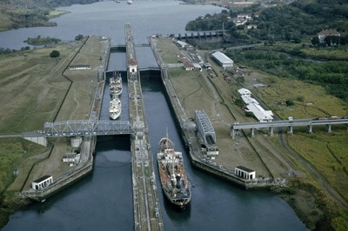
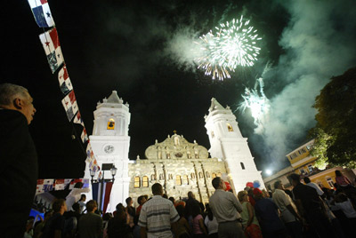
The Canal Today….

Slide 39
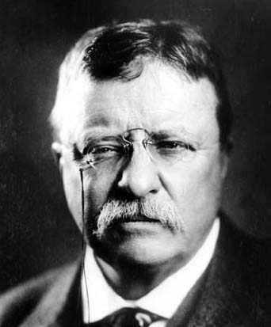
America as a World Power
Anti-Imperialist league's spring up. Why?
Assassination of William McKinley by an anarchist Polish immigrant, puts VP Theodore Roosevelt in power.
Russo- Japanese War
Building on the Open Door Notes Teddy mediated a settlement in a war between Russia and Japan. As a result Japan and the U.S. pledged to protect each other's interests in east Asia and Pacific. Also Teddy won the Nobel Peace Prize.

Slide 40
The Roosevelt Corollary
Financial factors drew the U.S. into Latin American affairs. Many had borrowed huge sums of money from European banks. Teddy wanted to make sure U.S was predominant power in the Caribbean and Central America.
Reminded European powers of Monroe Doctrine. Which is?
Then issued Roosevelt Corollary – under the philosophy, “speak softly and carry a big stick.”
Disorder in Latin America, “might force the U.S. to exercise police power to protect its economic interests.”

Slide 41
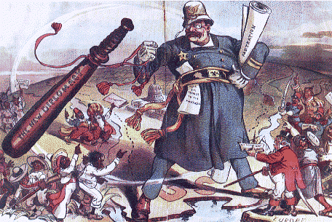
Interpret the following…..

Slide 42
Dollar Diplomacy v. Missionary Diplomacy
Dollar Diplomacy
Police power was exercised in Nicaragua, as a result Dollar Diplomacy was used to keep European powers out. U.S government would guarantee loans made to foreign countries by American businesspeople.
Missionary Diplomacy
President Woodrow Wilson gave the Monroe Doctrine a moral tone.
U.S has a moral responsibility to deny recognition to any Latin American country it viewed as oppressive, undemocratic, or hostile to U.S interests.

Slide 43
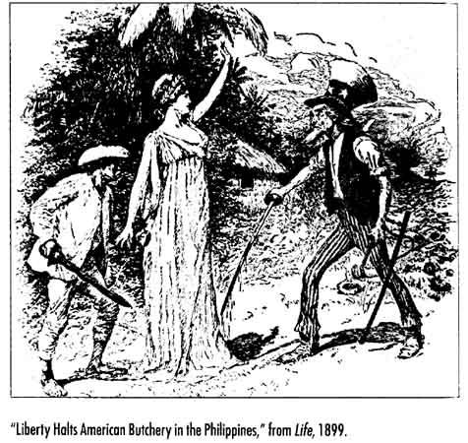
Political Cartoons
Think about what you know about Missionary Diplomacy, Moral Diplomacy, or The Roosevelt Corollary
Pick one and create a political cartoon that exemplifies how it was used during this time period.

Slide 44
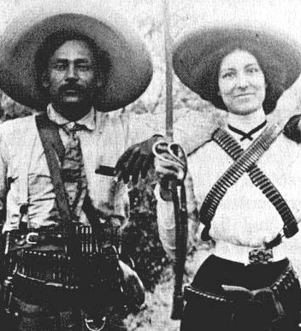
Mexican Revolution
Mexico had been ruled for more than three decades by military dictator Porfirio Diaz and friend of the U.S.
Motive: Protect American business interests
1911: Diaz overthrown
1912: General Huerta Takes Power
1913: Wilson does not recognize “government of butchers”
1914: Huerta’s officers arrest group of U.S citizens- Wilson sends troops 1915: Huerta regime collapses- Carranza takes power- Wilson withdraws troops
1916: Carranza invited American engineers to operate mines in northern Mexico. Villa took men off train and killed them. Villa raided New Mexico and killed 17 Americans. 15,000 American soldiers invade Mexico to capture Villa. Troops clash on both sides.
1917: U.S facing war in Europe withdraws troops. (John J. Pershing)

Slide 45
Did we succeed in our goals for the early 20th century?
Access to foreign markets?
Growth of domestic economy?
Modern navy to protect interests abroad?
Exercise of international police power in Latin America?
Can we now assess whether American imperialism affected developing nations positively or negatively?
Can you weigh out the two sides as a group? Then make your decision if imperialism was more helpful or hurtful to the developing nations. Persuade us!
Positive
Negative

Slide 46
3,2,1
3 things you learned
2 things you found interesting
1 thing you have a question about

