Slide 1
Period 6: Global Connections and Changes Accelerate
C. 1900 to the Present
Source: Crash Course AP World History by JP Harmon
Ch 18

Slide 2
Global Conflicts Shake World Stability
Some historians see WWI and WWII as one war similar in structure as the Crusades or the Hundred Years’ War

Slide 3
World War I
War to End All Wars

Slide 4
Causes

Slide 5
“The Powder Keg”
Imperialism
Competition by European powers for territory in Africa and Asia
Shrinking available land led to tensions between “Core” nations
Nationalism
Extreme pride in one’s country/nation
Italy & Germany newly formed – something to prove
Desire for independence or autonomy by ethnic groups

Slide 6
“The Powder Keg”
Militarism
Mass production of deadly weapons
Arms race between Great Britain and Germany
Alliance System
Triple Alliance
Germany, Austria-Hungary, Italy
Triple Entente
Great Britain, France, Russia

Slide 7
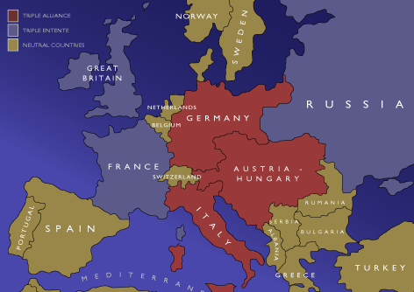
Before the War

Slide 8
“The Fuse”
All of the previous causes combined to heighten tensions in Europe
Serbian nationalists assassinated heir to the throne of Austria-Hungary
Shifted the pre-war alliances to:
Central Powers
Germany, Austria-Hungary, Ottoman Empire, Bulgaria
Allied Powers
Great Britain, France, Russia, Belgium
Later, Italy, Japan, Montenegro, Serbia…. and USA

Slide 9
War Breaks Out, Con’t
The Assassination of the Archduke
Archduke Franz Ferdinand of Austria visited the Bosnian capital of Sarajevo on June 28, 1914
7 assassins from the Black Hand, a Serbian nationalist group, plot against him
19-year-old Gavrilo Princip shot the Archduke and his wife

Slide 10
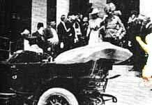
The Assassination of Archduke Francis Ferdinand and his wife Sophie

Slide 11
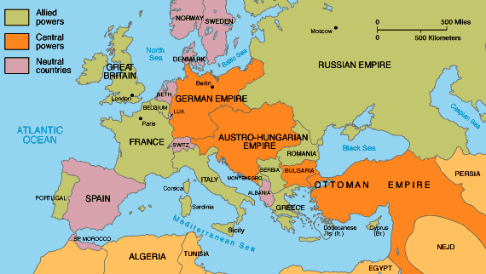
During the War

Slide 12
Central Powers
Had short term advantages
Connected geographically
Germany had the best trained and equipped army in the world
Germany industrial capacity was better set up for conversion to wartime production

Slide 13
Allied Powers
Long term advantages
More men of military age (thanks Russia)
More factories even though conversion was more difficult (thanks GB and US)
Stronger navy (thanks GB) and able to blockade the Central Powers

Slide 14
Features of WWI
Both sides thought war would be short
Schifflen Plan
Germany to attack & defeat France quickly then turn to Russia before they could mobilize
After 1st 6 months, dug in for Trench Warfare on Western and Eastern fronts
Fighting spread to include Ottoman Empire and African colonies

Slide 15
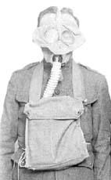
New Weapons
Thanks, Industrial Revolution

Slide 16
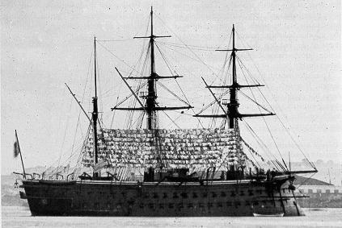
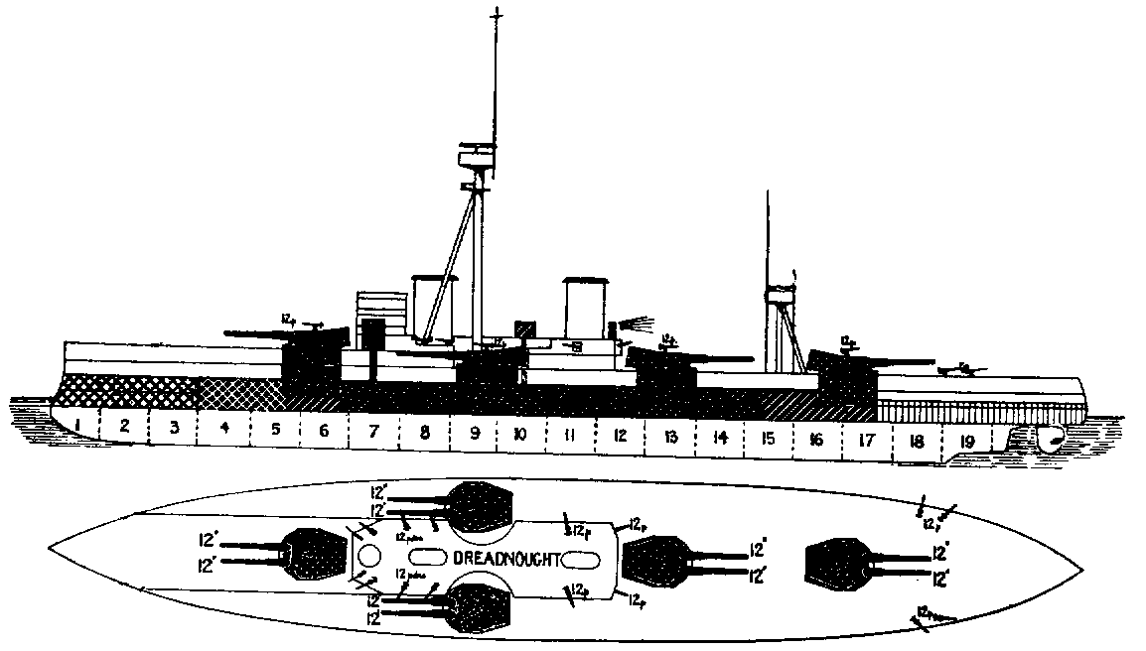
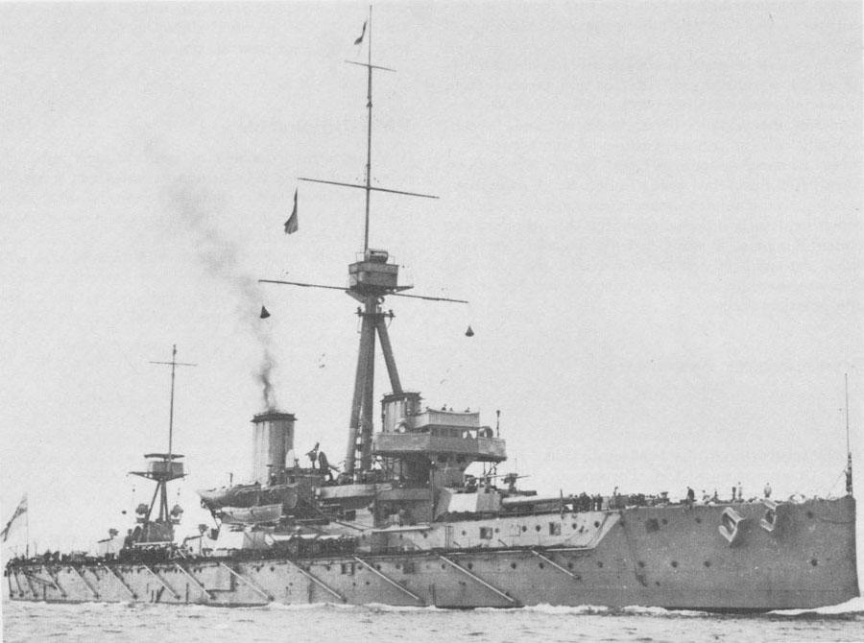
Dreadnought

Slide 17
The Machine Gun
Modern industry replaced the single-fire, short range rifle
British machine guns fired 8 rounds per second, at a distance of 2,900 yards
Artillery
Greater power and carried much further
24 million shells used in the Battle of Verdun alone

Slide 18
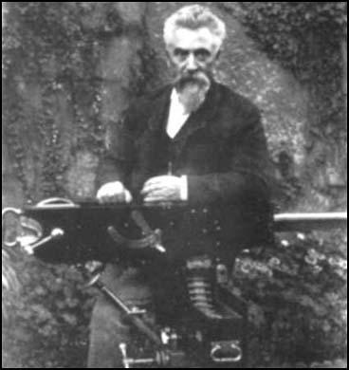
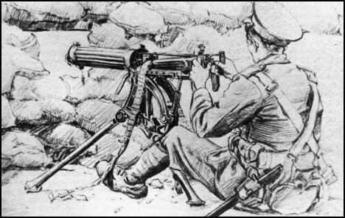
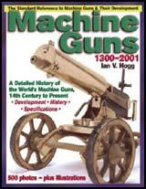
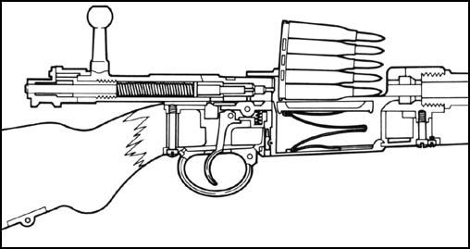
Machine guns

Slide 19
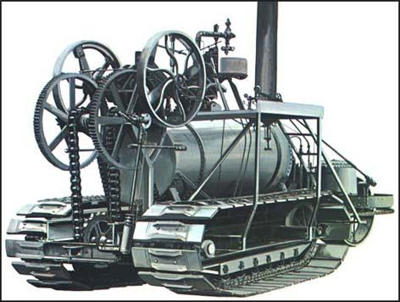
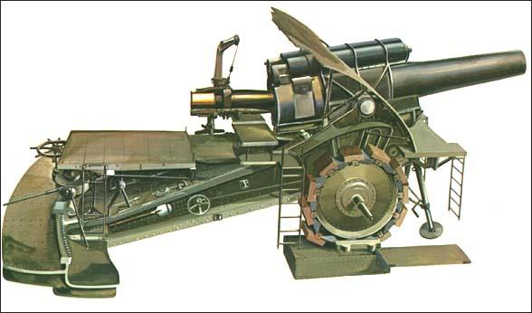
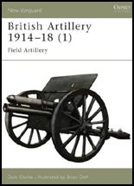
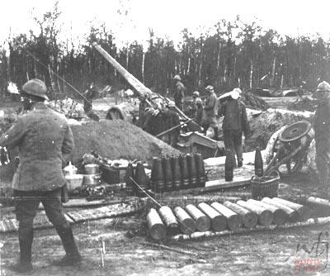
Artillery

Slide 20
Weapons of the Industrial Age
75 different types of poison-gas bombs
Flame throwers
Tanks
Airplanes
submarines

Slide 21
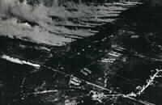
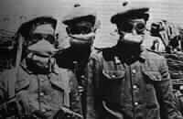
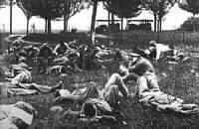
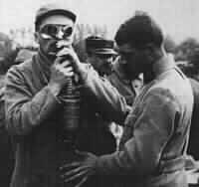
Poisonous Gas!!!

Slide 22
benzyl bromide
German, tearing, first used 1915
bromacetone
Both sides, tearing/fatal in concentration, first used 1916
carbonyl chloride (phosgene)
both sides, asphyxiant, fatal with delayed action, first used 1915
chlorine
both sides, asphyxiant, fatal in concentration, first used in 1915, cylinder release only
chloromethyl chloroformate
both sides, tearing, first used in 1915, artillery shell
chloropircin
both sides, tearing, first used in 1916, artillery shell (green cross I)
cyanogen (cyanide) compounds
allies/Austria, asphyxiant, fatal in concentration, first used in 1916, artillery shell
dichlormethylether
German, tearing, first used 1918, artillery shell
dibrommethylethylketone
German, tearing, fatal in concentration, first used in 1916
dichloroethylsulphide (mustard gas)
both sides, blistering, artillery shell (yellow cross)
diphenylchloroarsine
German, asphyxiant, fatal in concentration, (dust - could not be filtered), first used in 1917, artillery shell (blue cross)
diphenylcyonoarsine
German, more powerful replacement for blue cross, first used in 1918
ethyldichloroarsine
German, less powerful replacement for blue cross, first used in 1918, artillery shell (yellow cross I, green cross III)
ethyl iodoacetate
British, tearing, first used in 1916
monobrommethylethylketone
German, more powerful replacement for bromacetone, first used 1916
trichloromethylchloroformate (diphosgene)
both sides, asphyxiant, fatal with delayed action, first used 1916
xylyl bromide
German, tearing, first used 1915

Slide 23
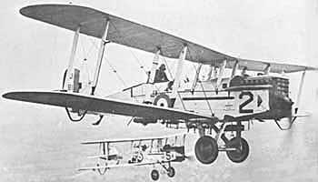
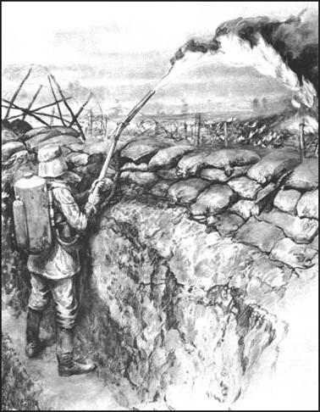
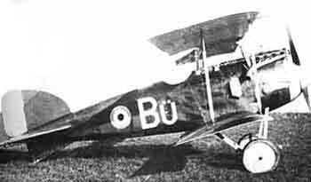
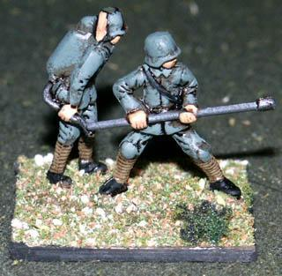
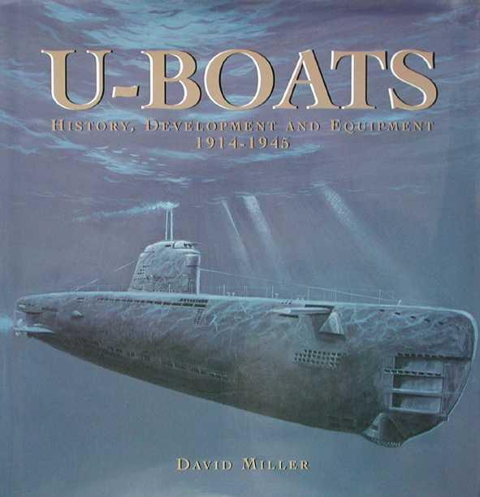
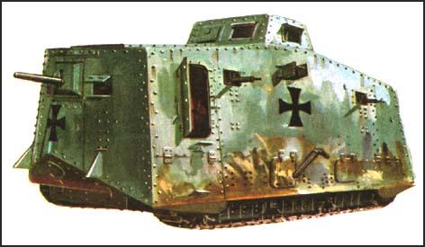
Other New Weapons

Slide 24
US Enters War -- 1917
Zimmerman Note
Entered war to “make the world safe for democracy”
1918 - added input of US pushed Central Powers to near defeat
Signed the Armistice 11am, 11-11-18
Armistice = agreement to stop fighting without declaring a “winner”

Slide 25
Casualties of Modern Weaponry
Casualties = dead, wounded, missing/AWOL/POW
Tactics of sending masses of men toward enemy didn’t work against modern weapons
Charging into “No Man’s Land”
Britain suffered 57,470 casualties on the first day of the Battle of the Somme
Total losses for WWI exceeded 10 million

Slide 26
Consequences

Slide 27
Unintended Consequences
Total War
Full economic production and political power of nations engaged in military victory
Civilian participation and sacrifice
Seemed to lower the value of humanity
Civilians became legitimate targets
Germany’s unrestricted submarine warfare
Lusitania
Cities as artillery targets

Slide 28
Paris Peace Treaty
Peace of Justice aka “Peace without Victory”
Leaders of Allied and Central powers met at the Palace of Versailles
President Wilson’s (US) 14 Points supported self-determination for all nations and a just peace
Peace of Vengeance
Italy and Britain wanted territory
France wanted to punish Germany
Italy and US left, leaving the peace settlement to France and Britain

Slide 29
Treaty of Versailles
$32 billion war reparations
War guilt clause
Demilitarized -- <100,000 troops

Slide 30
Wilson’s Fourteen Points
Designed to stop future wars with international agreements
League of Nations
Organization set up to mediate between member nations
US Congress refused to join
Dooming it to failure

Slide 31
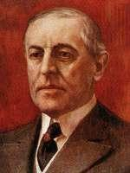
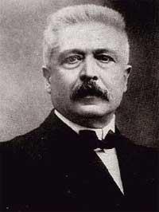
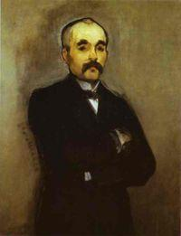
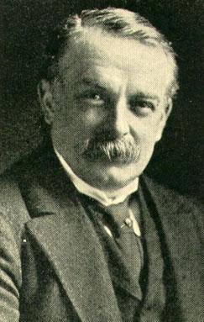
Woodrow Wilson Georges Clemenceau David Lloyd George Vittorio Orlando

Slide 32
Germany at Risk
Due to harsh nature of Versailles Treaty, many Germans deeply resented the Allied powers AND the Germans who signed the Treaty
German currency decreased in value from 4 marks = 1 US dollar to >1 trillion = 1 US dollar
Weimar Republic set up in stead of monarchy, too weak and fragmented
Led many Germans to seek radical alternatives…such as Hitler

Slide 33
International Treaties
Five Power Treaty, London Conference of 1930
Limited # of battleships to a % of the population
Japan resented this…
Geneva Conventions
Rules of war
Treatment of POWs
Kellogg-Briand Pact
Outlawed war

Slide 34
Colonial Control
Germany and Ottoman Empire lose overseas colonies
Mandate System formed
Caretake colony until LoN believes colony is ready for independence
REALITY…just added to France’s and GB’s empires
France
Syria, Lebanon
England
Palestine, Jordan

Slide 35
Empires fall
Russia
Lost ¼ territory in peace treaty with Germany in 1917
MORE TO COME>…
Austria-Hungary
Divided into many countries
Austria, Hungary, Yugoslavia, Czechoslavkia
Ottoman
Democratic nation of Turkey
Led by Mustafa Kemal, aka “Ataturk”

Slide 36
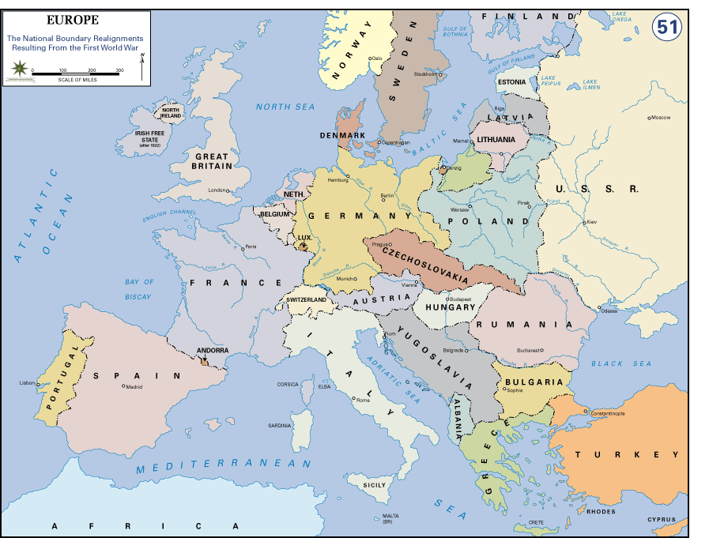
After the War

Slide 37
US & Japan
Emerge with industrial capacity undamaged and greatly enhanced
Colonial empire intact
Able to rise to top of world economy

Slide 38
Russian Revolution
1917 Tsar resigned, provisional democratic government
Quickly fell to communist revolt
Bolshevik leader, Vladmir Lenin, gains early withdrawl from WWI with Treaty of Brest-Livosk
Allowed Germany to concentrate on Western Front

Slide 39
Colonial Soldiers
India – 1 million troops to GB
Africa – German, GB, France
Australian/New Zealand (ANZAC) – GB at Galipoli
Arabs in Mid East – fought Ottomans for GB

Slide 40
Colonial input
May not have been the smartest move
Gave colonial nationalist leaders military training and equipment
Populous gained ”enlightenment” ideas and instilled sense of national pride

Slide 41
Biggest consequence
Left MANY old issues unresolved
“What is the future of imperialism?”
“Can military tech be controlled in colonies?”
“How would the colonial nationalsit movements be dealt with?”
New issues develop
“What to do with Communist Russia?”
“How do recover from the devasting damages from WWI?”

