Slide 1
Overview of Period 1:
Test structure:
Period 1 is roughly 5% of the exam:
You will NOT see an essay exclusively on this period
You could see a topic that incorporates this period as part of a broader idea
For example - Experiences of European countries in America
Why was 1491 - 1607 chosen for the dates?
1491 = 1 year prior to European contact
1607 = first permanent English settlement - Jamestown
Much of the focus of this period is on Native life PRIOR to contact, and interactions between Natives, Africans, and Europeans (Columbian Exchange)
Key Terms to know more about are in BOLD and underlined- that doesn’t mean you only study those.

Slide 2
Period 1: 1491 - 1607
On a North American continent controlled by American Indians, contact among the peoples of Europe, the Americas, and West Africa created a new world.

Slide 3
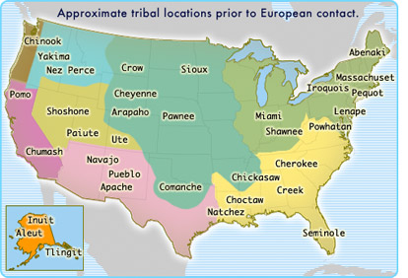
Period 1 1491 - 1607 Key Concept 1.1
Before the arrival of Europeans, native populations in North America developed a wide variety of: social political and economic structures based in part on interactions with the environment and each other.

Slide 5
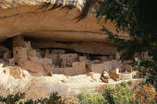
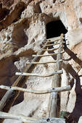
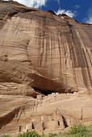
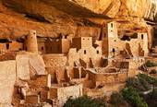
Anasazi Pueblo: New Mexico
Spread of maize cultivation from present day Mexico northward into the American Southwest and beyond supported the economic development and social diversity among societies in these areas.

Slide 6
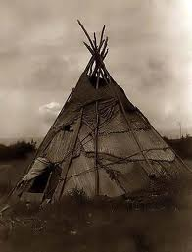
Different and increasingly complex societies develop due to diverse environments
Great Plains or Great Basin
Lack of resources
Nomadic hunters: Why?
buffalo
lived in tepees
Migration: Movement of people within an area/country

Slide 7
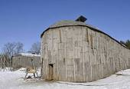
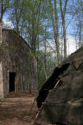
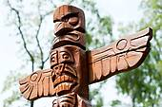
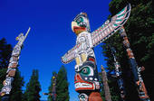
Different and increasingly complex societies develop due to diverse environments.
Longhouses: Pacific Northwest-

Slide 8
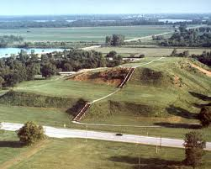
Different and increasingly complex societies develop due to diverse environments
Midwest Settlements
Woodland American Indians
hunted, fished, farmed
Adena-Hopewell
large earthen mounds
present day Ohio
Cahokia
30,000 inhabitants
present day East St. Louis

Slide 9
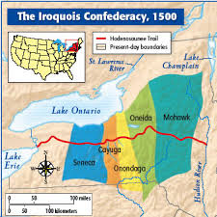
Different and increasingly complex societies develop due to diverse environments
Northeast Settlements
Hunted and Farmed
Iroquois Confederation: political union of 5 tribes, Seneca, Cayuga, Onondaga, Oneida, Mohawk
Matrilineal heritage: families organized through female lineage
Lived in longhouses
development of permanent villages- Why?

Slide 10
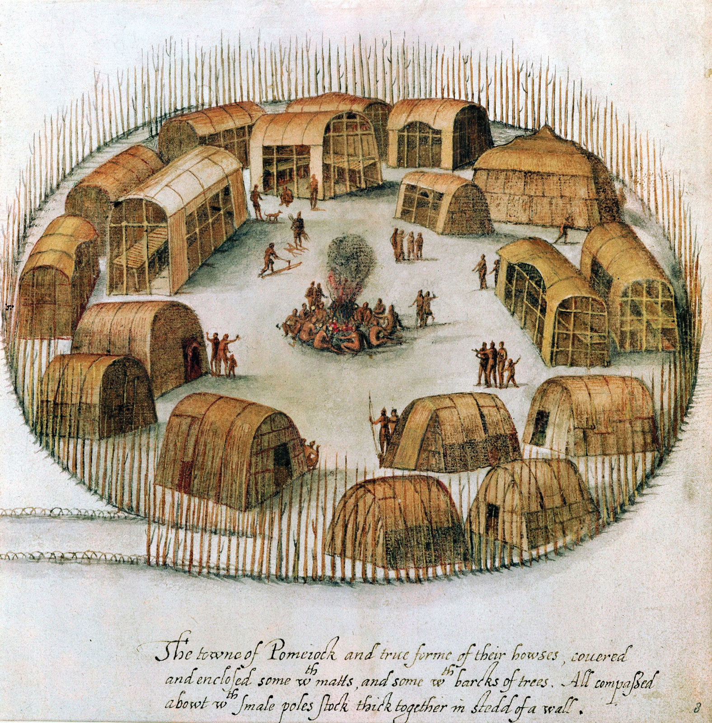
Different and increasingly complex societies develop due to diverse environments
Atlantic Seaboard Settlements
Coastal Plains:
-from New Jersey to Florida
-built timber & bark lodgings along rivers
-rivers & Atlantic Ocean utilized for food

Slide 11
Period 1 1491 – 1607 Key Concept 1.2
E
European overseas expansion resulted in the:
Columbian Exchange
a series of interactions and adaptations among societies across the Atlantic

Slide 12
European arrival triggered extensive demographic and social change
Widespread deadly epidemics
Smallpox, measles, influenza
Racially mixed populations
Mestizo: (in Latin America) a man of mixed race, especially the offspring of a Spaniard and an American Indian.
Mulatto: a person of mixed white and black ancestry, especially a person with one white and one black parent.
Caste system:
based upon intermixture of Spanish settlers, Africans, and indigenous Native Americans

Slide 13
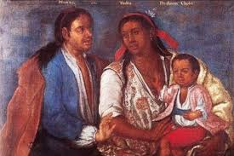
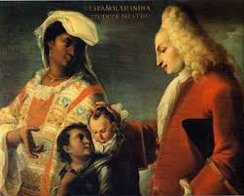

Slide 14
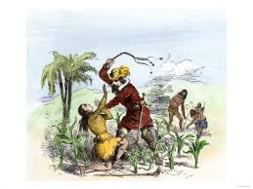
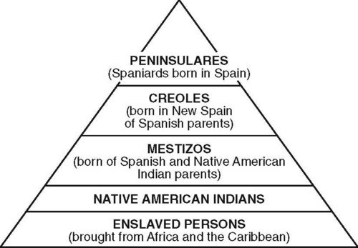

Slide 15
European arrival triggered extensive demographic and social change
Spanish/Portuguese traders reached West Africa
trade for resources, slaves
Prince Henry the Navigator- Led Portuguese exploration of African Coast
Begin new age of racism
New crops, livestock introduced to New World
Columbian Exchange
sugar cane, bluegrasses, pigs, horses, cows
the wheel, iron implements, guns

Slide 16
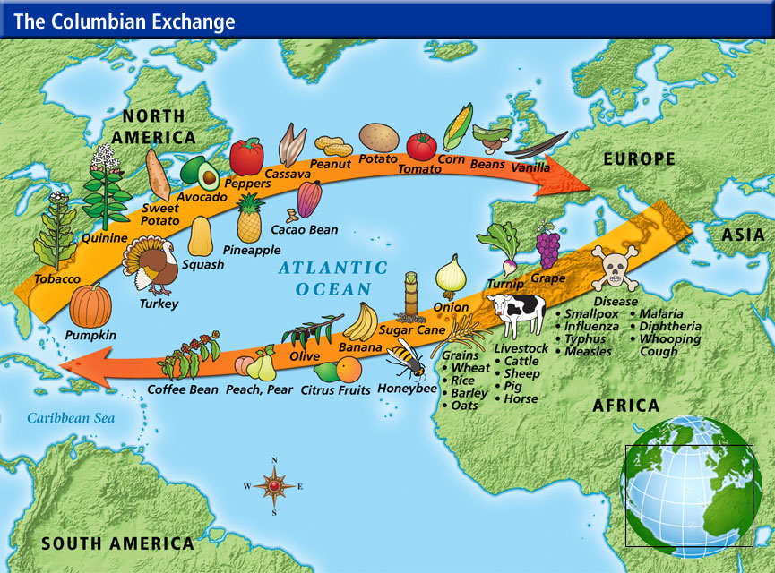
Columbian Exchange

Slide 17
European arrival triggered extensive demographic and social change
Encomienda System:
Slave labor used in New World Spanish colonies
-Vast tracts of land
-The indigenous people living there were given to the Spanish lord/conquistador, who promises to uplift and Christianize them!
-Slavery by another name- often brutalized, exploited in sugar fields, silver mines

Slide 18
European expansion caused social/religious, political, and economic competition and promoted empire building.
Causes of European expansion:
The 3 G’s: Gold, God, Glory
New crops from the America’s fuel population growth
Columbian Exchange: beans, corn (maize), sweet/white potatoes, tomatoes, tobacco,

Slide 19
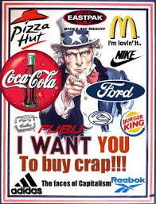
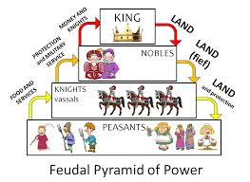
European expansion caused social/religious, political, and economic competition and promoted empire building.
New sources of wealth
gold, silver: fuel shift from feudalism to capitalism

Slide 20
European expansion caused social/religious, political, and economic competition and promoted empire building.
Improvements in technology and trade
weapons
bureaucracy, mechanical printing
amassing wealth/dominating people positively valued on Earth and towards salvation (Lies, p.33)
nature of European Christianity, rationalized conquest, “the Requirement” (Lies, p. 34)

Slide 21
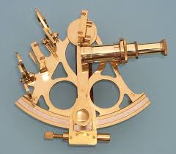
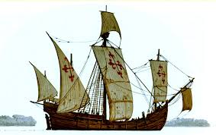
European expansion caused social/religious, political, and economic competition and promoted empire building.
Improvements in technology and trade
European success in island conquests- Malta, Sardinia, Canary Islands, Ireland, etc…a route to wealth
caravel- small, fast Spanish ship
sextant- measures altitude
joint-stock companies- precursor to corporation

Slide 22
Period 1 1491 – 1607 Key Concept 1.3
Contacts among American Indians, Africans, and Europeans challenged the worldviews of each group.

Slide 23
European expansion/contact dramatically altered European views of social, political, and economic relationships between white and nonwhite peoples.
Contact with people different from themselves caused debates
comparisons of nature and degrees of civility
Juan de Sepúlveda, Bartolomé de Las Casas
How should Native American’s be governed?
Sepulveda- as slaves, naturally Spanish are given authority “claiming that the Amerindians were "natural slaves" as defined by Aristotlein Book I of Politics”
Las Casas- governed as anyone else in Spain- “Las Casas thought they should be governed just like any other people in Spain, while Sepúlveda thought they should become slaves.”
ethnocentrism- Belief that one’s own culture and way of life is best, superior to all others. Common among all human cultures.
belief in white superiority evolves

Slide 24
European expansion/contact dramatically altered European views of social, political, and economic relationships between white and nonwhite peoples.
Politically
challenged European ideas of government, social organization
“Lies”, pp. 57-58
Religiously
challenged Europe’s uniformity
leads to Protestant Reformation
established “mission system” The mission system was a chain of missions established by Franciscan monks in the Spanish Southwest and California that forced Indians to convert to Catholicism and work as agricultural laborers.
Presidio- fort & mission to protect selves and Christianize natives

Slide 25
Native peoples and Africans strove to maintain their political and cultural autonomy.
Forms of resistance - Native Americans:
refused to plant food
abandoned towns near Spanish settlements
fled beyond mountains and rivers
suicide
shunned conception & childbirth
aborted
murdered their children
slave revolts

Slide 26
Native peoples and Africans strove to maintain their political and cultural autonomy.
Forms of resistance: African Americans:
run to Native American communities
Slave Revolts
New York City 1712- 21 blacks executed over a slow fire
1712 Slave Revolt
Stono Rebellion 1739- South Carolina, 21 whites and 44 blacks killed

Slide 27
Native peoples and Africans strove to maintain their political and cultural autonomy.
Juan de Onate
Spanish conquistador
attempted to spread Catholicism among natives of New Mexico
Acoma War - 1598
800 villagers, including men, women, and children killed
enslaved the remaining 500
they amputated the left foot of every Acoma man over the age of twenty-five
females sent off to be slaves for twenty years
Pope’s Rebellion -1680
also known as the Pueblo Revolt
an uprising of Pueblo Indians against the Spanish colonizers in present day New Mexico
the Pueblo killed 400 Spanish and drove the remaining 2,000 settlers out of the province

Slide 28
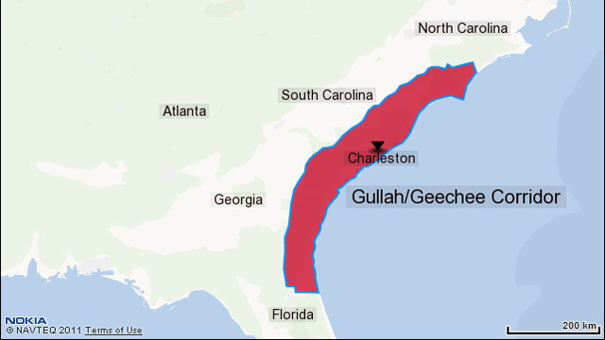
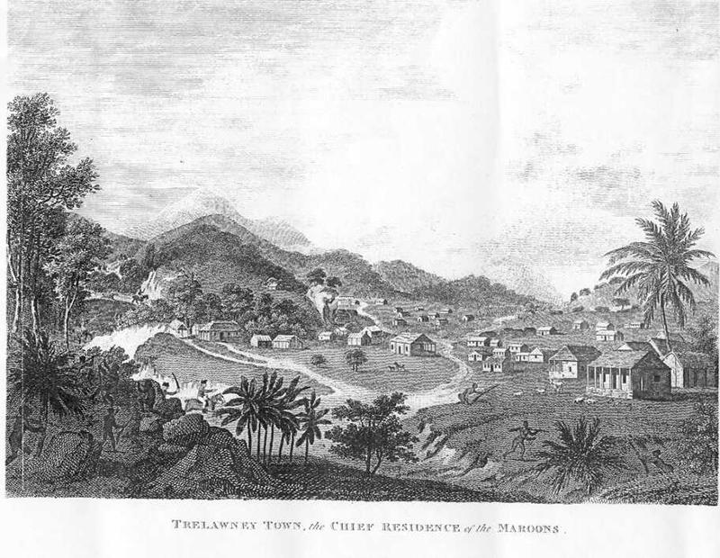
Native peoples and Africans strove to maintain their political and cultural autonomy.
Gullah: Blend of English & several African languages spoken by blacks in The Carolinas & Georgia
Ring Shout: West African religious dance- contributed to development of jazz
Maroon communities: runaway black slaves who formed their own communities in Caribbean Islands & South America
Great Dismal Swamp

