Slide 1
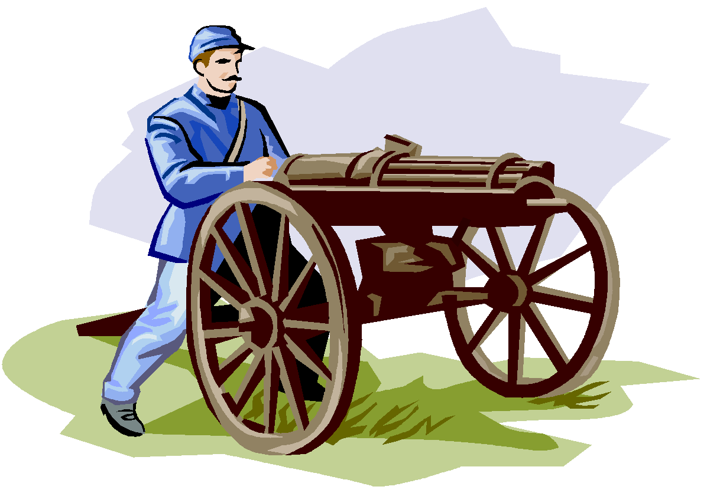
The Union in Peril: Chapter 10
Civil War
Define:
Illustrate:
Connection to Prior Learning/Theme:
Examples Today

Slide 2
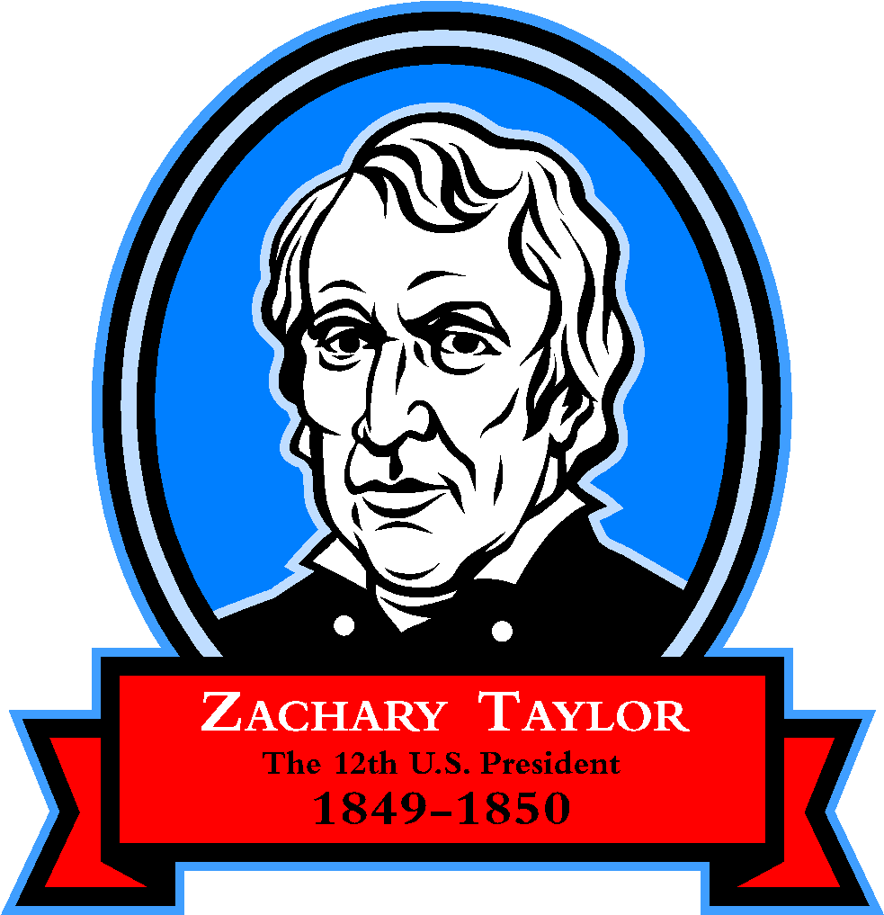
Differences Between the North and the South
What are these!
In 1846 Congress debated the Wilmot Proviso.
Would ban slavery in the new territories acquired from Mexico. Northerners favored the bill. Southerners opposed. Why?
In 1849 California asked to enter the Union as a free state. But southerners argued because of the Missouri Compromise line.
President Zachary Taylor supported CA admission as a free state. Plus felt that slavery should be left up to individual territories rather than Congress.

Slide 3
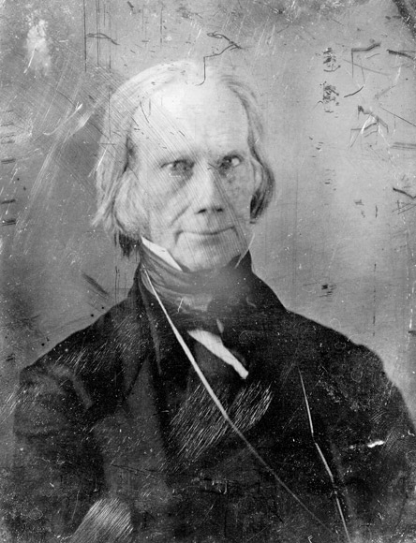
Senate Debates:
Congress met in December 1849 and opened up the question of CA.
Northerners demanded the abolition of slavery in the District of Columbia.
Southerners accused North of failing to enforce fugitive slave act of 1793.
As tension mounted some southern states threatened secession.
Henry Clay put forward the Compromise of 1850.

Slide 4
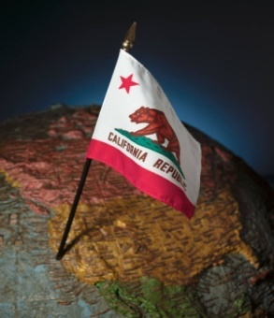
Compromise of 1850:
Called for CA to be admitted as a free state.
Called for a stricter fugitive slave law.
Popular sovereignty: New territories were able to decide for themselves.
Federal government pay TX 10 million to surrender its claim to NM. Good for North and South.
Compromise failed to pass.
Senator Stephen A. Douglas took over and was able to pass it by submitting each part of the plan as a separate bill. Also the unexpected death of Taylor helped because Millard Fillmore became president and he supported the compromise.

Slide 6
Section 2
Fugitive Slave Act
Harsh punishment for escaped slaves and anyone who helped them.
Any federal marshal who did not arrest an alleged runaway slave could be fined $1,000.
Any person aiding a runaway slave by providing shelter, food or any other form of assistance was liable to six months' imprisonment and a $1,000 fine.
Thomas Garrett, the Delaware station-master, paid more than $8,000 in fines.
Calvin Fairbanks served over seventeen years in prison for his anti-slavery activities.
John Fairfield, one of the best known of the white conductors, was killed working for the underground railroad.

Slide 7
Personal Liberty Laws
Personal Liberty Laws. (Passed by 9 Northern States)
Banned the imprisonment of escaped slaves, and guaranteed them a trial by jury.

Slide 8
Underground Railroad
The Underground Railroad
system by which escaped slaves from the South were helped in their flight to the North.
The system started in 1787 when Isaac T. Hopper, a QuakerThe system started in 1787 when Isaac T. Hopper, a Quaker, began to organize a system for hiding and aiding fugitive slaves.
Opponents of slavery allowed their homes, called stations, to be used as places where escaped slaves were provided with food, shelter and money.
The various routes went through 14 Northern states and Canada.
It is estimated that by 1850 around 3,000 people worked on the underground railroad.

Slide 9
People of the Railroad
The Underground Railroad also had people known as conductors who went to the south and helped guide slaves to safety.
Harriet Tubman
Stations were usually about twenty miles apart. Conductors used covered wagons or carts with false bottoms to carry slaves from one station to another.
Runaway slaves usually hid during the day and traveled at night.
Some of those involved notified runaways of their stations by brightly lit candles in a window or by lanterns positioned in the front yard.

Slide 10
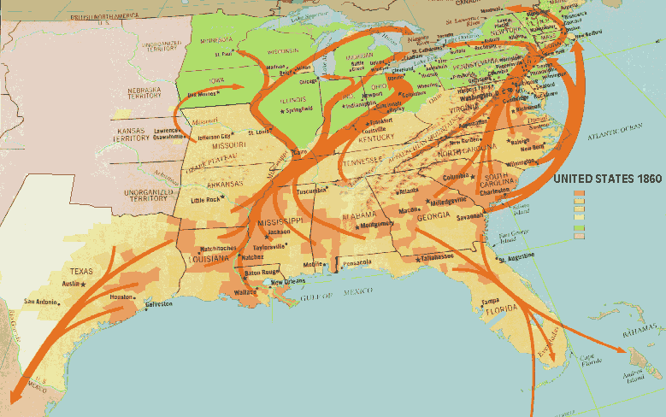
Routes of the Underground Railroad

Slide 11
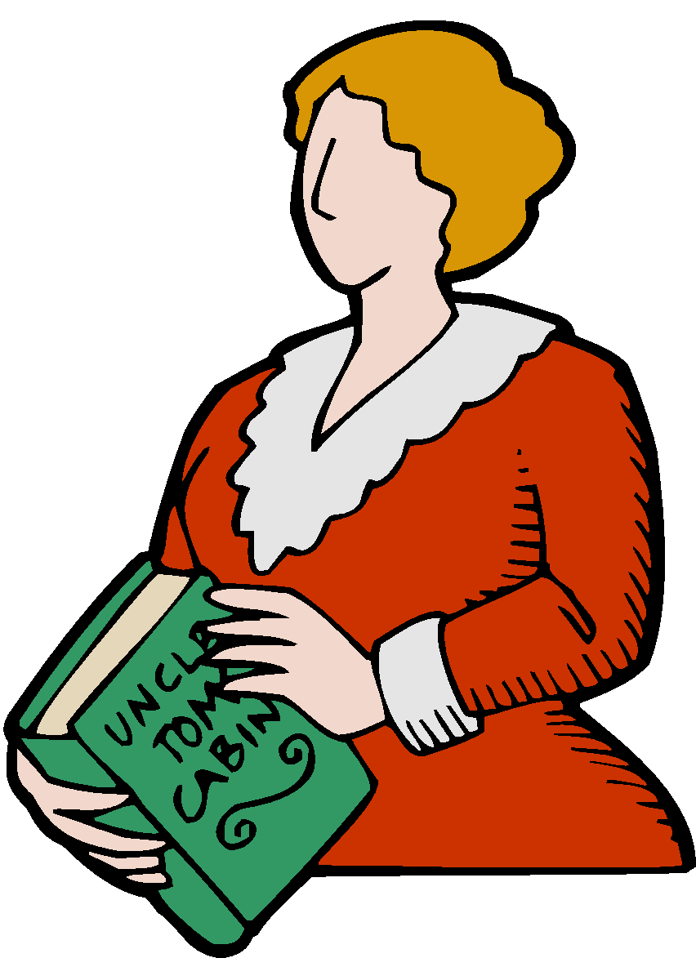
Uncle Tom’s Cabin
Harriet Beecher Stowe, Uncle Tom’s Cabin
More than a million copies had sold by the middle of 1853
Impact: Angered the south, inspired the north

Slide 12
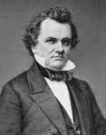
Popular Sovereignty
In 1844 Stephen A. Douglas was pushing to organize the huge territory where present day Kansas and Missouri are.
Strong believer in popular sovereignty
People’s right to vote (on slavery) creates chaos in elections
In 1854 Douglas introduces the Kansas-Nebraska Act
Repeal the Missouri Compromise and establish popular sovereignty for the new state.
Became a law in 1854.

Slide 13
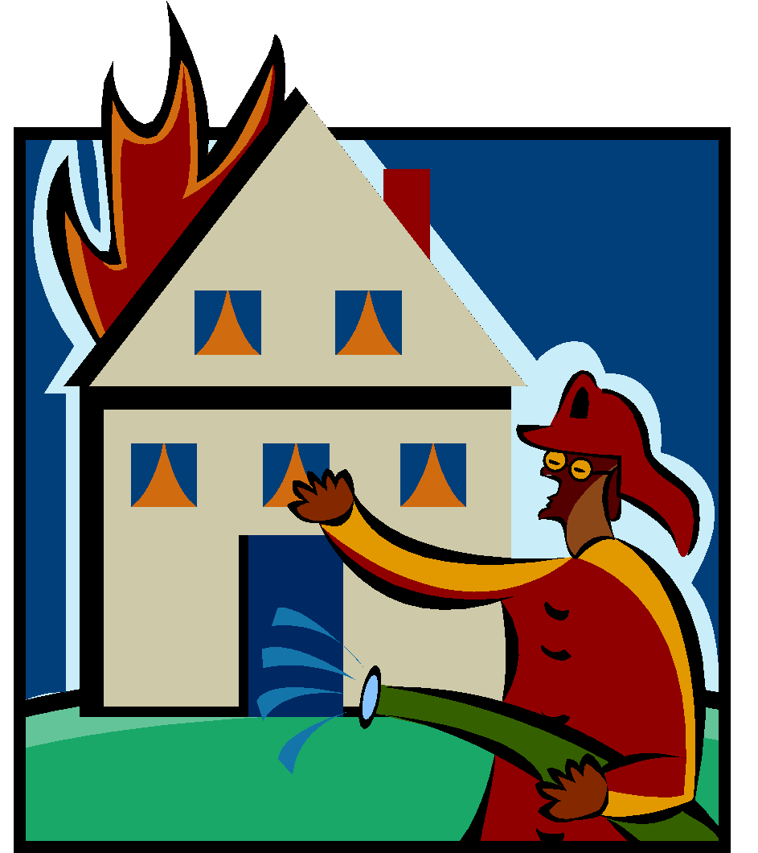
Bleeding Kansas
Race for possession of Kansas.
Northern and Southern settlers flowed in.
Soon had enough settlers to hold an election for a territorial legislature.
You had “border ruffians” which crossed the line and voted for the south illegally.
Violence erupts. Anti-Slavery jury condemns proslavery inhabitants as traitors and asks for their arrest.
“Sack of Lawrence”
Posse burns antislavery headquarters. Makes anti-slavery abolitionist John Brown very upset.

Slide 14
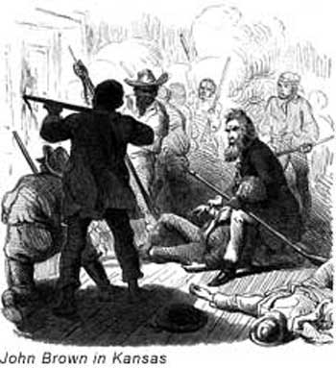
Pottawatomie Massacre
News about Lawrence reached John Brown.
God had called upon him to fight slavery.
Mistaken impression that proslavery posse had killed 5 men. Brown decides for revenge and pulls five proslavery men from their beds at Pottawatomie Creek hacks off their hands and stabs them with broadswords.

Slide 15
Violence in the Senate
Senator Charles Sumner delivers an impassioned speech about Kansas. Attacks colleagues for their support of slavery.
Abusive to aged senator Andrew P. Butler.
Butlers nephew comes in and attacks Sumner with his cane for the abuses against his Uncle.

Slide 16
Block Party Political Cartoon
Your team has 2 minutes to discuss Cartoon 1 and fill out the information!
Love Vigilantes
Switch! You and your new partner have 2 minutes to discuss Cartoon 2 and fill out the information!
Ready, Set, Go!
Check off the cartoons you discussed.

Slide 17
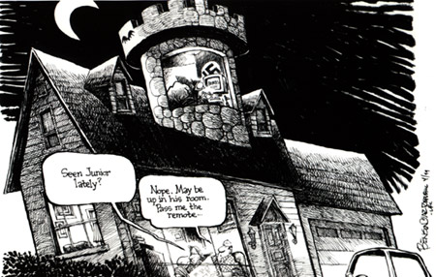
Political Cartoons
Reading about Columbine Political Cartoon
Political cartoons are drawings representing current public figures or issues symbolically and often satirically. Satire is irony, sarcasm, or caustic (burning) wit used to attack or expose folly, vice, or stupidity (The American Heritage Dictionary).

Slide 18
The Elements of a Political Cartoon.
Assignment: Political Cartoons
In order to give an accurate representation of the subject that you choose you need to think of special details about the subject that you wish to portray. Here are some tips for drawing your cartoons:
You need to think of how the person looks so that you can draw them.
Think about what particular event or characteristic you want to highlight.
The facial features in people really stand out in cartoons.
You can draw caricatures of your subjects as well.
Words in cartoons can be important as well. They can add clarity and insight as to how the cartoonist feels about the subject. Words can be integrated into the cartoon or they can act as captions.

Slide 19
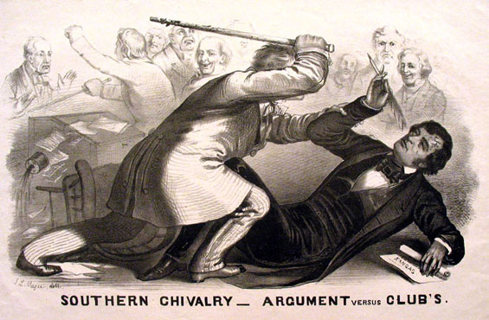
Political Cartoons!
Choose one of the following events for your political cartoon:
Sumner v. Brooks
Pottawattamie Massacre (Bleeding Kansas)
Kansas Nebraska Act
Uncle Tom’s Cabin
Compromise of 1850
Fugitive Slave Act

Slide 20
Republican Party Section 3
I Know
Nothing!
Political parties shifted by 1856
Whig party split over issue of slavery
Presidential election of 1852 fell to Democratic Candidate Franklin Pierce
Democratic party had become weak
Nativism: The American Party (Secret Organization believed in favoring native born citizens over immigrants.)
Used secrete handshakes and passwords.
Members were told to answer questions about their party with, “I know nothing.” Became the know nothing party.
Ended up merging with the Republicans

Slide 21
Anti-Slavery Parties
Liberty Party: purpose was to pursue the cause of abolition by passing new laws.
Free-Soil Party: Opposed the extension of slavery into the territories. Did not win any electoral votes in 1848.
Could be free soil and not an abolitionist. “It’s a party for keeping Free Soil and not for setting men free.”
Convinced that a conspiracy existed on the part of the “diabolical slave power” to spread slavery through the U.S.

Slide 22
Rollin, Rollin, Rollin Rawhide!
Republican Party: Formed in 1854 by discontented northern Whigs who held a meeting with anti-slavery democrats and free-soilers. Horace Greeley was one of the founders.
Opposed Kansas-Nebraska Act
Keeping slavery out of territories
1856 Election: Rep chose John C. Fremont who had mapped the Oregon Trail.
Democrats nominated James Buchanan. He won!

Slide 23
Tree Map
Complete a tree map for the political parties we have talked about in this section…..

Slide 24
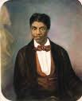
Slavery and Secession Section 4
Dred Scott Decision
(Dred Scott v. Sanford)
Slave from Missouri
Roger B Taney Supreme Court Chief.
Ruled that slaves did not have the rights of citizens.
Ruled that the Missouri Compromise was unconstitutional.
Congress could not forbid slavery in any territory because it was interfering with a slaveholders right to own property (5th amendment)

Slide 25
Lincoln-Douglas Debates.
1858 race for the U.S. senate between Dem Stephen A. Douglas and Rep Abraham Lincoln.
Lincoln successful lawyer and politician.
Douglas 2 time senator.

Slide 26
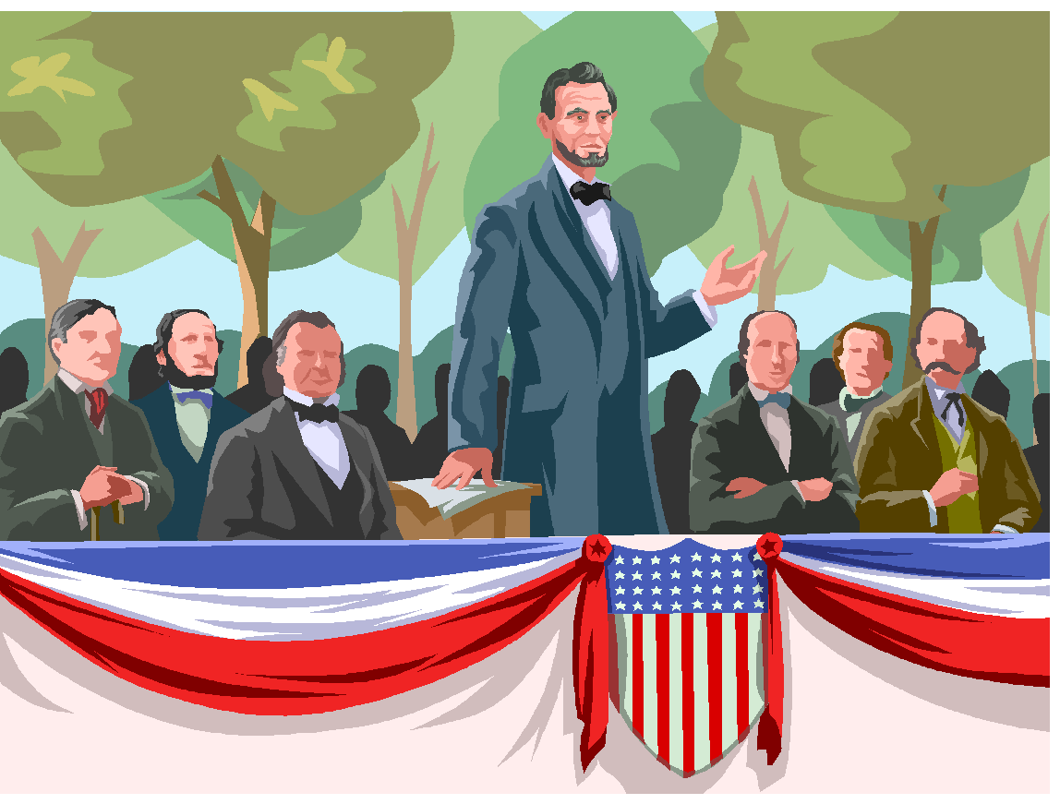
Their Positions!
Lincoln
Slavery Immoral
Doubted that slavery would cease to spread without legislation outlawing it in the territories.
Douglas
Popular Sovereignty
Slavery is backward labor system
Felt that with popular sovereignty slavery would pass away on its own.
Freeport Doctrine: Idea that any territory could exclude slavery by simply refuse to pass laws supporting it.

Slide 27
Freeport Doctrine and The Debates End
Douglas won the Senate seat, but his response had worsened the Split between the Northern and Southern wings of the Democrats.
Lincolns attacks on the “vast moral evil” of slavery drew national attention.
Republicans looked at him as an excellent candidate for the presidency in 1860

Slide 28
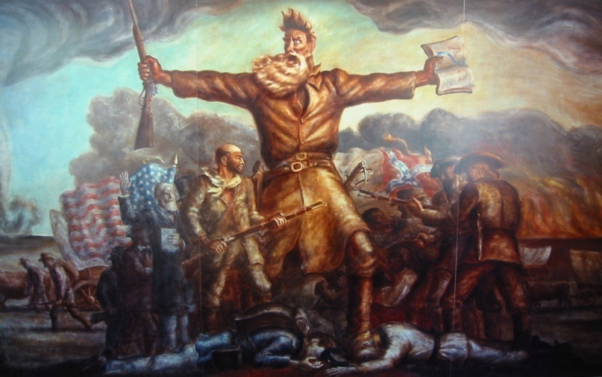
Harpers Ferry
“Gods Angry Man” John Brown reemerged and ended all hopes of compromise.
Studied slave uprisings in ancient Rome and believed that he could do the same in America
October 16, 1859 he led a band of 21 men black and white into Harper’s Ferry Virginia.
Hoped his actions would arouse Northern fury and start a war for abolition.
December 2, 1859 John Brown was hanged for high treason.
Some began to call Brown a martyr for the cause of freedom
Harpers Ferry terrified southern slaveholders.
People again voiced secession.

Slide 29
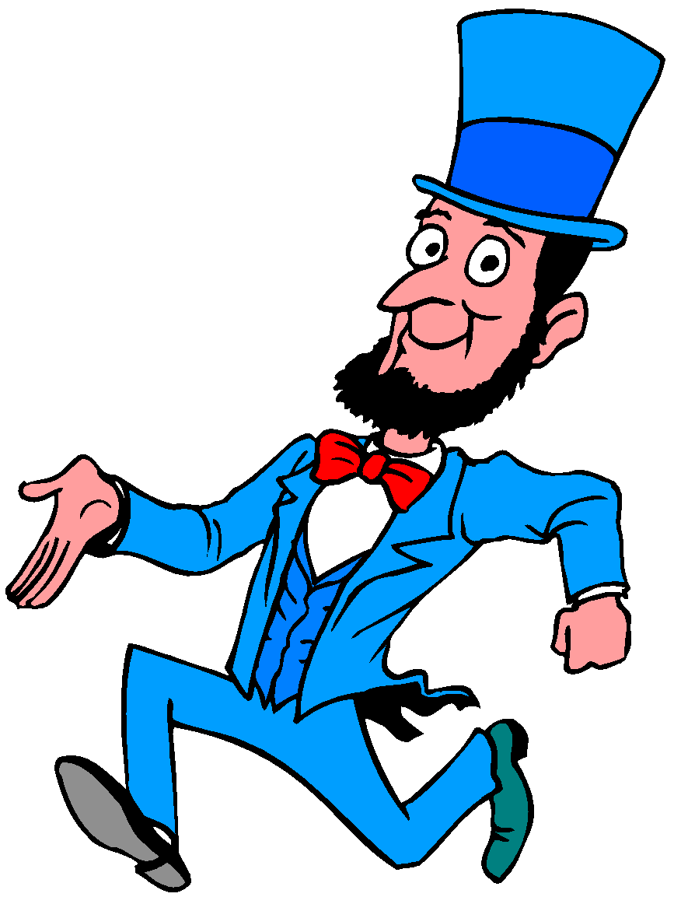
Lincoln as President
Had sectional rather than national support
Not even on some southern ballots
Convinced southerners that they had lost their political voice in the national government.
South Carolina seceded first then Mississippi, Florida, Alabama, Georgia, Louisiana, and Texas.
Confederacy formed on February 4, 1861

Slide 30
The Confederacy
It “protected and recognized” slavery in new territories.
Each state sovereign and independent. (Ended up hampering efforts to unify the south.)
Elected Jefferson Davis as President.
“The time for compromise has now passed.”

Slide 31
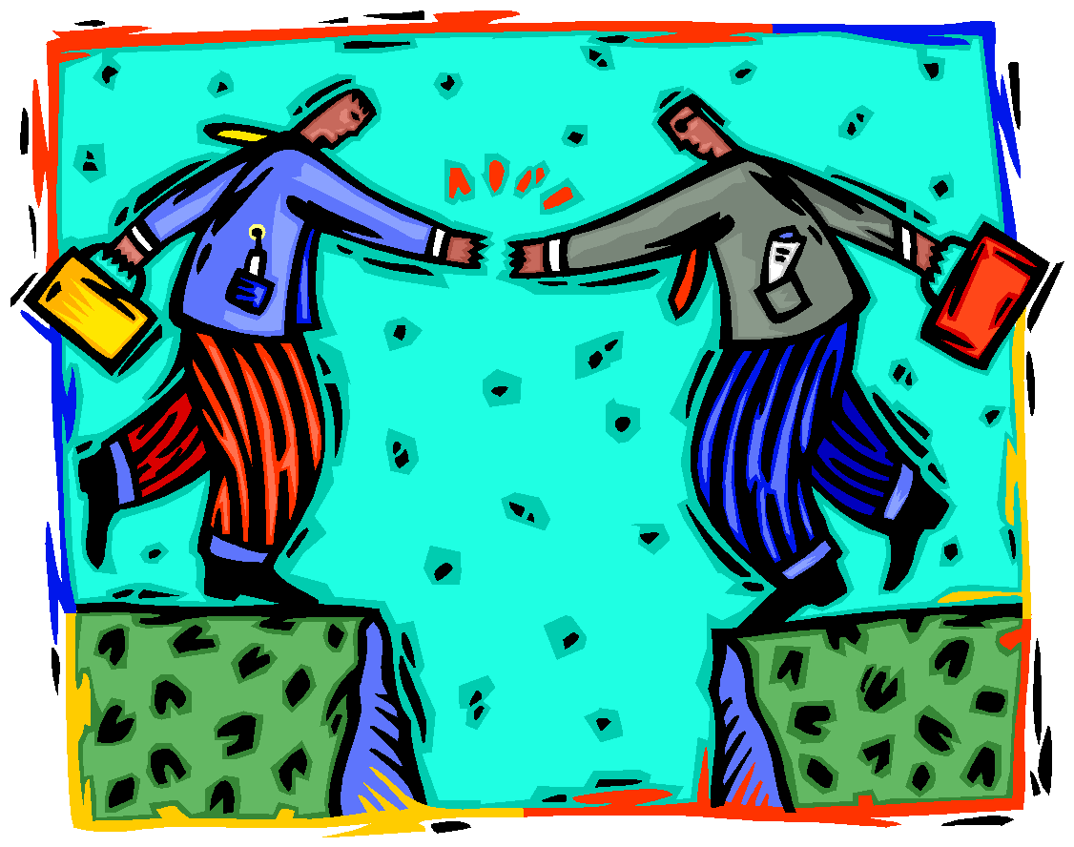
Calm Before the Storm
Nation awaited Lincoln’s Inauguration
Citizens confused
Washington DC a southern city.
Would the north allow the south to leave the Union without a fight?
Exit Slip: Do you feel there is a current issue today that COULD have the potential to split the nation? Explain

Slide 32
Thinking about the Chapter
Complete a bubble map to organize your thoughts before you start writing.
Write a brief summary of the events that led up to the secession of the southern states. Be sure to include all major events with dates we have talked about and how they relate to the division between the north and the south. Make sure your summary is in chronological order and they are concepts linked in time not isolated facts.
Min 1 page typed – double spaced.

Slide 33
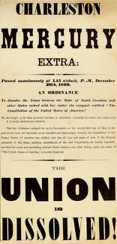
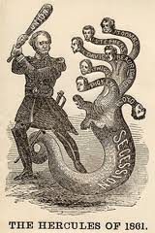
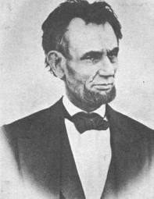
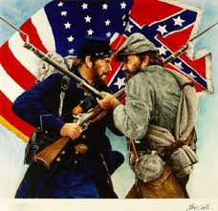
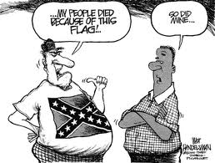
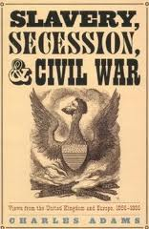
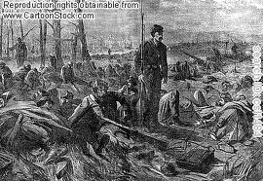
The Civil War! Chapter 11

Slide 34
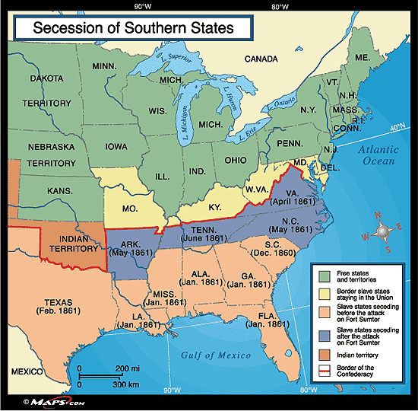
Southern Secession

Slide 35
Section 1 Fire on Fort Sumter
Advantages of North
More factories
Greater food production
More extensive railroad system.
Lincoln as leader
Advantages of South
“King Cotton”
First rate generals
Strong military tradition.
Defending homeland

Slide 36
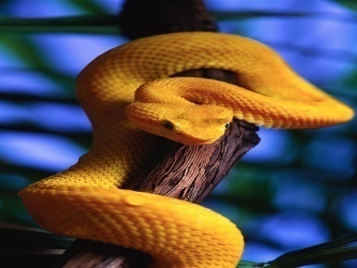
Anaconda Plan
Union had a three part plan
Union navy would blockade Southern Ports so they couldn’t export cotton.
Union riverboats and armies would move down the Mississippi River and split the confederacy in two.
Union armies would capture the Confederate Capital in Richmond, Virginia.
Confederates: Strategy mostly defensive.

Slide 37
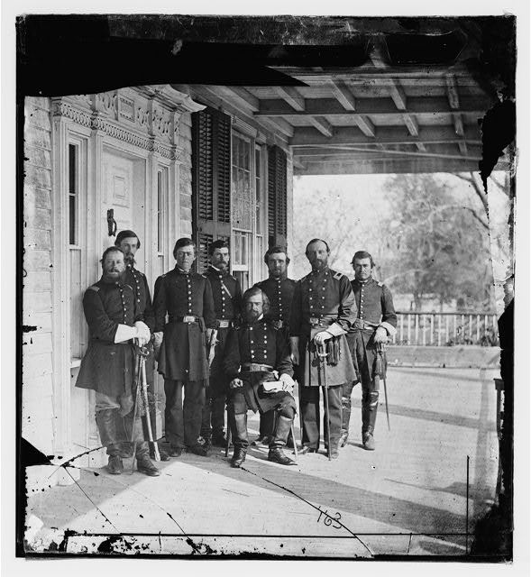
The South - Confederacy

Slide 38
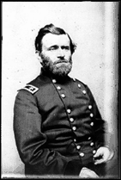
Battles, Bulls, and Beat’ens
First major bloodshed battle of Bull Run. Victory for the South.
Stonewall Jackson emerges as a strong Confederate general.
George McClellan lead the Union army.
Ulysses S. Grant another general under McClellan emerges as a strong military commander.
Battle at Shiloh: Close to Mississippi border, thousands of yelling confederate soldiers surprised Union soldiers. Caught off guard. In the end confederate forces retreated but over 100,000 troops were killed.
Showed that at least part of the Unions strategy to use the Mississippi River and split the confederacy might succeed.

Slide 39
Battle at Bull Run!
Whoa Buddy!

Slide 40
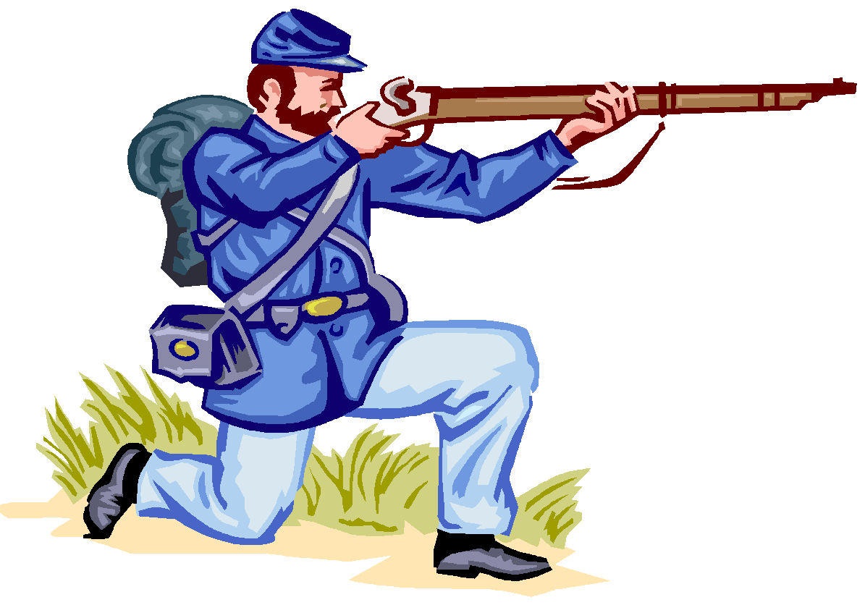
A Revolution In Warfare
Ironclads
New Weapons
Mini Ball
The War for the Capitals
Union army advances towards Richmond.
Encountered Confederate Army and General Joseph Johnston. Johnston wounded and command goes to Lee.
Confederate troops win a surprising victory at the Second Battle of Bull Run.
Battle at Antietam: Single Bloodiest battle in American history.
Lincoln Fires McClellan.

Slide 41
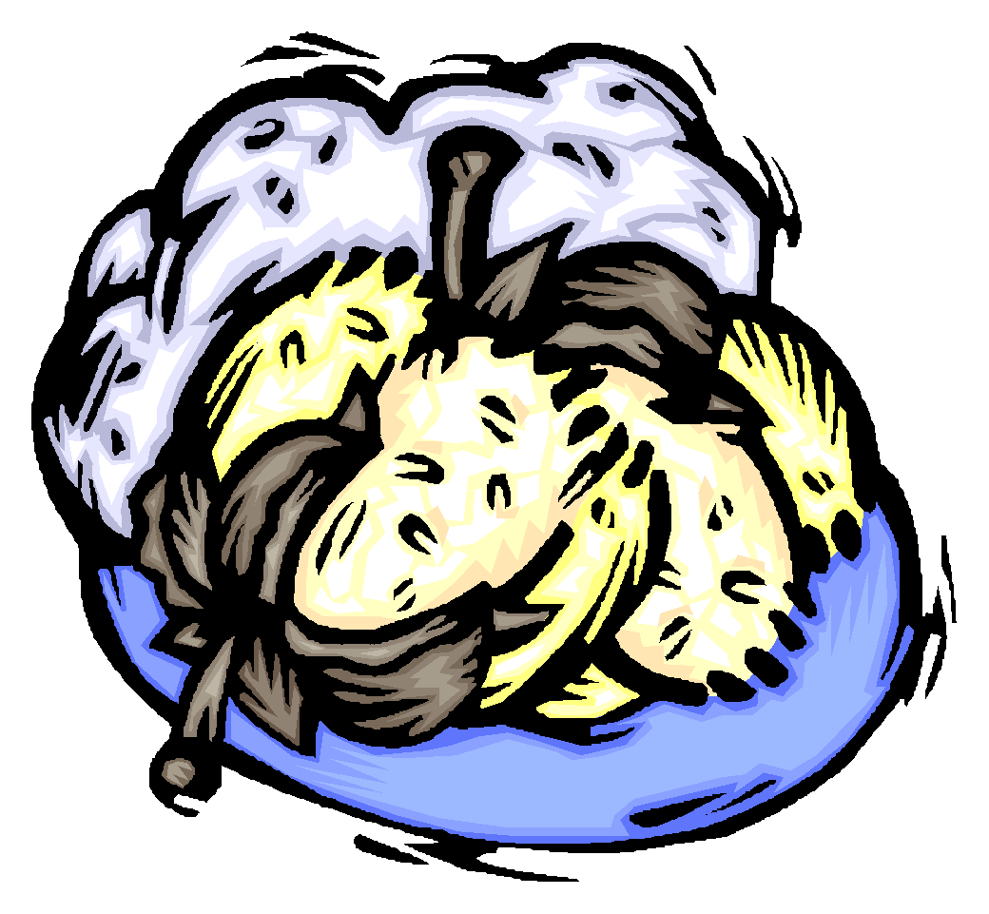
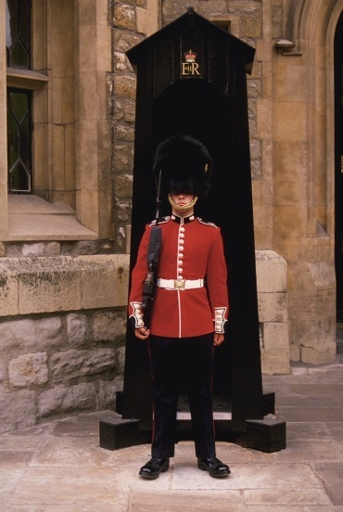
The Politics of War Section 2
Britain no longer dependent on southern cotton. Accumulated a large cotton industry in Egypt and India.
Britain declared neutrality.
Trent Affair
Confederate government sent two diplomats.
American warship stops the British merchant ship the Trent with the two men aboard and arrests the two men.
British threatens war against the union. However Lincoln released men.

Slide 42
Emancipation
Emancipation Proclamation: An executive order issued by Abraham Lincoln, Jan 1, 1863. Freed slaves in all regions behind confederate lines.
Reactions

Slide 43
Political Problems
Neither side was completely unified. (Confederate sympathizers in North, Union Sympathizers in the South)
How should the respective governments handle their critics?
How cold they ensure a steady supply of fighting men for their armies?
Lincoln dealt forcefully with disloyalty
Example: Baltimore crowd attacks union regiment. Suspended writ of habeas corpus for that state.
Confederate sympathizers were arrested and held without trial. Arrested copperheads: Northern Democrats who advocated peace with the south.
Lincolns was of dramatically expanding presidential powers in time of war set a precedent in the U.S. history. Since then presidents have cited war or “national security” as a reason to expand the powers of the president.

Slide 44
Report to Duty!

Slide 45
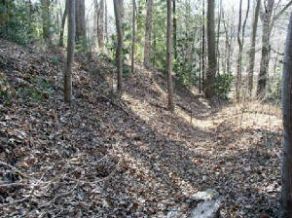
Local Examples of Dissent
The Shelton Laurel Massacre refers to the execution of 13 accused Union sympathizers around January 18, 1863 by a Confederate regiment in the Shelton Laurel Valley of Madison county, NC at the height of the American Civil War.
Shelton Laurel Massacre
Poem- “To Go or Not to Go”
“Tall Woman” Reading
Discuss
Why do you think there was more dissent towards the war in our local area?

Slide 46
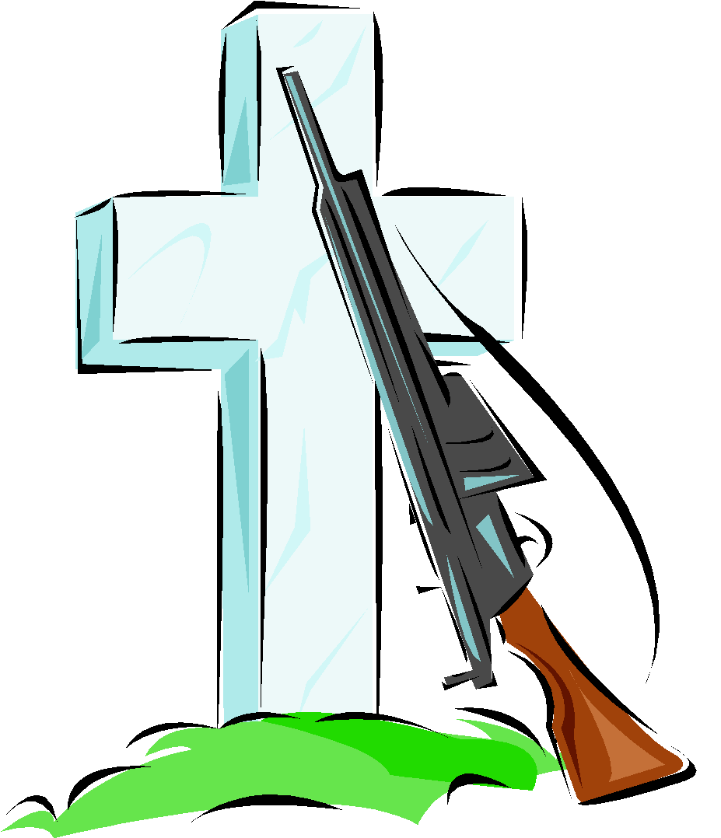
Political Problems: Conscription
Both armies relied on volunteers.
Heavy casualties and widespread desertions led to conscription. (A draft that would force certain members of the population to serve in the army.
Confederate army passed draft in 1862
18-35 white men
Those who could afford substitutes were allowed.
If you owned 20 more slaves you were exempted.
Union army passed draft in 1863.
Drafted white men between 20-45. For three years.
Could hire substitutes
Paying a $300 fee to avoid conscription.
46,000 draftees went into the union army.
92% of 2 million soldiers were volunteers and 180,000 of them African Americans.
Draft Riots: Riots in NYC, poor white workers afraid of free blacks taking their jobs.

Slide 47
Reflection on Conscription
Wealthy- how did it feel to be able to pay your way out of the draft?
Soldiers- how did it feel to get enlisted and not be able to get out of the war?
Do you think this scenario is fair?
What are some similarities between the draft during the Civil War and the War in Afghanistan today?
Explain

Slide 48
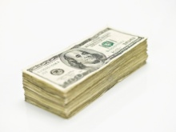
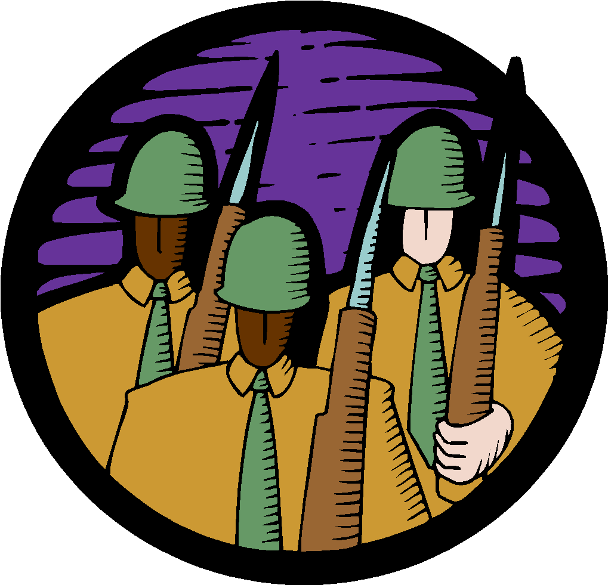
Life During Wartime: Section 3
African American soldiers: Civil war began as white mans war. In 1862 Congress passed law allowing African Americans to serve in military. After emancipation a large scale enlistment occurred.
Paid less
Could not rise above the rank of captain
Fort Pillow: Tennessee in 1864 gruesome massacre. Confederacy killed 200 African Americans soldiers.
Slave resistance in the confederacy. Slaves sought freedom behind lines of Union army.

Slide 49
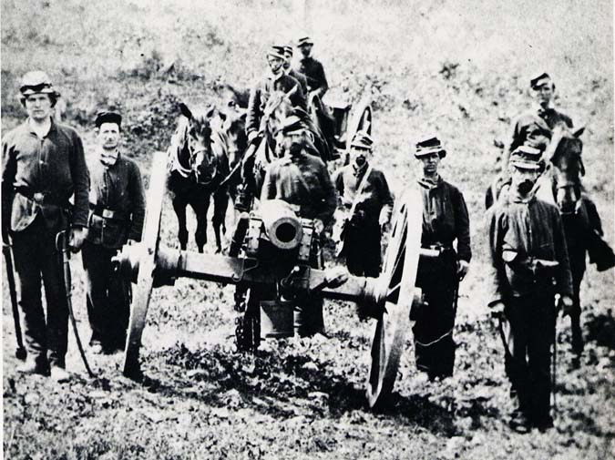
Complete 5 Senses:

Slide 50
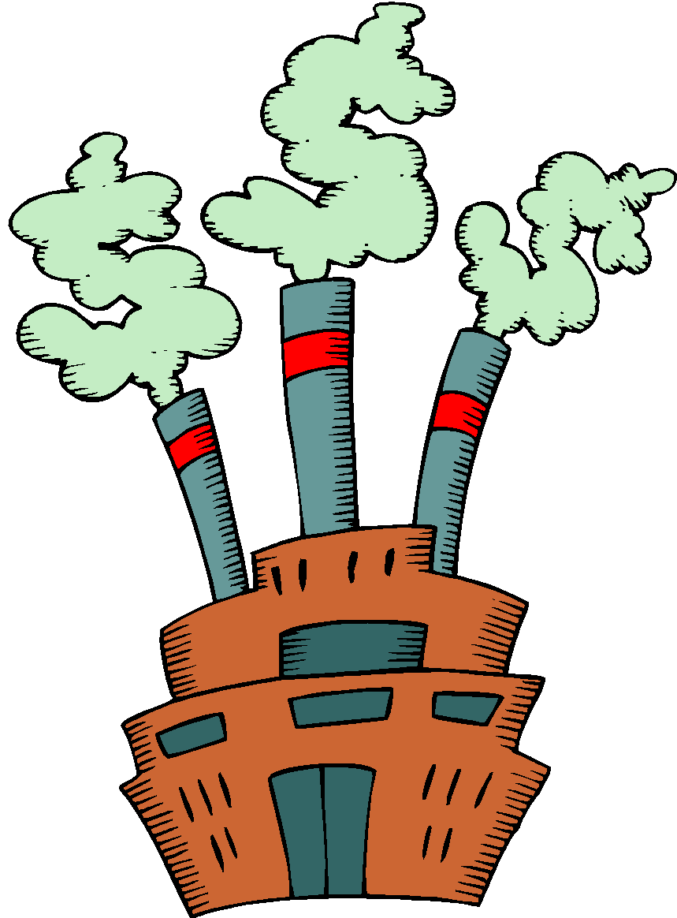
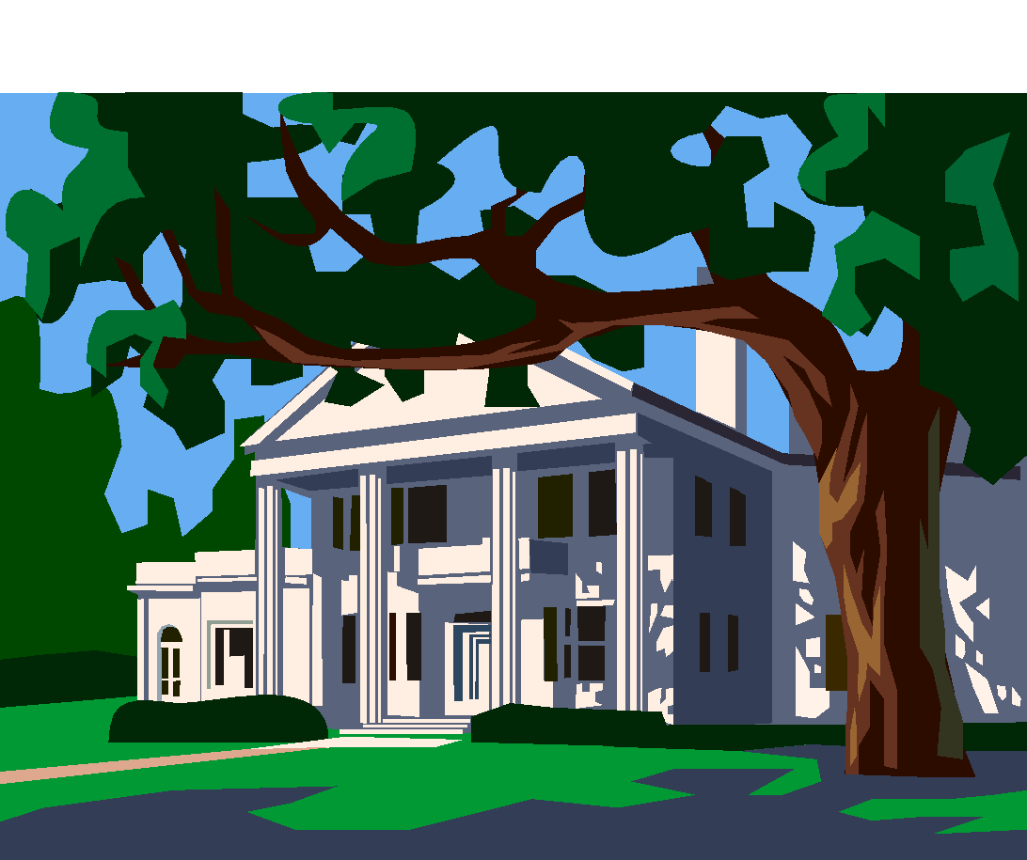
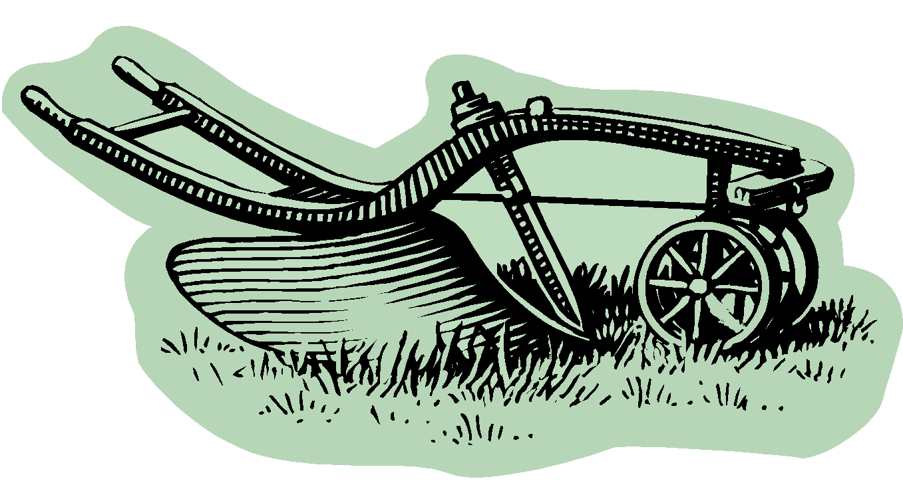
Economics!
Confederacy
Food shortage
Drain of manpower
Union occupation of food growing areas
Loss of slaves
Union blockade of southern ports.
Union
Economy grew
Industries boomed.
Need for uniforms, shoes, guns, etc.
Draft reduced available workforce.
Bought labor saving machines.
Standard of living declined. When white workers declined immigrants and free blacks took their places.

Slide 51
Soldiers Suffer on Both Sides
Garbage disposal and latrines unknown.
Body lice, dysentery, and diarrhea common.
Armies rations were small and mal-nutritious.
Dorthea Dix: became nations first superintendent of women nurses.
Clara Barton: was one of many union hospital nurses.
Prisons: Andersonville, Georgia hammed 33,000 men into 26 acres. No shelter except for tents out of blankets or sticks. Poor conditions in the both Union and Confederate Prisons.

Slide 52
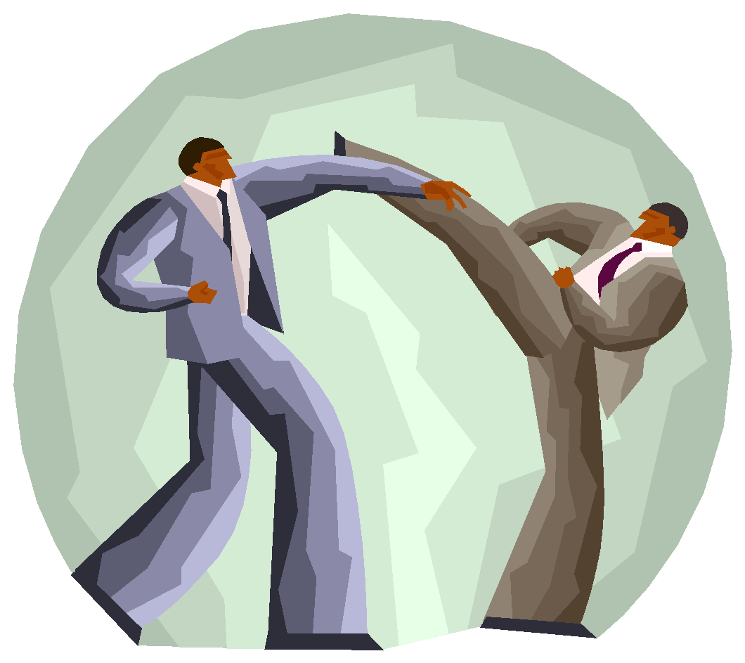
Battles, bulls, and beatens!
You will be organized into groups of 4.
In your group you are in charge of teaching your battles to the rest of the group. Please remember to explain the reasons the battle was important.
Part of your grade will be based on how well you teach the rest of your group.
You have 20 minutes

Slide 53
North Takes Charge: Section 4
Gettysburg: July 3rd 1863 - A three day battle, considered the turning point of the civil war. Crippled General Lee so badly that he would never again possess sufficient forces to invade a northern state.
Grant wins at Vicksburg July 4th 1863
Gettysburg Address – November 1863
Read Address Lesson

Slide 54
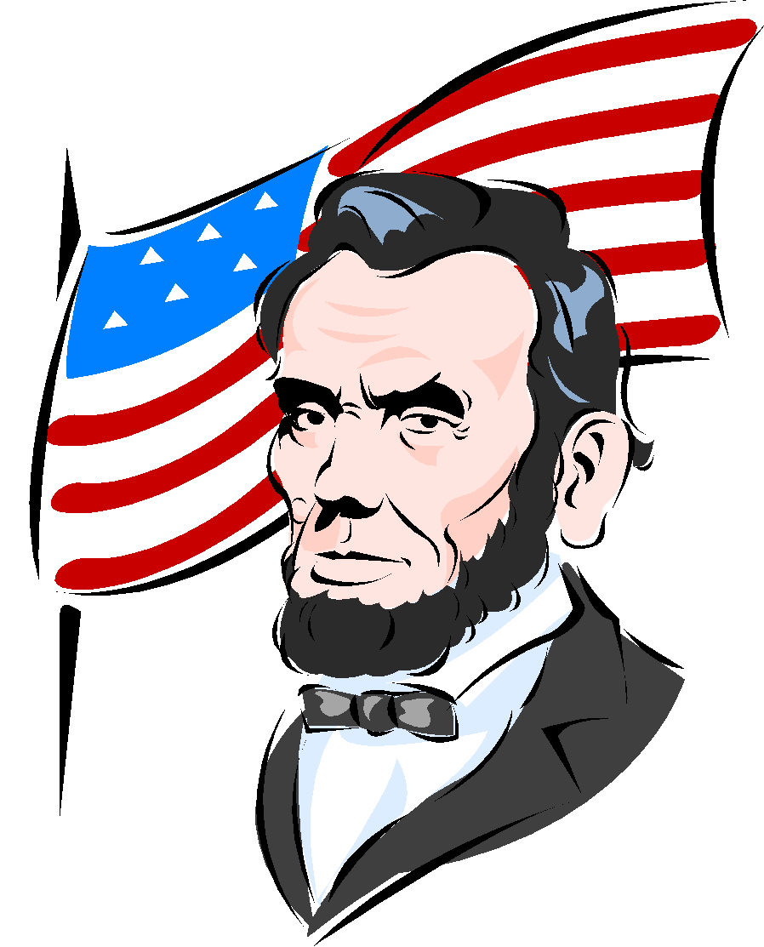
Confederacy Wears Down
Confederate Morale
Food production poor
Discord with the government
In 1863 North Carolinians who wanted peace held more than 100 open meetings.
President Lincoln appoints Grant as commander of all union armies.
Grant appoints Sherman as commander in Mississippi.
Grant and Lee in Virginia
Grants strategy to immobilize Lee’s army in Virginia while Sherman raided Georgia.

Slide 55
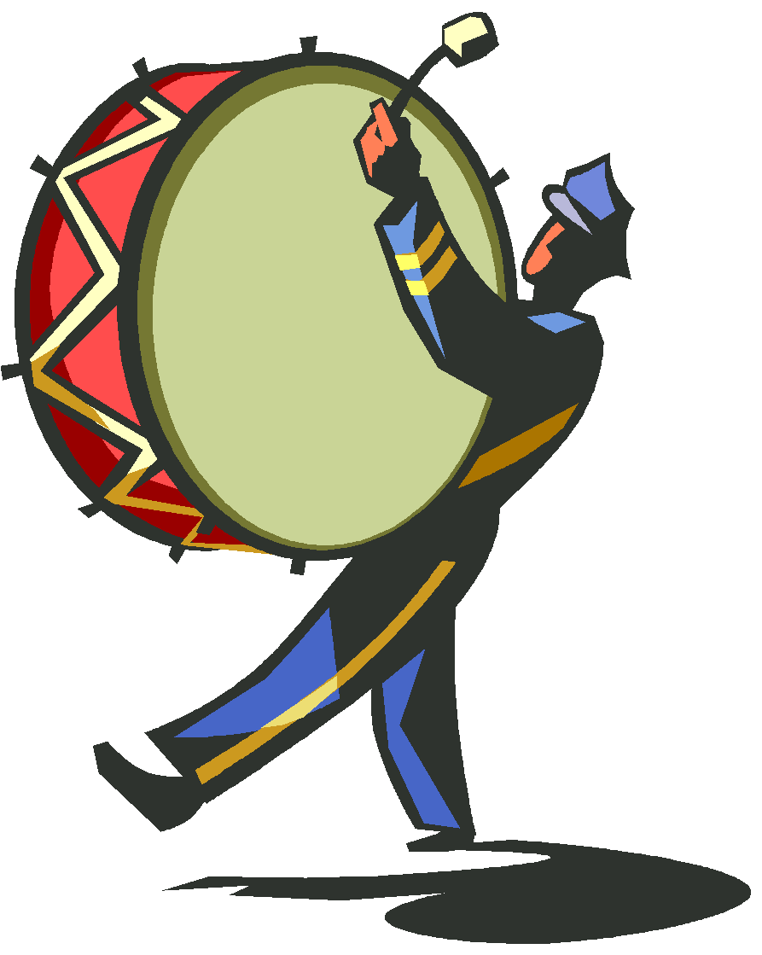
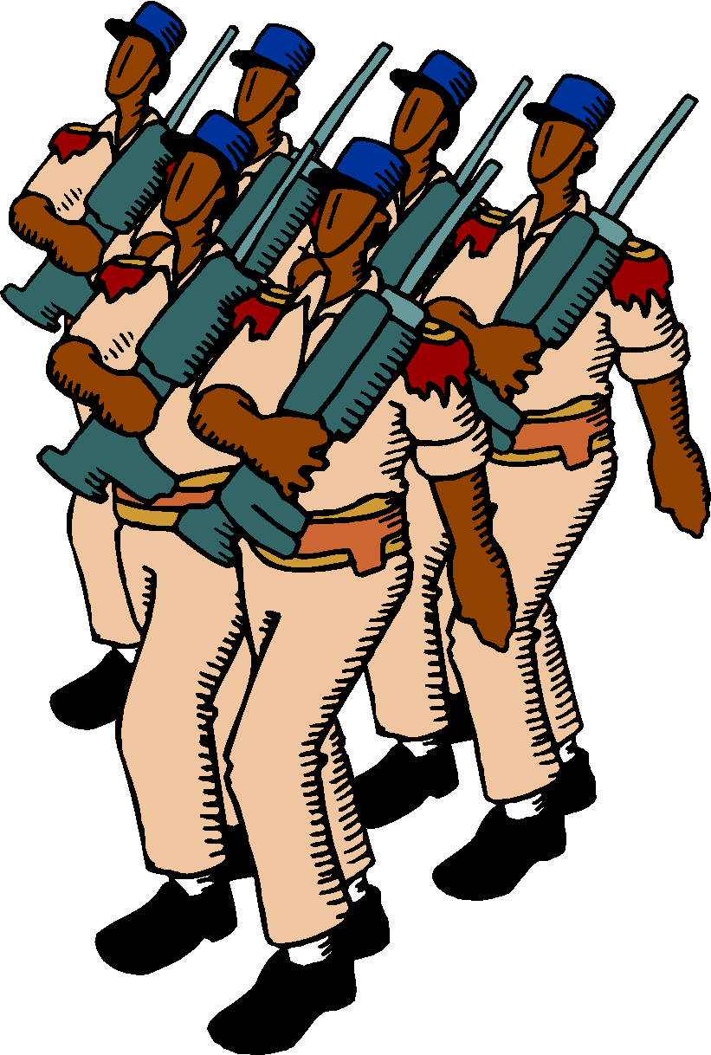
Sherman
Sherman’s March
Marched southeast through Georgia creating a wide path of destruction.
“would make southerners so sick of war that generations would pass away before they would again appeal to it.” Army burned almost every house in its path. Marched on to help Grant in Virginia.

Slide 56
Election of 1864
Lincoln faced heavy opposition
Pro Southern Party nominated George McCllellen (Northern Democrats)
Radical Republicans- Favored harsher proposal for readmission of southern states into union. They nominated John C. Fremont
Republicans changed party name to National Union Party and chose Andrew Johnson as Lincoln’s running mate.
Several important union victories happened before the election and ensured Lincoln’s win.

Slide 57
End of War…
Surrender at Appomattox, Virginia
April 9, 1865. Terms were generous:
Grant paroled Lee’s soldiers and sent them home with their personal possessions.
Within 2 months all remaining confederate resistance collapsed.

Slide 58
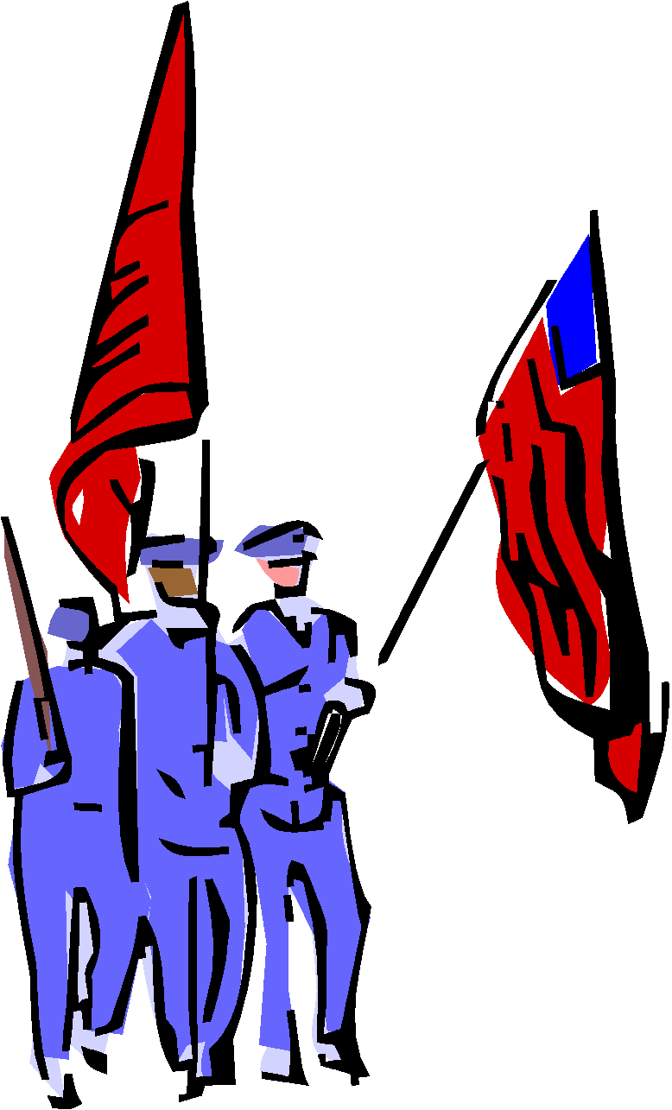
Legacy of War Section 5
Civil war cause tremendous political, economic, technological, and social change in the U.S.
Increased Federal Governments Power
Ending the threat of secession
National Bank Act of 1863: Set up system of federally chartered banks, set requirements for loans, and provided banks to be inspected.
Northern states economy boomed.
Entrepreneurs got rich selling supplies and opened new businesses after the war.
South’s economy devastated. Large economic disparity now between the two regions.
Humans costs: 360,000 union soldiers and 260,000 Confederate soldiers.
Union and Confederacy spent a combined total of 3.3 billion during the war.

Slide 59
War Changed Lives
By the end of 1865 27 states including 8 from the south had ratified the 13th amendment.
“Neither slavery nor involuntary servitude except as punishment for crime whereof the party shall have been duly convicted, shall exist within the U.S.
New careers: Military Careers, Clara Barton formed the Red Cross.

Slide 60
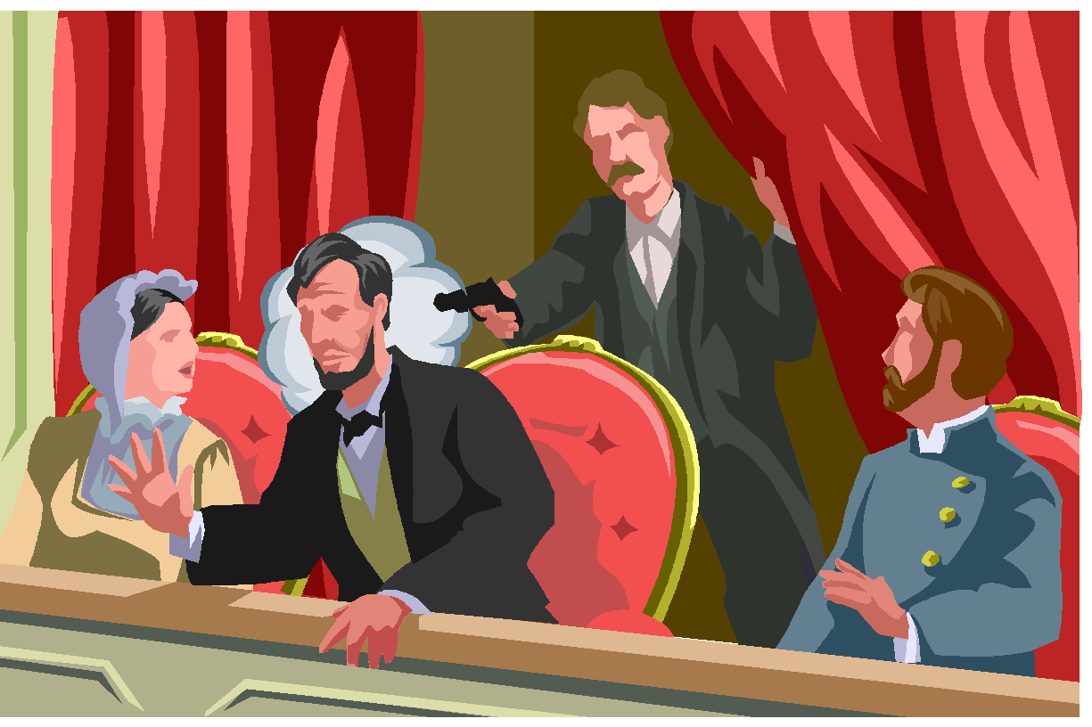
Assassination of Lincoln
5 days after Lee surrendered at Appomattox John Wilkes Booth assassinated Lincoln at Ford’s Theatre in Washington.
Booth a southern sympathizer.
1/3 of the American population turned out to publicly mourn Lincoln.

Slide 61
Cause and Effect Flow Map
As an exit slip for this section please complete the following to test to see if your target goals are met.
Complete a cause and effect flow map with at least 5 causes and 5 effects for each side.
Civil War

