Slide 1
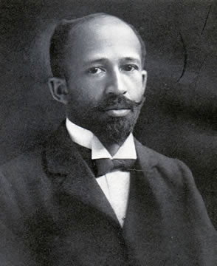
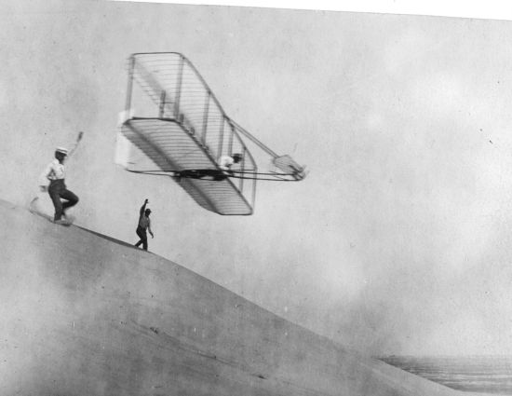
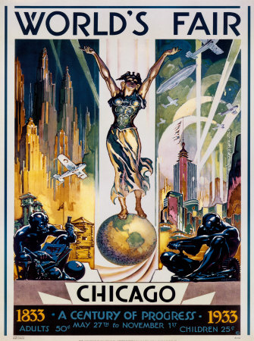
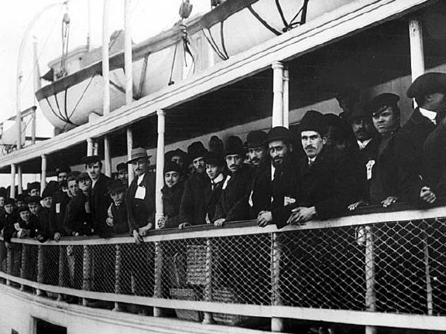
Period 6
THE RISE OF IMMIGRATION
AND
LIFE AT THE TURN OF THE 20TH CENTURY
Key Concept 6.2 and 6.3

Slide 2
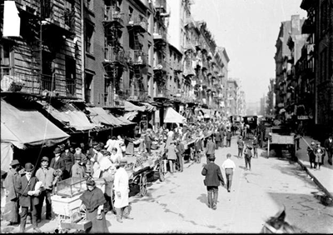
Immigrants and Urbanization
New York’s Lower East Side 1880- 5 Senses?

Slide 3
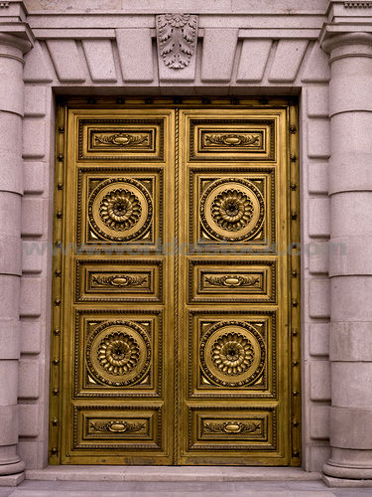
The New Immigrants
Section 1: View- From China to Chinatown
Complete Circle Map
Through the Golden Door
Why did people immigrate to the U.S?
Famine, land shortages, religious political persecution, earn money and then return to homeland.
Europeans
1870-1920 20 Million Europeans arrived in the U.S many from southern and eastern Europe.
Chinese and Japanese
1851-1883 about 300,000 Chinese came to the West Coast.
What kind of jobs did they have?
West Indies and Mexico
1880-1920 about 260,000 immigrants arrived in the eastern and southeaster United States.

Slide 4
Chinese Immigrants

Slide 5
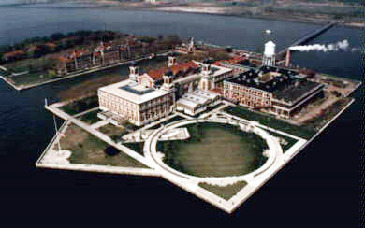
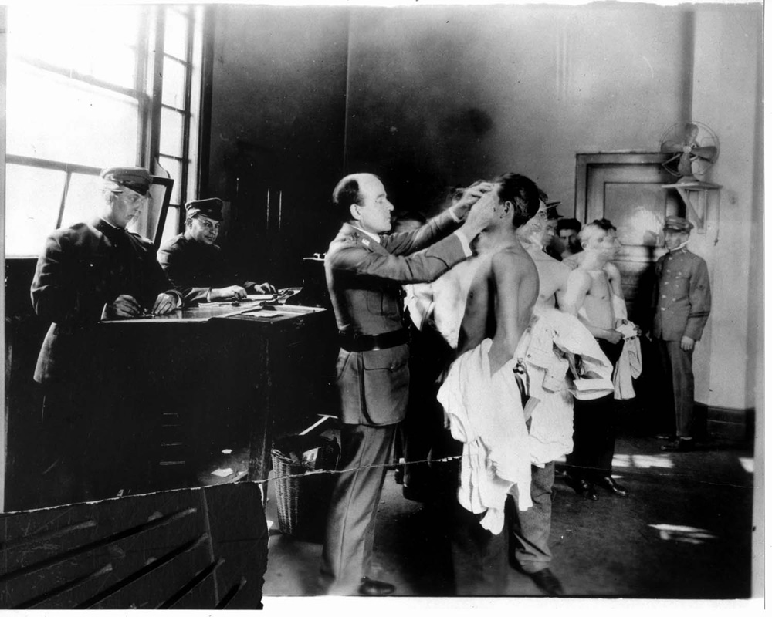
Life in the New Land
Difficult Journey?
Steamship – Cargo holds
Disease spread
“Coffin Boats”
Ellis Island
New York – Would take 5 hours or more
Checked documents, health exam, able to work?
Angel Island
San Francisco Bay
Long Detention, Bad facilities

Slide 6
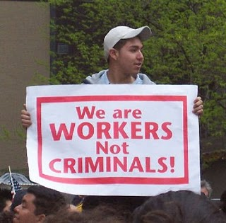
Reactions to Immigration
Melting Pot- Blending of
Different Cultures
Rise of Nativism- Remember this?
Anti-Catholic attacks
Immigration Restriction League- passed a bill requiring a literacy test for immigrants. Bill vetoed by the president.
Anti Asian Sentiment- Chinese Exclusion Act- banned entry to all Chinese except teachers, students, merchants, tourists, and government officials. Repealed in 1943
Gentlemen’s Agreement- Segregated Schools in CA, Japan raises angry protest and Teddy Roosevelt works out a deal. Japan would limit immigration of unskilled workers if the segregation order was repealed.

Slide 7
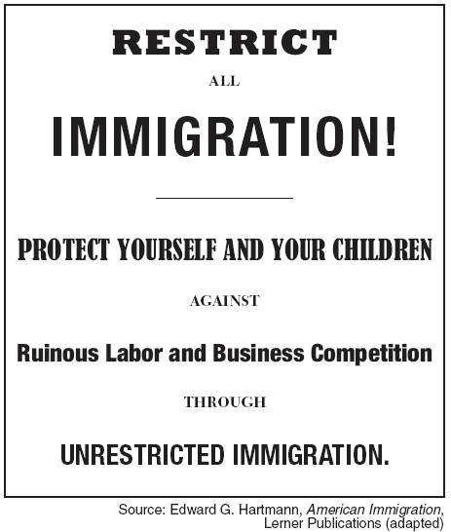
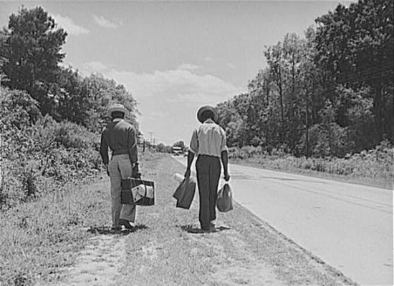
Urbanization: Section 2
Urbanization Means?
Americanization Movement- Assimilate people of wide-ranging cultures into the dominate culture.
Page 469 in Text- Look At Ethnic Enclaves in 1910 New York City
Move to cities by immigrants, southern farmers, African Americans

Slide 8
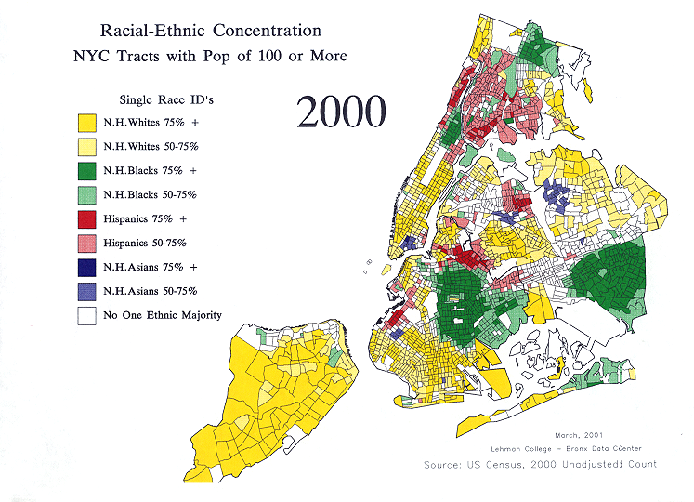
Ethnic Enclaves in NYC

Slide 9
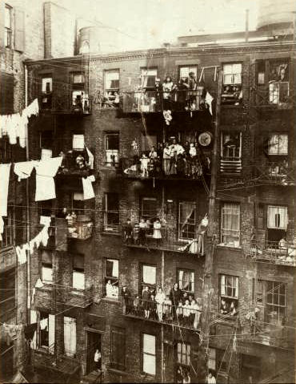
Urban Problems
What issues would occur with a rise in population in America’s cities?
Housing?
Tenements- Multifamily urban dwellings, overcrowded and unsanitary.
NYC passed a law that set minimum standards for plumbing and ventilation in apartments.
Transportation
Mass Transit
Electric Subways
Water
Sanitation
Crime
Fire

Slide 10
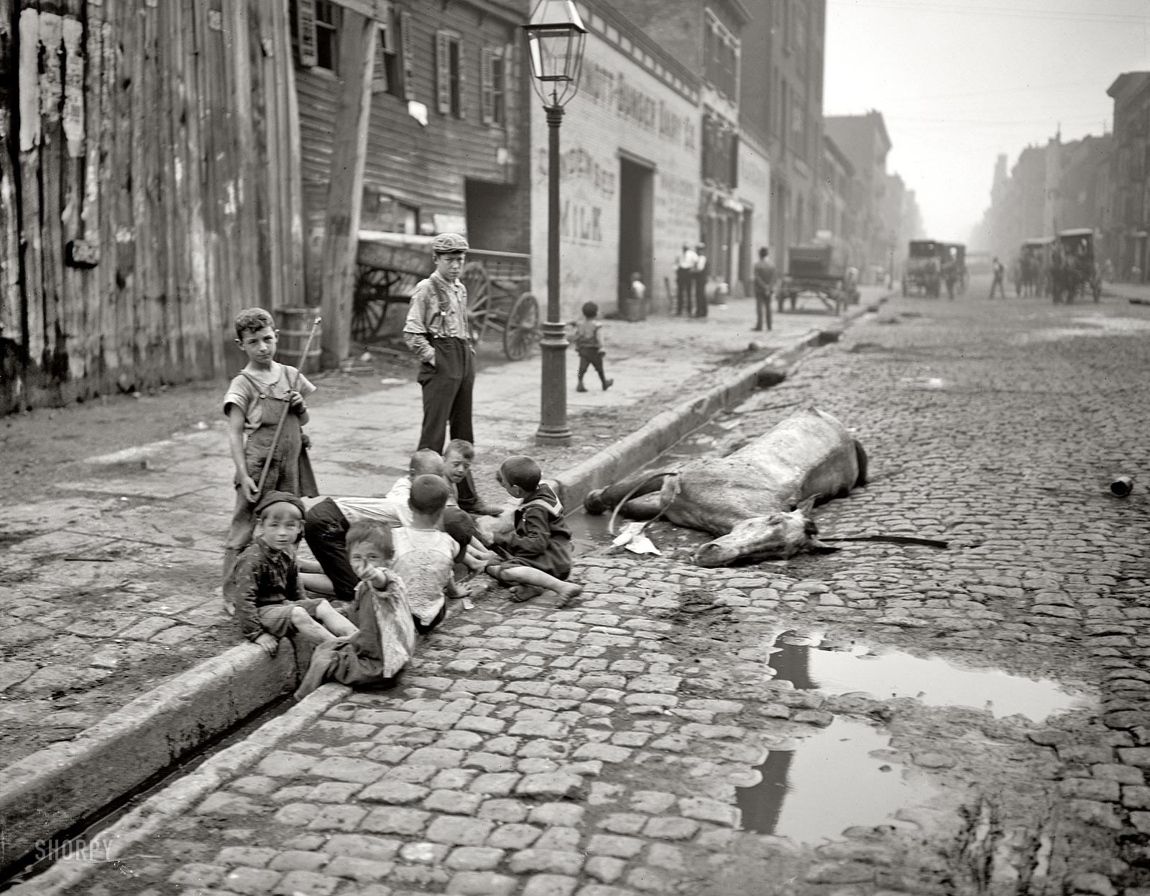
What does this tell you about the conditions of the cities in the late 1800s?

Slide 11
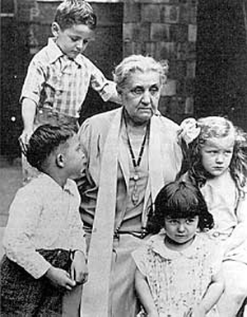
Reformers! Yay let’s make it better!
Settlement House Movement
Social Gospel Movement
Service to the poor
Settlement Houses- Community centers in slum neighborhoods that provided assistance to people in the area.
Jane Addams- One of the most influential members of this movement.
Reflection: Complete a flow chart like the one displayed on the board….work with a partner.

Slide 12
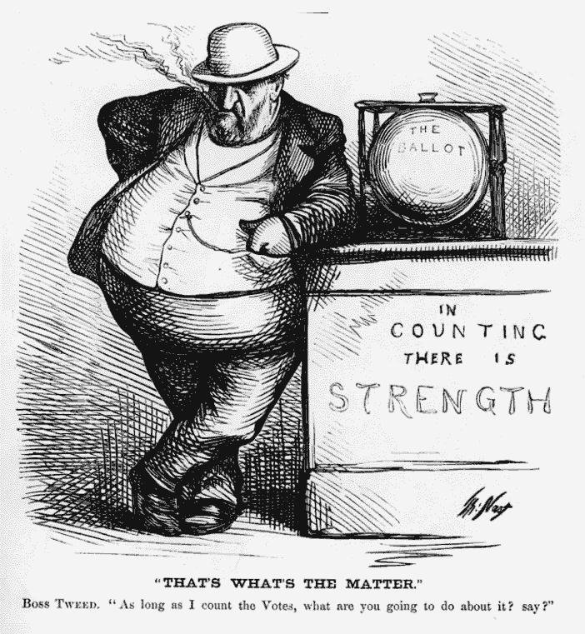
The Gilded Age: Section 3
Local and national political corruption in the 19th century led to calls for reform.
Emergence of the Political Machine
An organized group that controlled the activities of a political party in a city. Also offered services to voters and businesses in exchange to political or financial support.
City Boss
Ward Boss
Precinct Captain
Precinct Worker

Slide 13
Immigrants and the Machine
Many precinct captains and political bosses were first generation or second generation immigrants.
Once a political machine got its candidates into office it could take advantage of numerous opportunities for graft – the illegal use of political influence for personal gain.
Example- A political machine could ask the worker to bill the city for more than the actual cost of materials and labor. The worker then “kicked back” a portion of the earning to the machine.

Slide 14
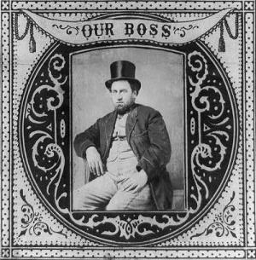
Tweed Ring Scandal
Boss Tweed and Tammany Hall – Famous political machine.
The construction of the New York County Courthouse cost taxpayers 13 million dollars while the actual construction cost was 3 million. Difference went into pockets of Tweed and others.

Slide 15
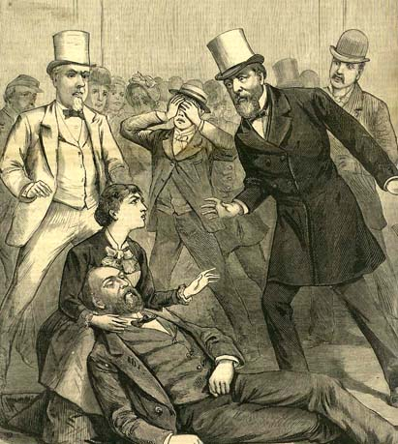
Presidents Attempt to Reform Politics
Patronage- giving of government jobs to people who had helped the candidate get elected.
Push for Civil Service – government administration should go to the most qualified persons.
President Hayes pushed for reform.
Garfield – supported Hayes reforms but was assassinated in 1881. Chester Arthur became president.
Pendleton Service Act- Bipartisan civil service commission to make appointments to federal jobs based on merit system.

Slide 16
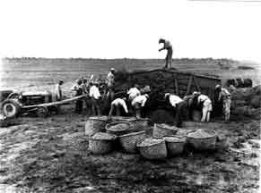
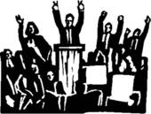
Business Buys Influence
Now that politicians could not get funding for their campaign through wealthy individuals they had to turn to big business.
Big business pushed high tariffs.
President Cleveland and Harrison later tried to cut tariffs but failed- big business was too powerful.

Slide 17
Chapter 15 Flow Map
Complete the following flow map using the chapter from your book.
Each Box needs to contain at least 6 branches.
Rise in Immigration
Urbanization
Corruption
Irish
Chinese
Angel Island

Slide 18
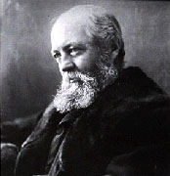
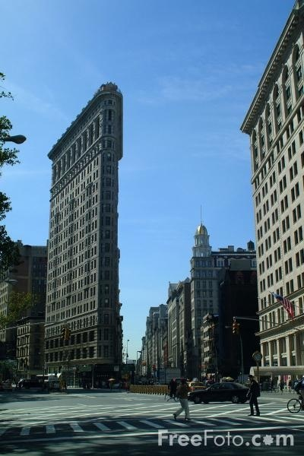
The 20th Century: Chapter 16
Technology-
Skyscrapers
Electric Transit
Urban Planning
Frederick Law Olmstead spearheaded the movement for planned urban parks. Central Park in NYC
Explosion of growth in major cities prompted architects and designers to “remake” the cities.

Slide 19
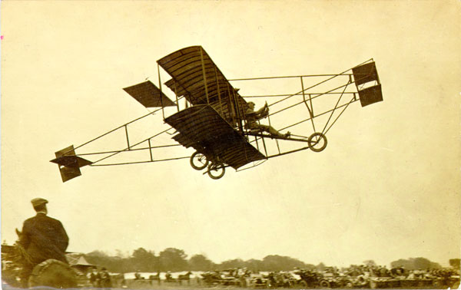
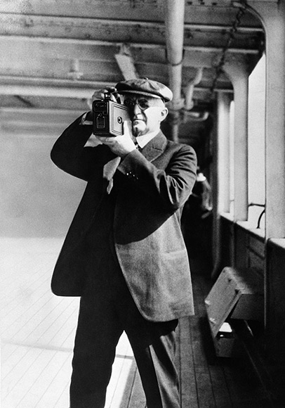
New Technologies
Printing
Cheap Paper
Airplanes
Orville and Wilbur Wright- Originally bicycle manufacturers from Dayton, Ohio.
Photography
George Eastman- Kodak Camera

Slide 20
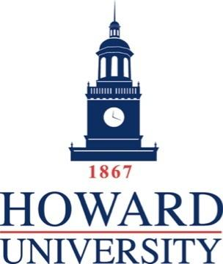
Expanding Public Education
1865- 1895 states passed laws requiring 12 -16 weeks annually of school attendance by students between the ages of 8 and 14.
“They hits ye if yer don’t learn, and they hits ye if ye whisper, and they hits ye if ye have string in yer pocket, and they hits ye if yer seat squeaks, and they hits ye if ye don’t stan’ up in time, and they hits ye if yer late, and they hits ye if ye ferget the page.”
African Americans mostly excluded from secondary education.
Higher Education
Between 1880 and 1920 College enrollments quadrupled. After the civil war with the help of the Freedmen’s bureau blacks founded Howard, Atlanta, and Fisk Universities.

Slide 21
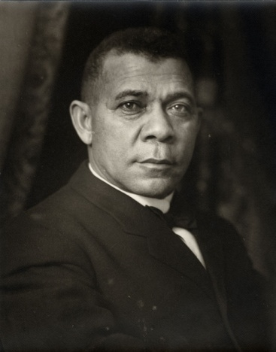
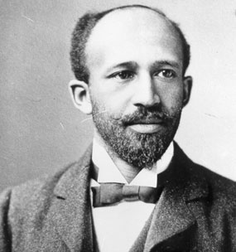
Prominent Black Educators
Booker T. Washington felt that racism would end once blacks acquired useful labor skills and proved their economic value to society.
W.E.B Du Bois- The first African American to receive a doctorate from Harvard strongly disagreed. He founded the Niagara Movement which insisted that blacks should seek liberal arts education so that the African American communities would have well-educated leaders.

Slide 22
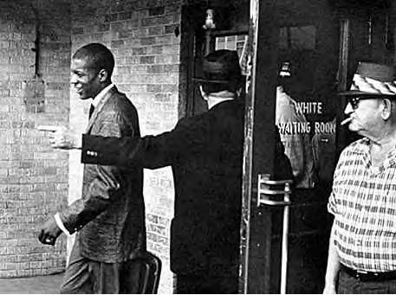
Segregation and Discrimination
African American led the fight against voting restrictions and Jim Crow laws- created to take political and economic power away from African Americans.
Poll Tax- Annual tax to be paid before you could vote.
Grandfather Clause- To reinstate white voters who may have failed the literacy test or could not pay the tax, said that a person was entitled to vote if he, his father, or his grandfather had been eligible to vote before Jan 1, 1867.
Segregation – separation of races
Jim Crow Laws- Laws that segregated blacks and whites.
Plessy v. Ferguson – Add to chart! Separation of Blacks and Whites in public facilities.

Slide 23
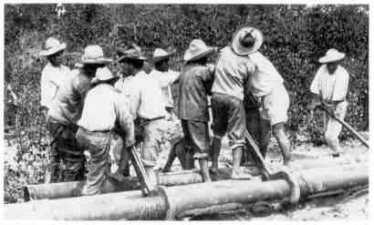
Discrimination in the West
Mexicans forced into debt peonage- a system, that bound laborers into slavery in order to work off a debt to the employer.
Chinese were forced into segregated schools.

Slide 24
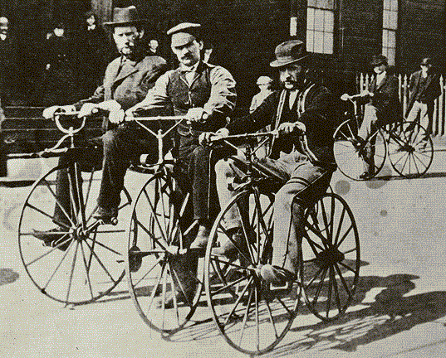
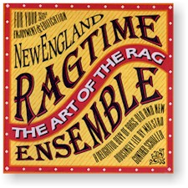
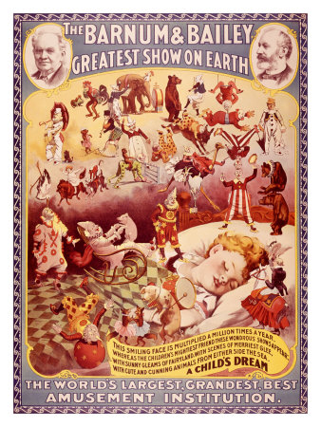
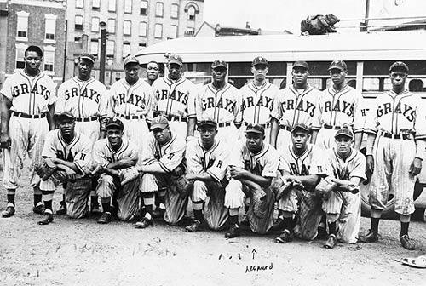
Dawn of Mass Culture

