Slide 1
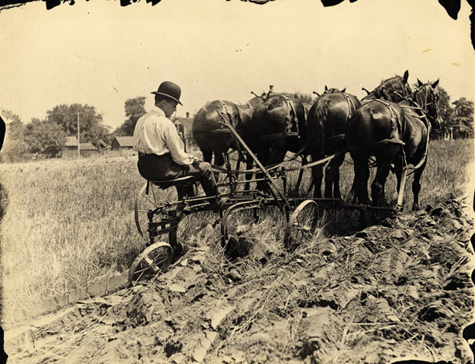
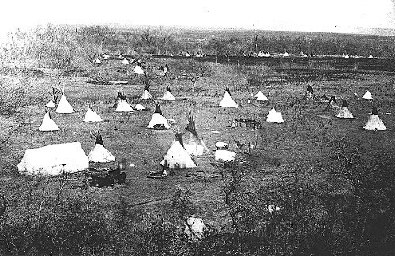
Changes on the Western Frontier
Period 6

Slide 2
Cultures Clash on the Prairie
Preview Clip: John Green Westward Expansion
Write a short journal entry (1/2 page) from the perspective of a Pioneer or a Native American using several terms from your guided reading. Use your text to help you find the definition for each term. (10 mins)
After everyone has finished, pair up with someone from the other perspective and share your journal (5 mins).

Slide 3
Battle of Little Bighorn
After the Civil War the U.S was engaged in a number of conflicts with Native Americans
Indian Wars- Primary Issue – Land
Several treaties were made however treaties were ignored or broken
Treaty of Fort Laramie- Sioux agreed to live on reservation in 1868.
Chief Sitting Bull Hunkpapa Sioux- Never signed treaty other Sioux nations did.
Gold in the Black Hills
On June 25th 1876 Civil War Veteran George Custer attacked over 2000 Sioux and Cheyenne warriors with a few hundred men; Custer and his men were overwhelmed and everyone of them was killed.

Slide 4
Battle at Wounded Knee
Helen Hunt Jackson wrote about “broken promises” in A Century of Dishonor.
Assimilation
Dawes Act of 1887: A federal law intended to turn Native Americans into farmers and landowners by providing cooperating families with 160 acres of reservation land for farming and 320 acres for grazing.
Destruction of the Buffalo
Ghost Dance Movement- Video
25,00 Sioux on reservation in South Dakota- Alarmed military leaders. Ordered arrest of Sitting Bull.
December 1890 rounded up 350 starving Sioux and took them to a camp near Wounded Knee- soldiers opened cannon fire 300 were slaughtered.
Wounded Knee

Slide 5
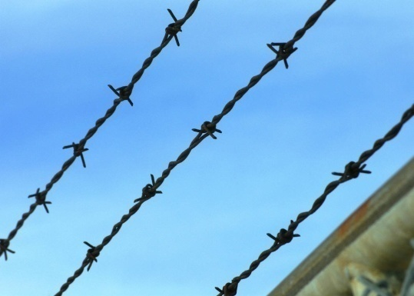
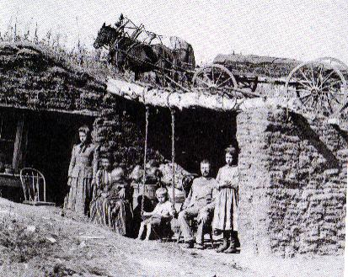
Closing of the Frontier
Cattle Herds multiplied and ranching became big business.
However, overgrazing, extended bad weather and the invention of barbed wire brought the frontier to an end.
Settlers meet challenges on the plains
Dugouts and soddies
Open range farming turns into single/multi-family farms

Slide 6
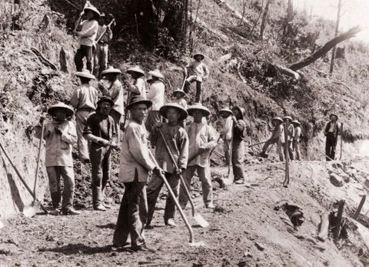
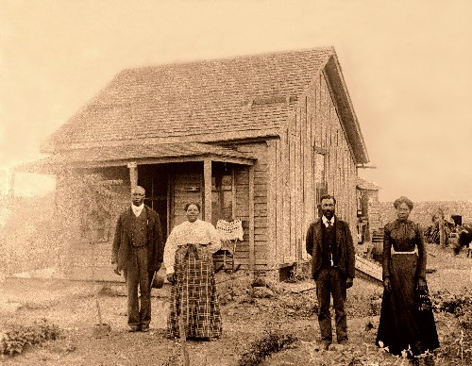
What kinds of people settled in the west?

Slide 7
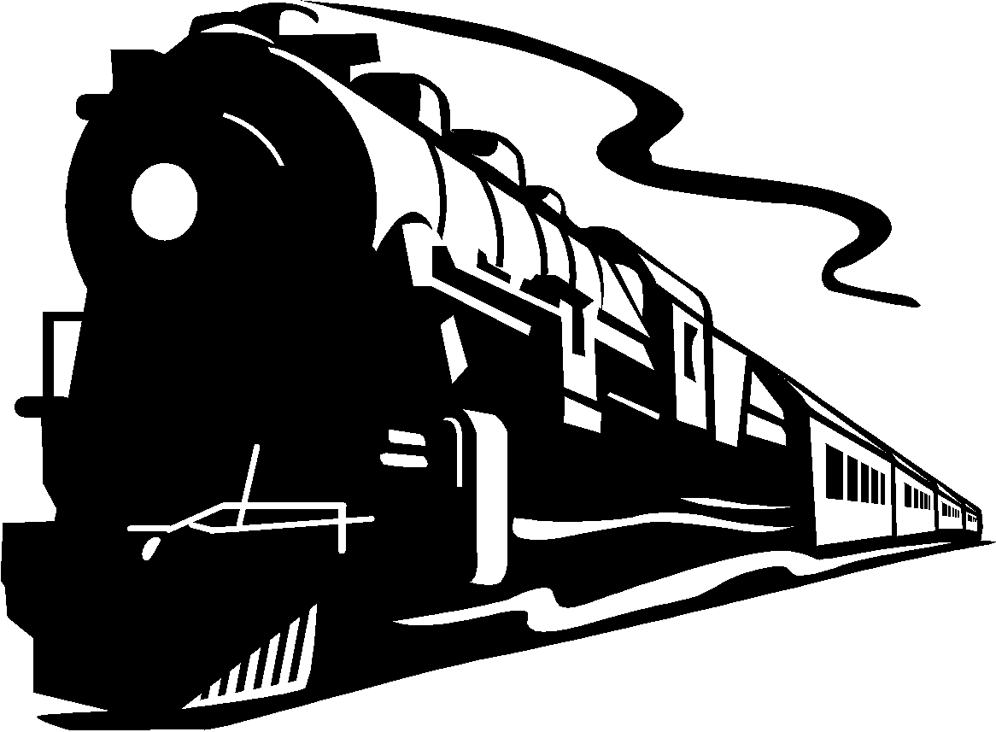
Settling on the Great Plains Section 2
Settlers Move Westward to Farm
Railroads open the west
1850-1871 Federal government made huge land grants 170 million acres.
Some railroads sold their land to farmers.
Irish Immigrants, Mexican Americans, African Americans, and Chinese Immigrants did most of the labor on the railroads.
Homestead Act
160 acres of free land to any citizen who was head of the household.
Thousands took hold of this opportunity – some called exodusters
African Americans who moved from the post reconstruction south to Kansas.
Dawes Act:
Morrill Act of 1862 and 1890
gave federal land to the states to help finance agricultural colleges. New techniques and products for farming.

Slide 8
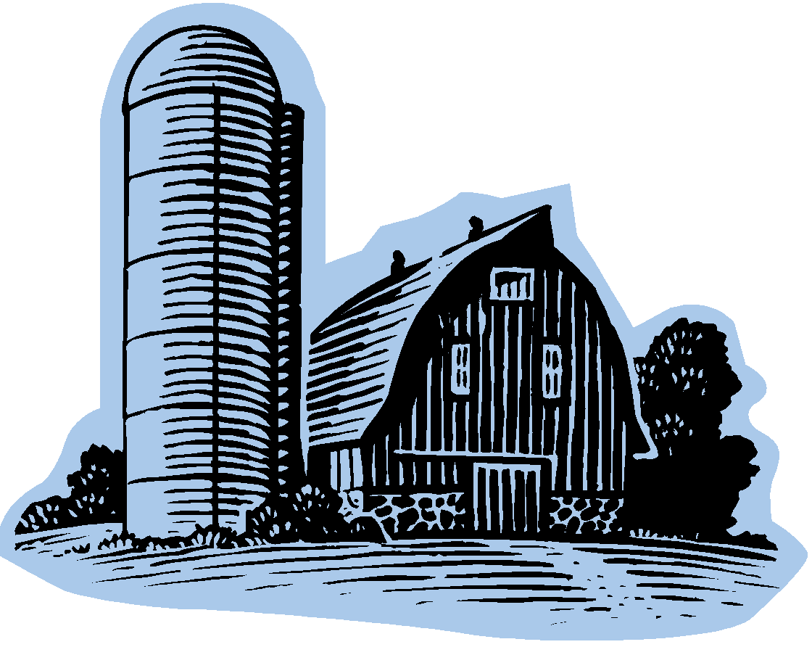
Farmers and the Populist Movement: Section 3
Farmers Unite to Address Common Problems
Elaborate Machinery Expensive –
Reaper, steel plow, windmill, barbed wire. Borrowed money to buy and had trouble paying back, therefore bonanza farming took hold.
Bonanza Farming = Big companies created single-crop spread of 15,000-50,00 acres.
Farmers trapped in economic cycle :
Crops were failing and they were in debt.
Land becoming scarce,
Railroads charging excessive shipping prices.

Slide 9
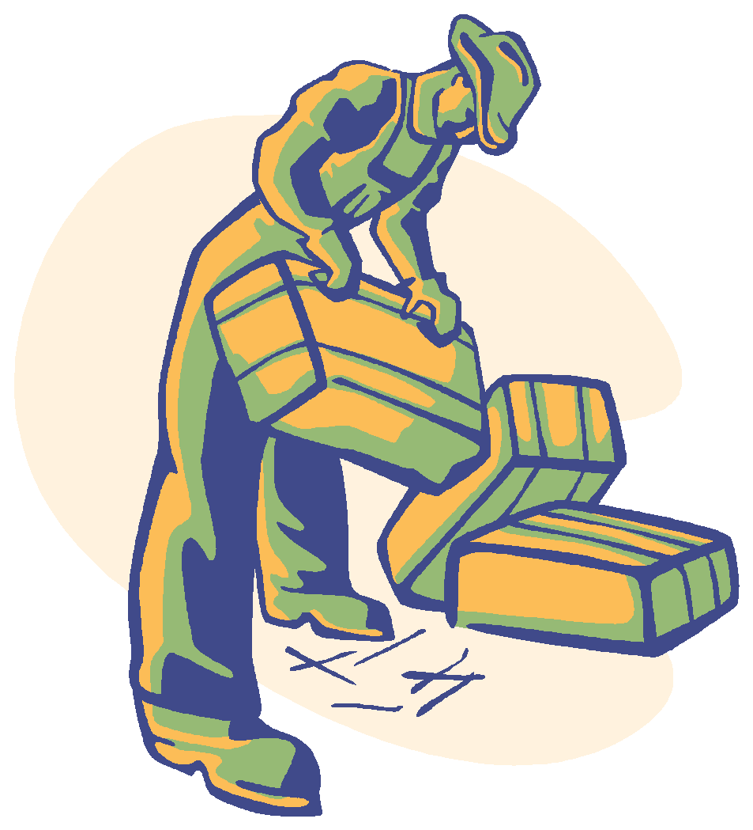
Farmers Unite
Economic Distress Cont:
Greenbacks not worth anything.
Farmers are paying high prices to transport goods by rail.
Farmers mortgage their farms for credit with which to buy seed and supplies.
Supplies charged high rates of interest. Farmers caught in cycle of debt.
Farmer’s Alliances: Oliver Hudson Kelley – Started organization for farmers that became popularly known as The Grange.
Purpose was to provide a social outlet and an educational forum for isolated farm families. Teaching members how to set up cooperatives.
Farmers Alliance: Sent lectures to educate people about money management topics.

Slide 10
Rise and Fall of Populism
Populism : The movement of the people
Demanded reform to lift the burden of debt from farmers and other workers and to give the people a greater voice in their government.
Platform:
Increase in the money supply
Graduated income tax
Federal loan program
Single terms for president
Secret ballots
Panic of 1893:
Farmers overextended with debts and loans.
Railroad companies go bankrupt, governments gold supply thin, stocks fell.
3 Million people lose jobs.

Slide 11
Silver or Gold?
Bimetallism :
A monetary system in which the government would give citizens either gold or silver in exchange for paper currency or checks.
Others favored the “gold standard”.
Bimetallism would make more currency with less value per dollar.
Bimetallists hoped this would stimulate the economy.

Slide 12
Gold Bugs and Silverites
 | Gold Bugs | Silverites
Who they were | Bankers and businessmen | Farmers and laborers
What they wanted | Gold standard- less money in circulation | Bimetallism- more money in circulation
Why | Loans would be repaid in stable money | Products would be sold at higher prices- because people have more money.
Effects | Deflation Prices decrease Value of the dollar increases Fewer people have money | Inflation Prices rises Value of money decreases More people have money

Slide 13
Bryan and the “Cross of Gold”
1896 Presidential Campaign
Republican – William McKinley (gold standard)
Democrat – William Jennings Bryan (bimetallism)-
“Cross of Gold Speech”
The speech that won William Jennings Bryan his nomination as the Democratic candidate for the presidential elections of 1896 (copies of speech)
cross of gold speech
Bryan – loses the candidacy because of the intense issue of gold or silver.
Populist party collapses

Slide 14
Hint: Turn and Talk
Why were speakers like Lease and Bryan popular in the 1890s
What images and rhetorical devices did they use to excite their audiences?
How did their audiences feel when they listened to these speeches?

Slide 15
The Rise of Populism and the Wizard of Oz…
Complete the handout in your learning teams to learn more about the allegory.
View clips from the movie and complete the allegory handout to understand the connections between the movie and The Populist Movement.

Slide 16
Flow Map for the Populist Party
Create a cause and effect flow map for the Populist Party using your Chapter 13 notes.
Cause
Populist Party
Effect

Slide 17
Third Parties Activity
Read the article detailing a third party. Create a cause and effect flow chart for your party.
Where is Mrs. Dunbar getting this information? Third Parties
Get into a group with two other members from your same political party.
Create a campaign poster that includes”
History of Party
Slogan: Make Your Own!
Platform
Names of well known members of your party.
Place poster on wall for a gallery walk
Take notes during your gallery walk and choose the best party!
Sit down and complete exit slip.
Award goes to the party with the most votes!

