Slide 1
Limits of a Superpower
United States Policy, Economy,
and Culture during the 1970’s
Notes:
Disco Stu (animated): http://bunkerpop.mx/bunker-cine/apoco-no-quieren-unos-zapatos-con-pescadito-como-los-de-disco-stu/

Slide 2
Essential Questions
Analyze the continuities and changes that occurred in U.S foreign policy during the the 1970’s. To what extent did policy change, to what extent did it stay the same?
Analyze the effectiveness of social movements in addressing major problems and inequalities, and assess the ability of these movements to affect political change during the 1970’s.

Slide 3
Richard M. Nixon
Background:
Yorba Linda, CA
Quaker
Whittier → Duke
Navy, World War II
Congressman & Senator
Vice President
The “Imperial Presidency”
Notes:
Cartoon: http://www.greenberg-art.com/.Toons/.Toons,%20Obits/NixonObit.html

Slide 4
Foreign Policy
Vietnamization and Détente

Slide 5
Vietnam
“Peace with Honor”
Reduce involvement
“Vietnamization”
Withdrawal:
540,000 (1969) → 30,000 (1972)
Nixon Doctrine
Support in Asia, without troops
Notes:
Image: http://dkobner.blogspot.com/2011/12/two-policies-in-vietnam-americanization.html

Slide 6
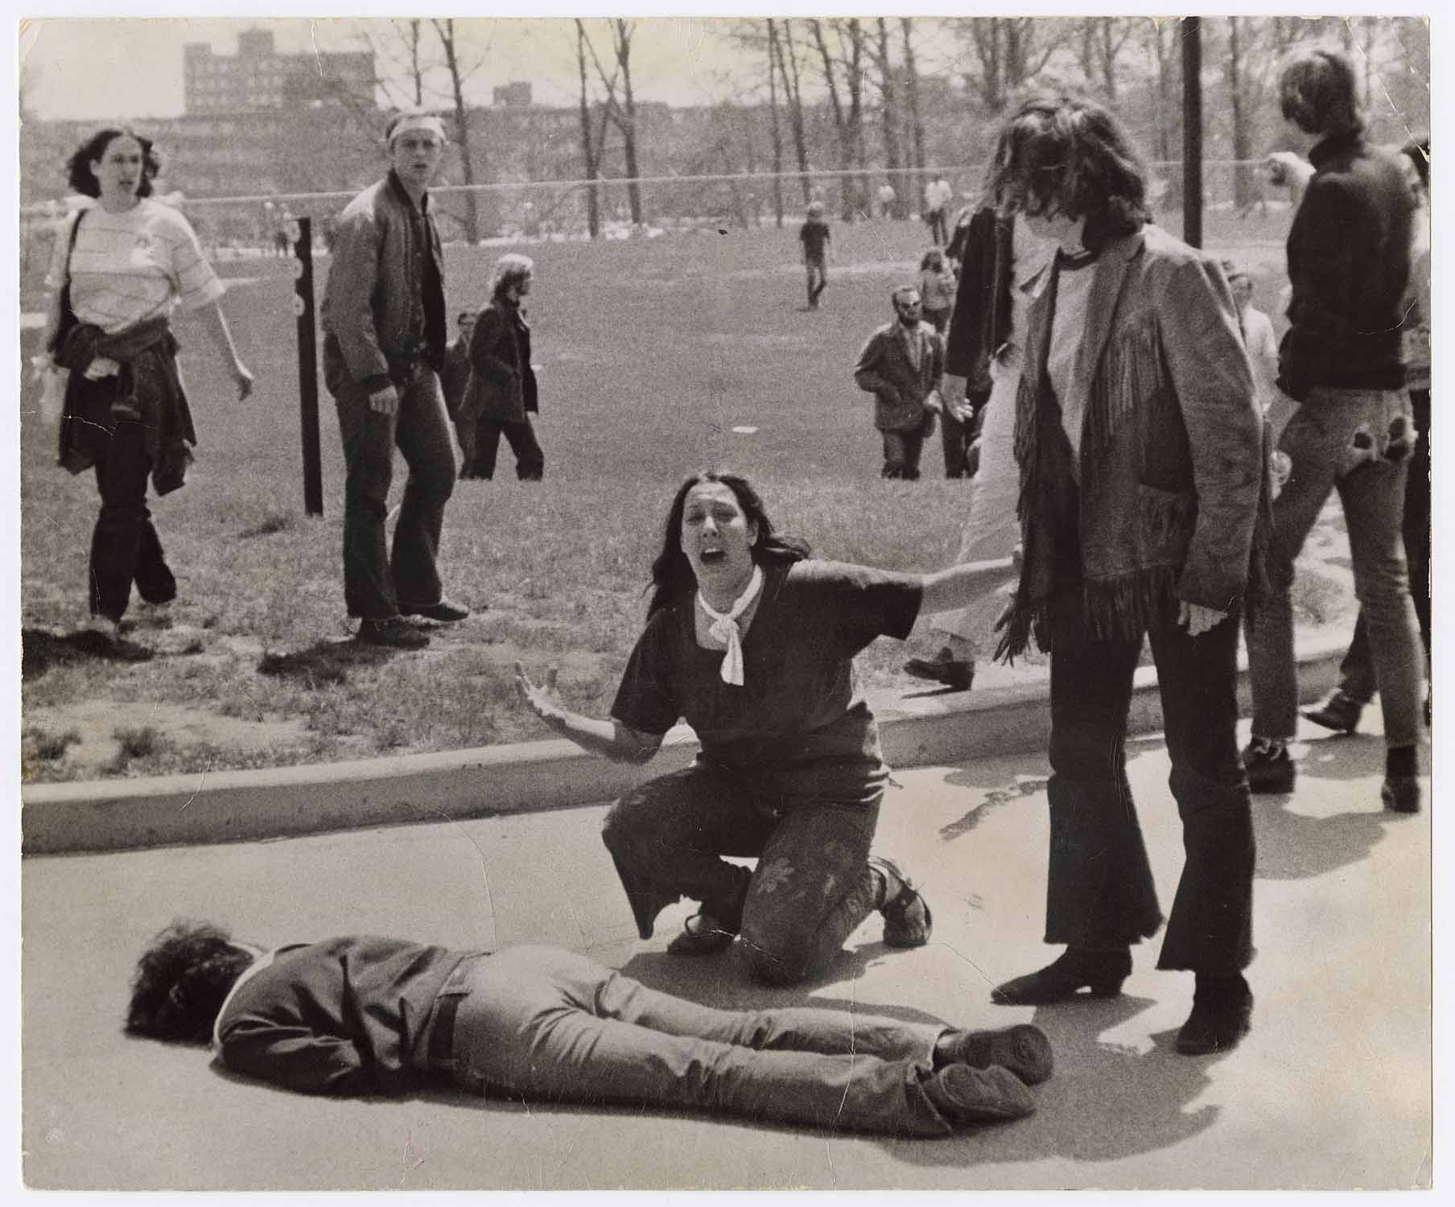
Opposition to Nixon’s War Policies
Laotian and Cambodian Campaigns
Kent State Massacre (1970)
Public Revelations:
My Lai Massacre (1968)
Pentagon Papers (Ellsberg, 1971)
NY Times v. United States
Notes:
Cartoon: http://voiceseducation.org/node/345

Slide 7
Ending the Conflict
Kissinger: “Peace is at hand”
Bombing of North Vietnam (1972)
Paris Accords (1973)
Armistice
Withdrawal
Return of POW’s
Results:
58,000 deaths
$118 Billion
Inflation
Notes:
Kissinger Cartoon: http://thecomicnews.com/edtoons/archive/2006/1122/kissinger/01.shtml

Slide 8
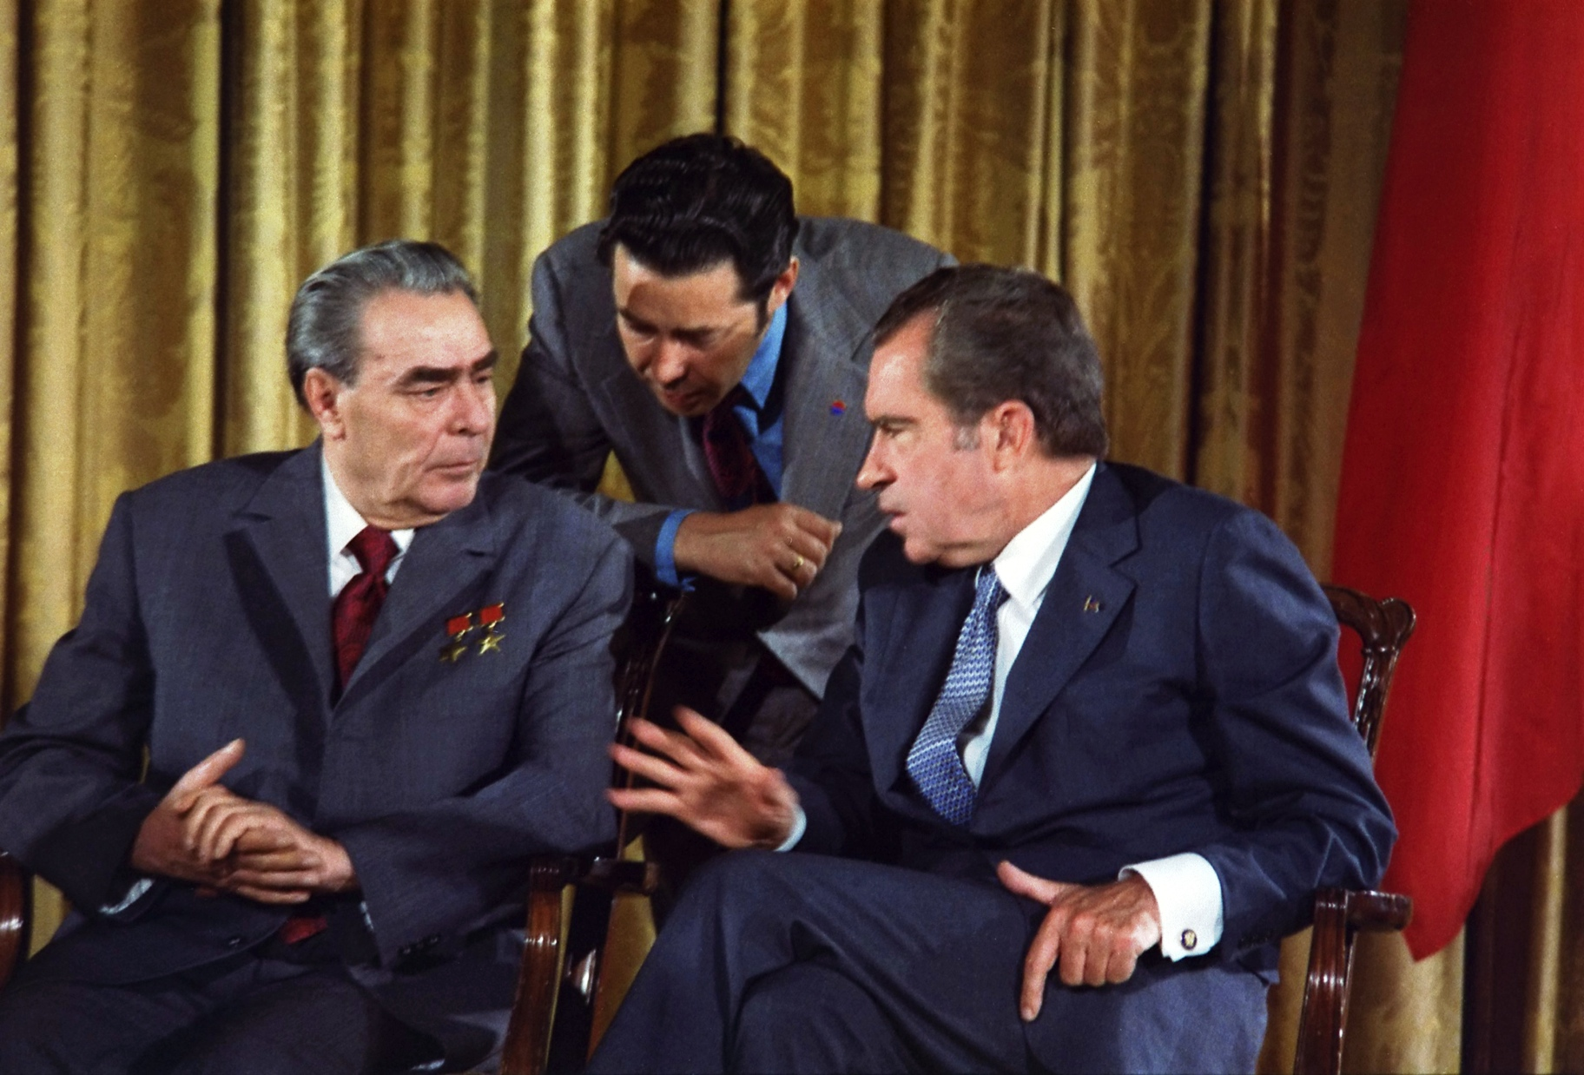
Détente with China and the Soviet Union
Visit to China
Travel ban lifted
“Ping-pong” diplomacy
Nixon meets w/Zhou Enlai & Mao Zedong (1972)
Arms Control with the Soviet Union
SALT I (1969-1972)
Visits U.S.S.R. (1972)
ABM Treaty
Arms limitations
Notes:
Ping-Pong Diplomacy: http://www.tabletenniscoaching.com/taxonomy/term/91
Breznev’s Visit to Washington, 1973: http://en.wikipedia.org/wiki/D%C3%A9tente

Slide 9
Domestic Policy
Nixon and the Rise of Conservatism

Slide 10
The New Federalism
Goal: shift responsibility of welfare back to the states
Manifestations:
Family Assistance Plan
Reduce welfare → defeated by Congress
Revenue sharing & Block grants
$30 billion to states
Impoundment of Funds
Notes:
Cartoon: http://www.loc.gov/rr/print/swann/valtman/presentation.html

Slide 11
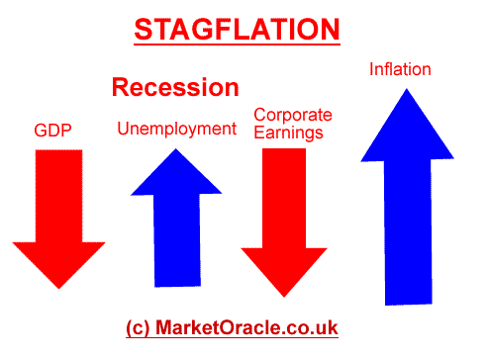
Nixon’s Economic Policies
Stagflation
Stagnation + inflation
Attempts to cut spending
90 day wage and price freeze (1971)
Removed gold standard
Improved balance of trade
Recession Ends (1972)
Increases Social Security w/COLA
Congress adds Title IX(CRA-64)
Includes sex discrimination (schools)
Notes:
Stagflation: http://www.darkgovernment.com/news/stagflation/
http://www.321gold.com/editorials/schoon/schoon092012.html

Slide 12
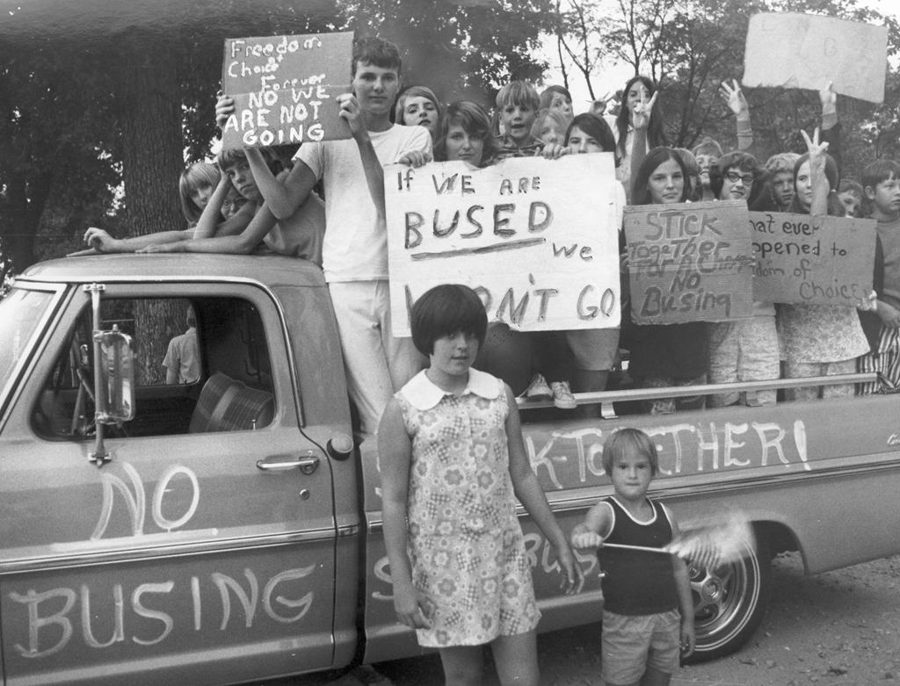
Conservatism
A New Coalition
The “Silent Majority”
Appeal to disaffected, conservative democrats
The “Southern Strategy”
Slow down desegregation
Appeal to Southern Democrats
Swann v. Charlotte-Mecklenburg (1971)
The Burger Court
Roe v. Wade (1973)
U.S. v. Nixon (1974)
Notes:
Image 1, school busing: http://www.delawareonline.com/picture-gallery/news/education/2014/05/16/looking-back-busing-in-wilmington/9201879/
Image 2, protest: http://www.vahistorical.org/collections-and-resources/virginia-history-explorer/civil-rights-movement-virginia/school-busing

Slide 13
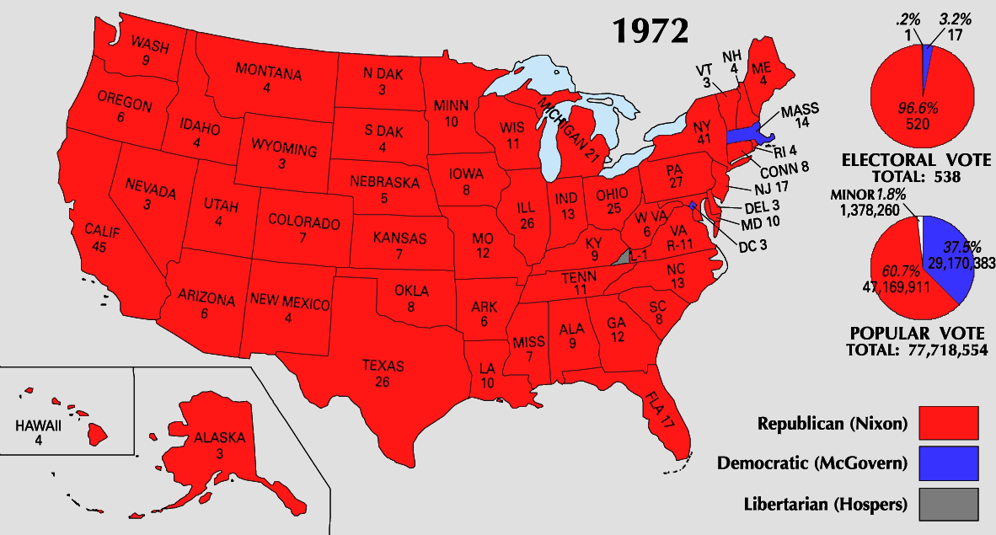
The Election of 1972
Republican Advantages
Foreign policy success
Removal of George Wallace
Democratic nominee
Democrats
Indecision, mismanagement
McGovern = very liberal, antiwar, antiestablishment
Results:
Nixon Landslide: 61% popular = carried every state except MA
Political realignment: Sunbelt and suburbs
Notes:
Life Magazine Cover: https://lostlaurel.wordpress.com/2012/05/15/laurel-shopping-center-george-wallace-40-years-later/
Electoral Map: http://hermelink-nixon.blogspot.com/2010/04/election-of-1972-second-term.html

Slide 14
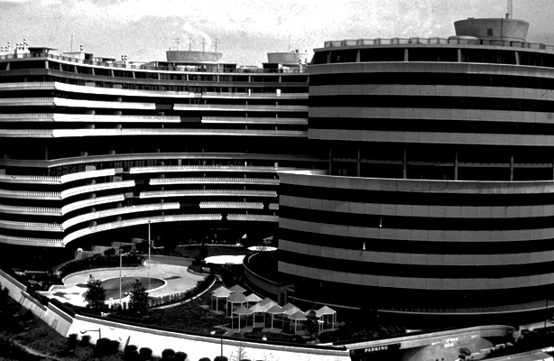
Watergate
The Scandal that Changed the Presidency and the Role of Media
Notes:
Watergate: http://www.esquire.com/blogs/politics/watergate-40-years-later-9747335

Slide 15
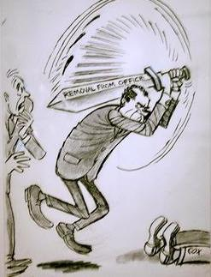
White House Abuses
The Break-in (June, 1972)
CREEP
Nixon’s “Dirty Tricks”
Wiretaps
“Plumbers”
“Enemies List”
All the President’s Men
Haldeman, Ehrlichman, and Dean
Washington Post
Woodward & Bernstein
Other Scandals
ITT Case – Agnew’s Resignation
Replaced by Gerald Ford
“Saturday Night Massacre” (Oct. 1973)
Two AG’s resign, Solicitor General (Bork) fires Cox
Notes:
Liddy Cartoon: http://www.dailykos.com/story/2013/05/10/1207661/-U-S-since-1865-Watergate-in-Cartoons-Herblock-s
Saturday Night Massacre: http://www.statecollege.com/news/columns/to-herblock-and-to-spring-flowers-postcard-from-washington,682171/

Slide 16
Other Developments - 1973
War Powers Act
Retaliation for Cambodian bombing
President must report to Congress any troop commitments within 48 hours
60 day limit to commitment w/out Congressional consent
Has largely been ignored by every subsequent president
October War and Oil Embargo
Yom Kippur War
U.S. sends $2 billion in arms to Israel
OPEC retaliates → embargo
Results:
Oil shortage, inflation, introduction of Japanese cars, collapse of auto industry, national speed limit (55 mph)

Slide 17
Resignation of the President
Impeachment Proceedings (1974)
The Tapes:
Transcripts (redacted) released
U.S. v. Nixon (July)
The “smoking gun”
Articles of Impeachment:
Obstruction of justice
Abuse of power
Contempt of Congress
Nixon Resigns (August 9, 1974)
Pardoned by Ford

Slide 18
The Ford Interlude
The Administration of the First Non-elected President (1974-1977)

Slide 19
The Ford Administration
Investigating the CIA
Attempting to expose assassination plots
Salvador Allende (Chile)
Ford appoints George H.W. Bush to head CIA
Southeast Asia Policy
Fall of Saigon (April, 1975)
Genocide in Cambodia
Economic growth of the rest of SE Asia
Notes:
Fall of Saigon: http://www.thedailybeast.com/articles/2014/04/30/remembering-the-fall-of-saigon-and-vietnam-s-mass-boat-people-exodus.html

Slide 20
Ford Administration (con.)
Domestic & Economic Policy
The “WIN” Campaign
The Veto (39)
The Bicentennial (1976)
Foreign Policy
Vietnam
Helsinki Accords (1975)
Notes:
Cartoon: http://www.huffakerart.com/illustration/big/Gerald%20Ford.html

Slide 21
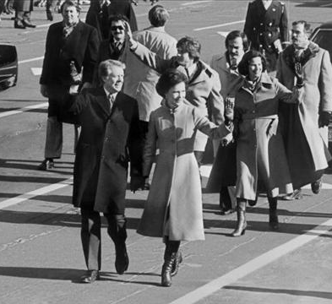
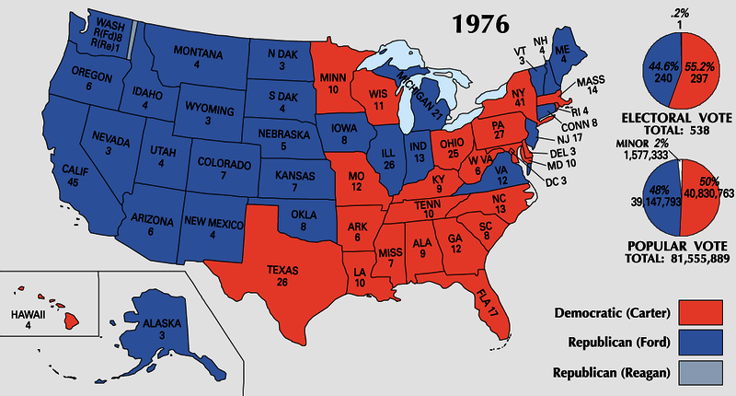
The Election of 1976
Ford vs. Carter
Low Turnout (53%)
Desire to move away from “politics as usual.”
Electoral: 240 to 297
Notes:
Ford Pin: http://www.vahistorical.org/sites/default/files/uploads/VHE_Campaigns_IL.2012.2.43.4.jpg
Map: http://i0.wp.com/www.philipcaruso-story.com/wp-content/uploads/2015/04/Election-of-1976.png
Carter’s “Presidential Strut”: http://archive.13wmaz.com/news/article/212316/318/Presidential-Strut-is-Now-Iconic-Inaugural-Moment

Slide 22
The Carter Administration
America at the End of the 1970’s

Slide 23
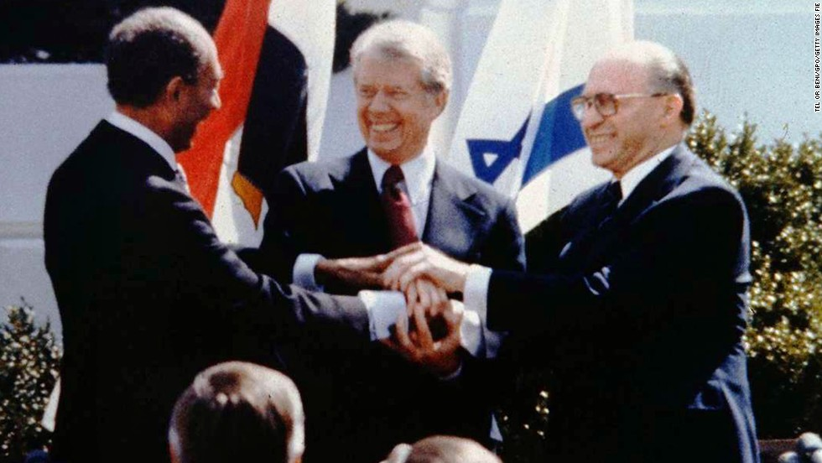
Foreign Policy & Human Rights
Human Rights
Guided policies w/South Africa and Latin America
Panama Canal
Nationalization by 2000
Camp David Accords (1978)
Begin (Israel) & Sadat (Egypt)
Egypt first Arab nation to recognize Israel
Notes:
Camp David Accords Image & Facts: http://www.cnn.com/2013/08/23/world/meast/camp-david-accords-fast-facts/
Cartoon: http://www.greenberg-art.com/.Toons/.Toons,%20political/CampDavid.html

Slide 24
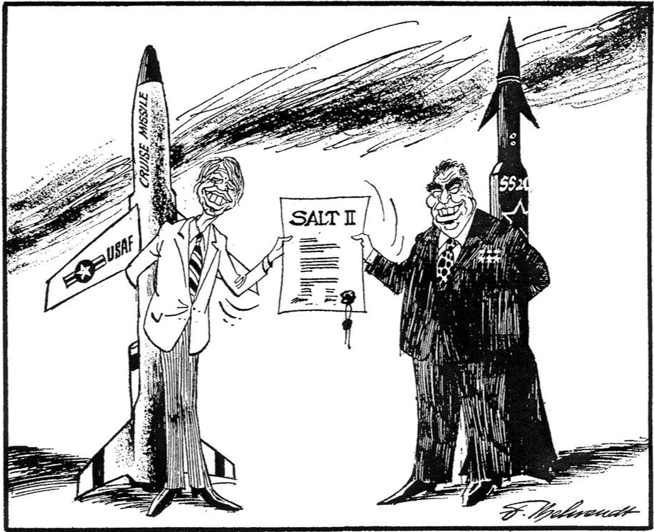
Foreign Policy Limitations
Iran Hostage Crisis (1979)
Rise of the Ayatollah Khomeini
2nd Oil Shortage
Seizure of Embassy in Teheran (Nov. 4, 1979)
Operation Eagle Claw (April, 1980)
Hostages not freed until January 20, 1981
Cold War
Continuance of Détente
Recognizes PRC (1979)
SALT II (1979)
Soviet-Afghan War (December, 1979)
US embargo on exports
Boycott 1980 Olympic games
Notes:
Image and Review of Argo: http://www.ctvnews.ca/w5/argo-iran-hostage-crisis-film-fiddles-with-the-facts-1.1167994
Cartoon: http://www.cvce.eu/en/obj/cartoon_by_behrendt_on_the_salt_ii_disarmament_agreement_4_may_1979-en-09e3b4d4-0b02-4b54-8ab6-afc0ef4c9246.html

Slide 25
Domestic Policy
Dealing with Inflation
13%
Volcker (Fed) pushed interest rates to 20%
Impact on the auto industry
Federal deficit to $60 billion (1980)
Loss of Popularity
“Malaise” Speech
Approval: 23%
Notes:
Image: http://topics.time.com/economy/covers/

Slide 26
American Society in Transition
Rise of the Sunbelt & Senior Citizens
Changing Demographics
Increase in minorities and cultural pluralism
Growth of Immigration
Largest segments: Latin America & Asia
Undocumented Immigrants
Est. 12 million by mid-70’s
Notes:
Map & Historical Population Analysis: http://2012books.lardbucket.org/books/regional-geography-of-the-world-globalization-people-and-places/s07-north-america.html

Slide 27
Demands for Minority Rights: Latinos
Hispanic Americans
Cesar Chavez, the UFW, and the Delano Boycott & March (1966)
Collective bargaining for farm workers (1975)
MALDEF (1968)
Educational Reforms
Bilingual schools
Notes:
Image and Chavez Bio: http://www.biography.com/news/cesar-chavez-biography-facts
UFW website on the Delano March: http://www.ufw.org/_board.php?mode=view&b_code=60_video&b_no=16344&page=1&field=&key=&n=1

Slide 28
Demands for Minority Rights: Native Americans
American Indian Movement (AIM-1968)
Occupation Movement
Wounded Knee & Alcatraz
Indian Self-Determination Act of 1975
Tribally Controlled Community College Assistance Act of 1978
Notes:
Occupation of Alcatraz: http://jewishcurrents.org/tag/american-indian-movement

Slide 29
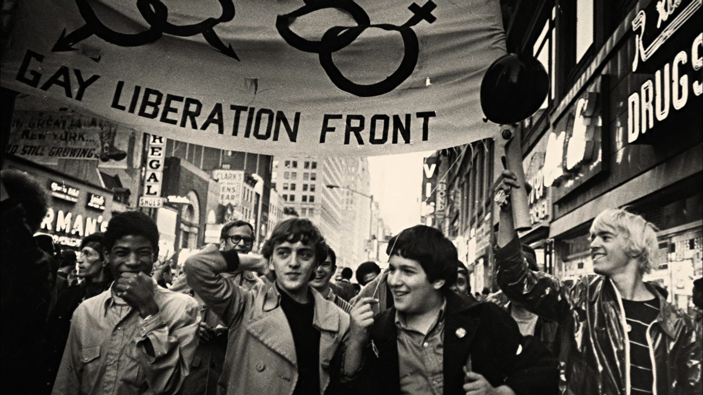
Demands for Minority Rights (con.)
Asian Americans
Fastest growing ethnic minority
Emphasis on education
Discrimination
JACL (1929)
Gay Liberation Movement
Stonewall Riot (1969)
Milk-Moscone Murders and the “White Night” Riots in SF 1978-79)
“Don’t Ask, Don’t Tell” (1993)
Movement for LGBT Rights
Notes:
JACL Parade: http://content.cdlib.org/ark:/13030/ft2d5nb0c3/
Legacy of the Stonewall Riots (PBS Video): http://video.pbs.org/video/2365073798/

Slide 30
The Environmental Movement
Increased Awareness
Rachel Carson’s Silent Spring (1962)
Earth Day (1970)
Major Oil Spills
Santa Barbara (1969)
Exxon Valdez (1989)
Nuclear Disasters
Three Mile Island (1979)
Chernobyl (1986)
Pollution and Dumping
Love Canal (NY)
Notes:
Three Mile Island Protest: http://mashable.com/2014/07/15/nuclear-disasters-before-after/#NSRpiN99_5qW

Slide 31
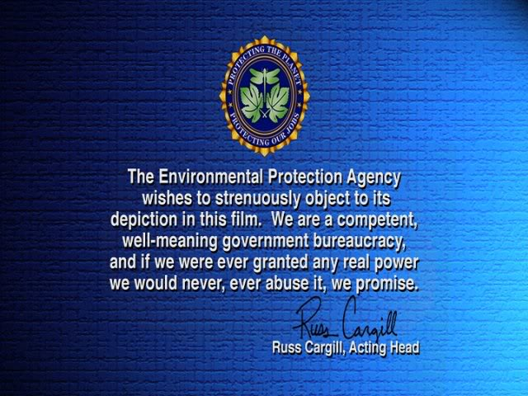
Protective Legislation
Environment:
Clean Air Act & the EPA (1970)
Clean Water Act (1972)
Endangered Species Act (1973)
Consumer Protection
Ralph Nader’s Unsafe at Any Speed (1965)
Automobile regulations: seat belts, weight distribution, and design
Freedom of Information Act (1967)
OSHA (1971)
Consumer Products Safety Act (1972)
Notes:
Simpsons’ Movie Intro Image: http://s177.photobucket.com/user/diskoboy1974/media/cap008.jpg.html
Cartoon: http://archive.floridatoday.com/content/blogs/jparker/2009/12/1211-cartoon-cry-us-river.shtml

Slide 32
Conservative Backlash
Conservative Reaction to “liberal” policies
Causes:
Rise of Religious Right
Response to SCOTUS decisions
Reaction to New Deal and Great Society Programs
Notes:
Synthesis to Trump campaign: http://www.businessinsider.com/donald-trump-trademarked-make-america-great-again-2015-5

