Slide 1
1
From Human History to the Early Civilizations
Notes:
‹#›

Slide 2
Human Life in the Era of Hunters and Gatherers
Human Life in the Era of Hunters and Gatherers
The Neolithic Revolution
Civilization
The Heritage of the River Valley Civilizations
Notes:
‹#›

Slide 3
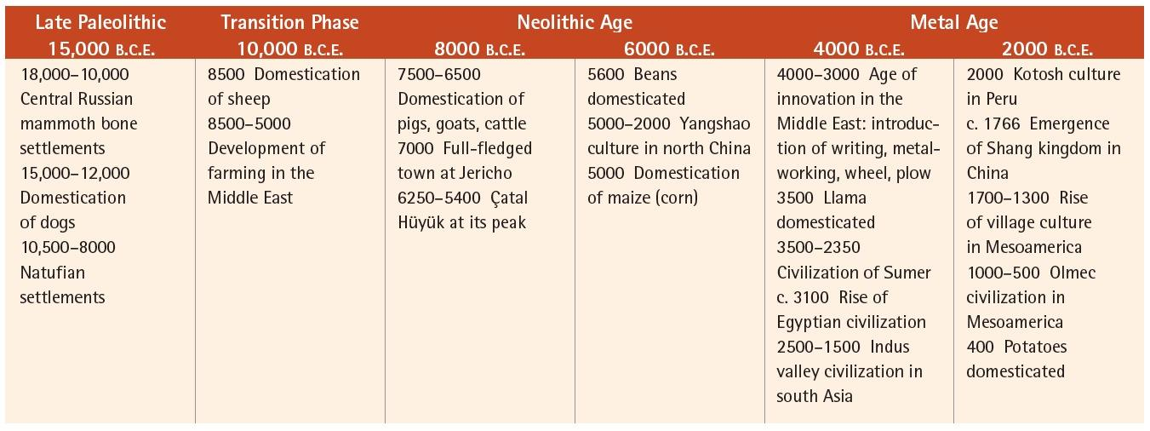
Human Life in the Era of Hunters and Gatherers
Notes:
‹#›

Slide 4
Human Life in the Era of Hunters and Gatherers
Homo sapiens by 10,000 B.C.E.
Larger brain
Tools, weapons
Notes:
‹#›

Slide 5
Human Life in the Era of Hunters and Gatherers
Paleolithic Culture
Developments by 12,000 B.C.E.
Hunting-gathering
Art
Spread to Europe, Asia, Australia, and the Americas
Notes:
‹#›

Slide 6
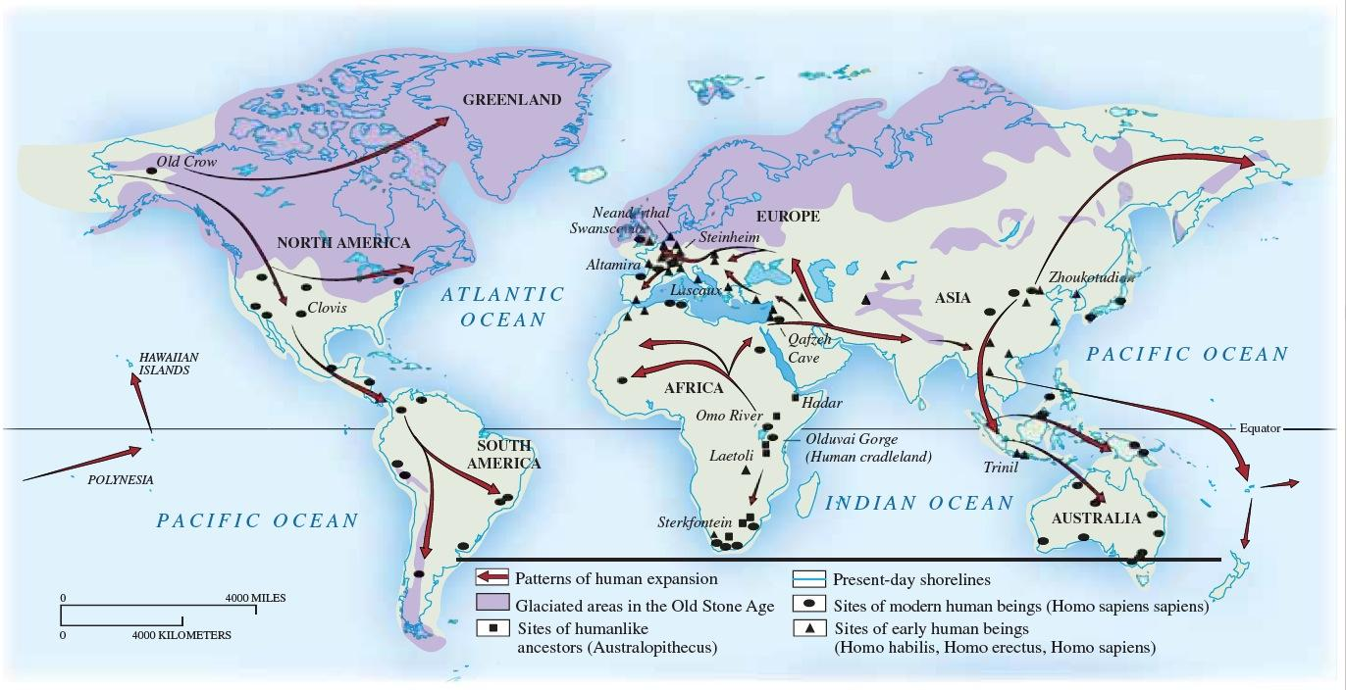
The Spread of Human Populations, c. 10,000 B.C.E.
Notes:
‹#›

Slide 7
Human Life in the Era of Hunters and Gatherers
Human Society and Daily Life at the End of the Paleolithic Age
Variety
Bands of hunter-gatherers
Agricultural settlements
Gender division of labor
Men: hunting, fishing, defense
Women: gathering, making medicine
Notes:
‹#›

Slide 8
Human Life in the Era of Hunters and Gatherers
Settling Down: Dead Ends and Transitions
Central Russia
c. 18,000 to 10,000 B.C.E.
Hunting mammoths, gathering wild plants
Trading
Social stratification
Eventually disappeared
Notes:
‹#›

Slide 9
Human Life in the Era of Hunters and Gatherers
Natufian Complex
Jordan River Valley, 10,500 to 8000 B.C.E.
Barley, wheat
Hunting-gathering
More densely populated
Building
Society: stratified, matrilineal, and matrilocal
Abandoned after 9000 B.C.E.
Notes:
‹#›

Slide 10
The Neolithic Revolution – 8000 to 3500 B.C.E.
Sedentary agriculture
Plants and Animals domesticated
Development of towns
Causes?
Climatic shifts
Notes:
‹#›

Slide 11
The Neolithic Revolution – 8000 to 3500 B.C.E.
The Domestication of Plants and Animals
Plants
Slow development
Animals from 12,000 B.C.E.:
dogs, sheep, goats, pigs
Notes:
‹#›

Slide 12
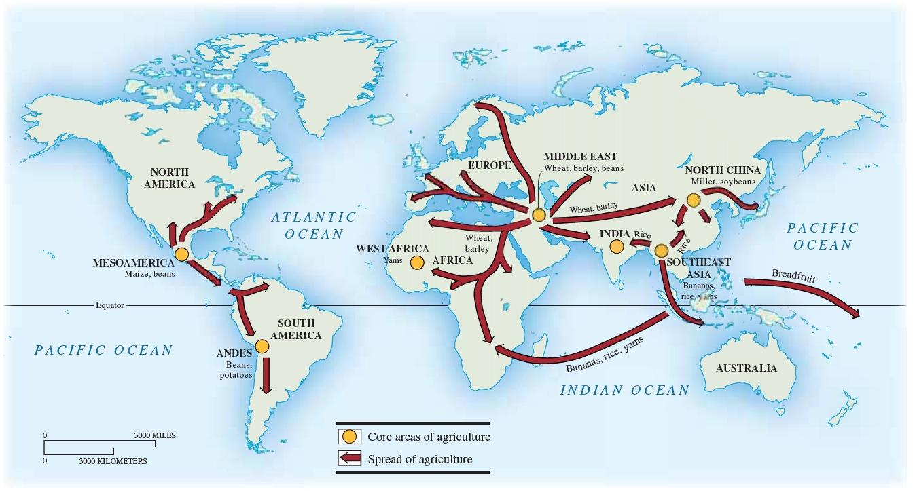
The Spread of Agriculture
Notes:
‹#›

Slide 13
The Neolithic Revolution – 8000 to 3500 B.C.E.
The Spread of the Neolithic Revolution
Hunting-and-gathering persists
Pastoralism
Sub-Saharan Africa
Root and tree crops
Notes:
‹#›

Slide 14
The Neolithic Revolution – 8000 to 3500 B.C.E.
The Spread of the Neolithic Revolution
Northern China
Millet
Rice
Southeast Asia, to China, India, islands
Mesoamerica, Peru
Maize, manioc, sweet potatoes
Notes:
‹#›

Slide 15
The Neolithic Revolution – 8000 to 3500 B.C.E.
The Transformation of Material Life
Population
Preneolithic: 5-8 million
By 4000 B.C.E., 60 or 70 million
Notes:
‹#›

Slide 16
The Neolithic Revolution – 8000 to 3500 B.C.E.
Social Differentiation
Specialized occupations
Regional exchange of goods
Communal ownership
Women lose political and economic roles
Notes:
‹#›

Slide 17
Early Neolithic Civilization
Settled Societies
Advantages
Irrigation, houses
Organization of labor
Notes:
‹#›

Slide 18
Early Neolithic Civilization
Çatal Hüyük
c. 7000 B.C.E., southern Turkey
Large complex
Agriculture, commerce
Shrines
Notes:
‹#›

Slide 19
Civilization
Defining Civilization
From Latin cives, city
Writing – earliest was cuneiform
Division of labor
Nomadism
No sharp division between settled and nomadic peoples
Environmental impact greater with civilizations
Notes:
‹#›

Slide 20
Four Major Civilizations
Mesopotamia
Sumerian
Babylonia
Phoenicians
Hebrews
Africa
Egypt
Kush
Nubia
Axum
Indus Valley Civilizations
China

Slide 21
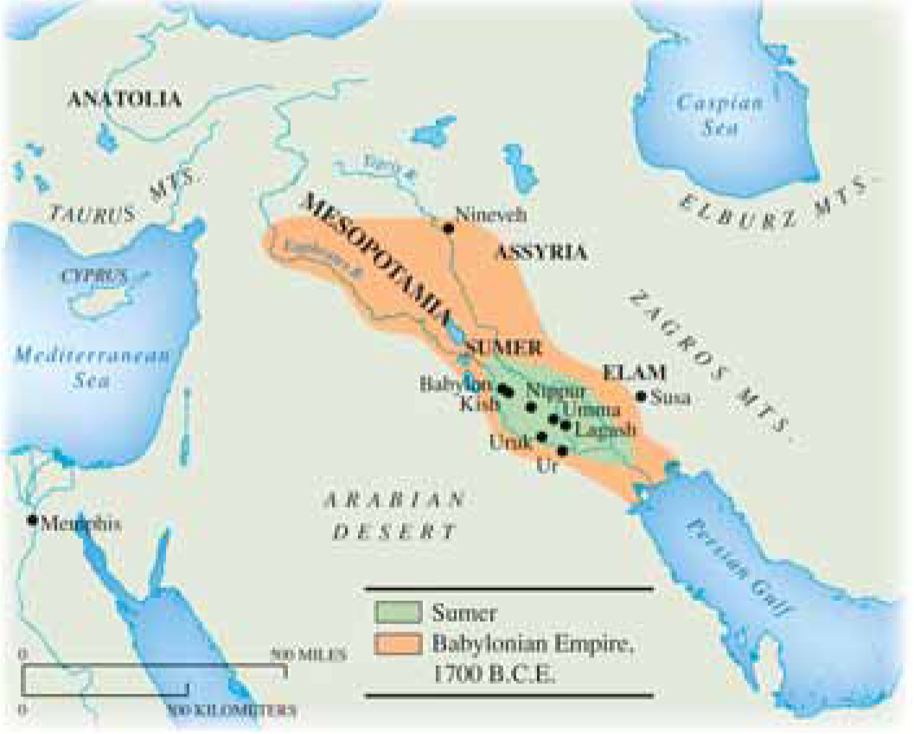
Ancient Civilizations
Notes:
‹#›

Slide 22
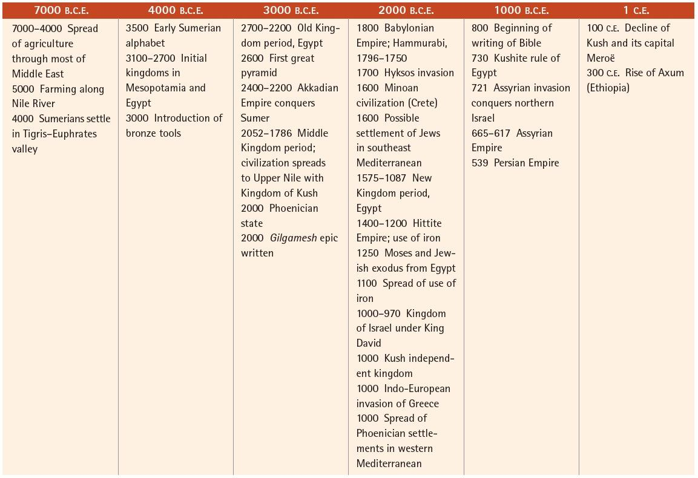
Notes:
‹#›

Slide 23
Ancient Civilization
Sumeria
Tigris and Euphrates plain
Irrigation > food surplusTigris and Euphrates plain
Sumerians in c. 4000 B.C.E.
Development of Number System-Based on 60
Notes:
‹#›

Slide 24
Ancient Civilization
Sumeria: Political and Social Organization
City-States-
Establish boundaries
State religion
Courts
Uruk- By 2700 B.C.E had a population of 50,000
Kings
Defense, war
Priests
With kings, administer state land and slaves
Notes:
‹#›

Slide 25
Ancient Civilization
Sumerian: Economy and Social Structure
Division of Labor-
Pottery, wove cloth, bronze utensils
Traded in beads, wood, resin, obsidian, lapis lazuli
7 Person Canoes
Social Structure
40% of the people living in Sumerian Societies may have been slaves
Women
Could own property and have separate incomes

Slide 26
Ancient Civilization
Sumeria: Culture and Religion
Writing
Cuneiform: stylus on clay tablets
Phonetic
Scribes
Gilgamesh- Perhaps oldest written story on earth
Astronomy, numeric system
Religion
Patron gods
Fell to invaders around 200 B.C.E- development of compound or composite bow
Notes:
‹#›

Slide 27
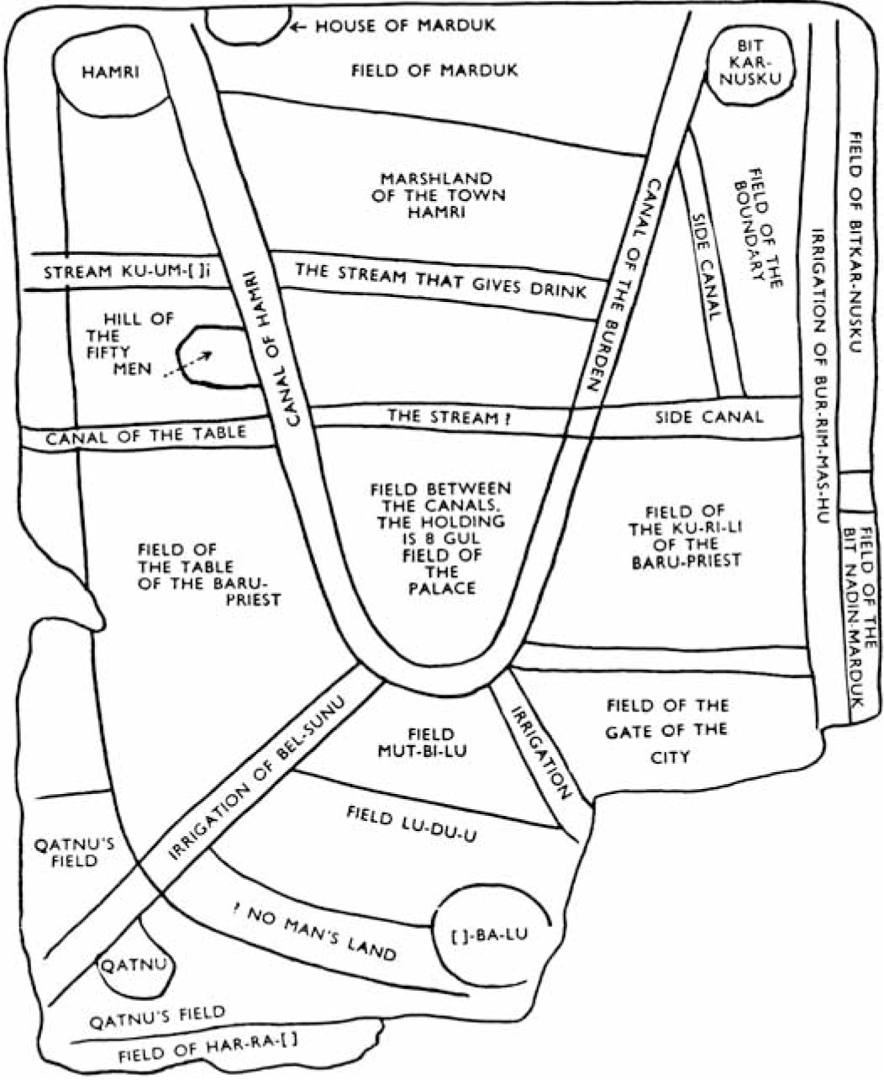
A Translation of an Early Map
Notes:
‹#›

Slide 28
Ancient Civilization
The Akkadian Empire
Sargon I
c. 2400 B.C.E.
To Egypt and Ethiopia
The Babylonian Empire
c. 1800B.C.E., unites under Hammurabi (40 years)
Abolished local governments, reorganized tax structure
Law Code- 282 Laws carved into Stone- Brought Stability and Justice
Notes:
‹#›

Slide 29
Ancient Civilization
Babylonian Society and Culture
Resembled Sumer Society
Patriarchal Society
Babylonian women- could be merchants, traders, and scribes. Marriages arranged by parents, could leave husband
Scientific Achievements
Astronomers- lunar calendar
Astrology

Slide 30
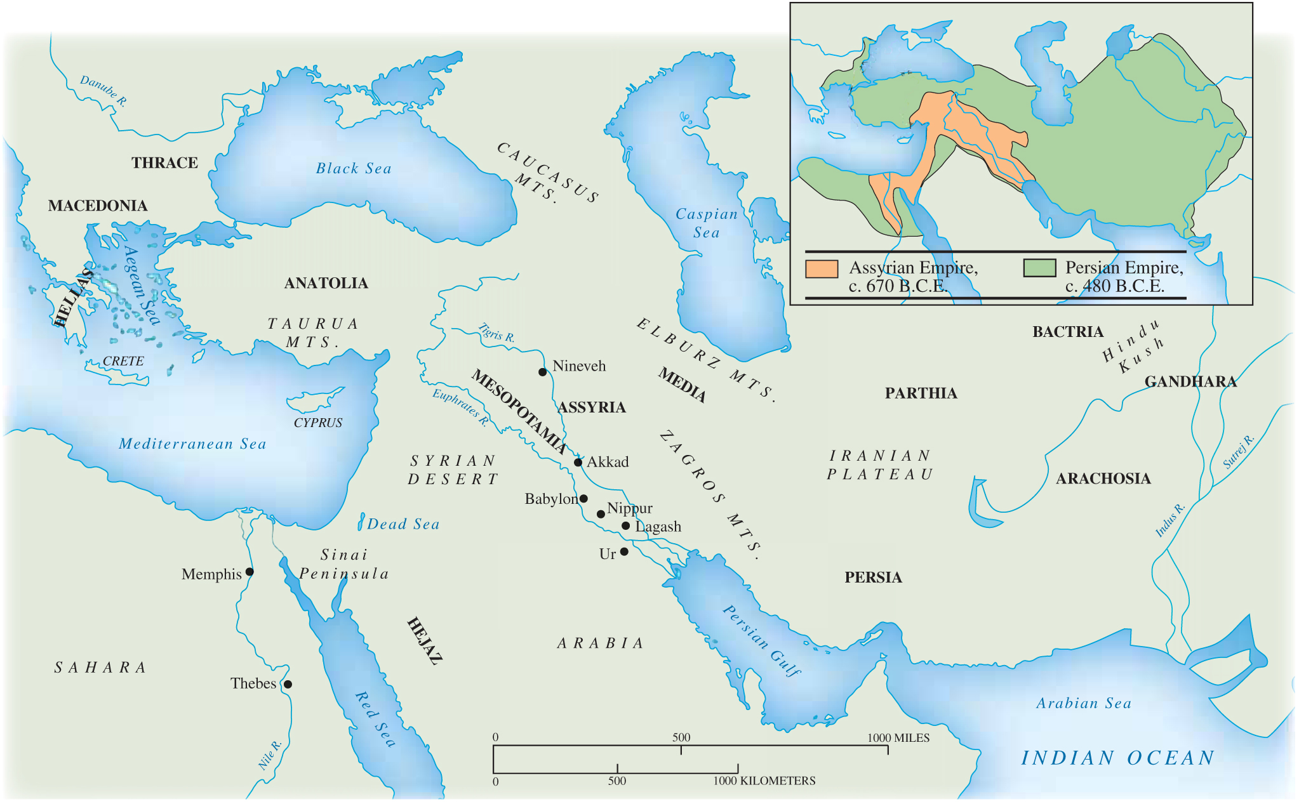
Mesopotamia in Maps
Notes:
‹#›

Slide 31
Ancient Civilization
The Phoenicians
3000 B.C.E
Explored Easter Atlantic Ocean
Carthage- North Africa
22 Letter Alphabet- later modified by Greeks and Romans
Hebrews
Israelites- lived in the region of Canaan- Present Day Israel
Founded by Abraham- Drought caused them to migrate to Egypt where they were enslaved
Monotheism

Slide 32
Ancient Civilization
Hebrews Lost Power-
Conquered by the Assyrians and Babylonians- Enslaved
Jewish Diaspora
Were able to return to Jerusalem 539 B.C.E after Persians took over.

Slide 33
Civilization
Egyptian Civilization
Farming by 5000 B.C.E.
Civilization emerges by 3200 B.C.E.
Difference: no city‑states
Government
Pharaoh, intermediary between gods and men
Bureaucracy
Regional governors
Notes:
‹#›

Slide 34
Civilization
Egyptian Ideas and Art
Hieroglyphic alphabet
Pictograms, phonetic
Papyrus
Monopolized by priesthood
Medicine
Religion
Isis, Osiris, Horus
Cycle of life, annual rise and fall of Nile
Notes:
‹#›

Slide 35
Civilization
Kush
Independent existence by 1000 B.C.E.
Conquered Egypt by 730 B.C.E.
After Assyrian conquest of Egypt
Kush moves south
Meroë, 6th century
Height from 250 B.C.E. to 50 C.E.
center of iron working
Defeated by Axum, c. 300 C.E.
Notes:
‹#›

Slide 36
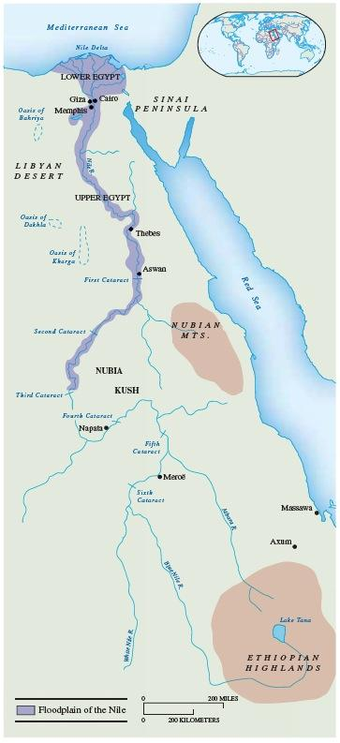
Egypt, Kush, and Axum
Notes:
‹#›

Slide 37
Civilization
Egypt and Mesopotamia Compared
Political form
Mesopotamian city-states
Egyptian centralized government
Epic tradition
Gilgamesh in Mesopotamia
None in Egypt
Notes:
‹#›

Slide 38
Civilization
Notes:
‹#›

Slide 39
Civilization
The Indus River Valley
Harappan civilization, 3rd millennium B.C.E.
Indus river system
Valley plains, snow-fed rivers
The Great Cities of the Indus Valley Harappa, Mohenjo-Daro
Densely populated
Walled
Square grid pattern
Construction: kiln-dried bricks
Notes:
‹#›

Slide 40
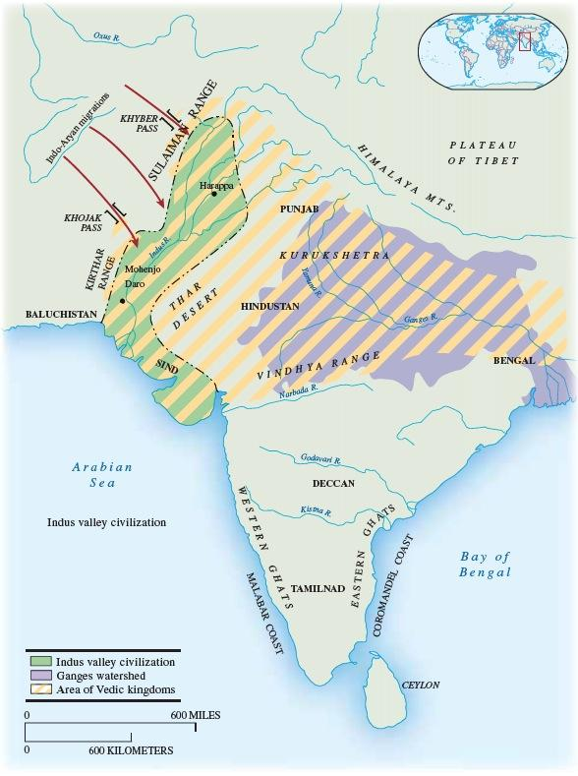
India in the Age of Harappa and the Early Aryan Migrations
Notes:
‹#›

Slide 41
Civilization
Beginnings of China
Longshan culture (2000-1500 B.C.E.)
Millet, larger villages
Controlled river with dikes
Rulers associated with flood control
Mythical Yu, ruler of Xia
Religion
Shamans served as oracles
Ideographs – about 3000 in Shang era
Notes:
‹#›

Slide 42
The Heritage of the River Valley Civilizations
Lasting impact of the first civilizations
Basic ideas about social structures
Basic differences between first cultures?
Understanding of nature
Notes:
‹#›

Slide 43
The Heritage of the River Valley Civilizations
New societies in the Middle East
Phoenicians
New alphabet from about 1300 B.C.E.
Active as traders in the Mediterranean
Hebrews
Settled in Eastern Mediterranean from 1200 B.C.E.
Special relationship with their deity
Monotheism
Notes:
‹#›

Slide 44
The Heritage of the River Valley Civilizations
Assessing the river valley period
Basic tools of civilization
Writing
Mathematics
Political forms
Enduring divisions among global populations
Modified by steadily increasing contact
Notes:
‹#›

Slide 45
Global Connections: The Early Civilizations and the World
Comparing Early Civilizations
Egypt largely isolated
Mesopotamia more open to the outside
China’s early influence not great
Developments emerging that would later influence Korea, Japan, Vietnam
Harappan society in contact with Mesopotamia
Notes:
‹#›

