Slide 1
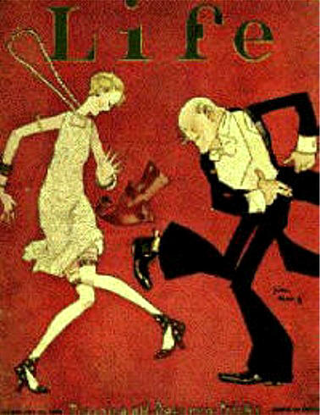
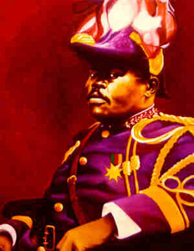
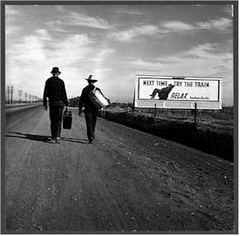
Prosperity and Depression
Chapters 20-23

Slide 2
Struggle With Postwar Issues
A desire for normality after the war and a fear of communism and “foreigners” led to postwar isolationism.
Nativism (You guys know this!)
Isolationism: A policy of pulling away from involvement in world affairs. (People were exhausted from the war.)
Soldiers had a hard time finding jobs
Cost of living doubled.
Factories suffered as wartime orders diminished.

Slide 3
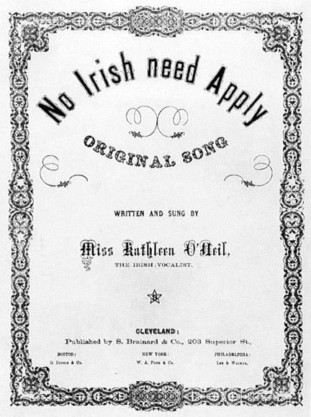
Nativism
Isolationism

Slide 4
Fear of Communism
Communism: What’s the big deal?
What’s are your ideas?
Economic and political system based on single-party government ruled by a dictatorship. (Text Definition)
OR
A socioeconomic structure and political ideology that promotes the establishment of an egalitarian, classless, stateless society based on common ownership and control of the means of production and property in general.
OR
Any political philosophy or ideology advocating holding the production of resources collectively.
Communism- Simulation- Debrief

Slide 5
Flow Chart

Slide 6
Effects of Isolationism
The Red Scare: The panic in the United States began in 1919 after the revolution in Russia overthrew the Czarist regime. Lenin established a new Communist country.
A communist party formed in the United States and 70,000 radicals joined including some from the IWW. When several dozen bombs were mailed to government and business leaders, the public grew fearful that the communists were taking over.
US Attorney general Mitchell Palmer took action.

Slide 7
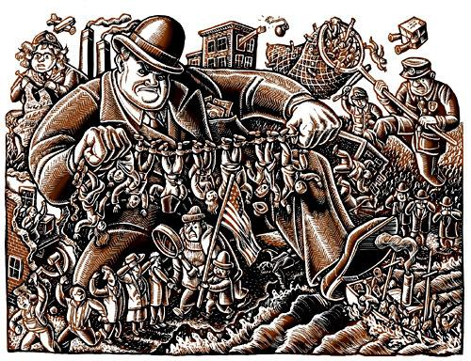
Palmer Raids
Palmer Raids: J Edgar Hoover as special assistant. Hunted down suspected Communists, socialists, and anarchists.
Trampled people’s civil rights invading private homes and offices and jailing suspects without allowing them legal counsel.
Sacco and Vanzetti Clip

Slide 8
More Effects of Isolationism
Panic in the U.S. started in 1919 after revolutionaries in Russia took over.
Sacco and Vanzetti: Most famous victims of the red scare. Were arrested and charged with robbery and murder. Evidence against them not enough but they were convicted and sentenced to death.
– Reading and Discussion Questions-
Gather into a group of 3 people.
Turn to the person on your left and discuss one “I noticed” about the reading and one “I wonder”…question.
Try to find some answers to the I wonders. Present findings to the class.
Have a completed chart with 3 I wonders answered and 5 I noticed.

Slide 9
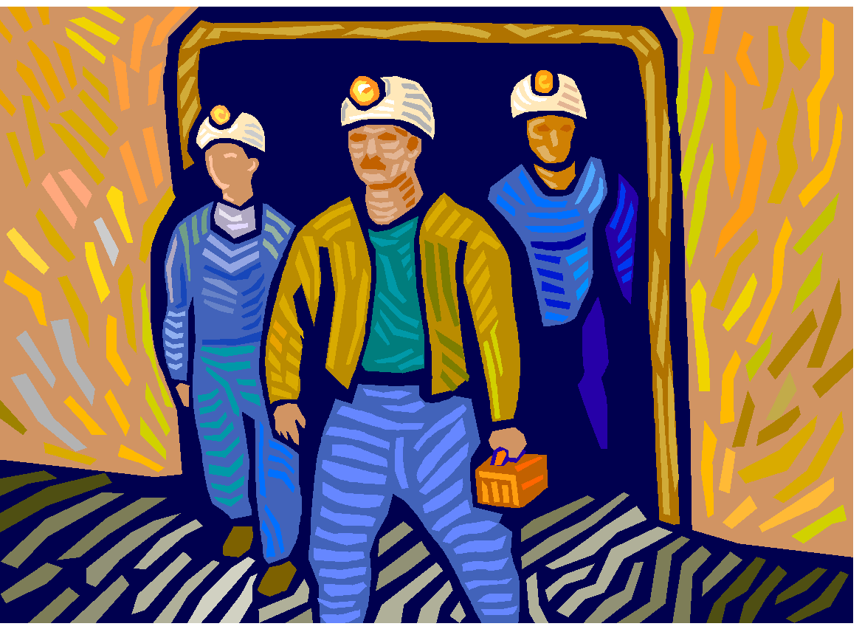
Limiting Immigration
KKK rises again- Why?
Quota System: Set up a max number of people who could enter the U.S. a year from a foreign country.- What do you think of this idea?
Strikes were common: Wanted shorter working hours and better wages.
Unionism Organized by John L Lewis; United Mine Workers of America

Slide 10
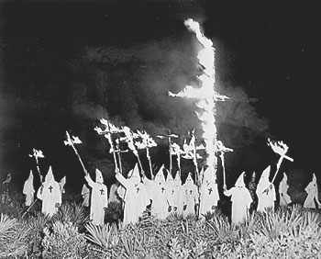
Journal: Write down your thoughts and feelings about this picture…..

Slide 11
Journal 2: Write down your thoughts and feelings about this picture.

Slide 12
Warren G. Harding
After WWI major nations got together except for Russia and agreed to disarm. (Secretary of State Charles Hughes)
Later France and Britain had to pay back $10 million they borrowed from America during the war.
America created the Fordney-McCumber Tariff. This raised taxes on American imports. Protected U.S. business but made it hard for Britain and France to make enough money to pay back U.S.
Caused resentment among the three countries. Why??????

Slide 13
Scandal with Harding
Harding’s cabinet included so-called “Ohio Gang”, presidents poker playing buddies.
Harding didn’t understand many of the issues that plagued his presidency.
His buddies used their offices to become wealthy.
Teapot Dome Scandal: Government had oil rich lands in Teapot Dome, Wyoming. Albert B. Fall got all the oil reserves secretly leased the land to two private oil companies. Albert ended up getting more than $400,000 from this deal and was the first American to be convicted of a felony while holding a cabinet post.
Harding Said: “I have no trouble with my enemies…but my friends…they’re the ones that keep me walking the floor at night.”
He shortly died from a heart attack or stroke.

Slide 14
American Industries Flourish
First affordable automobile invented in 1927 became the backbone of the American economy in the 1920s.
New President Calvin Coolidge: Fit into the pro-business of the 1920s.
Route 66 finished: Chicago to Los Angeles.
Urban Sprawl: cities spread
Standard of Living Soars: Electrical Conveniences: refrigerator, cooking ranges, toasters.

Slide 15
Superficial Prosperity
Producing Great Quantities of Goods: Iron and railroad industries were not very prosperous and farms were producing more food than was needed. (Drove down food prices)
Buying Goods on Credit: Installment Plan (credit)
Why would this be called Superficial Prosperity?
Complete:
3 Things you learned
2 Things you found interesting
1 Question you still have

Slide 16
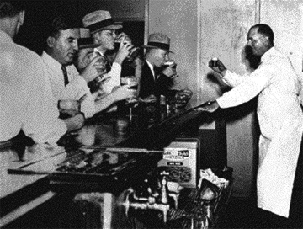
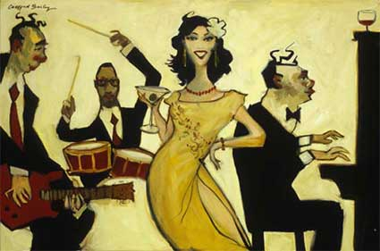
Roaring 20s
Chapter 21

Slide 17
The year is 1920. The World War has just ended. Boosted by the growth of the wartime industry, the U.S. economy is flourishing. Americans live life to the fullest as new social and cultural trends sweep the nation.
As Americans leave farms and small towns to take jobs in the cities, how might their lives change?
How will economic prosperity affect married and unmarried women?
How might rural and urban areas change as more and more families acquire automobiles?

Slide 18
Changing Ways of Life
People moving to the cities. New York had a population of 5.6 million people. Chicago had 3 million, Philadelphia 2 million.
Why?
Prohibition began in January of 1920. Prohibition: time in which the manufacture, sale and transportation of alcoholic beverages was prohibited.
Reformers thought liquor a prime cause of corruption, child-abuse, accidents on the job, and accidents on the job.
Speakeasies – underground and hidden saloons and nightclubs.
Bootleggers: smugglers practice of carrying liquor in the legs of boots.
Organized Crime: Al Capone, took control of Chicago liquor business buy killing off the competition.

Slide 19
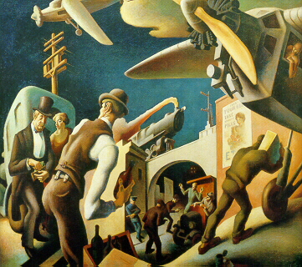
What is this artist trying to convey about the culture of the 1920s?

Slide 20
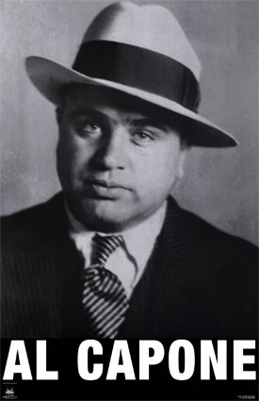
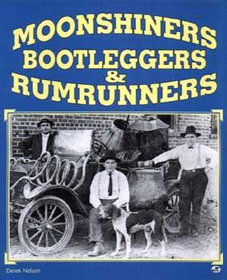
Watch- http://abcnews.go.com/video/playerIndex?id=6127766

Slide 21
Science and Religion Clash
Fundamentalism: literal interpretation of the Bible. How does that affect standard education?
Scopes Trial: TN passes law that made it a crime to teach evolution. ACLU got in and defended a teacher who wanted to challenge the law.
http://historicalthinkingmatters.org/scopestrial/
Clarence Darrow was the lawyer for the ACLU. William Jennings Bryan served as the prosecutor.
Inherit the Wind- http://www.youtube.com/watch?v=S_DQUAuNUvw
Scopes trial was a fight over evolution and the role of science and religion in public schools.
TN authority fined scopes $100 and kept the law outlawing evolution.

Slide 22
Small Group Discussion
Norms: 2 minutes per question, everyone has a voice, active respectful listening
Opening Question:
Who supported or opposed the Butler Act/ Quote
Core Questions:
Discuss the differing views of place? (ex. Rev Stratton and big cities or New York Times and Dayton)
In what ways did the historical context of the 1920s affect the battle over the Butler Act?
Closing Question:
How was the Scopes Trial more than just a simple debate between evolution and creationism?

Slide 23
Short Response
Why did people care about the Butler Act? Use at least one piece of evidence in your response.

Slide 24
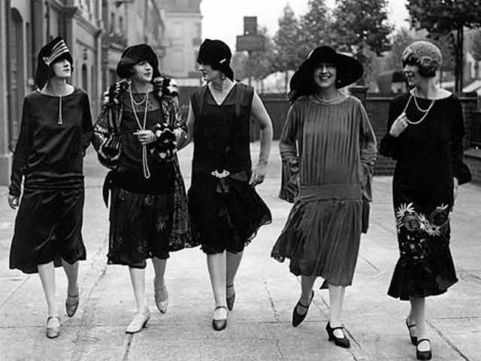
The Twenties Woman
Flapper

Slide 25
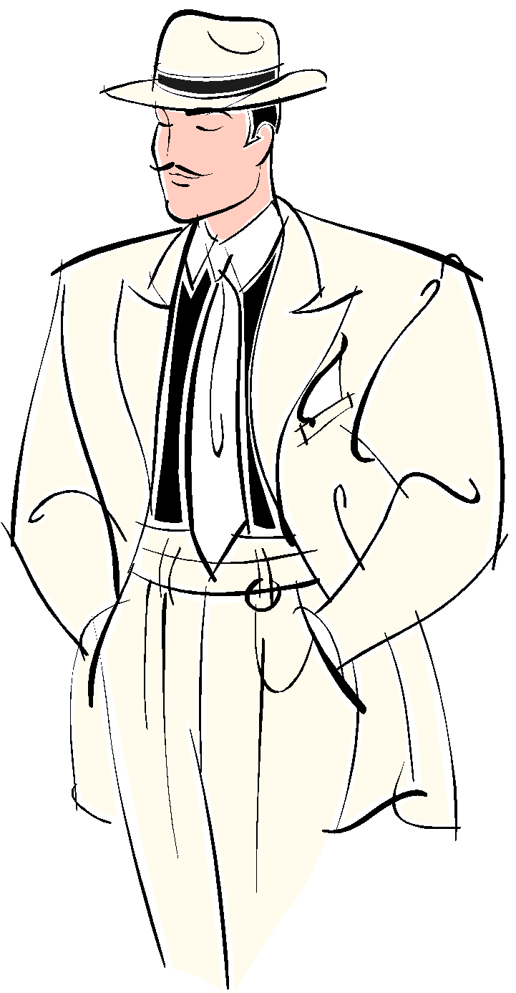
Double Standards
Double Standard: Set of principles granting greater sexual freedom to men than to women – required women to observe stricter standards.
Paraphrase: Turn and Talk
Has the double standard become less pronounced over time?
Is this idea present in today’s society- examples?
Read Margaret Sanger and her thoughts on Birth Control.- How would this grant greater sexual freedom to women?

Slide 26
Changing Roles at Home and Work
“Women’s Professions”
By 1930s 10 million women were earning wages.
Birthrate declined because of availability of birth control.
Simplified household and family life.
Schools and Mass Media Shape Culture: School costs went up, more children in school, expanding news coverage (newspaper circulation rose, radio)

Slide 27
Key Question
How did the roles for women change during the 1920s? What events helped create this change?
(Use at least 3 sentences for your response)

Slide 28
A Little Research……
In groups of three research the topic you have been given. Preferred Roles:
Researcher/Summarizer
Multimedia Director
Sound Editor
You will create a 5 slide PowerPoint that presents your topic in the most creative way possible
Requirements: 10 important facts in your OWN words about the topic. Names and Dates are important.
At least 5 quality visuals (maps, diagrams, original photographs that represent your topic)
At least 1 audio and 1 video (Must be less than 3 minutes each) embed in the powerpoint.
Works Cited Page MLA Format
We will present these in a gallery walk format using our computers.

Slide 29
Heroes and Old Dreams Research Topics
Sports: Babe Ruth, Gertude Ederle, Andrew Foster, Charles Lindberg (Group 1)
Jazz: George Gershwin, Louis Armstrong, Bessie Smith, Duke Ellington (Group 2)
Literature: F. Scott Fitzgerald, Ernest Hemingway, Zora Neal Hurston (Group 3)
Civil Rights: NAACP, Harlem Renaissance, Marcus Garvey, Great Migration (Group 4)
Poetry: Langston Hughes, Claude McKay, Edna St. Vincent Millay (Group 5)
Art: Georgia O'Keeffe, Edward Hopper, Maxfield Parrish (Group 6)

Slide 30
Chapter 22: The Great Depression
The year is 1929. the U.S. Economy has collapsed. Farms, businesses, and banks nationwide are failing, causing massive unemployment and poverty. You are out of work with little prospect of finding a job.
What would you do to feed your family?
What groups of people will be most hurt by the economic crash?
What can you do to find a paying job?
What can unemployed and impoverished people do to help each other?

Slide 31
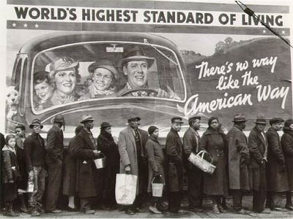
Free write…your thoughts and feelings of this picture. Then turn to your partner and share…

Slide 32
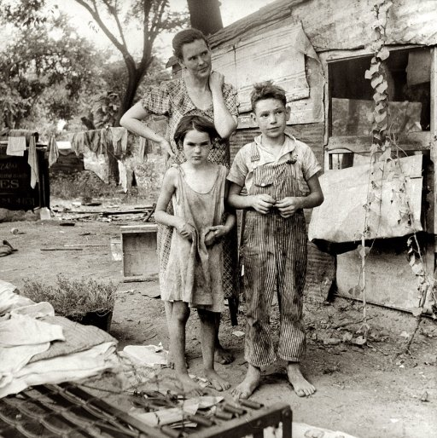
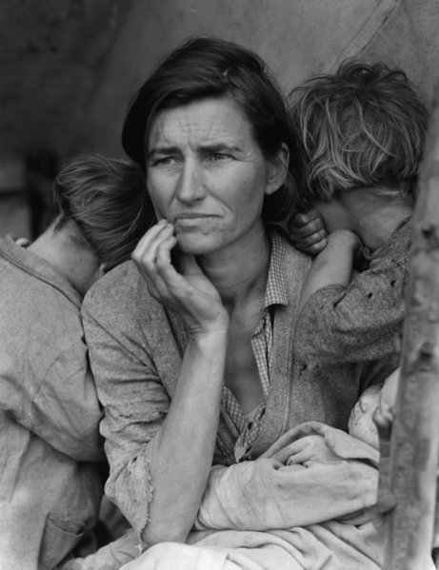
Dorothea Lange

Slide 33
Economic Troubles
Industries were hardly making a profit.
Problems in farming: Many lost mortgage payments on their farms not being able to pay on their farms.
Price supports passed: Would not allow food prices to fall below a certain level. But Coolidge vetoed the bill and farmers incomes dropped.
Credit: Too many Americans accumulating debt.

Slide 34
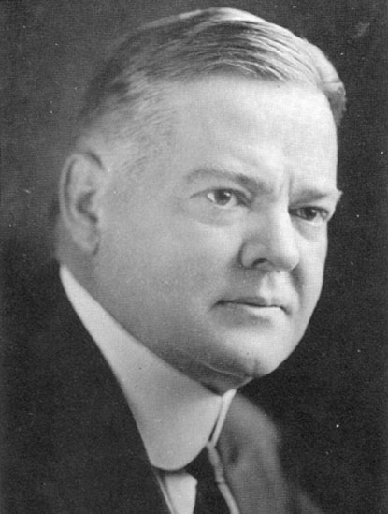
Hoover is such a positive guy!
Hoover said American economy was healthy.
Dow Jones was way up and people rushed to buy stocks. Many people were buying on margin – paying a small down payment and borrowing the rest.
Black Tuesday: Crash and Burn
Great Depression: Period of bad economic times when many people were out of work from 1929-1940.
Hawley-Smoot Tariff Act made it worse: Taxes on imports hoped Americans would buy American good. People didn’t have money!

Slide 35
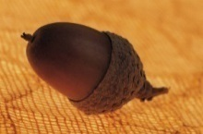
Causes in a Nutshell
Tariffs and war debt policies that cut down the foreign market for American goods.
A crisis in the farm sector
The availability of easy credit
Unequal distribution of income.
The Great Depression

Slide 36
Hardship and Suffering
Essential Question: What were some of the main causes of the great depression?
Shantytowns
Soup Kitchens and Bread Lines
Dust Bowl: Regions that were hardest hit. (Kansas, Oklahoma, Texas, New Mexico, and Colorado)
No Direct Relief- What is Direct Relief?
View Bailout or Bull?- http://www.youtube.com/watch?v=Tda0-cDyD0U

Slide 37
Hoover and the Depression
Reassuring
Boulder Dam (Hoover Dam)
Federal Home Loan Bank: mortgage rates for homeowners and allowed farmers to refinance farms.
Reconstruction Finance Corp: $2 billion for emergency financing for banks, life insurance companies, railroads and other large businesses.
Bonus Army: Out of work WWI veterans with no benefits protested against Hoover.

Slide 38
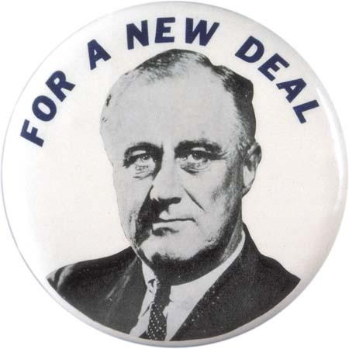
Roosevelt! The New Deal
Essential Question: How did the new deal program address the economic problems of the depression?
Franklin D. Roosevelt: Roosevelt promised a New Deal to the people and focused on three general goals: relief for the needy, economic recovery, and financial reform.
First Action in Office
Declared Bank Holiday- to halt bank failures.
Who was Eleanor Roosevelt?
Played a key role in opening doors for African Americans in government.
Social Reformer
Fireside Chats- Radio talks about issue of public concerns

Slide 39
The New Deal Programs
First 100 Days: Lasted from March 9th to June 16th, 1933. Congress passed more than 15 major pieces of legislation.
Significantly expanded the government's role in the economy
What would the arguments be against this type of legislation?
Second 100 Days: With the widespread popularity of the first 100 days, FDR wanted to expand his programs.
Provided more extensive relief for farmers and workers
WPA
Wagner Act
National Youth Administration
Social Security Act

Slide 40
Social Security
Review Norms of Socratic Seminar
Opening Question
What was the opinion of your document about the Social Security Act? How do you know? Use evidence from your document.
Core Questions:
Which historian does your document support Degler or Bernstein? Explain.
Which historian do you agree with? Why?
Closing Question:
How much should the government be involved in the economy? Do you think people should expect the government to act in times of trouble and make things better for individuals? Explain.

Slide 41
New Deal Under Attack
Deficit Spending
Supreme Court Reacts
Struck Down AAA and other programs that the court felt like took too much power away from the states
American Liberty League, Charles Coughlin, Dr. Francis Townsend, and Huey Long.
http://historicalthinkingmatters.org/socialsecurity/
Turn and talk about brainstorming question
Questions for clip- Use white board in teams

Slide 42
Hoover v. Roosevelt?
Using a double bubble describe the differences between Herbert Hoover and the Republicans and FDR and the Democrats in the 1930s.
(Regarding their attention to the Great Depression.) Use your textbook.

Slide 43
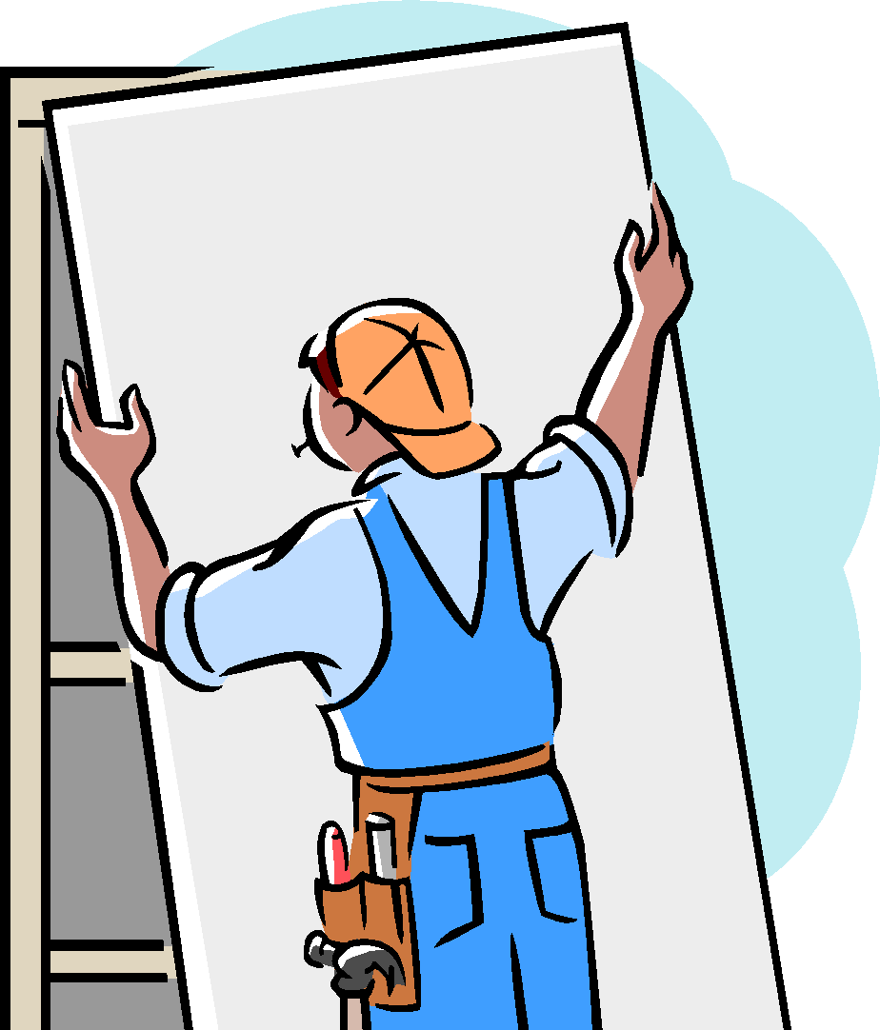
New Deal Project
Each group will be in charge of researching two programs from the New Deal and creating a presentation for the class. Your group roles will be:
Researcher- Summarizer 1- You will research one of the programs and summarize that program for the writer
Researcher-Summarizer 2 – You will research one of the programs and summarize that program for the writer. Your research will include:
Purpose, Results, Present Today
Writer/ Illustrator- You will be in charge of taking the information from the researchers and summarizers and putting this on your poster. You must also have two illustrations that represent your two programs on your poster.
Smartphones may be used for research
When you are finished put your poster up somewhere around the room
Then take out your New Deal Program sheet, walk around the room and fill out your chart. (gallery walk)

