Slide 1
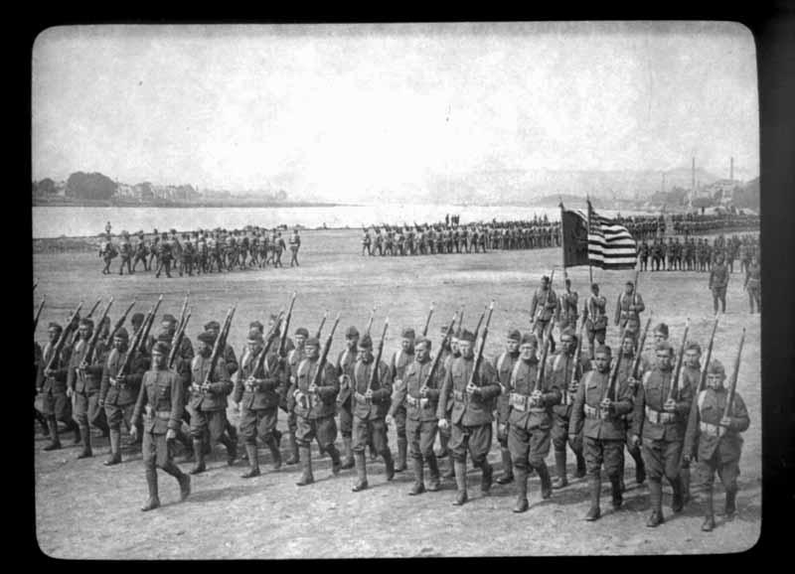
The United States in WWI 1917-1918

Slide 2
Warm-Up!
View the following clips to get a better idea of the conditions of soldiers during WWI and trench warfare.
Create a bubble map describing WWI Firsts! Include at least 5 new technologies that came out of this war.
Create a bubble map as you are watching to describe the War. (Your bubble map must have at least 5 facts/per person)
WWI Firsts
Bet You Didn't Know- History Channel

Slide 3
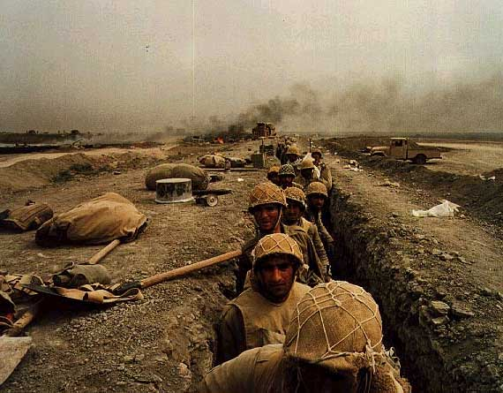
What does this have to do with my life??
Well….You may ask yourself that and really your right…history may not affect you directly but it does indirectly in many ways.
Many questions that we could ask about WWI we can ask those same questions about US foreign policy today. Legacy of WWI
Is it right for America to intervene in foreign conflicts?
When American lives are threatened how should the government respond?
Should America go to war to make the world “safe for democracy”?

Slide 4
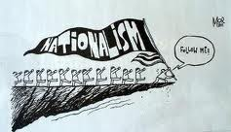
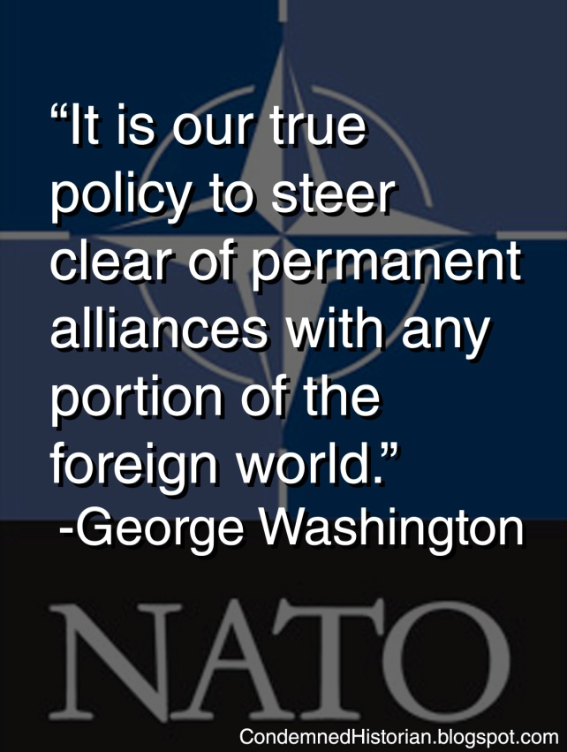
The 4 MAIN Causes
Term
Militarism
Development of armed forces.
Alliance System
Group of nations that pledge
to support each other.
Imperialism
Economic, political control over a
smaller nation.
Nationalism
A devotion to the interests and
culture of one’s nation.

Slide 5
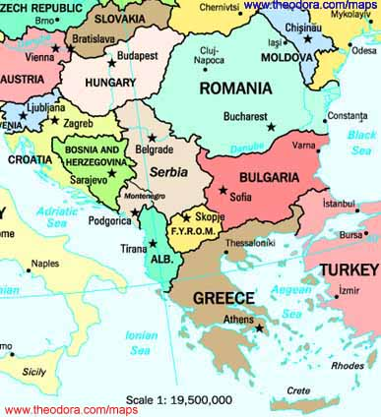
Short Term Causes: Assassination!
The spark that flared in the Balkans, also known as the “powder keg of Europe.” Europe’s leading powers had a lot of interest there.

Slide 6
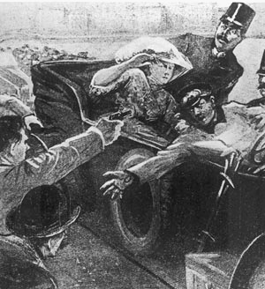
The Archduke and His Wife….
In June 1914 the Archduke Franz Ferdinand, heir to the Austrian throne, was visiting the Bosnian capital. A Serbian nationalist and member of the Black Hand shot the duke and his wife.
The alliance system pulled one nation after another into the conflict.
archduke and his wife

Slide 7
Who is Who?
Complete a Tree Map here: Use Page 581
WWI Alliances

Slide 8
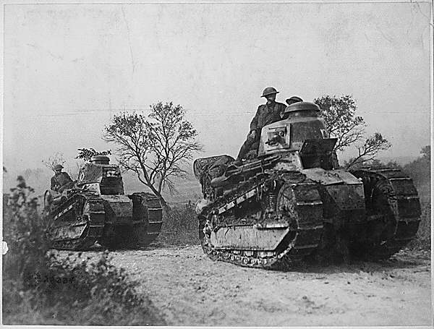
The War Begins…
The alliance system pulled one nation after another into the conflict.
Austria-Hungary also declares war on Russia.
Germany obligated to help out declares war on Russia’s ally France and invades Belgium.
Britain declares war on Germany and Austria-Hungary.

Slide 9
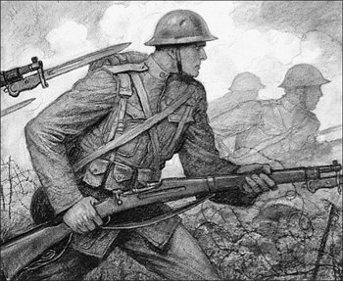
German Invasion
Schlieffen Plan:
Germany invades Belgium and plans to overrun France and then attack Russia. The British and French could not save Belgium. But they stopped Germany’s advance.
A line of deep trenches were dug in France. Germans occupied one line and Allies the other….the part in between was “no mans land”.
Trench warfare continued for more than three years in France. Neither side gaining territory. But more than one million soldiers died.

Slide 11
The Realities of War
Intro: View: Life in Trenches Video- Discuss Details
https://www.youtube.com/watch?v=WDhUDTHg7-I
Read excerpt in groups from Dalton Trumbo, Johnny Got His Gun (1939)-
Coding and Discussion Questions-
Intro - One Metallica
One- Metallica

Slide 12
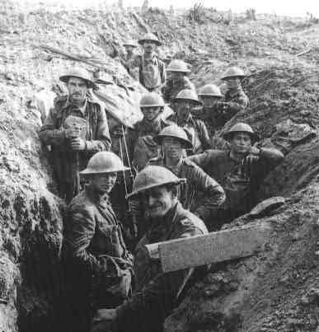
Trench Warfare: Follow-Up
Cover your head! Get down in your trenches, THIS IS WAR!
It’s your last chance to write to those you love…while in your trench you need to write a ½ page letter to someone back home detailing your life in the trenches and WWI.

Slide 13
Americans Join the War
America decided to join based on several incidents.
Germany announced it would sink all ships in British waters on sight whether they were hostile or neutral.
British Blockade: Threatened freedom of the seas and prevented Americans from trading goods with Germany.
Sinking of the Lusitania. May 7th 1915 U-Boat sank British Liner 128 Americans were killed.
British agents intercepted the Zimmerman note, a telegram that proposed an alliance between Germany and Mexico.
Replacement of a Russian Monarchy with a representative government.
President Wilson declares war. (View short video if time)
Make the “world safe for democracy.”

Slide 14
Americans Join the War
At first, opinion over the war is divided.
Many naturalized citizens felt a strong tie to their homeland.
Most Americans tended to sympathize with Great Britain and France.
Socialists criticized the war as a capitalist and imperialist struggle.
Parents did not want their sons to experience war.
War affected American Shipping. Great Britain set up a blockade along German coast. However German U Boats attacked British Ships.

Slide 15
Social Systems: Small Group Activity
Compelling Question: How important are social systems in creating effective political change during and after war?
Set up for Socratic Seminar: Each group will have 2 minutes to discuss each question. Please continue discussing until time is called. Each member must have a voice! (Chart will be completed after discussion)
Opening Question: What word or phrase stood out most to you from the text? Why? (2 minutes)
Core Questions: (4 minutes)
What is the social system or individuals main message about war? Are they convincing? Why or why not?
What evidence do you see that they created political change?
Closing Question: (2 minutes) What does this activity teach you about your own role in society with regards to war? What impact does your role have on others?

Slide 16
Reflection Question
Free Write:
Write a paragraph that addresses the questions:
What does patriotism mean to you?
Do you think it’s important for people to be patriotic? Why or why not?
Is it patriotic or Anti-American to criticize the United States Government?

Slide 17
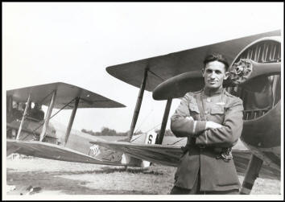
New Technologies…
German U Boats
Fighter Planes
Tanks

Slide 18
Section 2: American Power Tips the Balance
U.S. needed to build up armed forces.
Selective Service Act
Required men to register with the government so that some of them could be selected for military service.
Put 3 million men in uniform
24 million men registered under the act
Units are still segregated
Women served in non-combat positions
Ships were built to transport men overseas. The government exempted many shipyard workers from the draft and gave others deferred classification.

Slide 19
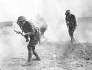
America in the War
Used convoy system where merchant ships traveled in a large groups guarded by naval vessels in order to be protected from German U Boats.
Thousands of fresh American soldiers eager for battle
Innovative Weapons: Tank and airplane.
American Hero
Alvin York- was a redheaded mountaineer and blacksmith from Tennessee. York sought exemption as a conscientious objector (opposes war on moral grounds). However he decided to fight if the war was “just”. And on Oct 8,th 1918 armed only with a rifle and revolver York killed 25 Germans and captured 132 prisoners with the help of 6 doughboys. Became an American celebrity.

Slide 20
The End of WWI
Americans arrived just in time to stop a German advance on Paris.
On Nov 3 1918 Austria-Hungary surrendered and German sailors mutinied against government authority. On Nov 9th socialist leaders in the capital of Berlin established a German Republic and the Kaiser gave up the throne.
Germany was exhausted and agreed to an armistice on November 11, 1918. Treaty of Versailles
22 million died in WWI
The direct economic cost of the war may have been about 338 billion dollars.

Slide 21
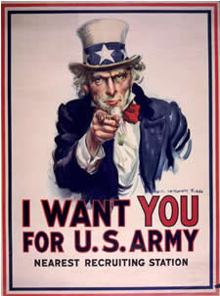
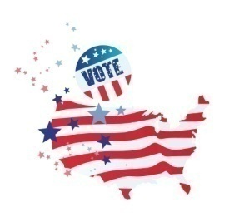
Section 3: The War at Home
To fight the war the U.S. needed the help of American Industry
Wilson’s power over economy
Food Administration: meatless, wheatless, sweetless, porkless
Economy changed from consumer goods to making weapons of war.
War Industries Board: Bernard M. Baruch ran it. Improved the efficiency of war related industry.
Propaganda helped in gaining support for the war. (Complete Propaganda Activity)
Civil Liberties: Anti Immigrant Hysteria
Espionage and Sedition Acts: Punished people who did not support the war. German Americans were targeted.
Schenck vs. U.S: ruled on “clear and present danger”

Slide 22
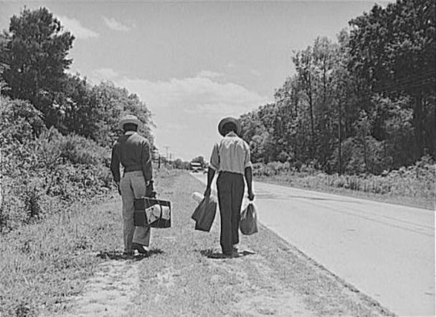
War encourages social change….
African American leaders were divided. Why?
Sped up Great Migration: Where thousands of African Americans moved to cities in search of jobs.
Women did jobs that were previously done by men.
Drove Trucks
Cooks
Builders
Weapons Factories

Slide 23
1918 Flu Epidemic
International flu epidemic affected about ¼ of the U.S Population.
Effects?
More than ¼ of all soldiers caught the disease.
500,000 Americans died
30 million people worldwide

Slide 24
Section 4: Wilson Fights for Peace!
Fourteen Points: (The important ones)
Countries should not make treaties with one another
Freedom of the seas should be maintained
Tariffs should be lowered to promote free trade
Countries should reduce their arms
Interests of the colonial people should be considered.
Self determination of boundaries.
14th Point League of Nations
International organization where countries could address problems before they go to war.
Wilson meets leaders of GB and France to discuss these terms. They want to punish Germany. Allies reject his plan. (“Big Four” Wilson, Clemenceau, Lloyd George, and Orlando.)
Wilson gives up most of his points except for the League of Nations.

Slide 25
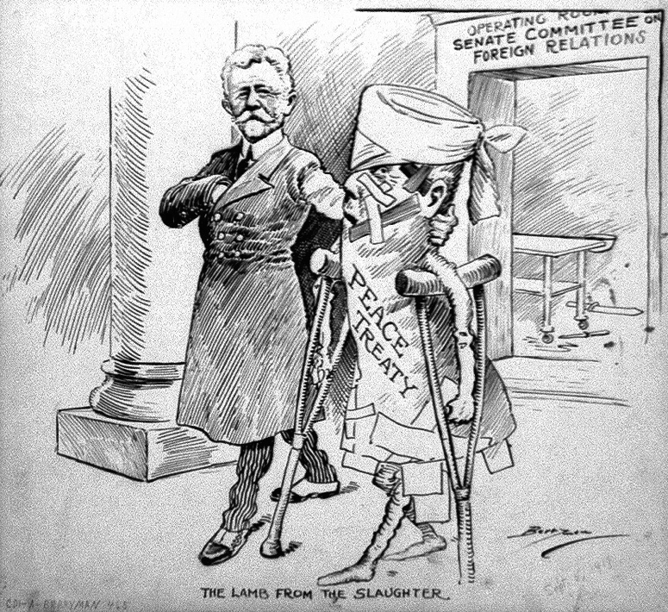
Treaty of Versailles
Created new national boundaries by establishing nine new nations. (Poland, Czech, and Yugo)
Took away Germany’s army and navy.
Forced them to pay reparations.
War guilt clause: Germany had to admit that it was responsible for the war.
Treaty had 3 basic weaknesses.
Germany humiliated, Germany alone punished
Russia lost more territory than Germany
Did not recognize the claims of colonies for self-determination.

Slide 26
Opposition to the Treaty
Americans
Believed it was too harsh.
Sell out to imperialism because it simply exchanged one set of rules for another.
Did not satisfy rules for self determination.
League of Nations
Threatened the idea of isolationism. (Civilians)
Wanted the right of Congress to declare war written in the treaty. (Senators)
Wilson supported it.
Believed nations could talk through their disagreements.

Slide 27
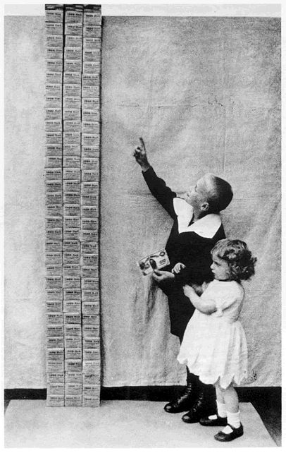
Legacy of the Great War
Wanted Normalcy
Changed society for African Americans and women. (How?)
Destruction
Germans feel a strong resentment towards the rest of Europe.

Slide 28
Complete a flow map for the causes and effects of WWI…..
WWI

Slide 29
Complete a Double Bubble
Pick another American war we have discussed and with a partner create a double bubble comparing it to WWI.
Spanish American War
Mexican War
War of 1812
Or WWII if your feeling super smart!
Think about:
How the war started.
Why America got involved.
What our overall mission was.
Consequences of each war.

Slide 30
Chapter 19: Project-Based Assessment
Think back to our focus questions at the beginning of this chapter.
Is it right for America to intervene in foreign conflicts?
When American lives are threatened, how should the government respond?
Should America go to war to make the world “safe for democracy?”
In groups of no more than 4:
Complete the reading material.
Complete the position guide.
Individually complete your position essay and group assessment.

