Slide 1
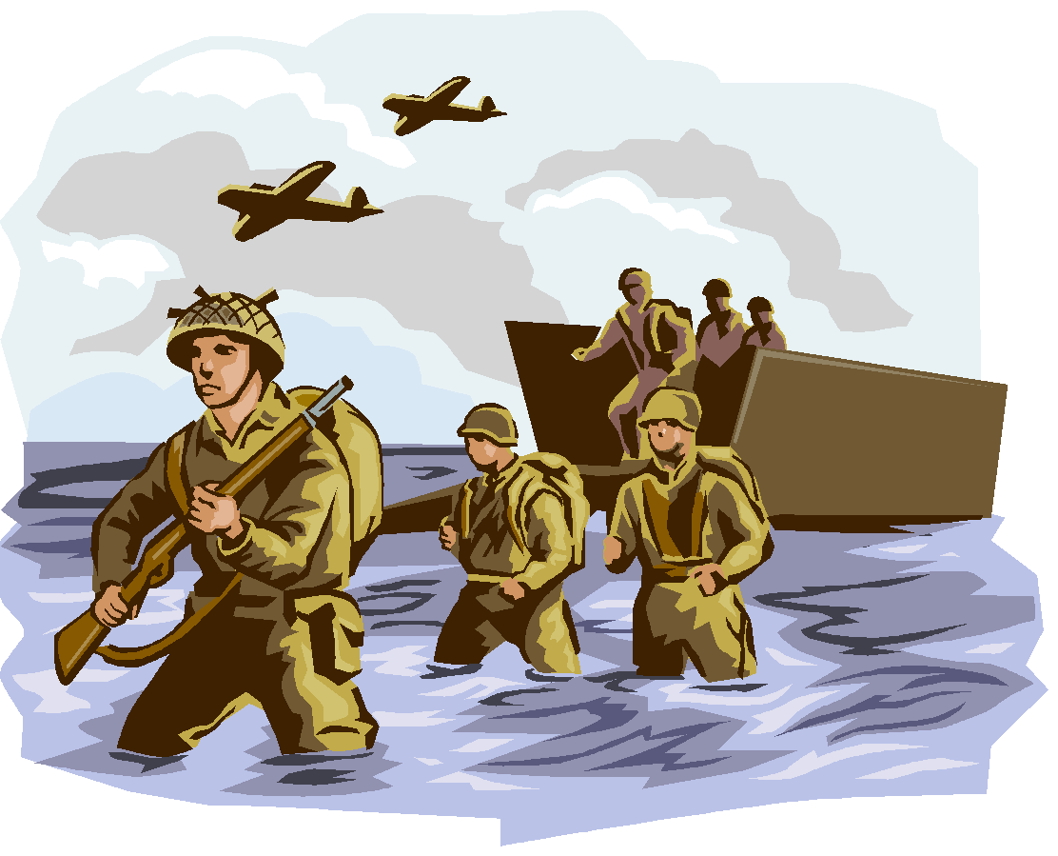
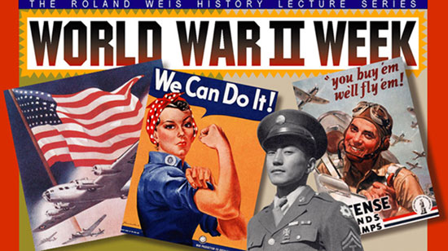
WWII
FROM THE BEGINNING TO THE END…….

Slide 2
WWII Powers
 | Russia | Italy | Germany | Japan | England | America
Type of Government | Communist | Fascist | Nazism | Dictatorship | Democracy | Democracy
Leader | Stalin | Mussolini | Hitler | Tojo | Churchill | FDR
Actions Taken by 1939 | Become worlds 2nd largest industrial leader | Marches on Rome declared head of gov. | Enforces racial purification. National expansion -wanted to create a great German Empire. | Take control of Manchuria China | Remain Isolationist until 1940 Britain attacked. | None

Slide 3
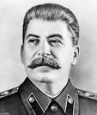
Dictators :Threaten World Peace
Nationalism in Europe and Asia
Remember from WWI
Failures of WWI peace settlement
Germany is angry
Joseph Stalin brings communism.
Wants to transform Russia into a great industrial power. Established a totalitarian government. – (government that tries to have complete control over its citizens)

Slide 4
U.S Responds Cautiously
Alarmed by conflicts overseas.
Kellogg-Briand Pact – declared “war could not be used as an instrument of national policy”
People did not want war….very isolationist – impacts Roosevelt’s foreign policy.
Congress passes neutrality acts – outlaws arms sales or loans to nations at war, the second extended the ban on arms sales and loans to nations in civil war.
Neutrality breaks down as Japan launches attack on China, Roosevelt delivers Quarantine Speech. (pair/share)

Slide 5
War in Europe
Austria and Czech fall to Germany in 1937
France and England are both alarmed and agree to meet with Hitler.
Hitler assures him that this will be his last demand. They appease him..and sign the Munich Agreement.
Appeasement (Giving up principles in order to satisfy someone)
German offensive begins Invasion of Poland
Soviet Union Declares Neutrality - signs non-aggression pact with Hitler.

Slide 6
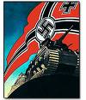
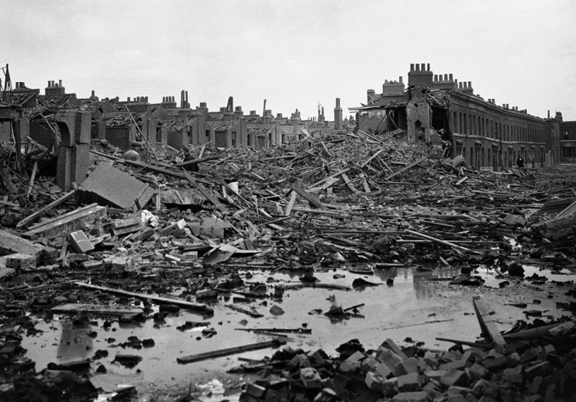
The German Offensive
Blitzkrieg in Poland “lightning war”
Fall of France
French General DeGaulle fled to England and set up government in exile.
Battle of Britain – 1940 – Germans assemble invasion fleet along the French Coast. Also launched an air war at the same time.
Lil' Hitler

Slide 7
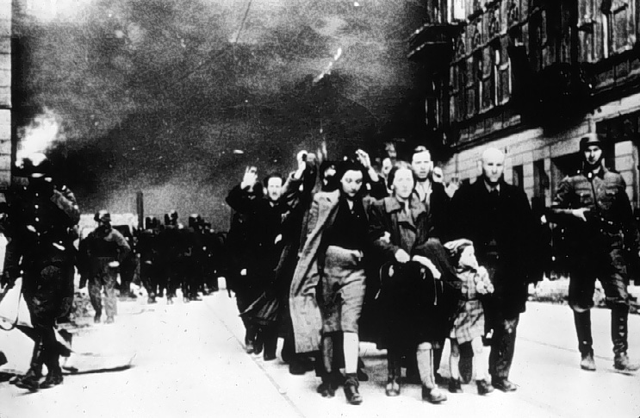
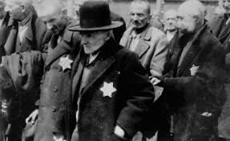
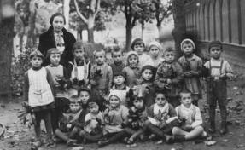
Holocaust
Persecution Begins –
Systematic murder of 11 million people across Europe, more than half of whom were Jews.
Nov 9-10 1938 Krisstallnacht “night of broken glass”
Nazi storm troopers attack Jewish businesses, homes, and synagogues across Germany.
By 1939 Hitler is obsessed with a desire to rid Europe of Jews and imposes the final solution –
systematic killing of an entire population.
Primary Documents Activity

Slide 8
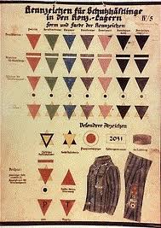
Holocaust
Condemned –
Gypsies, Freemasons, Jehovah’s Witnesses, Scholars, Scientists, mentally ill, physically disabled.
Forced Relocation –
ghettos – segregated Jewish areas that were sealed off with barbed wire and stone walls.
Concentration Camps
Final stage of solution in 1942.
Murder by poison gas. Built 6 death camps in Poland. As many as 12,000 people were killed a day.
Survivors –Gerta Klein (Interview)

Slide 9
America Moves Towards War
Roosevelt persuades cash and carry provision that allowed warring nations to buy U.S. arms as long as they paid cash and transported them in their own ships.
Axis Threat – Germany Italy and Japan sign a mutual defense treaty (Axis Powers)
U.S increased spending on defense.
Roosevelt runs for a third term – elected.
Lend Lease Plan – lend or lease arms to another country that needed it. Sent to Britain, and Soviet Union. A lot of these arms being transported were destroyed by German Subs.

Slide 10
FDR plans for war
Atlantic Charter –
Britain and U.S pledge the following – collective security, disarmament, self-determination, economic cooperation and freedom of the seas.
Allies( U.S., Britain, USSR, and many more)
Japan attacks the United States!! December 7, 1941
Pearl Harbor
2403 Americans Killed
“A date that will live in infamy”
Declaration of War

Slide 11
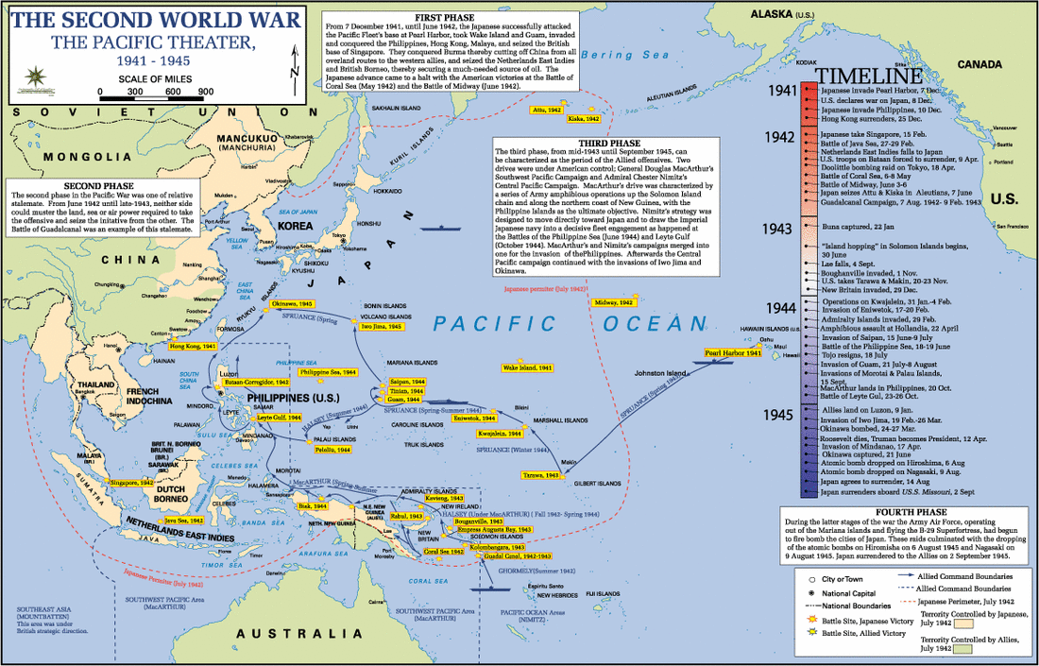
War in the Pacific
Use the internet to find out more information about the important battles that were fought in the pacific.

Slide 12
The War Effort
Selective Service
George Marshal Pushes for the Women’s Auxiliary Army Corps –
nurses, ambulance, drivers, radio operators, electricians, and pilots.
Industry goes up!
OPA –
Office Price Administration Froze Prices on Goods to stop inflation. Pg 773
Rationing- sugar, coffee, tea, etc.

Slide 13
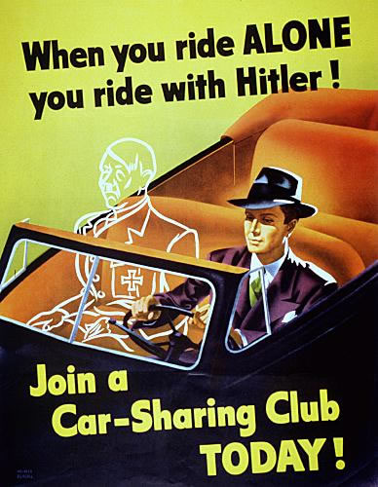
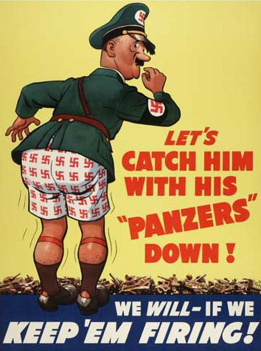
Propaganda in WWII

Slide 14
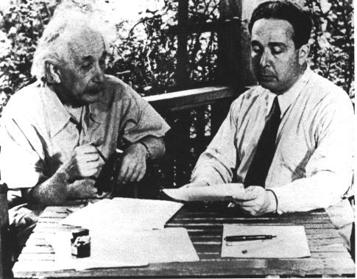
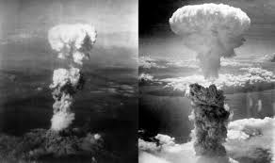
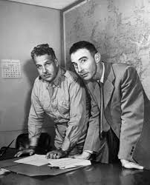
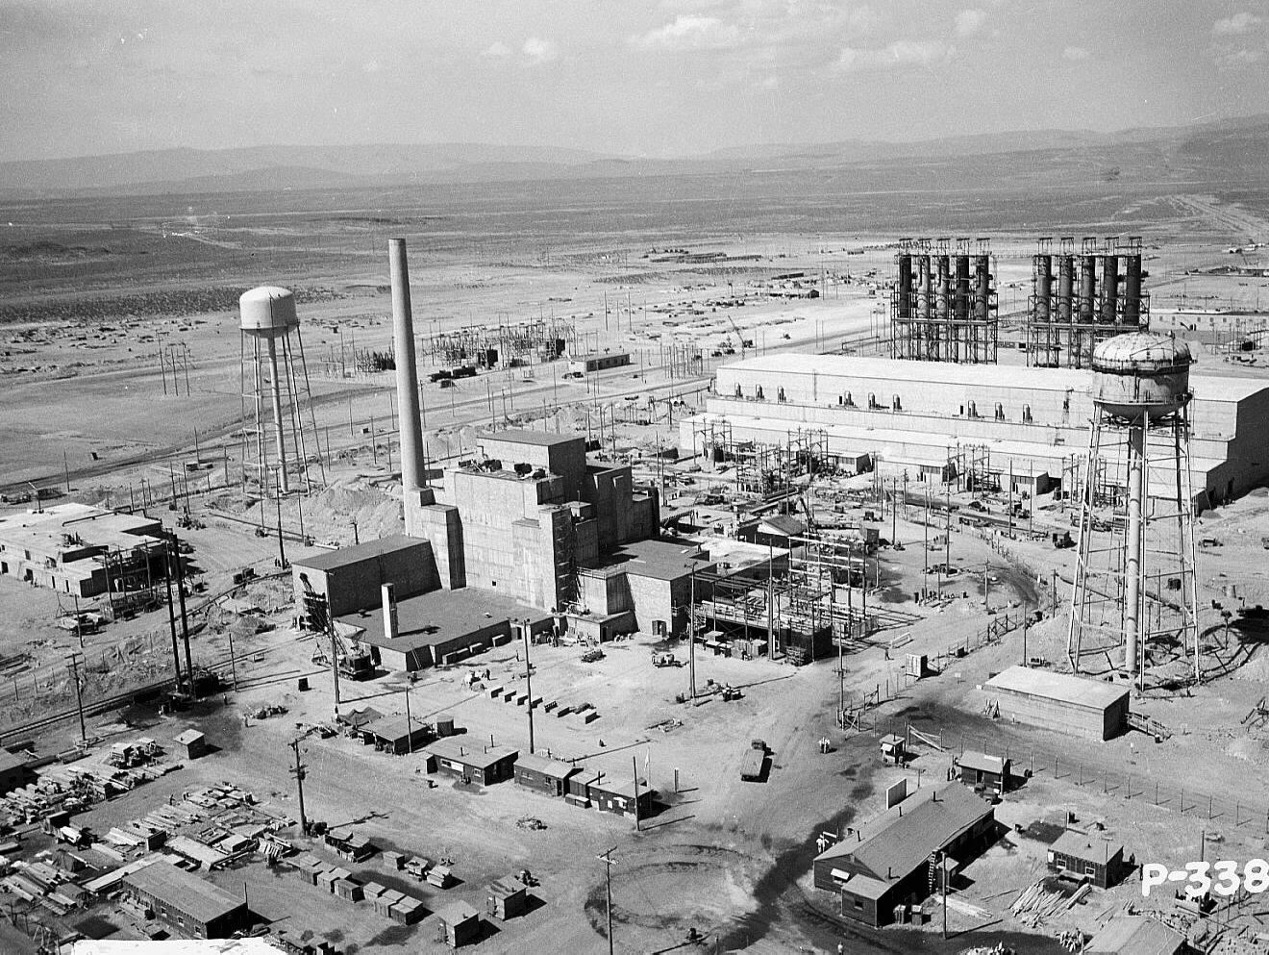
The War Effort: The Manhattan Project
The Manhattan Project
Discovery Ed- Profiles of Courage

Slide 15
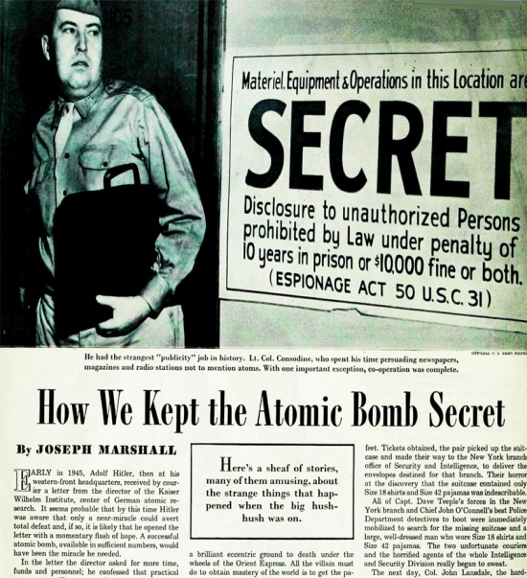
Atomic Bomb Ends the War
Remember Manhattan Project?
Bombs are dropped on Hiroshima and Nagasaki-
by the end and estimated 200,000 people had died by the atomic blasts.
Go to page 791 in your books. Complete Questions 1 and 2. (Pair Share)
Activity- Dropping the Atomic Bomb
Central Question: How should we remember the dropping of the atomic bomb?

Slide 16
Rebuilding
Yalta Conference –
Feb 1945 discussed fate of Germany. Created the UN as a peacekeeping organization.
Nuremberg War Trials –
Hitler’s most trusted party officials.
Japanese occupied by the U.S for 7-years.

Slide 17
Home Front!
Economic Gains! – Women, Farmers!
Movement of people to the West Coast- Cities
GI Bill of Rights –
education and training for young veterans.
Civil Rights Protests-
Congress of Racial Equality and James Farmer.
Zoot Suit Riots-
Mexican Americans protest against discrimination.
Japanese Internment Camps –
Japanese American Citizens League – forgiveness for the treatment of Japanese Americans.
Korematsu v. United States (Reading) Court Case Chart

Slide 18
Causes to Effects
Create a flow chart
List the causes and effects of WWII

