Slide 1
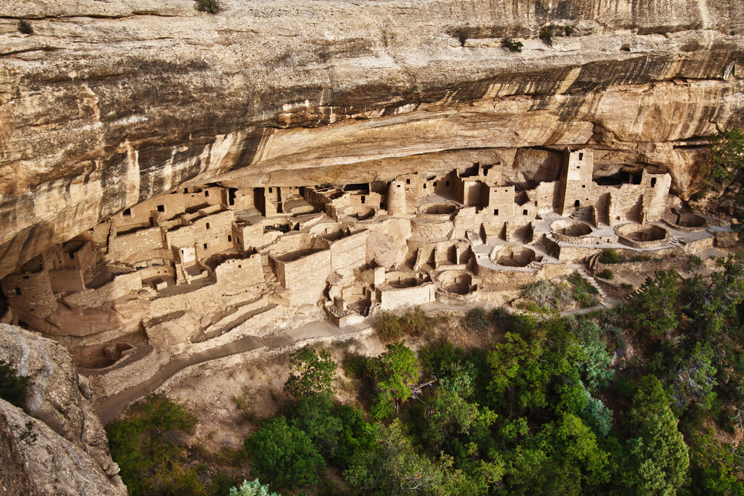
American History—Unit 1
Native American and Colonial Beginnings
Outcome 1: Analyze the social & economic effects of exploration pre-1630

Slide 2
Terms
Nomadic—groups of people who roamed from place to place in search of water and food. Did not develop any sort of agriculture.
Land Bridge—when Alaska and Russia were connected by land (Ice)…the first people to America walked across this bridge.

Slide 3
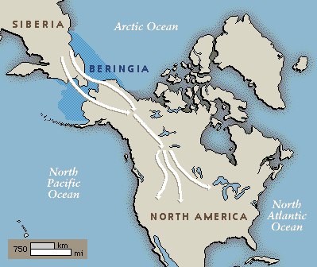
Land Bridge

Slide 4
Indians of the Southwest
Hohokam, Hopi, Pueblo.
Multi-story houses that were built into the sides of cliffs/caves. (Adobe)
Used irrigation systems to grow corn, beans, squash, melons.

Slide 5
Mesa Verde- New Mexico

Slide 6
Eastern Woodland Indians
Iroquois (most powerful)
Lived and hunted in the wooded area east of the Mississippi River.
Lived in villages, blended hunting and agriculture together.
Formed communities…tribes worked together.

Slide 7
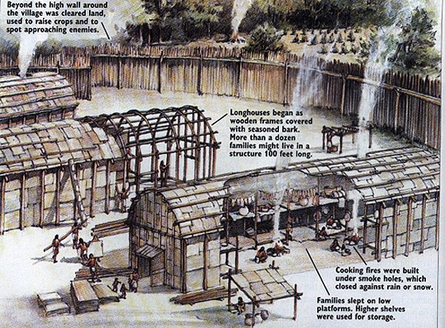

Slide 8
Importance of…..
Trading—this was the main way different tribes communication with each other, along with how they transported goods.
Land Use—way of life for the Indians. Land was to be shared and worked by everyone…land was not owned, hence not for sale.
Religion—Natural World was filled with spirits that would help/harm people.

Slide 9
The Importance of cont…
Kinship—strong ties between family members. This helped ensure that family customs would be passed down from generation to generation. Also, men and women had clearly defined roles in their tribes.
Division of Labor—dividing up the land and responsibilities according to gender, age, status.

Slide 10
European Societies around 1492…
Outcome 1: Analyze the social & economic effects of exploration pre-1630

Slide 11
Terms and Importance
Hierarchy—Social ordering by rank and class. Problem was that there was little chance to move up in class…economic opportunities of the New World gave some people hope. Also, most of the people of Europe were Peasants (bottom of ladder)
Nuclear Family—father, mother, children. This is what was important to the Europeans (much different than the Native American Kinship)

Slide 12
Reasons For Exploration
Renaissance
Period of Time in Euro History (1400-1600)
People paid more attention to the world around them..human achievement became more important.
Crusades
Series of Military Expeditions to the Middle East (Spread Christianity)
Caused Europeans to increase trade with the Middle East…led to a strong desire for their goods and a need for an easier trade route.
Reformation
Split in the Christian Church (Catholic vs Protestant)
Caused people to want to move away because of Religious Persecution

Slide 13
Reasons for Exploration
Growth of Commerce and Population
More people lived longer lives—a lot less land
More trade with Asia---more need for easy route
Rise of Nations
Portugal, France, England, Spain
These nations all wanted to be more powerful, so they wanted to find easier ways to trade
Renaissance
Sailing Technology
Compass and Astrolabe made it easier to travel around the world.
Able to sail against the wind

Slide 14
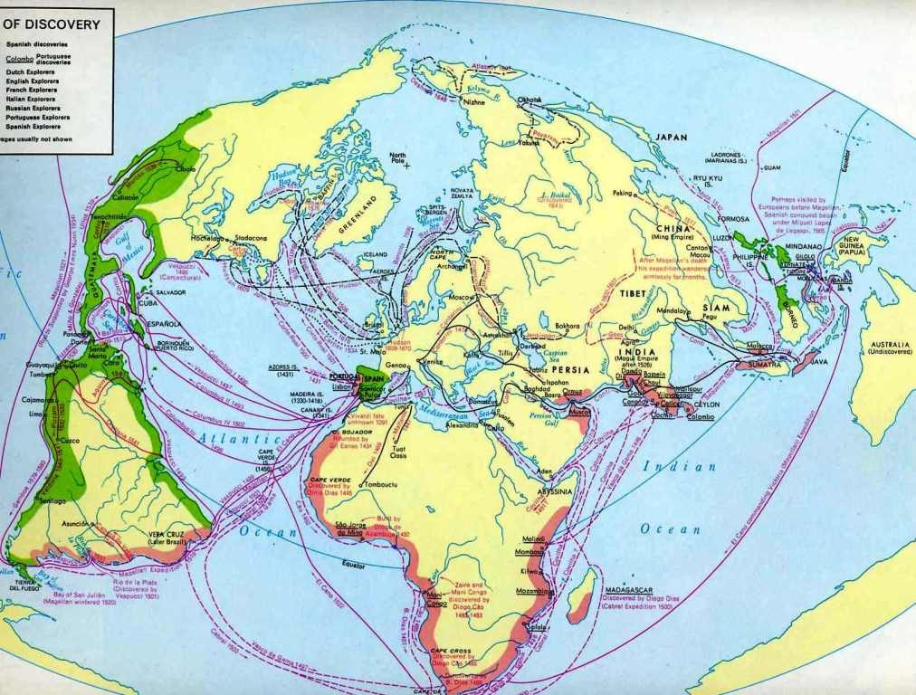

Slide 15
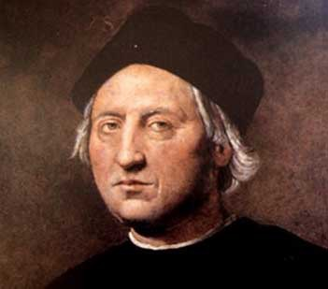
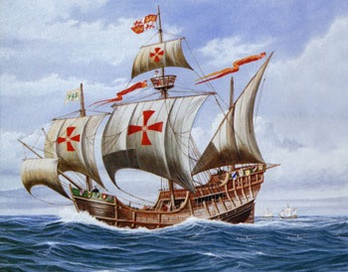
Christopher Columbus
Was from Italy but sailed for Spain
Aiming for Asia by sailing West…but landed in the West Indies.
1492—first trip
Started European trade with the Indies
Hero or Villain? - Read Excerpt from “Lies”

Slide 16
Columbus…hero or villain?
Hero
Explored the West Indies
Started Colonization
Started Trading with Africa/Europe/N America
Villain
Started Colonization
Greedy—Killed and Controlled the Natives
Slavery—natives then Africans
Killed Thousands by disease

Slide 17
Leading Towards Slavery
Spanish first enslaved the Natives…Natives worked until they died or ran away.
Then African Slaves were used when the Natives died.
Slave trade brought big money
Trade slaves for spices and sugars
Encomienda

Slide 18
Resisting the Spanish
Best option was to move away.
Some natives tried to fight back in protest, very rarely was this successful.
Spanish were “supposed” to try to convert the Natives, in reality they used them to look for gold that was not available.

Slide 19
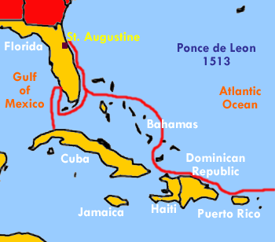
Juan Ponce De Leon
Spanish Explorer
Sailed to the American SE (Florida) around 1513.
He was looking for Gold and the Fountain of Youth

Slide 20
John Smith
English Explorer
Sailed to Virginia in 1606
Established the first English Settlement (Jamestown)
Wanted to colonized America

Slide 21
Key Terms
Colonization—establishment of distant colonies by a parent country. Usually these colonies gave the parent country many natural resources.
Conquistadors—Spanish Explorers that were looking for gold.
New Spain—name for the Spanish colony in America. Mexico City was Capital.
Encomienda—economic system in which Natives worked for the Spanish in return for the opportunity to learn Christianity.

Slide 22
English Settlements in America
John Smith—Englishman who sailed to Jamestown, Virginia.
Jamestown
First English settlement in America
April 1607
Joint-Stock Company—people would pool their money together to fund a trip to America. How Jamestown got started.

Slide 23
Jamestown
Jamestown got off to a bad start
Climate was not good for growing food
Lots and lots of disease
Indians started to kill livestock
60 of 600 survived
Jamestown turns the corner
New leaders made people work
Began to grow tobacco!!!

Slide 24
Economy of early Virginia
Tobacco was very popular in Europe
Headright System—anyone who paid for their own land or paid for someone else to come to Virginia would receive 50 acres for free.
Indentured Servants—people that came from Europe to work on the tobacco plantations
If they worked for 7 years they would be able to own their own land
Caused a lot of people who were in bad economic shape to move to America
Before long, there was not as many indentured servants so African Slaves were brought over to work the land (Native Americans would run away)

Slide 25
Bacon’s Rebellion
Over time, the poor people of Virginia were forced Westward
Those people were taxed more and had to deal with constant Native American Attacks
In 1675, western settlers fought a series of battles against the Native Americans.

Slide 26
Bacons Rebellion
The western farmers became upset at the governor of Virginia over lack of help fighting these battles.
Nathaniel Bacon
He hated Native Americans and was upset at the governor (Berkley) not helping
Bacon and his followers went to Jamestown to protest many things (lack of help, no representation, etc)
Protest turned violent, many buildings were destroyed.
Virginia changed some of its policies and it set the precedent that rebellion was a way to get things done in the colonies.

Slide 27
New England Terms
Puritans—people who wanted to “purify” the Church of England
Separatist—Puritans known as Pilgrims that came to America to escape persecution and start a new life.
John Winthrop—first governor of Massachusetts
Wanted to create a “city upon a hill” or a colony that everyone would want to be like

Slide 28
New England Terms
Plymouth Colony—first colony founded by the Pilgrims in 1620.
Massachusetts Bay Colony—in 1630, Pilgrims set up a larger colony….Boston would be the capital.
Government and the church would be ruled by the same people. The church was center to the lives of the people

Slide 29
Differing Views for Puritans
Roger Williams
He did not think that religion should be forced on people. Also wanted Mass. To be more democratic.
He also did not like how the early settlers were taking land from the Native Americans.
He was kicked out of Mass and started a new colony called Rhode Island
Anne Hutchinson
She claimed that the holy spirit lived in the hearts of believers and that people did not need the church/govt. to be religious.
She eventually moved to New Netherlands (New York) b/c the Dutch were more tolerant

Slide 30
Indian Wars
Native Americans had differing beliefs about land ownership..this caused many conflicts.
Pequot War
1st major conflict in Mass
Colonist and another Narragansett Indians destroyed an entire Pequot Village
Around 600 Pequots were murdered..this led to Narragansett to not like the English
King Phillips War
Indians used hit and run tactics to destroy many towns
The settlers were finally able to defeat them
This was the last real Native American threat in the New England

Slide 32
Middle Colonies
William Penn
Founded Pennsylvania
He was a Quaker (peaceful group)
Gave religious freedom, voting rights, and land to all people who moved.
They had very good relationship with the Native Americans.
New Netherlands
Dutch settled this area, major city would be New Amsterdam (NYC)
Peaceful, tolerant
Taken over by England and renamed New York
Also split the land (New Jersey)

