Slide 1
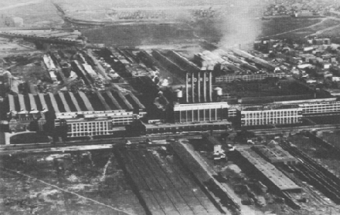
A New Industrial Age
Chapter 14

Slide 2
Warm Up: Mountaintop Removal
Democracy Now
Black Lung- By Hazel Dickens
Current Mountaintop Removal Legislature
Questions:
What is mountaintop removal? Who is responsible?
How is can we connect this to the Age of Industry or our theme for this unit? The Rise in Industry

Slide 3
Unit 2: The Industrial Age
Outcome 2: Analyze how business changes created social and economic changes.
P1: Describe the effect of new technology on business life in the 1800s.
P2: Describe the development of Big Business
P3: Examine the reason and purpose for labor unions

Slide 4
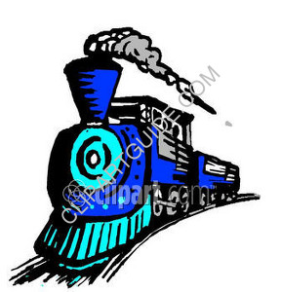
Railroad Expansion Ch 14
The year is 1863 and railroad construction is booming. In six years, the U.S. will be linked by rail from coast to coast. Central pacific railroad employs mainly Chinese immigrants to blast tunnels, lay track, and drive spikes, all for low wages. You are a journalist assigned to describe this monumental construction project for your readers.
What dangers do the railroad workers encounter?
How will business and the general public benefit from the transcontinental railroad?
How might railroad construction affect the environment?

Slide 5
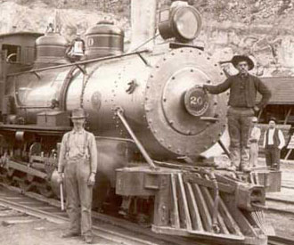
Section 1: The Expansion of Industry
There are several reasons for the expansion of industry by the late 1800s.
Wealth of natural resources- such as?
Government support for private business – Capitalism Yay!
Growing urban population that provided both cheap labor and markets for new products.

Slide 6
What Natural Resources?
Oil! Also known as good ol’ Black Gold!
Early in America’s history white settlers had little use for oil.
Kerosene Lamps-
1859 – Edwin L. Drake successfully used a steam engine to drill for oil near Titusville, Pennsylvania.- Started the Boom!
Steel!
Abundant deposits of coal and iron.
Removing carbon from iron produces a lighter, more flexible, and rust resistant metal – steel.
This processes for making steel is know as the Bessemer Process

Slide 7
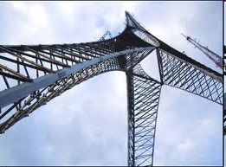
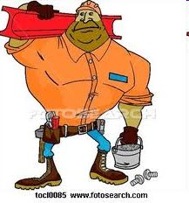
New Uses for Steel
Railroads- with thousands of miles of track were the biggest customers.
John Deere and Cyrus McCormick’s Inventions
Brooklyn Bridge
First Skyscraper with steel frame
Barbed Wire

Slide 8
Reflection on Factory Simulation
What kind of conditions were you working in?
What was the boss like? Do you feel like he/she cared about your well being? What was their primary motive?
What do you think you could do to improve your conditions? Would you have done this? Why or why not.
What may have prevented you from going on strike?

Slide 9
Inventions Promote Change
In groups of three you will choose a role for the following activity and collaborate with your team to create two simple but informative posters about 2 inventor or inventions from this chapter. You will present your findings to class.

Slide 10
Inventor/Inventions Research
Role 1: (Researcher) Detailed description of inventor, invention, or business and any important dates.
Role 2: (Presenter and Illustrator) You are going to present your findings to the class, Draw at least 2 illustrations that are related to the research (per topic). (please draw while the others are working DO NOT wait for the others to finish.
Role 3: (Fact Checker and Connector) You are going to check the facts of the researcher and then build a connection using the research to how this inventor or invention affected society at the time or today.

Slide 11
Who or What | Description: Invention or Business | Years | How it Affected Society
Alexander Graham Bell | telephone | 1876 | Opened worldwide communications and jobs for women
Samuel Gompers | Founder of cigar makers union | 1886 | Gave advantages into becoming pres of AFL
American Federation of Labor | Bargaining between workers and management – wanted collective bargaining | 1890-1950 | Average wages rose weekly hours fell.
Thomas Edison | Light bulb | 1880 | First generator
Christopher Shoals | Typewriter | 1867 | Gave women more job opportunities. 5%-40%
George Pullman | Railroad cars and sleepers. | 1880 | Population grow and spread out
Social Darwinism | Based on Charles Darwin “Survival of the fittest” | 1859 | Justified racism Poverty Uproar
Andrew Carnegie | Carnegie Steel Company | 1899 | Produced half of nation's steel – brings new technologies and business
Sherman Antitrust Act | Illegal to form trust that interfered with free trade | 1890 | Made it harder to trade and get goods. More expensive
John D. Rockefeller and Robber Barons | Established standard oil company Philanthropists- that invest in business | 1839-1937 | Funded universities and medical institute

Slide 12
Exit Ticket!
Describe the role you played during the activity and how close to completion you are.
Describe what you have left to complete
Describe the ways in which you may have helped/hurt the group's goals.
What grade would you give yourself based on what extent you worked will with and benefited the group.

Slide 13
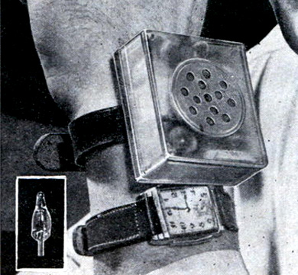
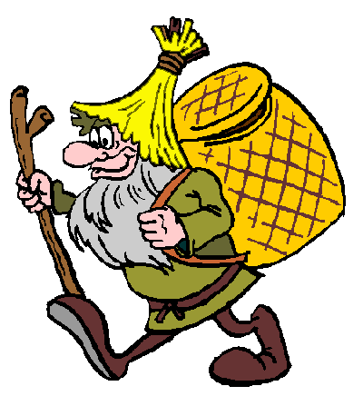
Effects of Industrialization
Freed some factory workers from backbreaking labor and helped improve workers’ standard of living.
Average workweek reduced by ten hours.
Workers regained some lost power

Slide 14
Assessment
Start a Causes and Effects Map for The Rise of Industry. We will add on to this later..

Slide 15
The Age of Railroads
Rails made local transit reliable and westward expansion possible. Helped settle the west and develop the country.
U.S. made huge land grants and loans to railroad companies.
National Network –
Transcontinental Railroad
Brought dreams of available land adventure and a fresh start within the grasp of many Americans. However harsh lives of railroad workers.
Central Pacific Rail – Mostly Chinese Immigrants
Union Pacific – Mostly Irish Immigrants

Slide 16
Railroad Time
Time Zones – 24 time zones on earth’s surface
Synchronized Watches
Opportunities and Opportunists
Growth of railroad influenced the industries and businesses in which Americans worked. Iron, coal, steel and lumber grew rapidly and kept pace with the railroads demand for materials and parts. Spread of railroad = spread of towns.

Slide 17
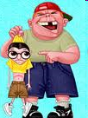
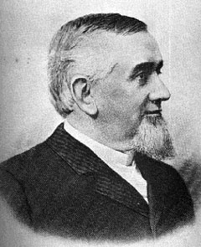
New Towns and George Pullman
George M. Pullman:
Helped railroads branch out. Built sleeper cars. He built a town for his employees. Lived in clean well constructed housing. Town was under company control. No alcohol no loitering on front steps.
Pullman wanted control and profit.
Scandals – Credit Mobilier and Union Pacific. It wasn’t all great…these guys were real money grubs.

Slide 18
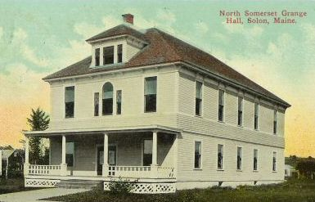
The Grange and the Railroads
Grange – remember? Farmers organization. Demanded government control over the railroad industry.
Farmers were angry with the railroad
Government land grants – sold to businesses
Formal fixed prices
Charges customers different rates.
Grange took political action. Elected legislatures and passed laws to protect their interests. Granger Laws.

Slide 19
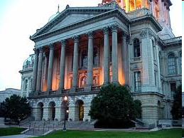
Railroads fight back….
Munn v. Illinois challenged constitutionality of some Granger laws. States won the right to regulate the railroads for the benefit of farmers and consumers.
Interstate Commerce Act – Granger power short lived – Right of federal government to supervise railroad activities and states could not set rates. Established a Interstate Commerce Commission. However the ICC did not have a lot of power.
Panic! – Railroads pushed to brink of bankruptcy – (it's their own fault) Played a nation wide role in the Panic of 1893.

Slide 20
P1: Proficiency Check!
Describe the effect of new technology on business and life in the 1800s. Use two specific examples to explain your answer.

Slide 21
Section 3: Big Business and Labor
P2: Describe the development of big business
Vertical Integration – Process in which he bought out his suppliers- coalfields and iron mines, ore freighters, and railroad lines- in order to control the raw materials and transportation systems.
Horizontal Integration- Buy out competitors.

Slide 22
Social Darwinism and Business
19th century philosophers offered an explanation for Carnegie’s success.
Social Darwinism- “Laissez Faire” hands off- the marketplace should not be regulated-
success and failure in business are governed by natural law and no-one has right to intervene.
Riches were a sign of God’s favor, and therefore the poor must be lazy or inferior people who deserved their lot in life.

Slide 23
Industrial Leaders: Fashion Show!
Activity: Research your industrial leader and take notes.
Designate roles. (x4)
Designer: Will create 3 symbols to be worn somewhere on Industrial Leader
Industrial Leader: Will parade through front of class displaying at least 3 symbols of their success. (Be creative!)
Narrator: Will describe leader in a very enthusiastic tone bringing attention to the 3 symbols of their success, and will address topics on notes for class.
Everyone! Reporter: Complete section in your notes for your leader.

Slide 24
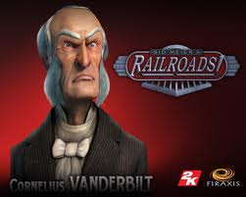
Industrial Leaders
Cornelius Vanderbilt- also know as “Commodore”
Shipping Tycoon
Railroad Empire
Married his first cousin- had 13 children
Later married his other cousin “Frank”
He was 45 years her senior

Slide 25
Industrial Leaders
Andrew Carnegie
Scottish American Industrialist
Gospel of Wealth
He built Pittsburgh's Carnegie Steel Company which he sold to J.P. Morgan in 1901 for $480 million (the equivalent of approximately $13.6 billion in 2013)
Carnegie devoted the remainder of his life to large-scale philanthropy, with special emphasis on local libraries, world peace, education and scientific research.
Carnegie Steel Company- 1899

Slide 26
Industrial Leaders
John Pierpont Morgan (JP Morgan)
Was an American financier, banker, philanthropist and art collector who dominated corporate finance and industrial consolidation during his time.
In 1892, Morgan arranged the merger of Edison General Electric In 1892, and Thomson-Houston Electric Company .

Slide 27
Fewer Control More
Monopoly- A firm that bought out all its competitors or had complete control over its industry’s production, wages, prices.
Standard Oil- John D. Rockefeller
Joined with competing companies in trust agreements. Stock of company controlled by trustees – separate companies and would create one large corp. Gained total control over oil industry.

Slide 28
Robber Barons
Within a decade of its start Standard Oil controlled 90% of the refining business.
Rockefeller got rich and paid his employees extremely low wages and drove out competition by selling oil at a really cheap price. Then in control he hiked prices.
Thus the term Robber Barons

Slide 29
How do we stop the “Robber Barons”?
Sherman Antitrust Act- Made it illegal to form a trust that interfered with free trade between state or with other countries.
Labor Unions
View- Camella Teoli
Samuel Gompers- Joined his Cigar Makers Union with other craft unions. Then led the American Federation of Labor- Focused on collective bargaining or negotiation.

Slide 30
Homestead Strike
Compelling Question: Why did the Homestead Strike turn violent?
Today we are going to practice the skills of Sourcing and close reading and corroboration, while looking at different accounts of one of the most violent strikes of the time.
Read through timeline
We will look at two accounts with different perspectives on the Homestead Strike. While looking at these documents, we are going to decide why these documents offer such different accounts of the strike and which one is more believable.

Slide 31
Homestead Strike
Turn and Talk
Why did the Homestead Strike turn violent?
What are the differences between Goldman’s account and Frick’s account?
Follow up questions:
On chart paper

Slide 32
The Growth Of Unions
Knights of Labor used arbitration – third party used to negotiate between employers and employees
Eugene V. Debs felt unions should include all skilled laborers in a specific industry. Attempted to form the American Railway Union.
Socialism- Government Control of Business.
Industrial Workers of the World

Slide 33
Strikes Turn Violent
Great Strike of 1877- workers for two major railroad companies strike and shut down rails for more than a week-
Haymarket Affair- 1886 people gathered in Chicago to protest police brutality (a striker had been killed) Someone tossed a bomb into the police line and police fired on workers. 8 protesters convicted four were sentenced to death by hanging.

Slide 34
Women Organize
Women barred from many unions.
United to demand better working conditions.
Mary Harris Jones- Organized the United Mine Workers of America. Endured death threats and jail time. Nickname “Mother Jones”
She exposed cruelties of child labor

Slide 35
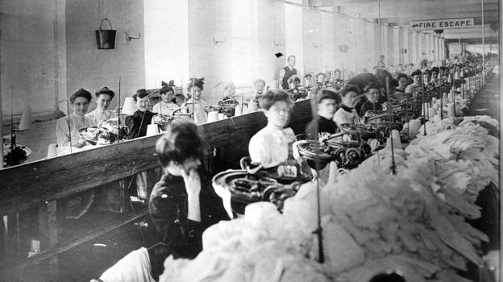
The Impact of the Triangle Fire
NPR Remembering the Fire

Slide 36
Reflection Questions
Why does the Triangle Shirtwaist Factory fire remain one the greatest workplace tragedies in American History? (Use an example from the text)
What connections does the story make with workplace disasters of today? (Use an example from the text.)
How have labor laws and labor in general changed since the late 1800s? Is it any better? Explain.

Slide 37
The Main Idea
The expansion of industry resulted in the growth of big business and prompted laborers to form unions to better their lives.
Why it Matters Today?
Many of the workers rights obtained during this time continue on into today’s workforce. Also similar strategies today are used to gain better wages and working conditions.
Let’s brainstorm….

Slide 38
Rise of Industry: (Section 1-3 Quiz)
Answer the following questions regarding the flow map below: (At least 1 page)
What caused the rise in industry and how did this lead to “Big Business”?
What are some examples of “Big Business” during this time and what are some examples of how this affected working conditions?
What was done by the people to better their conditions? What rights did they gain for the working class?
(
Working Conditions
Workers Rights
Rise of Industry
Big Business

