Slide 1
The Great Depression
AP World History
Chapter 21
“THE Collapse and Recovery of Europe”
(1914-1970s)

Slide 2
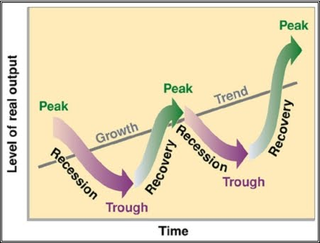
Industrial Capitalism
Benefits:
Created the most substantial economic growth in the 19th century
Provided opportunities for wealth and social advancement
Problems:
Promoted individualistic materialism
Created vast social inequalities
Unstable system → cycles of boom and bust, expansion and recession

Slide 3
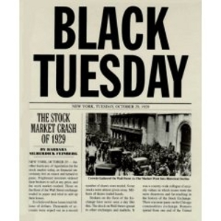
The Stock Market Crash
October 1929 = the stock market crashed
Stock prices plummeted
“Paper” fortunes were wiped out
Banks and businesses closed
People lost their savings
World trade dropped 62% in a couple of years
People lost their jobs → unemployment soared

Slide 4
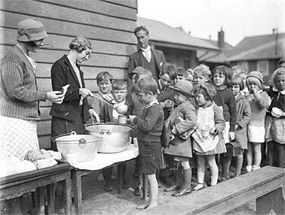
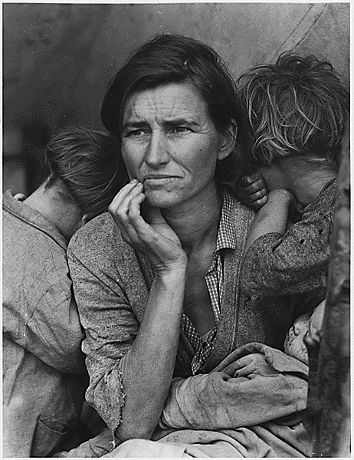
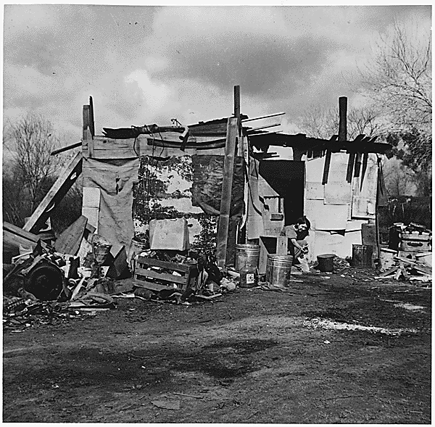
The Great Depression
Emergence of:
Vacant factories
Soup kitchens
Bread lines
Shantytowns
Homeless people and beggars

Slide 5
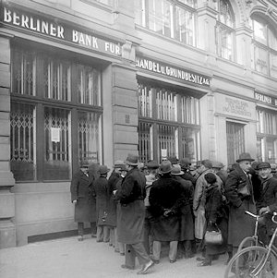
The Great Depression
Worldwide phenomenon
Spread from America to Europe and beyond
Lasted about 10 years
A Run on a Bank in Berlin

Slide 6
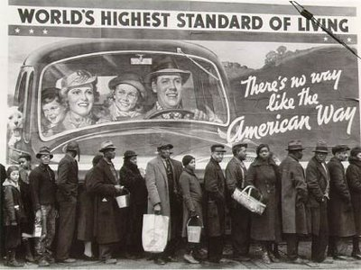
Leading up to the Great Depression: Problems for U.S. Factories in the 1920s
U.S. = physically untouched by WWI
1920s = farms and factories were producing more goods than could be sold
Unequal income distribution in U.S. = many Americans did not have enough money to buy these products
Line to a Soup Kitchen

Slide 7
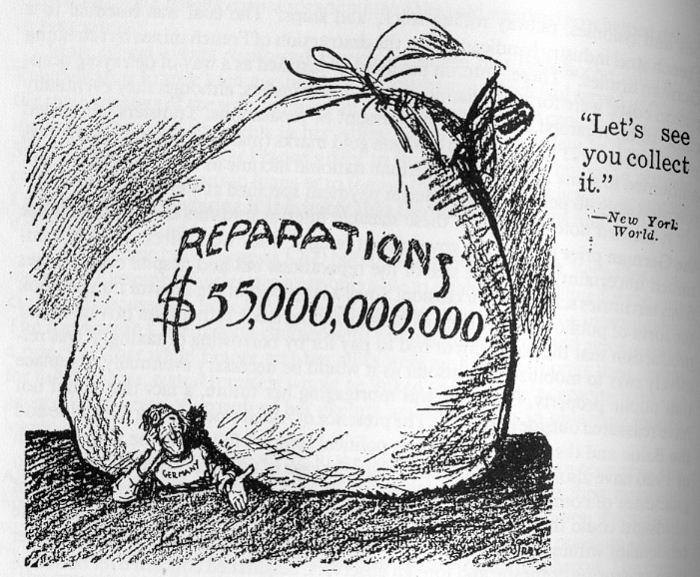
Leading up to the Great Depression: Problems for U.S. Factories in the 1920s
Many European countries could not afford to buy these goods either
Germany and Austria = had to make reparations payments and needed U.S. loans to make them
Britain and France = in debt to the U.S. from money they borrowed during WWI
Europeans began producing their own products again as their economies recovered
This reduced demand for American products

Slide 8
The Great Depression
Countries and colonies dependent on 1-2 products = hit especially hard by the Great Depression
Example: Chile = dependent on copper exports → value of its copper cut by 80%
Cocoa farmers in Ghana = badly hurt as prices of “luxury” and “commodity” goods dropped

Slide 9
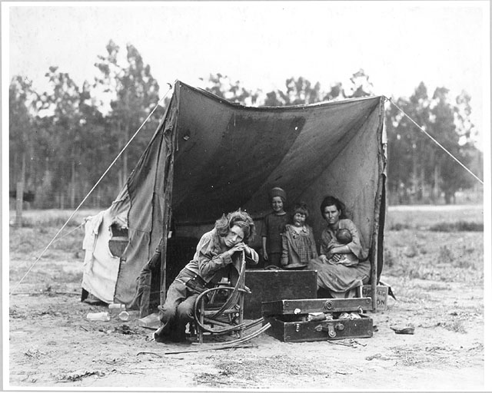
The Great Depression: Capitalism Challenged
Major result of the Great Depression = capitalist countries were challenged and criticized
Capitalist countries = claimed the economy would regulate itself and self-correct itself if any problems arose
But this wasn’t happening during the Great Depression

Slide 10
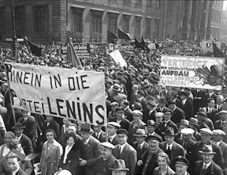
The Great Depression: Capitalism Challenged
Some countries became interested in communism and looked twice at the Soviet Union
Many Western European countries adopted “democratic socialism” = greater government regulation of the economy and a more equal distribution of wealth through peaceful means and electoral politics

Slide 11
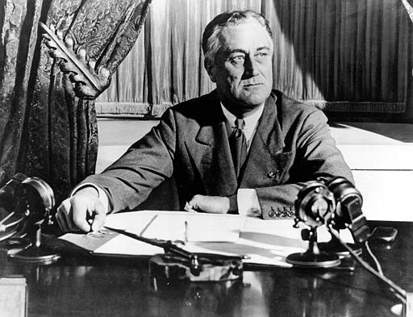
U.S. Response to the Great Depression
Franklin D. Roosevelt’s New Deal Program (1933-1942)
Combination of reforms designed to restart economic growth and prevent problems in the future
Government projects → dams, highways, bridges, parks, etc.
Social Security system
Federal minimum wage

Slide 12
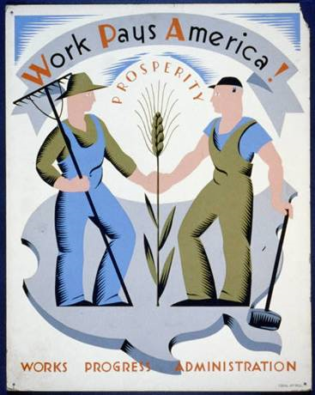
U.S. Response to the Great Depression
Various relief and welfare programs to aid the poor, unemployed, and elderly
Support for workers and labor unions
Government subsidies for farmers to encourage more production
Creation of new government agencies to help supervise the economy

