Slide 1
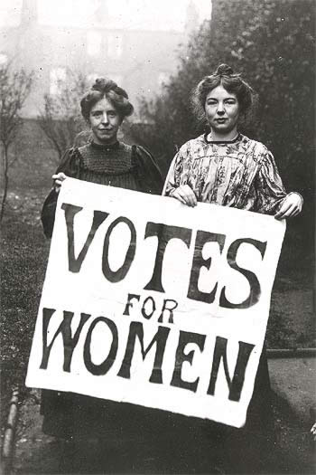
The Progressive Era: Period 7
1890-1920
Notes:
‹#›

Slide 2
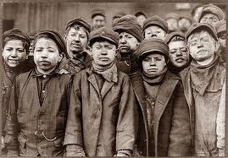
P1: Describe the different social, political, and environmental problems in 1900
#1

Slide 3
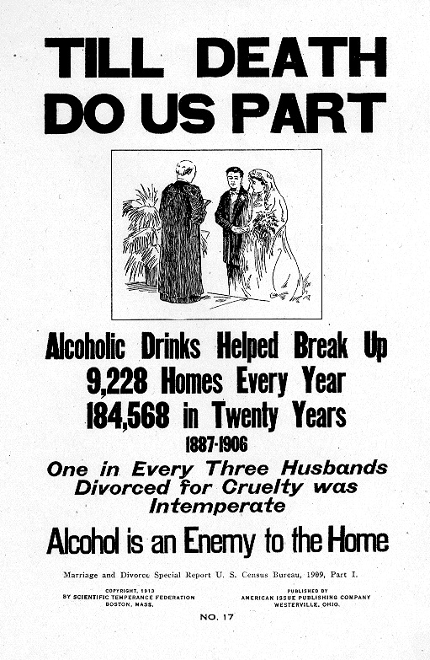
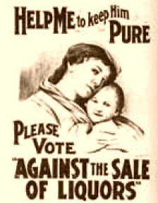
#2

Slide 4
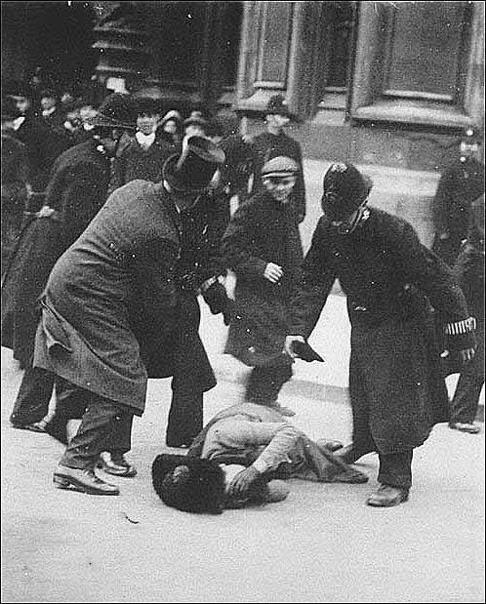
#3
Notes:
‹#›

Slide 5
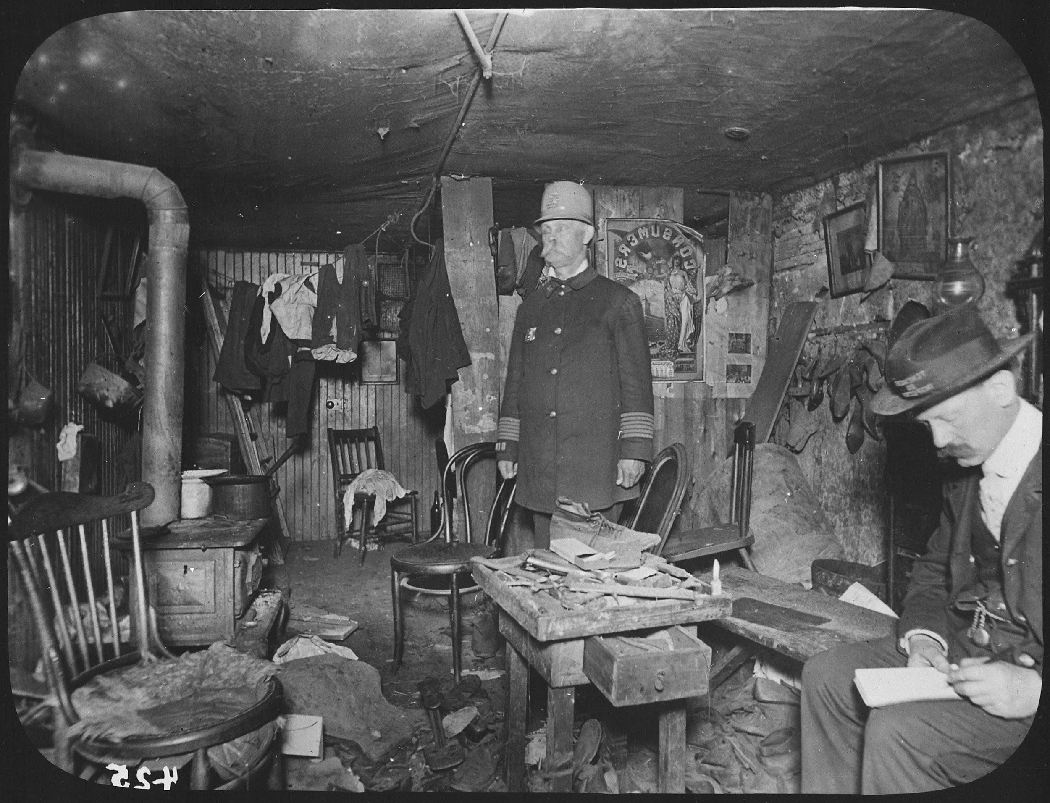
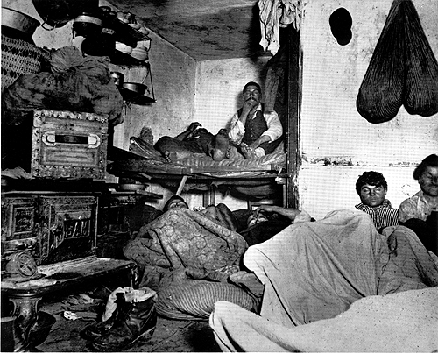
#4

Slide 6
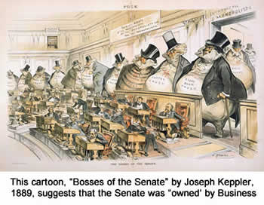
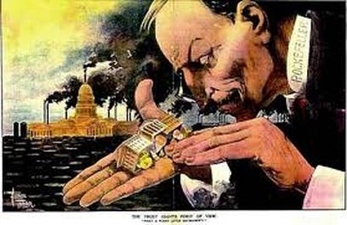
#5

Slide 7
Origins of the Progressive Movement
It is the dawn of the 20th century and the reform movement is growing.
What is a progressive?
Moral reformers are trying to ban alcoholic beverages.
Political reformers work toward fair government and business practices.
Women fight for equal wages and the right to vote. Throughout society, social and economic issues take center stage.
What actions do progressives take against:
Big Business
Government
Notes:
‹#›

Slide 8
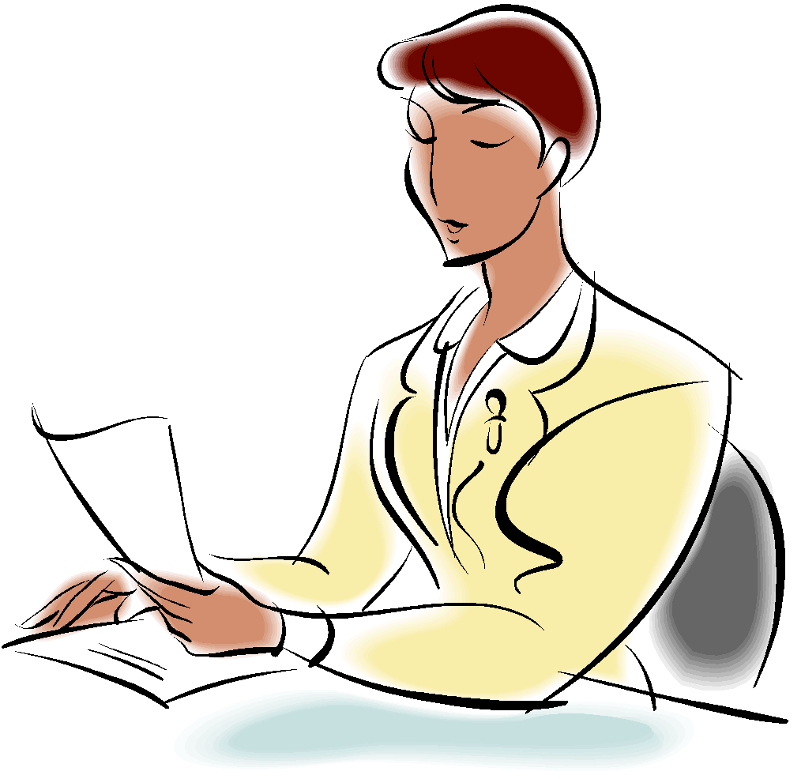
Origins of Progressivism
The reform efforts put into place to address these issues made up the progressive movement.
Four Goals of Progressivism
Protecting social welfare
YMCA, Salvation Army
Florence Kelley- chief inspector of factories- prohibited child labor in Illinois
2. Promoting moral improvement
Prohibition
Carrie Nation- Women’s Temperance Movement
3. Creating economic reform
Muckrakers- Ida Tarbell, Upton Sinclair, Lincoln Steffens
4. Fostering efficiency
Scientific Management- Henry Ford

Slide 9
Cleaning Up Local Government
Mayors
Began to focus on dismissing corrupt and greedy private owners of utilities and converting them to publicly owned enterprises.
Citizens paid more active role in city government.
Driving corporations out of politics
Protecting working children.
Camilla Teoli?
1904 Child Labor Committee sent investigators to gather evidence of working conditions.
Keating-Owen Act in 1916 prohibited the transportation across state lines of goods produced with child labor.
Efforts to limit working hours

Slide 10
Reforming Elections
17th Amendment:
Before 1913 each state's legislature had chosen its state senators now there would be a popular election of senators.
How would this help clean up local government?
Citizens could petition to place an initiative –
a bill originated by the people rather than lawmakers- on the ballot.
Referendum
voters could reject or accept the initiative by referendum- a vote
A Recall
allowed voters to remove public officials from office.

Slide 11
Women in Public Life
Work Force:
Farm women (not much changed),
Women in industry (better paying opportunities became available in cities women had new options for jobs), domestic workers (70% of women employed in 1870 were servants.
Higher Education: Most progressive women had attended women’s colleges.
Reform: National Association of Colored Women (managed nurseries and reading rooms and kindergartens)
Susan B. Anthony and woman suffrage.
National American Women’s Suffrage Association. NAWSA

Slide 12
Women’s Suffrage Movement

Slide 13
Teddy Roosevelt’s Square Deal (Teddy Reforms)
Born into wealthy NY family in 1858.
Became famous as a leader of the rough riders a volunteer cavalry that fought in the Battle of San Juan Hill.
Takes the presidency after the assassination of William McKinley
Bully pulpit and the Square Deal
Progressive reforms sponsored by the Roosevelt Administration.

Slide 14
Upton Sinclair and The Jungle
Teddy Roosevelt was nauseated by Sinclair’s account and asked the author to visit him at the White House.
Passed Meat Inspection Act
Failed to address the plight of immigrant workers.

Slide 15
Progressivism and Taft
Taft (R) vs. William Jennings Bryan (D) in 1908.
Taft Wins
Cautiously progressive agenda
Busted over 90 trusts
Payne-Aldrich Tariff
Compromise that only moderated the high rates (Goods) of the Aldrich Bill

Slide 16
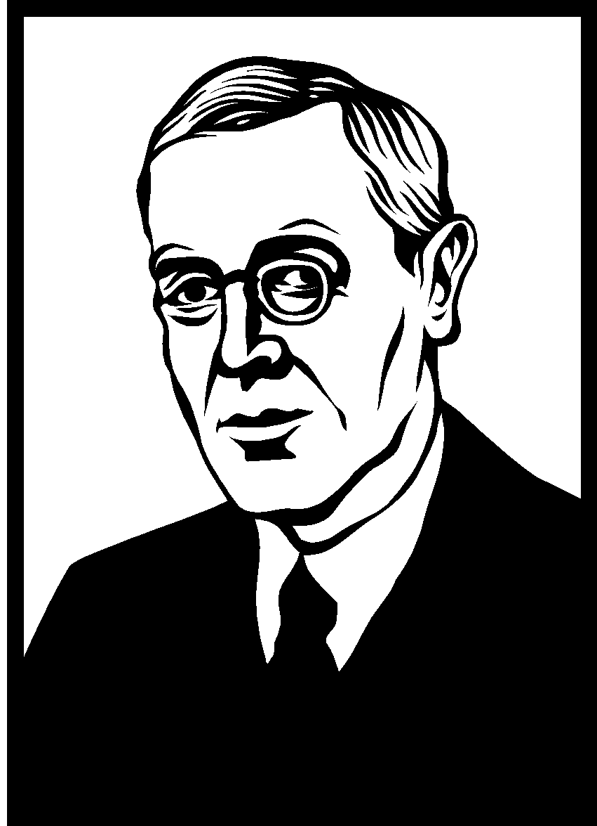
Republican Party Splits
Republicans and Progressives split over Taft’s approach to reform.
Teddy while retired from office decided to run for a third term after returning from Africa.
Taft had advantage of being incumbent (holder of the office). Many republicans split and created the Bull Moose Party which Roosevelt ran under.
Woodrow Wilson v. Roosevelt (1912)

Slide 17
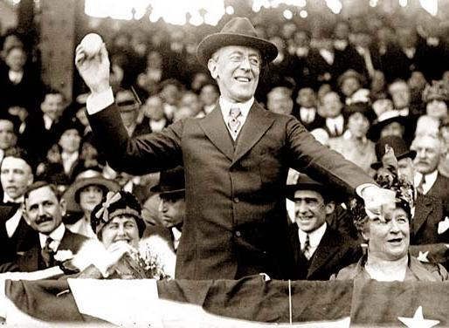
Democrats Win
Woodrow Wilson wins and endorses a progressive platform.
Supports small business and free-market competition.

Slide 18
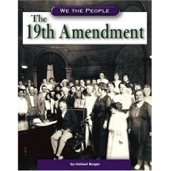
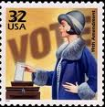
Wilson’s New Freedom
Clayton Antitrust Act
Federal Trade Commission
Federal Reserve
Nineteenth Amendment
Federal “Graduated” income tax

Slide 19
Complete the Visual Summary Add at least two points for each square…
Social and Moral
Economic
Progressivism
Health and Safety
Political
Industry

Slide 20
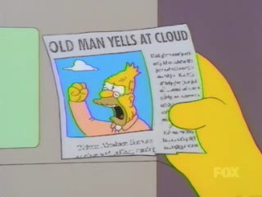
Progressives Today? Remember progressivism means: the political orientation of those who favor progress toward better conditions in government and society, (often encouraging more government control)
banning energy drinks FDA
airport security
health care act
juveniles life sentence

