Slide 1
Welcome to American II!
Ms. Dunbar’s Class

Slide 2
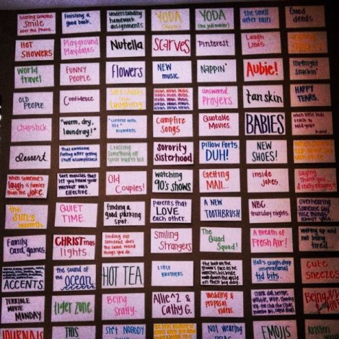
Warm Up:
Student Questionnaire and Wall of Happiness

Slide 3
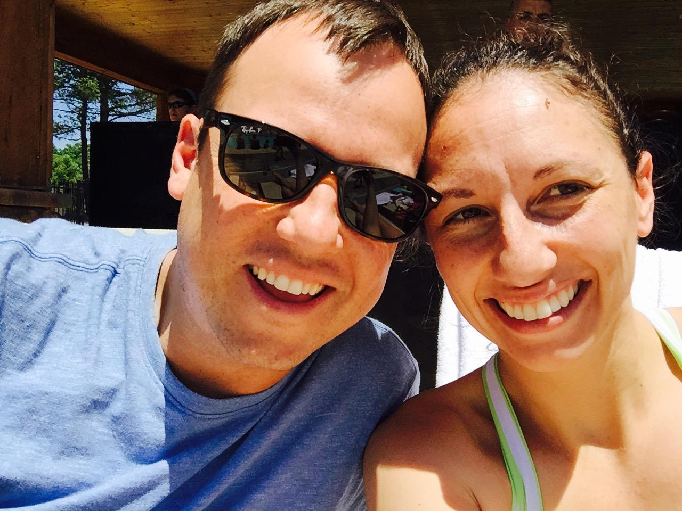
Syllabus and Introduction to Course
Welcome!
Who is Ms. Dunbar?
Syllabus American II
  Course Description and Pacing

Slide 4
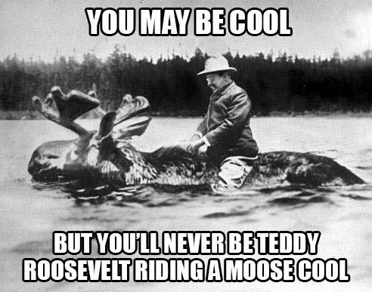
Time Periods and Pacing
Unit 1: Post Civil War America
1862-1901
Unit 2: Imperialism and Progressivism
1900-1914
Unit 3: The Great War and It’s Legacy
1914-1939
Unit 4: WWII and Early Cold War
1933-1975
Unit 5: Social Movements
1950-1980
Unit 6: Closing of the Cold War
1968-1991
Unit 7: Role of Terrorism in Modern America
1990-Present

Slide 5
Expectations and Rewards
Expectations: Students will be expected to perform to the best of their potential. This includes creating and completing an interactive notebook that will include ALL of the course activities for the entire semester. Students are also expected to attend and participate in classes as well as work to improve their performance on course tests.
-Mrs. Dunbar has 0 Tolerance for any racial, discriminating, or bigoted language. Please educate yourself and recognize that intolerance for others only shows your own ignorance.Rewards:
TOKENS are given out during the school year for strong leadership in the classroom and winning educational games played in class.
  Tokens are worth 5 extra credit points on any assignment and may be added together.
Students that miss no more than 3 days of class will be able to drop their lowest grade at the end of each 9 weeks.
Class Dojo: Get signed Up!

Slide 6
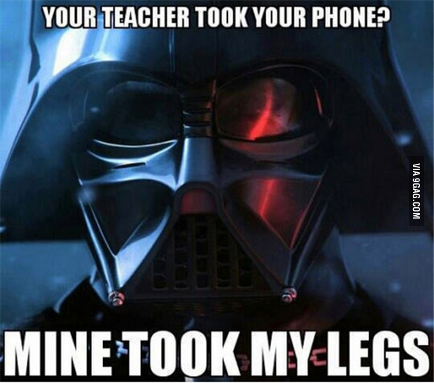
Cell Phone Policy
ou have entered this classroom to learn. You are here to engage with those who are present in this room. If you CHOOSE to participate with us, then you may CHOOSE to put your phone in a cubby. If you CHOOSE not to do so, and you get caught with your phone being used inappropriately, you will be asked to give your phone to Mrs. Dunbar and she will have to follow our school cell phone policy.
-1st offense turn into front office- student picks up at end of day
-2nd offense turn into front office- parent/guardian picks up at end of day
“We make our choices, then our choices make us.”

Slide 7
Homework and Learning Teams
Homework
Stay on pace with in class assignments
My Website- www.owenhsdunbar.weebly.com
Learning Teams
Your support throughout the semester
Will change throughout the semester

Slide 8
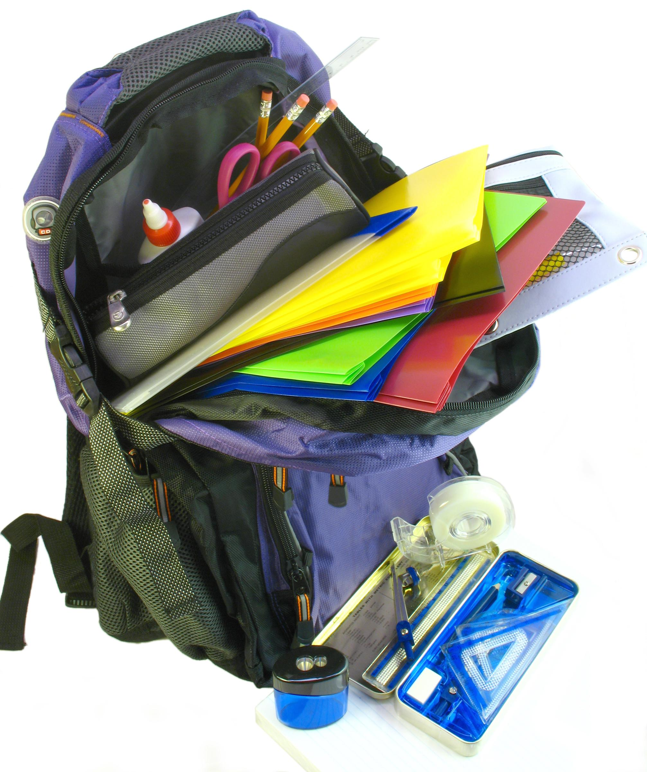
Supplies
Write this down on syllabus:
1 Marble Composition Book
Pen/Pencil
Pack of Colored Pencils
(If you can also get)
Yellow, red or pink, and green highlighter
Glue or Tape
2 Packs of Sticky Notes
Classroom Donations for a Token!
Hand Sanitizer
Kleenex

Slide 9
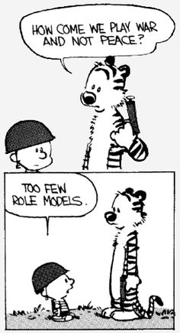
Textbooks and Resources
Textbook- The Americans - Will be kept in class to use for research.
May check a book out if you get behind- See sign in/sign out sheet on cart.
Please be kind to the books and all classroom resources, they are very difficult to get more of and have to be shared by multiple classes.

Slide 10
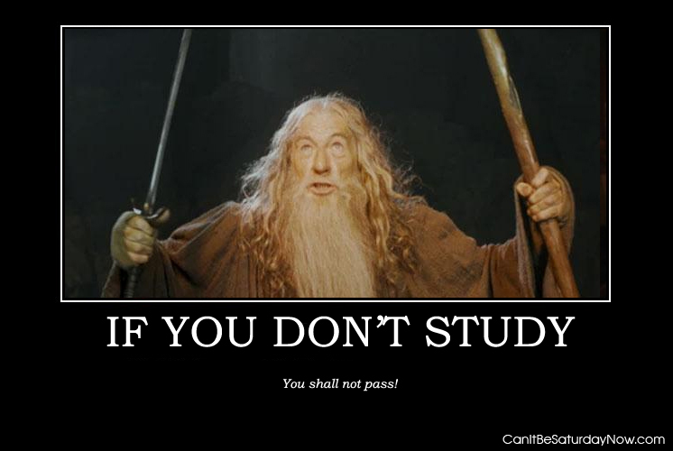
Grades
Quizzes- Always open notes Exams- Never open Notes
Guided Notes and Group Work- 30%
Tests- 40%
Quizzes- 20%
Participation/Class Activities- 10%
Summative Assessments- 60%
Formative Assessments - 40%
(Your grade is based on how well you can demonstrate understanding of the American II standards)

Slide 11
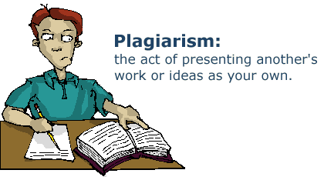
Final Grades
10 Point Scale
Makeup and Late Work Policy
  10 points off when late
Cheating
  Guided notes are to be done individually
    Penalty- you won’t know anything for the test, Ms. Dunbar will loose respect for you, she will take up your work and you will receive no credit.
  Group work is done as a group
Please Sign and get your Parents/Guardians to Sign Syllabus and bring back by Friday.- 100% daily grade. Thank You!

Slide 12
A Short Pretest
Purpose: To explore and get excited about American II and to meet your learning team!
  Get together with your assigned team.
  Designate a writer
    Number your paper 1-27
  Wait for Mrs. Dunbar

Slide 13
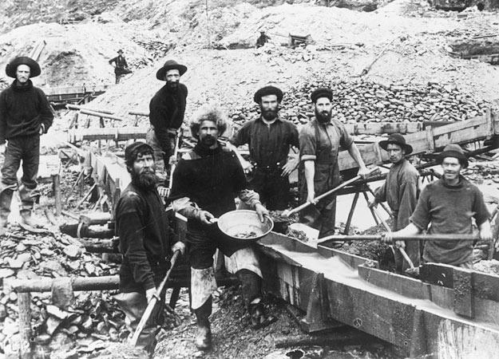

Slide 14
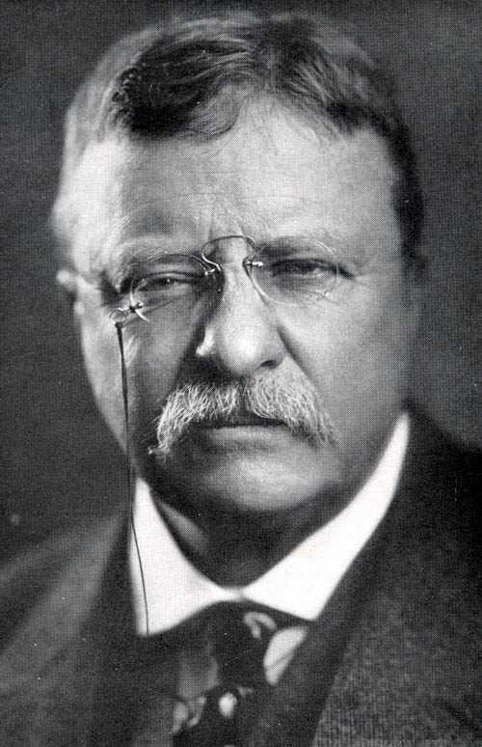

Slide 15
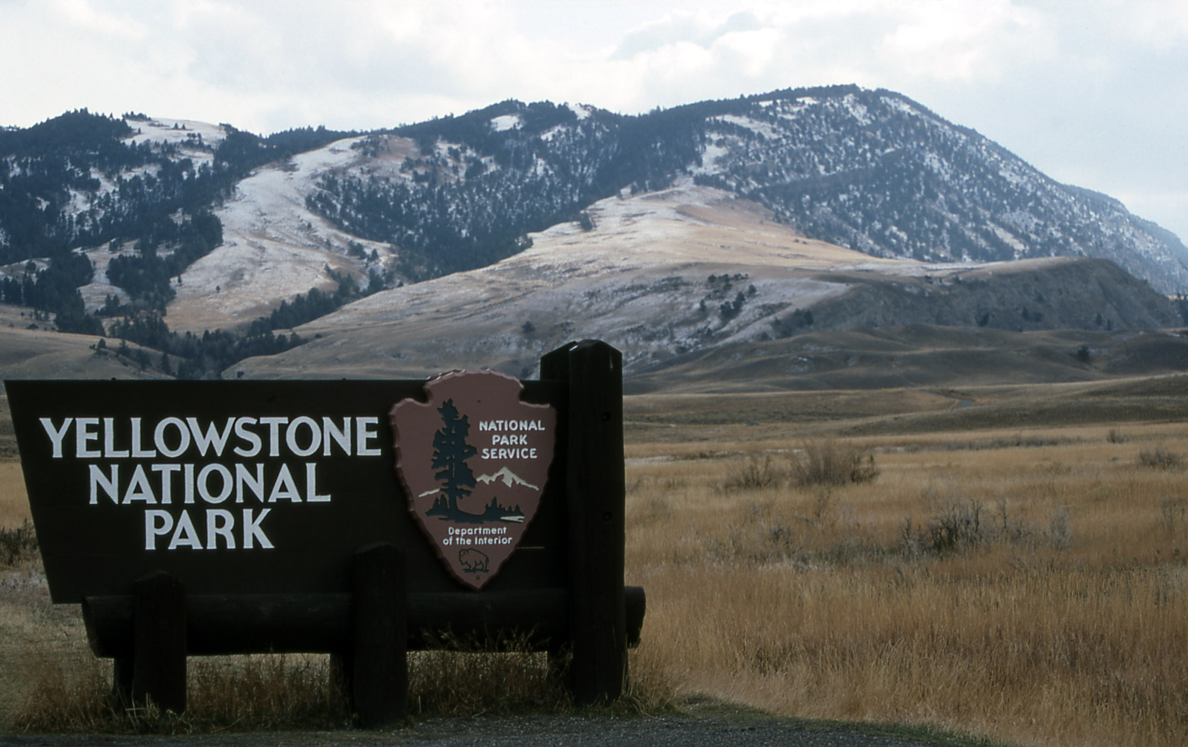

Slide 16
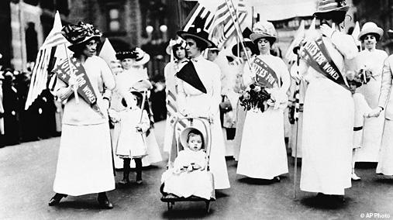

Slide 17
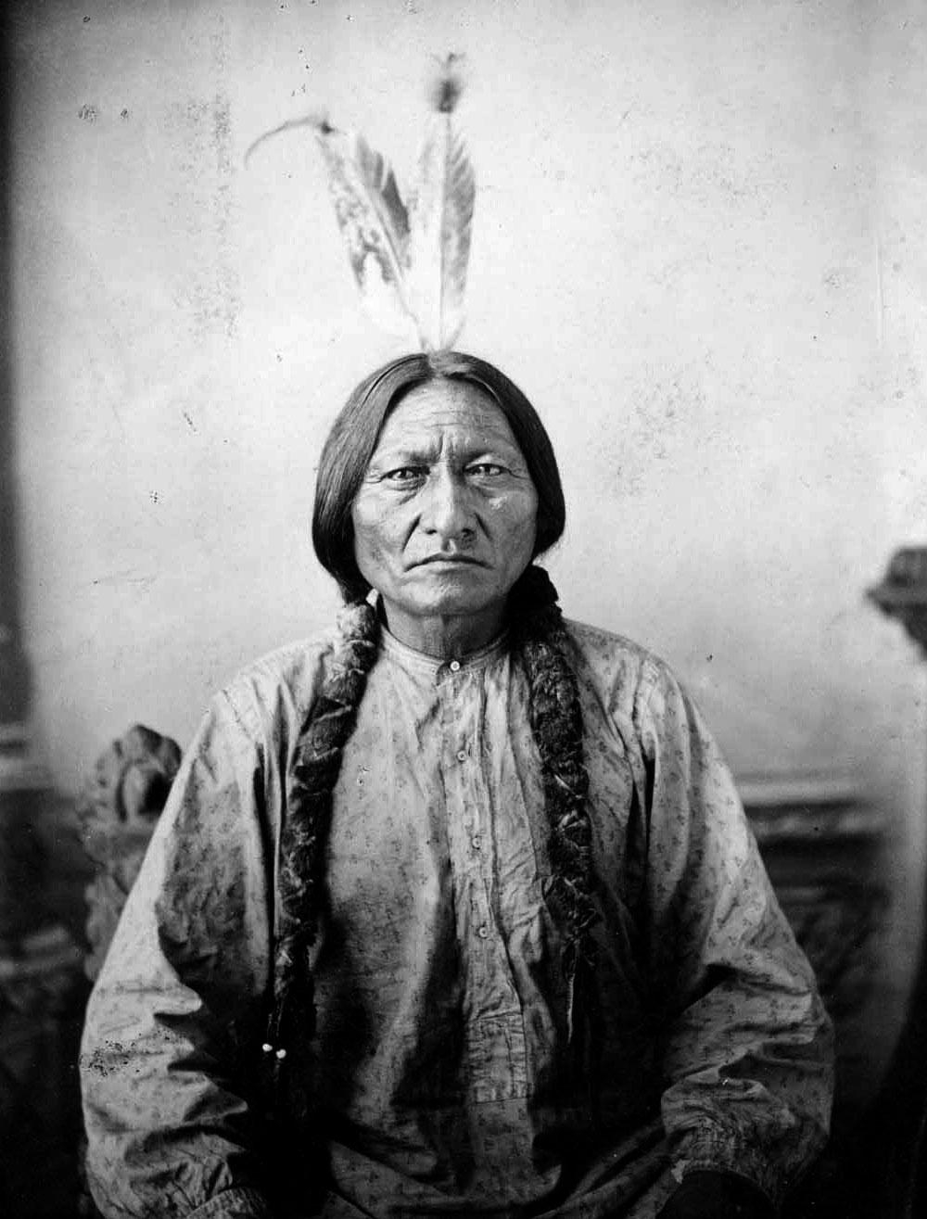

Slide 18
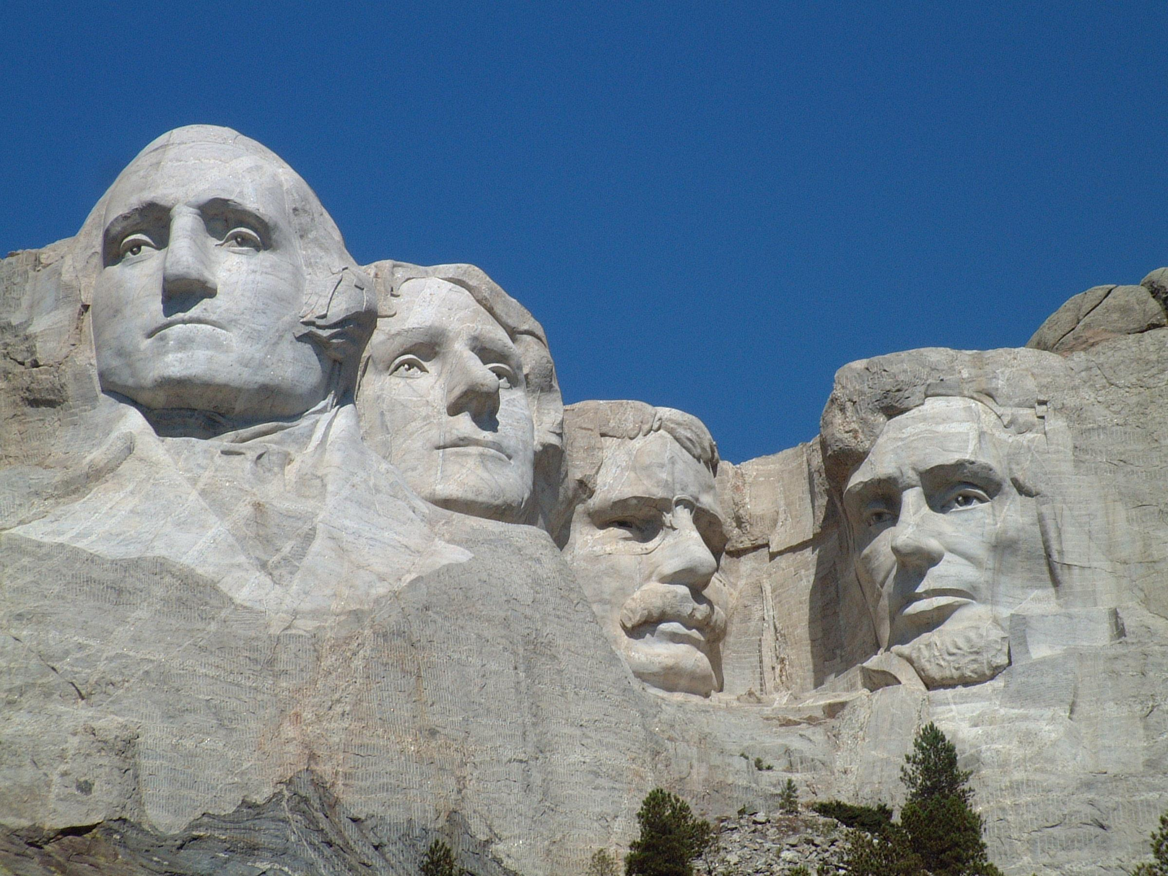

Slide 19
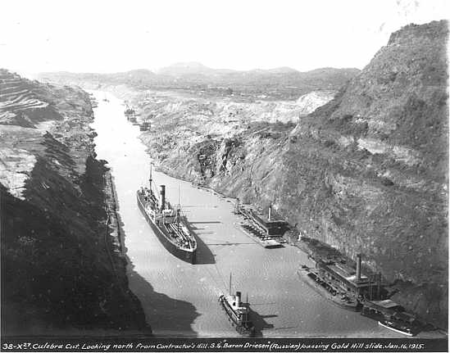

Slide 20
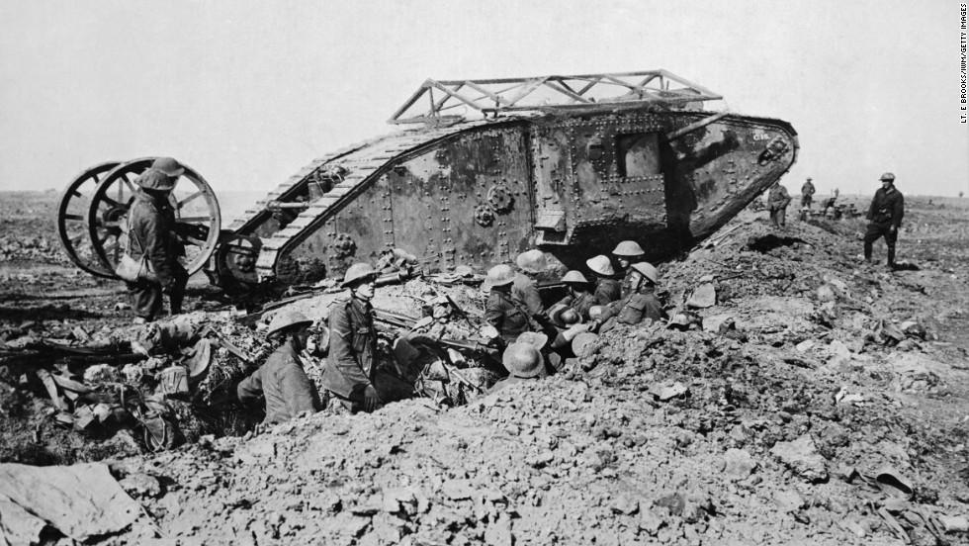

Slide 21
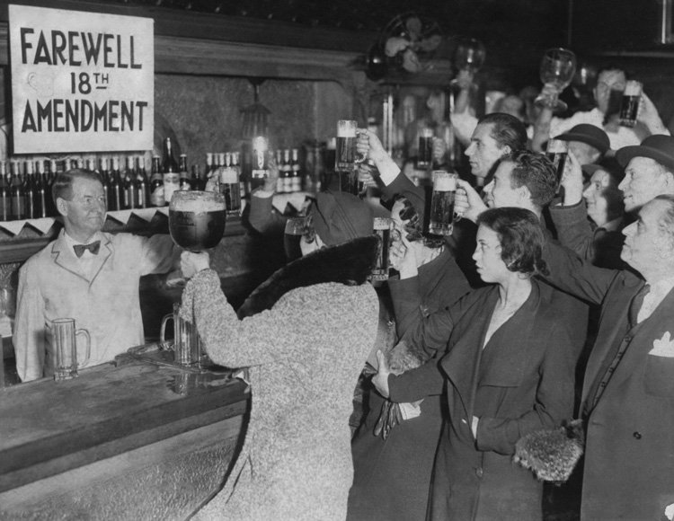

Slide 22
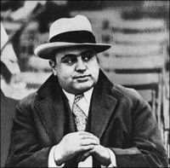

Slide 23
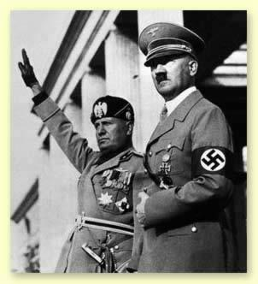

Slide 24
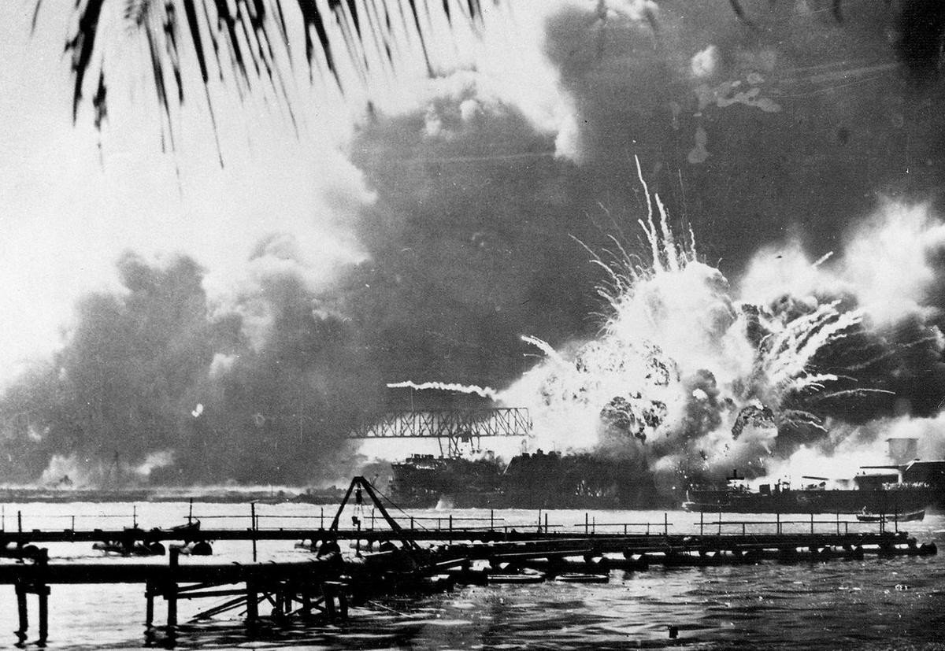

Slide 25
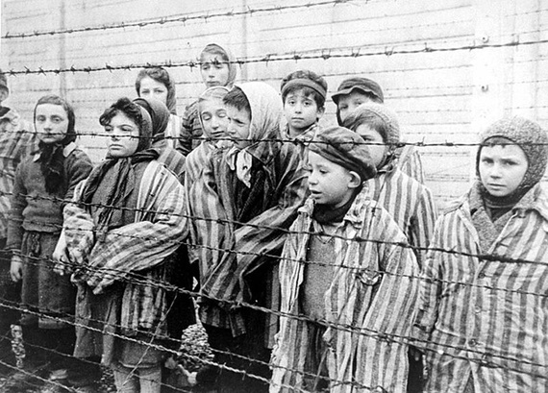

Slide 26
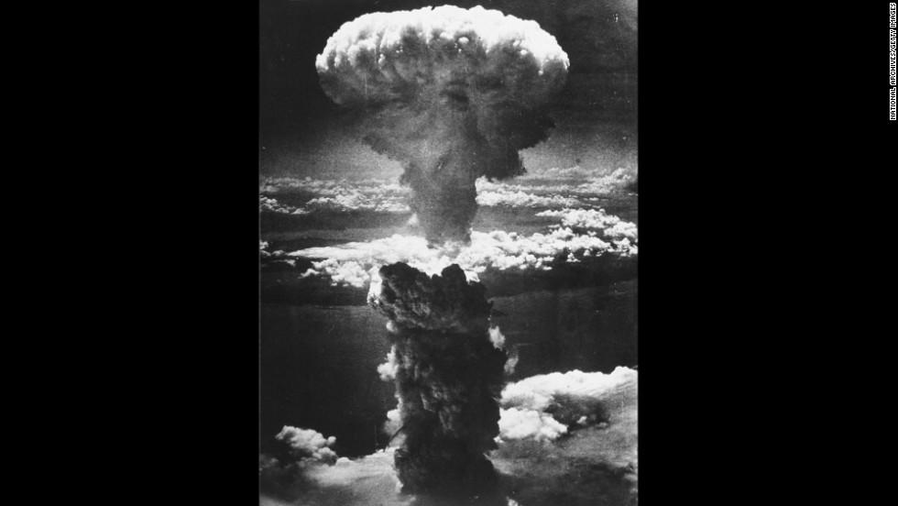

Slide 27


Slide 28
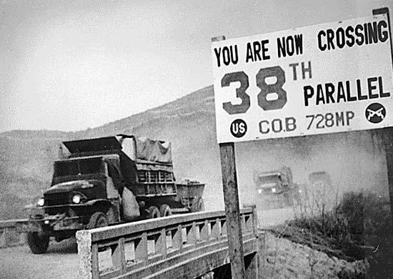

Slide 29
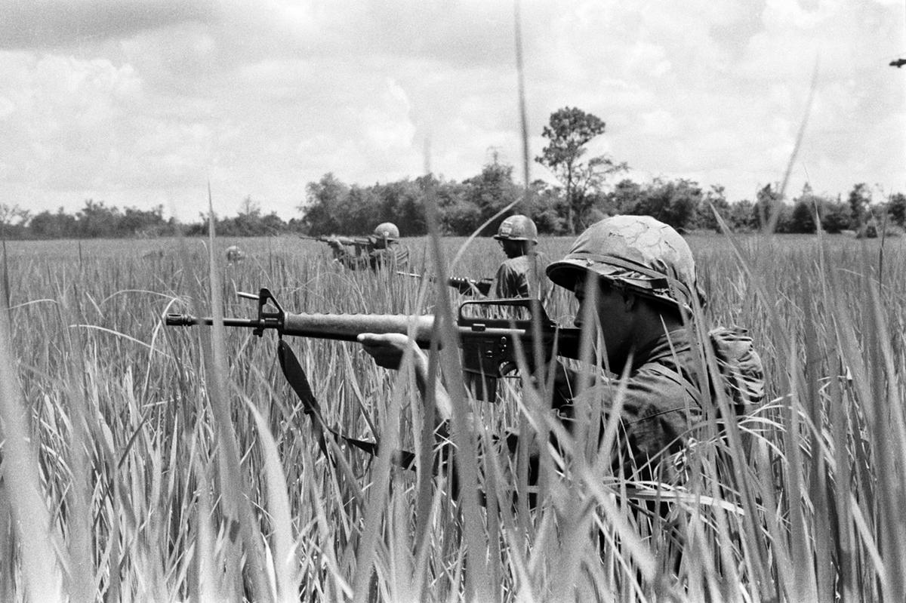

Slide 30
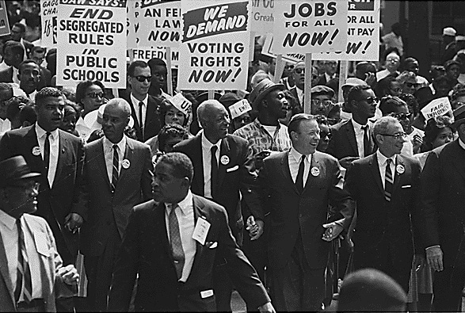

Slide 31
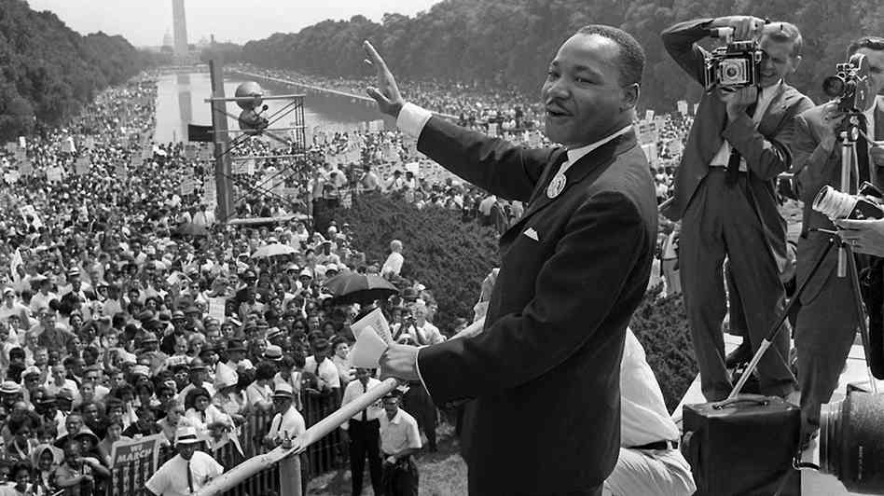

Slide 32
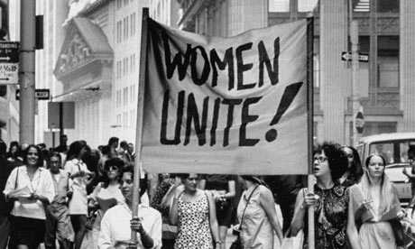

Slide 33
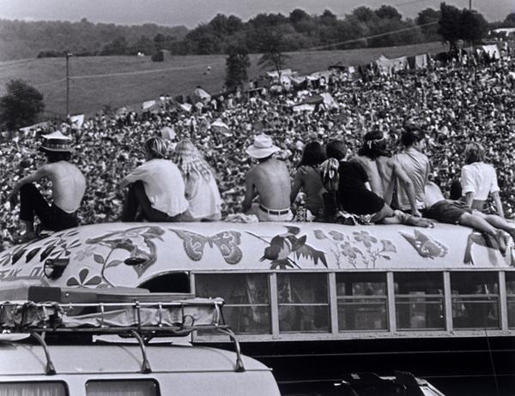

Slide 34
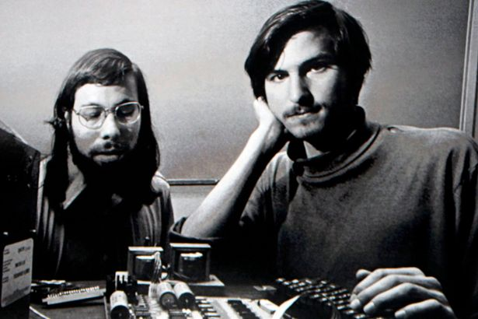

Slide 35
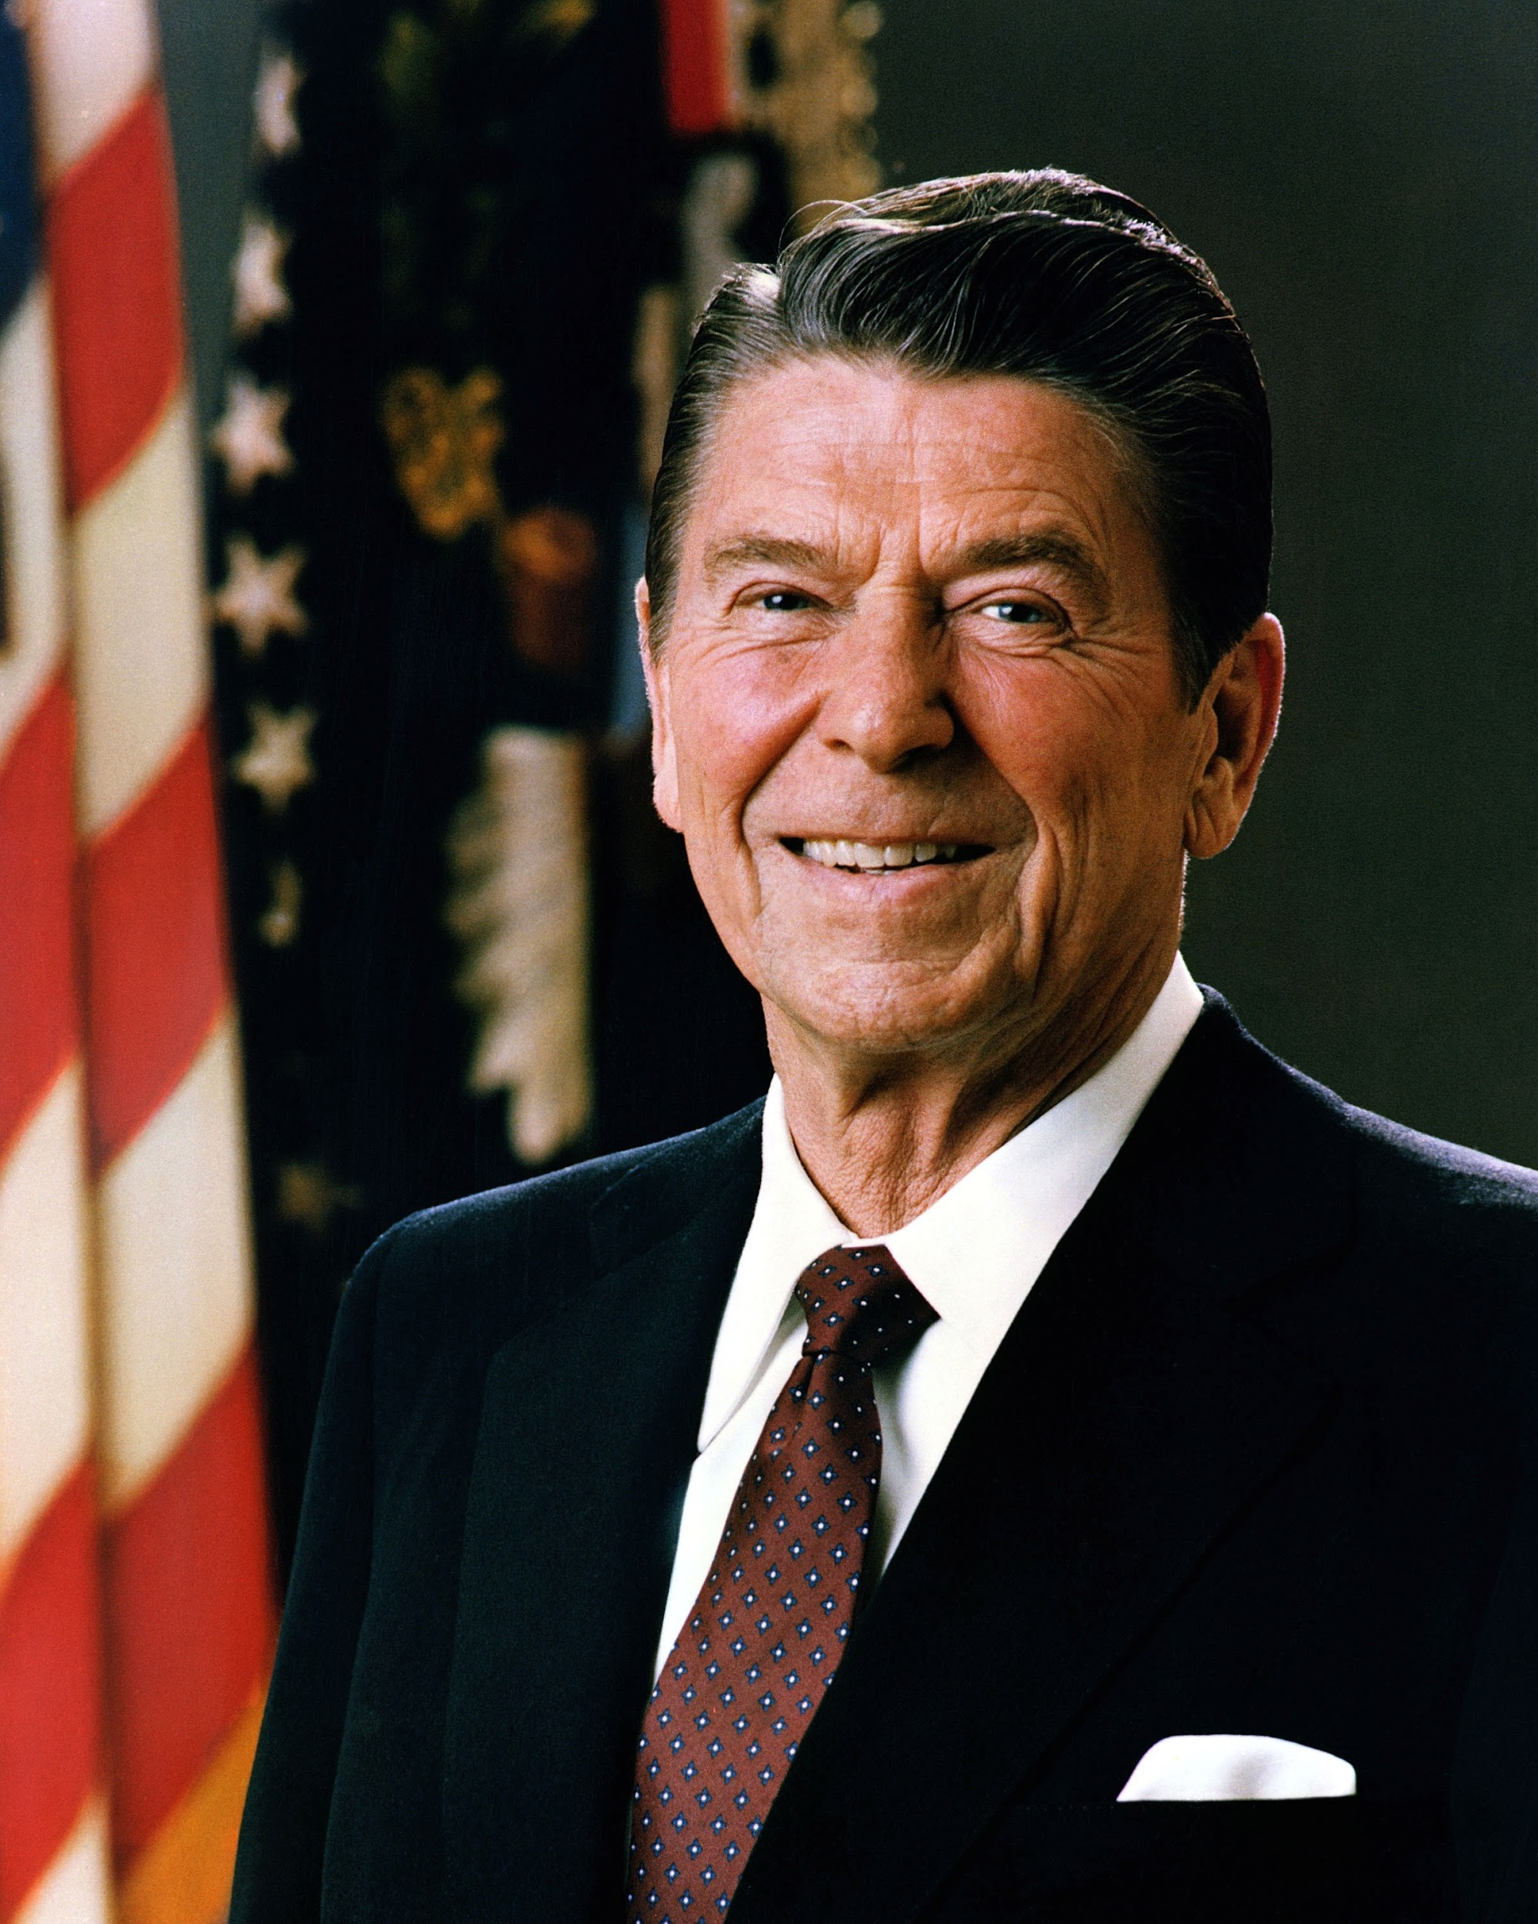

Slide 36
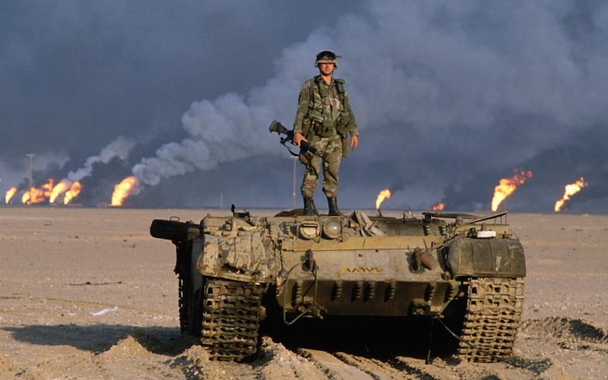

Slide 37
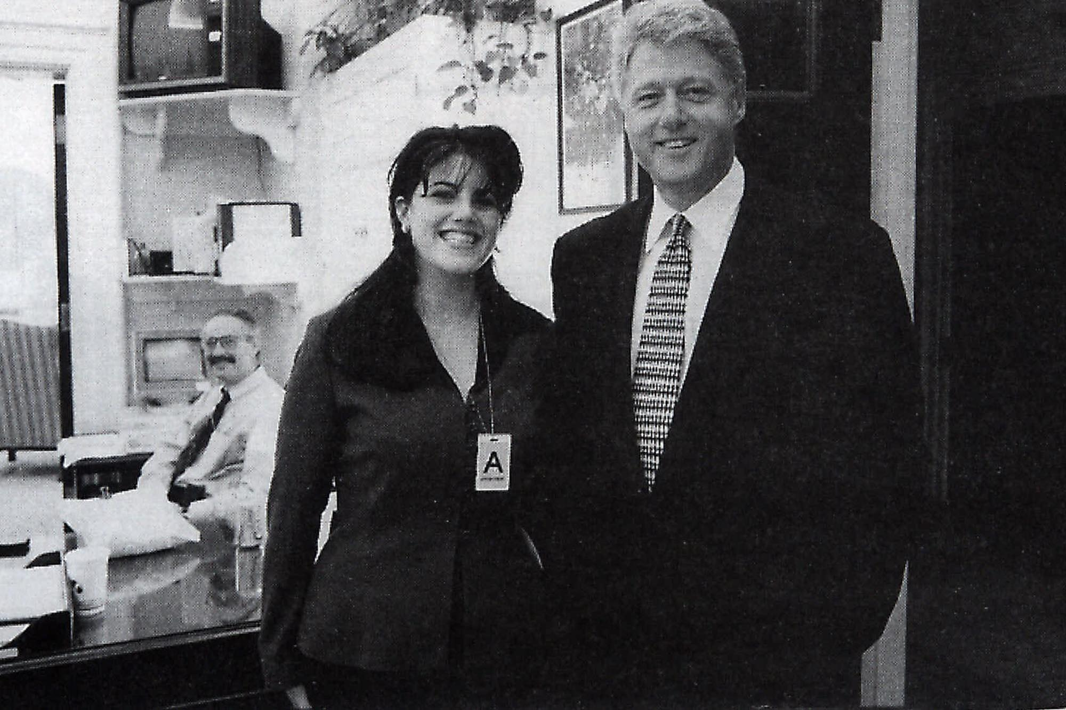

Slide 38
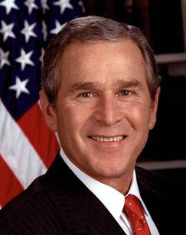

Slide 39
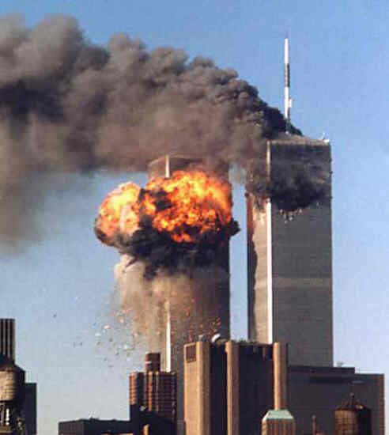

Slide 40
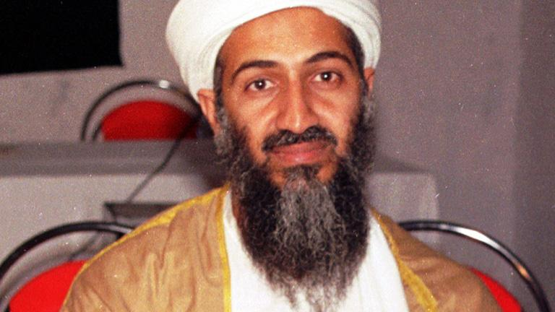

Slide 41


Slide 42
Creating Positive Classroom Culture
Initiative: Blind Polygon (Time 30 mins)
Objectives: Communication, Collaboration, Team Strategy
Materials: Blindfolds - 1 per person, rope
Debrief:
What were some of the challenges you faced in the first round? 2nd Round?
How would you describe your communication as a group? 1st Round/ 2nd Round
How did your communication change over time and how did this impact you and the work of the team?
Did anyone emerge as a leader during this activity?
What did they do to provide leadership to the group?
What lessons/insights might we take with us?

Slide 43
Creating Positive Classroom Culture
Culture refers to a wide range of identity and community characteristics. Culturally responsive pedagogy engages identities and identity issues across all groups and communities: gender, ability/disability, religion, sexual orientation, socioeconomic status, race, ethnicity, language and nationality. Culturally responsive classroom culture exists when classrooms are safe spaces where students are seen, valued, cared for and respected as their full selves.
What Makes a Classroom Culture Positive? Listening, Respect, Humility, Voice, Trust
How do we communicate with one another? How well do we listen to each other? While watching this video, define each component and list in the right column examples of how the teacher includes the five components above.
Video
Complete Handout: Components of Positive Classroom Culture and Discuss

Slide 44
Day 2: Full Value Contract
Warm-Up
What 4 values are most important to you in the classroom?
What illustrations represent these values?
What can you as an individual contribute to creating a positive classroom environment?

Slide 45
Historical Thinking: Snapshot Autobiography
Journal: Free Write: What is the story of your birth?
Pair/Share
2. Whole Class Discussion: How do you know the story of your birth?
What evidence do you have to back your story?
How might someone else remember this story?
3. Pass Out and Explain Directions for Snapshot Autobiography
3. Homework: Students interview someone for second perspective.
Finish Pamphlets

Slide 46
Snapshot Autobiography
Share Out Events-
Discussion:
Why did students choose certain events and not others?
What made some events more important or memorable than others?
Was it difficult to select events? Why or why not?
What types of evidence would be necessary to corroborate that your selected event actually happened?
What happened when you asked someone about the event?
Did they agree with your version? Did they remember things differently?
3. Closing Comments: Relation to History

Slide 47
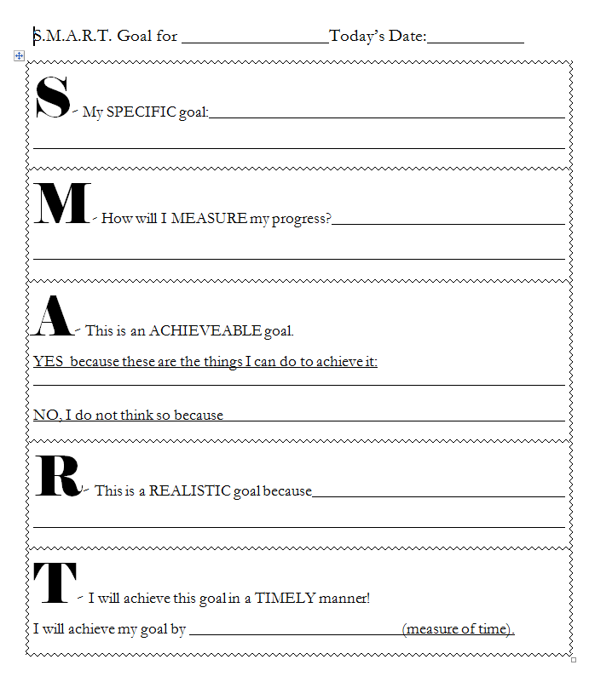
SMART Goals
It is especially important that these are kept in the front of your binder for the entire duration of this class. We will check in periodically throughout the semester/semesters.

Slide 48
Option 2: Historical Thinking
Lunchroom Fight I:
Roles: Timer, Writer, Presenter
How could their be different stories of the event if no one is lying?
Who are the different people who might have seen this fight?
What might make one person’s story more believable than another person’s?
Debrief:
Why might people see or remember things differently?
Who has an interest in one person getting in trouble instead of another? Who was standing where? Could they see the whole event?
The plausibility- issues of exaggeration
Time: Do stories change over time? How? Does this make it more or less trustworthy?

Slide 49
Lunchroom Fight II
First fight focused on sourcing
Now we are going to receive evidence from eyewitness accounts connected to the fight.
Your job is to figure out who should get suspended for starting the fight.
  In order to do that you are going to need to source, contextualize, and corroborate. (Pull multiple pieces of information to see how they fit together to fill out the story of what happened.
Your Job: In teams read the sources and complete the evidence context handout. (Roles: Timekeeper, writer, presenter)
Discussion: Town (Outer Circle), School (Middle Circle), Cafeteria (Inner Circle)
  What is the role of context? Can you completely throw out unreliable information?
Fill out suspension report with your teams final decision.

